Slide 1
Hong Kong Banking Sector:
2009 End-Year Review and
Prospects and Priorities for 2010
Hong Kong Monetary Authority
21 December 2009

Slide 2
Performance of the banking sector (1)
Actual performance in the first three quarters of 2009
Global economy remains uncertain though some signs of stabilisation
Loan loss provisions not as severe as anticipated. NIM has narrowed but impact on profitability less than expected
Deterioration in asset quality observed but still comfortable by historical standards
Projections for 2009
Bleak economic outlook
Banks’ profitability may be affected by loan loss provisions and narrowing interest margin
Asset quality may deteriorate

Slide 3
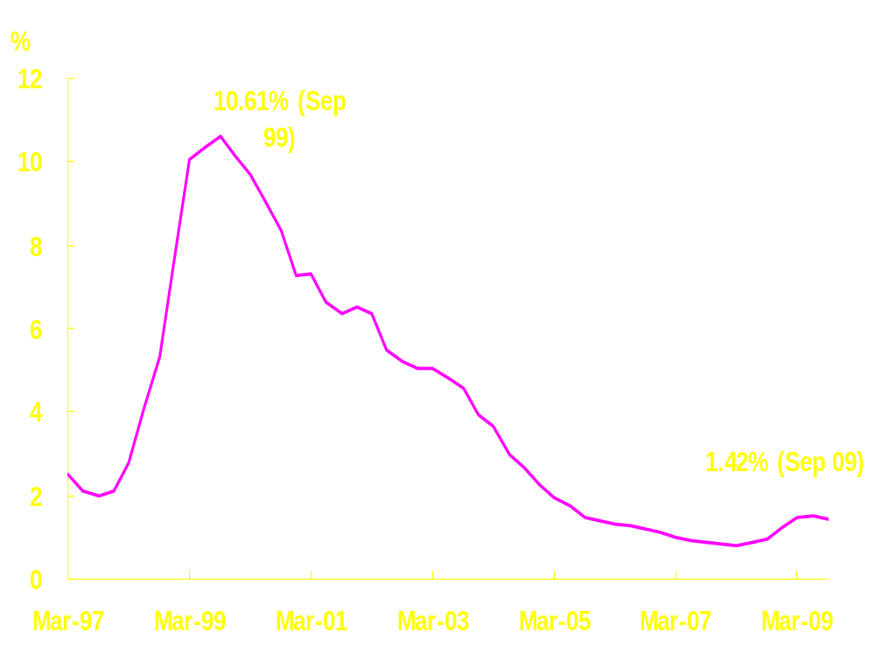
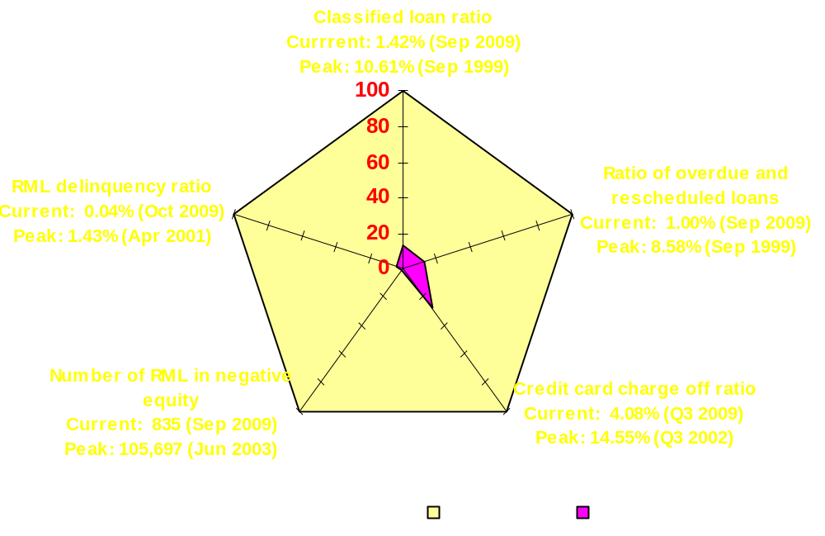
Performance of the banking sector (2)
Classified loan ratio rose to 1.42% at end-Sep 2009 from 1.24% at end-2008 and a low of 0.81% at end-Mar 2008
Asset quality remains good compared to historical levels
Classified loan ratio of retail banks
Asset quality indicators compared to peak

Slide 4
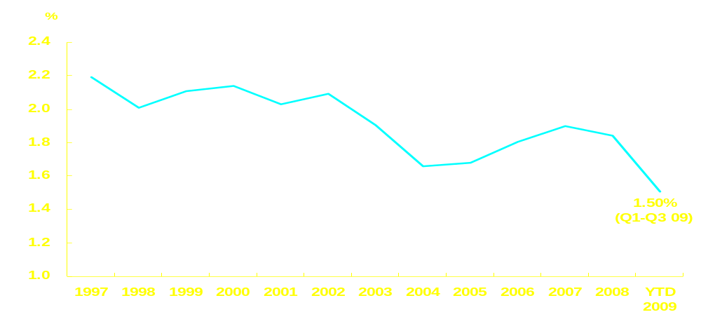
Performance of the banking sector (3)
Pre-tax operating profit of retail banks dropped 9.7% in the first three quarters of 2009 compared with the same period in 2008
Net interest margin of retail banks narrowed to 1.50% in the first three quarters of 2009 compared to 1.84% in 2008 – a historically thin level

Slide 5
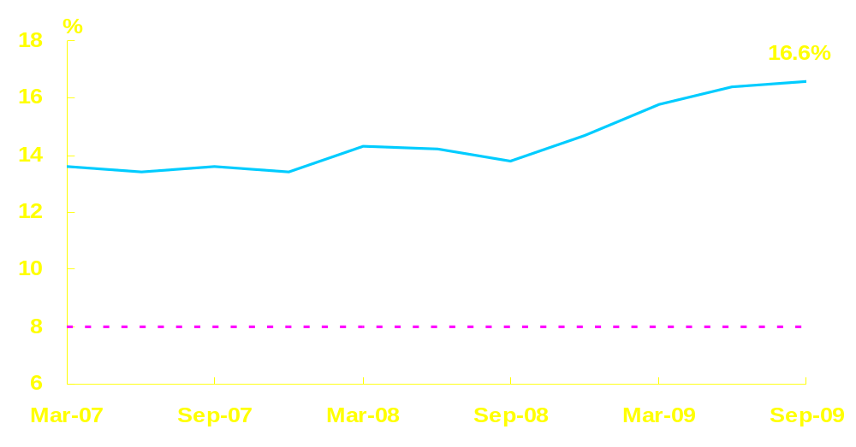
Performance of the banking sector (4)
Capital adequacy ratio rose notably from 14.7%
at end-2008 to 16.6% at end-September 2009
Capital adequacy ratio of locally incorporated AIs

Slide 6
Performance of the banking sector (5)
Other key indicators of retail banks
Liquidity ratio (quarterly average)
Loan growth
Deposit growth
HK$ loan-to-deposit ratio
2009 2008
47.5% (Q3) 45.0%
1.8% (Oct) 10.6%
8.2% (Oct) 6.6%
62.7% (Oct) 69.4%

Slide 7
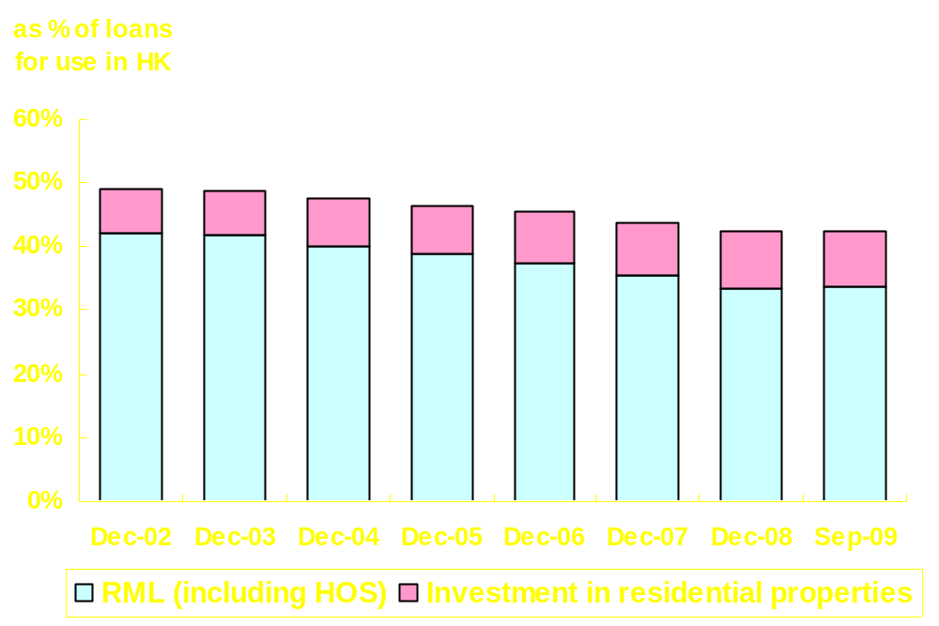
Key results in 2009 (1)
Residential mortgage loans – a long standing supervisory focus given its significance to banks’ loan portfolios

Slide 8
Key results in 2009 (2)
The HKMA has always been vigilant in the supervision of residential mortgage loans
  Introduction of 70% loan-to-value ratio (LTV) in 1991
  Refinements to LTV to maintain the integrity of the guideline
    Co-financing scheme
    Package RML with personal loans
  Interest/principal repayment holiday
  Prudence in setting mortgage interest rates
  Tightening of LTV ratio for luxury property
  Best practices including computation of debt servicing ratio and prudent valuation of property

Slide 9
Key results in 2009 (3)
Investor protection
Implemented recommendations of the Lehman Report, including audio recording and physical segregation
Simplified selling process by RIs concerning relatively simple investment products
Minibond Repurchase Scheme
Investigations and disciplinary actions
  Around 22,000 complaints
  77% handled
  Target to complete the remaining 5,000 investigations by March 2010

Slide 10
Key results in 2009 (4)
Financial stability and other supervisory initiatives
Work with international standard setting bodies to enhance banking regulatory policies
  – capital adequacy and liquidity
Consultation on remuneration system
Review of Deposit Protection Scheme
Consultation on AML/CFT legislation

Slide 11
Outlook of the banking sector for 2010 (1)
Operating environment remains difficult
Financial markets stabilising but uncertainty remains
  Timing in exit of quantitative easing strategies adopted by major economies
  Funds flow might increase market volatility and risk of asset bubble

Slide 12
Outlook of the banking sector for 2010 (2)
Message to banks
  Need to be vigilant in risk management
  Need to maintain adequate capital and liquidity to cater for potential market volatility
  Due consideration to impact of a reversal of funds inflow and interest rate movements
Key message to investors
  Beware of highly uncertain market environment in making investment decisions
  Home-buyers should consider loan repayment affordability if current interest rate returns to a normal level

Slide 13
Priorities for 2010 (1)
Preparations for exit from full deposit guarantee
Tripartite working group with Singapore and Malaysia to co-ordinate exit strategy
Enhance protection under DPS before end of 2010
Publicity campaign to be launched to introduce enhanced DPS and remind the public of the expiry of the guarantee
Continue to monitor AIs readiness for the uplift of full deposit guarantee
AIs to rigorously assess implications for their funding and liquidity management

Slide 14
Priorities for 2010 (2)
Enhancement of the regulatory framework
Continue to participate in the work of international standard setters
Complete legislative amendments for Basel II enhancements
Participate in quantitative impact study covering Basel’s enhancements
Finalise guidance on liquidity risk management, to be followed by compliance review
Support implementation of new legislation for AML/CFT and develop industry guidelines

Slide 15
Priorities for 2010 (3)
  Supervisory and enforcement focus
  Enhance surveillance of RIs’ regulated activities to ensure compliance with enhanced selling procedures
  Onsite examinations of AIs’ Mainland subsidiaries
  Review of AIs’ compliance with RML policies
  Benchmark review of AIs’ stress testing policies and processes
  Target to complete Lehman-related investigations by March 2010

