Slide 1

Bauhinia Summit on
“Creating a World Class PRD Metropolis”
cum The Second Pearl River Forum
Financial Infrastructure for Metropolitan Living Area:
e-money for Cross-Border Payments
Mr Norman T.L. Chan
Chief Executive, Hong Kong Monetary Authority
26 January 2010

Slide 2
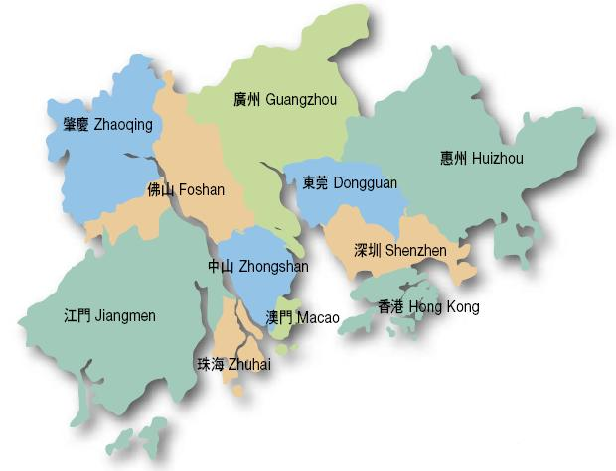
Pearl River Delta (PRD) Metropolis
9 Cities and
2 Special
Administrative Regions
Area
55,800 km²
Resident
Population
55.28 mn
GDP
USD 673.2 bn
GDP per
capita
USD 12,178
Sources: Guangdong Yearbook, Hong Kong Yearbook, Macao Statistics and Census Service, Macao Yearbook; 2008 figures.

Slide 3
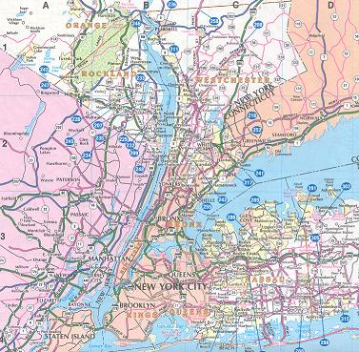
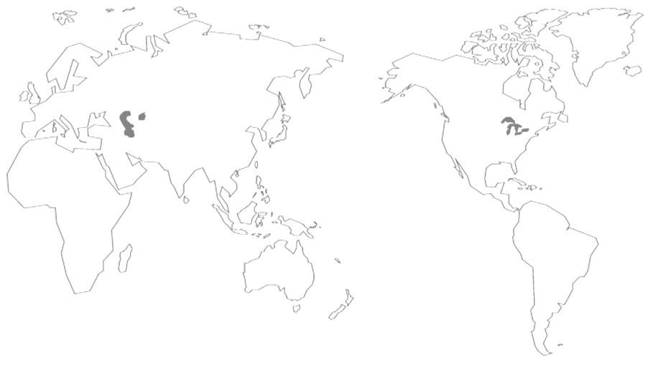
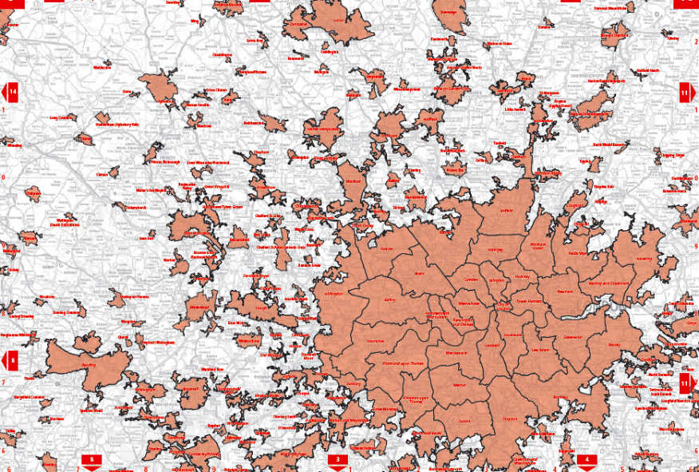
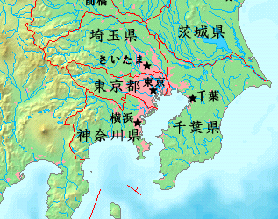
World Class Metropolises
The London Metropolis
The Tokyo Metropolis
The New York Metropolis
New York City+Northern New Jersey+Long Island +Southwestern Connecticut
Area: 33,483 sq. km.
Resident population: 28.71 mn
GDP: USD 1,614.2 bn
GDP per capita: USD 56,227
City of London+11 Neighbouring Counties
Area: 11,427 sq. km.
Resident population: 14.6 mn
GDP: USD 677.7 bn
GDP per capita: USD 46,418
Tokyo+Kanagawa+Saitama+Chiba
Area: 13,508 sq. km.
Resident population: 32.56 mn
GDP: USD 1,655.6 bn
GDP per capita: USD 50,849
Sources: Bauhinia Foundation
Research Centre; 2007 figures.

Slide 4
What is a World Class Metropolis
1. A cluster of vibrant and mutually interactive cities capable of achieving synergy
2. Smooth flow of factors of production - goods, talents, capital and information
3. Sharing a common living area
Challenge for the PRD region and Hong Kong － to develop a closely linked and highly interactive metropolitan living area within the framework of “One Country, Two Systems”

Slide 5


Payment for Spending
within the Metropolitan Living Area
Methods of Payment
Large Value
banknotes, remittances, cheques, credit cards, debit cards
Small Value
banknotes, coins, credit cards, debit cards, electronic money

Slide 6
One Country, Two Systems;
One Country, Two Currencies
Cross-Border Small-Value Payments
within the Metropolitan Living Area
Banknotes and coins are very inconvenient for cross-border purchases
Credit or debit cards are inefficient payment means for small-value purchases
The use of e-money is convenient for people within the metropolitan living area in making cross-border payments
Mutual use and access of e-money is an important financial infrastructure

Slide 7
Small-Value Payments Means
in Hong Kong
Security
Convenience
(Storage/
Giving changes)
Public Acceptance
Coverage
Coins
1 5 1 1
Small-denomination
notes
1 4 1 1
Credit/debit cards
3 3 3 4
An ideal electronic
money system
1 1 1 1
1 1 1 1
“1” : best, “5” : worst

Slide 8
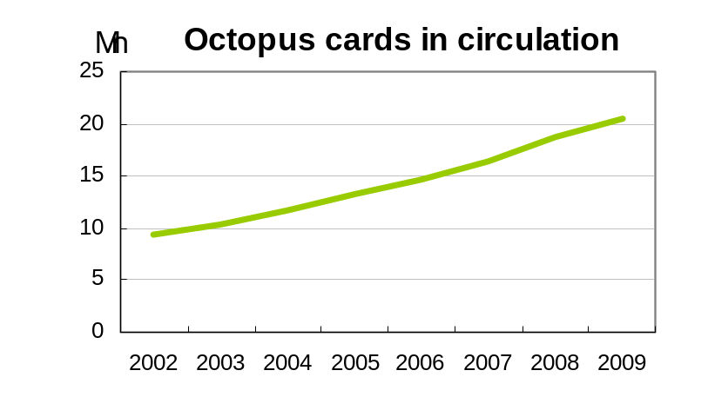
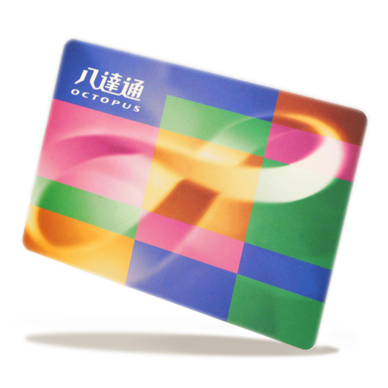
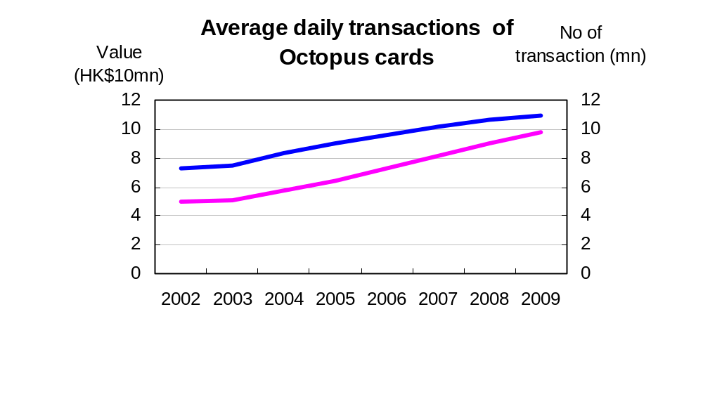



Overview of e-Money in Hong Kong
Currently there are over 20 million Octopus cards in circulation
No. of daily transactions processed exceeds 10 mn
Launched in 1997, Octopus card system became the e-payment system for public transport
Value of daily transactions exceeds HK$90 mn
Scope of service has steadily expanded to small-value retail payments
Average value of transaction is HK$9 (public transport: HK$7; retail spending: HK$22)
Avg daily transaction value (HK$10Mn) (left axis)
Avg daily no of transaction (Mn) (right axis)
Source: Octopus Cards Ltd.

Slide 9

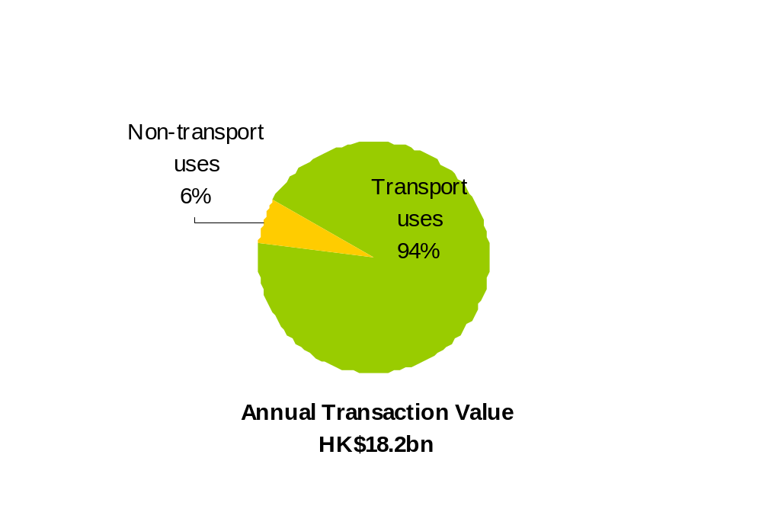
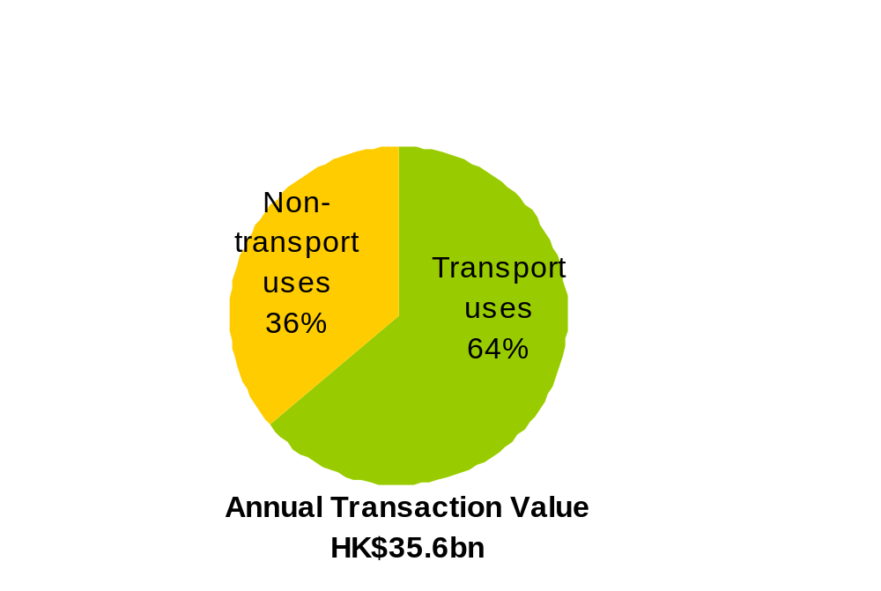
Overview of e-Money in Hong Kong
The Octopus card is extensively used in Hong Kong, with approximately 56,000 readers covering 3,000 service providers across different businesses, including public transport and retail shops (e.g. convenience stores, fast food outlets, carparks and vending machines).
2002
2009
HK$1.1bn
HK$17.1bn
HK$12.8bn
HK$22.8bn
Source: Octopus Cards Ltd.
(Outstanding store value: HK$1 billion)

Slide 10
Comparing Small-Value Payment Tools
in Hong Kong
Convenience
(Storage/
Giving changes)
Public acceptance
Coverage
Security
Coins
1
5
1
1
Small-denomination
notes
1
4
1
1
Credit/debit cards
3
3
3
4
An ideal electronic
money system
1
1
1
1
1
1
1
3
“1”: best, “5”: worst

Slide 11
HKMA’s Policy Initiatives in the Development of e-Money in Hong Kong
Promote
Development
Support Octopus’s expansion of retail payment network, facilitating it to become a form of e-money in Hong Kong
Octopus has 3 roles: settlement platform operator; card issuer; merchant acquirer
Access to settlement platform made available to other card issuing banks; currently there are 2 Hong Kong banks which issue bank cards with Octopus function
Open up merchant acquiring business: in addition to Octopus Cards Ltd, there are currently 12 merchant acquirers
Introduce
Competition
Prudent
Oversight
Ensure the Octopus electronic settlement platform operates safely and efficiently

Slide 12

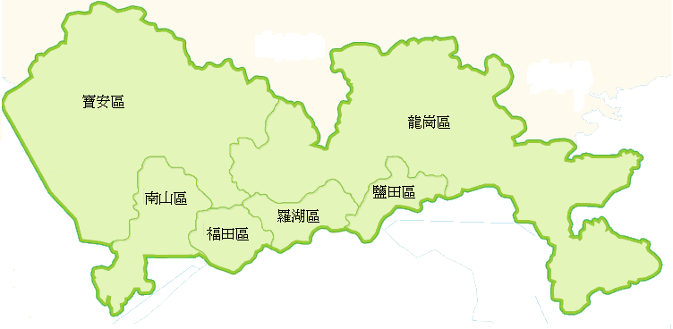

Cross-Border Usage of
Hong Kong’s e-Money
Very limited usage of Octopus across the border
Accepted only at 11 fast food outlets in Shenzhen and 4 duty free shops in Lowu and Huanggang control points.
Shenzhen
Hong Kong

Slide 13
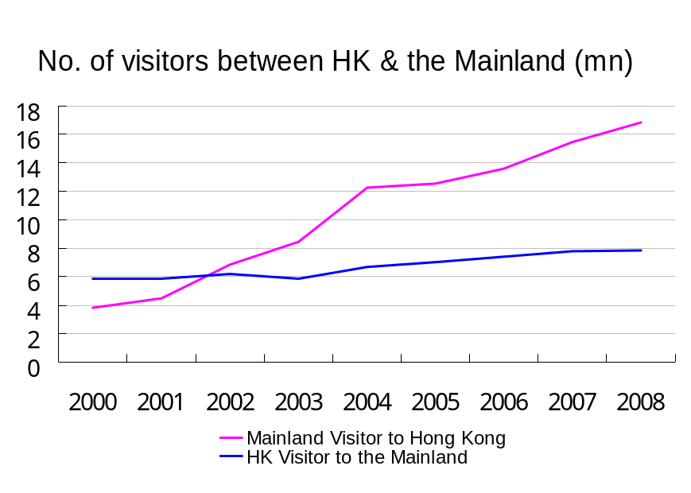
Interaction between Residents
in Hong Kong and the Mainland
2008
No. of Visitors
Tourist Spending
Hong Kong
residents visiting
Mainland
7.84 mn
HKD 718 bn
Mainland residents
visiting Hong Kong
16.86 mn
HKD 692 bn
Total
24.7 mn
HKD 1,410 bn
Sources: National Tourism Administration of PRC ; Hong Kong Tourism Board.

Slide 14
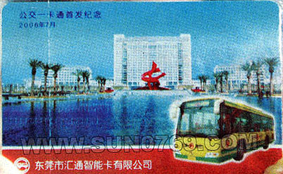

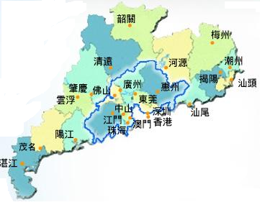


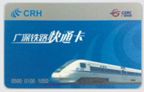

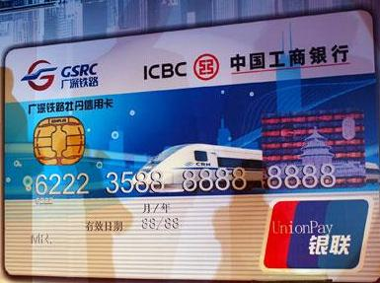
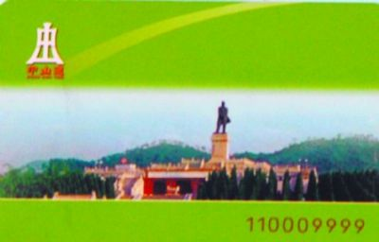
Current Status of
Electronic Stored Value Cards in PRD
Dongguan
Public Transport
IC Card
Guangzhou
Yang Cheng
Tong
Huizhou Public
Transport Card
Shenzhen
Tong
Foshan Tong /
Guang Fo Tong
Guangshen
Railway Card
MacauPass
Jiangmen Public
Transport Card
Guangshen Railway
Mudan IC Card
Zhongshan
Public Transport
IC Card
Zhuhai Public
Transport Card
Mainly used in public transport with limited application in retail payments
Different technology platforms and modes of operation, offering limited mutual access and usage

Slide 15
Strategy for Long-Term Development
Development, mutual access and usage of e-money in the PRD region and Hong Kong should facilitate the need for small-value payments within the PRD metropolitan living area
PRD
E-money
in the Mainland
(e.g. Shenzhen Tong,
Bank Card)
E-money in
Hong Kong
(e.g. Octopus Card)
HK

Slide 16
Pilot Scheme in Shenzhen and Hong Kong
Two feasible proposals:
Proposal 1
Proposal 2
“Two-in-One Card”
Common Card Reader

Slide 17

Proposal 1 – “Two-in-One Card”
Shenzhen
One card embedded with two chips
Hong Kong
To develop a card with chips for both Shenzhen Tong and Octopus so that cardholders can pay for services and purchases conveniently and efficiently in the two places
“Two-in-One Card” is technically simple but needs to issue new cards and tackle value upload involving different currencies across the border

Slide 18

Proposal 2 – Common Card Reader
Shops
Shenzhen
Bank
Card
Common card
reader for:
-Shenzhen Tong
-Octopus
-Bank Card
Shops
Bank
Card
Hong Kong
To jointly develop a common card reader for the e-money in Shenzhen and Hong Kong (e.g. Shenzhen Tong, Bank Card and Octopus) to achieve mutual access and usage with scale
Common card reader is not a complicated technology, but involves software development and reader replacement, as well as value upload involving different currencies across the border

Slide 19
Work Target
It is estimated that the “Two-in-One Card” can initially be implemented in Shenzhen and Hong Kong, within one year
The use of common card reader is a solution that can achieve mutual access and usage of e-money with scale. As it involves software development and replacing existing card readers, more time would be required for implementation. Relevant parties in the two cities have already started the discussion.
To further expand the mutual access and usage between Shenzhen and Hong Kong to the whole PRD region in the long run.

Slide 20
Pearl River Delta (PRD)
Metropolitan Living Area
9 Cities and
2 Special
Administrative Regions
Complete realization of Mutual Use and Access of e-money

Slide 21

Thank you!

