Slide 1

Bauhinia Foundation Research Centre
Thought Leaders Forum 2010 - Hong Kong’s Changing Roles
under the National 12th Five-year Plan
“External Use of RMB”
Hong Kong’s Contribution to
China’s Reform and Liberalisation
Mr. Norman T.L. Chan
Chief Executive, Hong Kong Monetary Authority
8 December 2010

Slide 2
China’s reform and liberalisation
Hong Kong’s role and contribution
To plan for the future, there is a need to understand the past and the present
Hong Kong has played an important and irreplaceable role in the country’s reform and liberalisation over the past 30 years
Hong Kong’s contribution will continue and increase over time

Slide 3
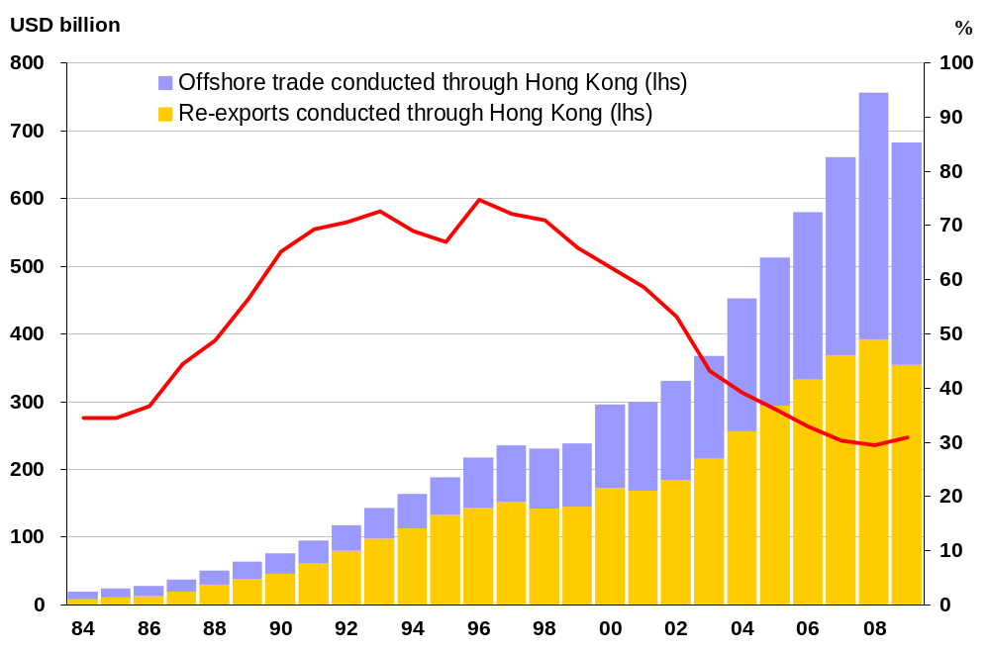
Hong Kong as the key intermediation platform for Mainland’s trade
Re-exports and offshore trade of Mainland origin intermediated through Hong Kong
During 1980-90’s, Hong Kong was the key re-export port for Mainland’s trade. With improved port facilities in the Mainland, Hong Kong has transformed itself into an offshore trading centre. Nowadays, about 30% of Mainland’s trade (including re-exports and offshore trade) is intermediated through Hong Kong.

Slide 4
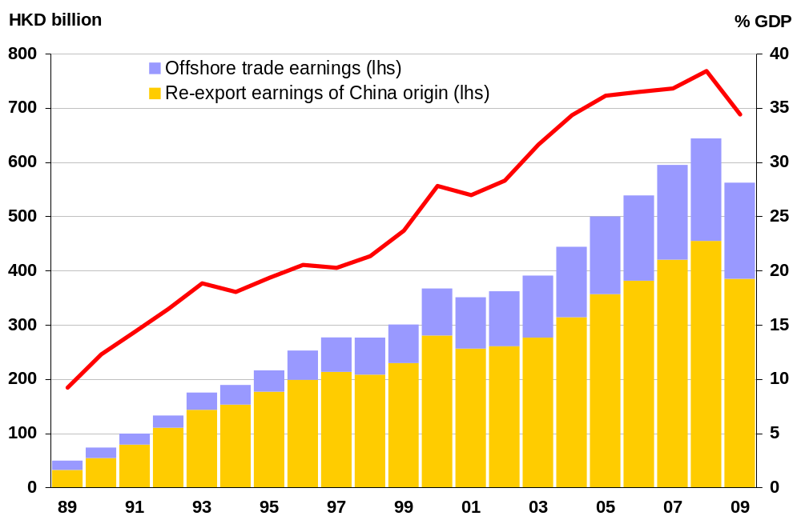
Contribution of trade intermediation services to the Hong Kong economy
Contribution of China-related trade intermediation services to Hong Kong
The fast-growing Mainland economy has provided an impetus for the development of re-export and offshore trade in Hong Kong. Over the past 20 years, gross earnings from Mainland-related trade intermediation services increased from an equivalent of 9% of GDP in 1989 to 34% in 2009.

Slide 5
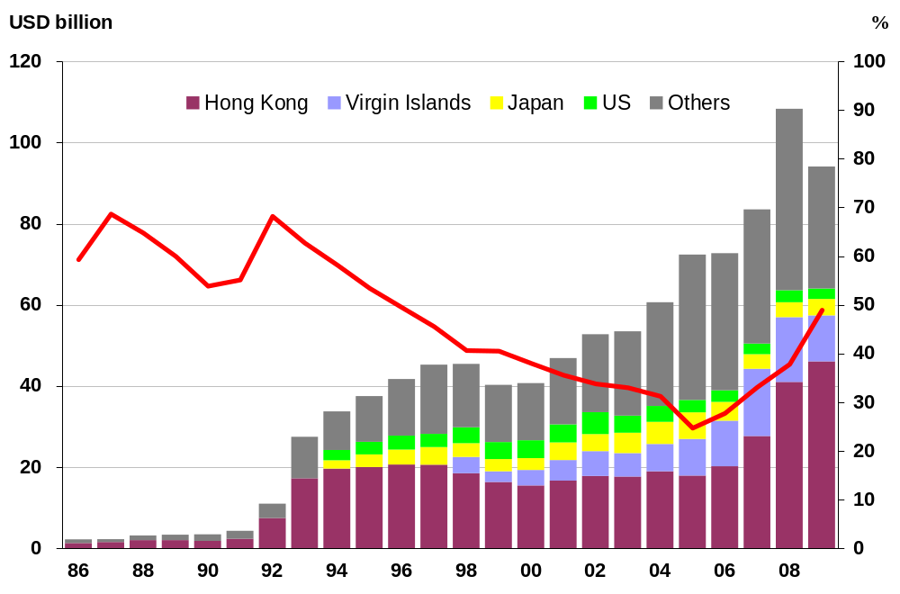
Hong Kong is the largest source of Mainland’s foreign direct investments
FDI to Mainland China
Since the opening up and reform of the Mainland 30 years ago, Hong Kong has been the largest source of Mainland’s foreign direct investments (FDI). While the share of Mainland’s FDI coming from Hong Kong was once on a decline, it has rebounded and accounted for half of Mainland’s total in 2009.

Slide 6
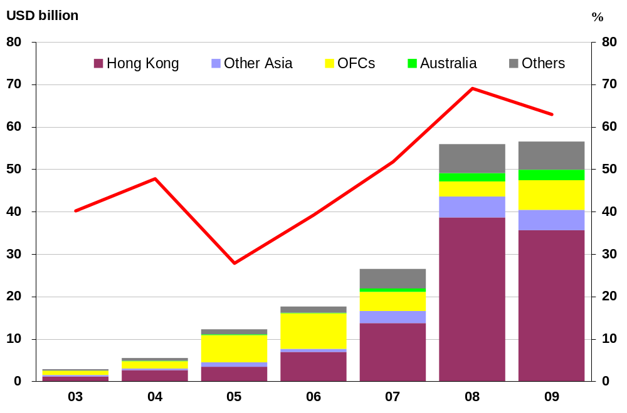
Hong Kong as a bridge for
Mainland enterprises investing overseas
Outward direct investments from Mainland China
Hong Kong also serves as a “window” and a “bridge” facilitating outward direct investments (ODI) by Mainland enterprises. In 2009, Mainland’s ODI increased to US$57 billion, of which 60% was invested in Hong Kong or through Hong Kong to overseas.

Slide 7
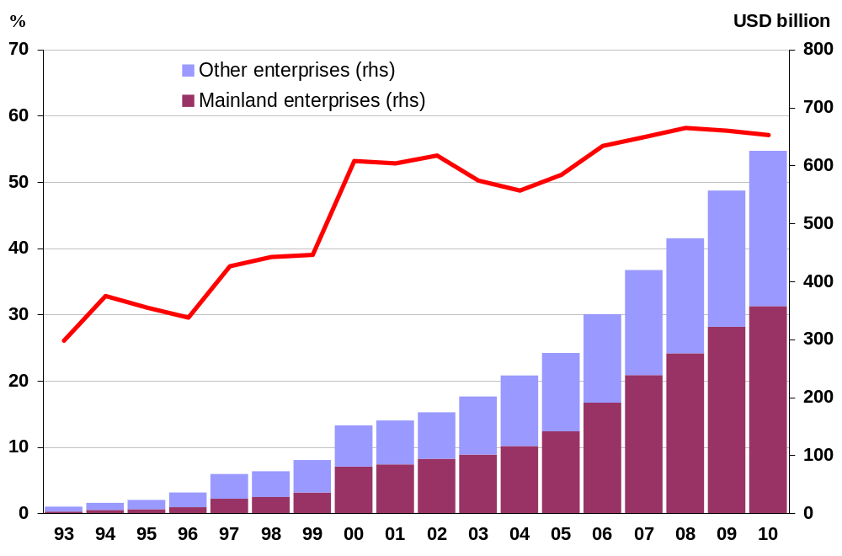
Hong Kong as a key fund-raising platform for Mainland enterprises
Cumulative amount of funds raised by Mainland enterprises in Hong Kong stock market
*As of October, 2010.
Hong Kong’s stock market provides an efficient fund-raising platform for Mainland enterprises. In the past 20 years, Mainland enterprises raised a total of US$360 billion, accounting for more than half of the funds raised in the Hong Kong stock market. Hong Kong continues to play this role today.

Slide 8
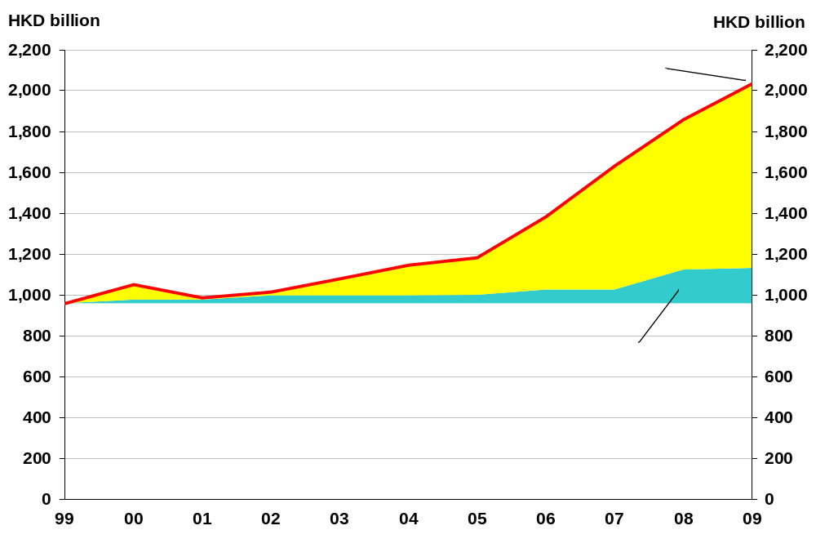
Hong Kong as a springboard for Mainland banks to develop overseas business
Source of growth of Mainland banks
operating in Hong Kong
Hong Kong has been the prime location for Mainland banks to expand their business overseas. During the past 10 years, the asset size of Mainland banks operating in Hong Kong increased rapidly, reaching HK$2 trillion or 20% of total bank assets in Hong Kong at the end of 2009.

Slide 9
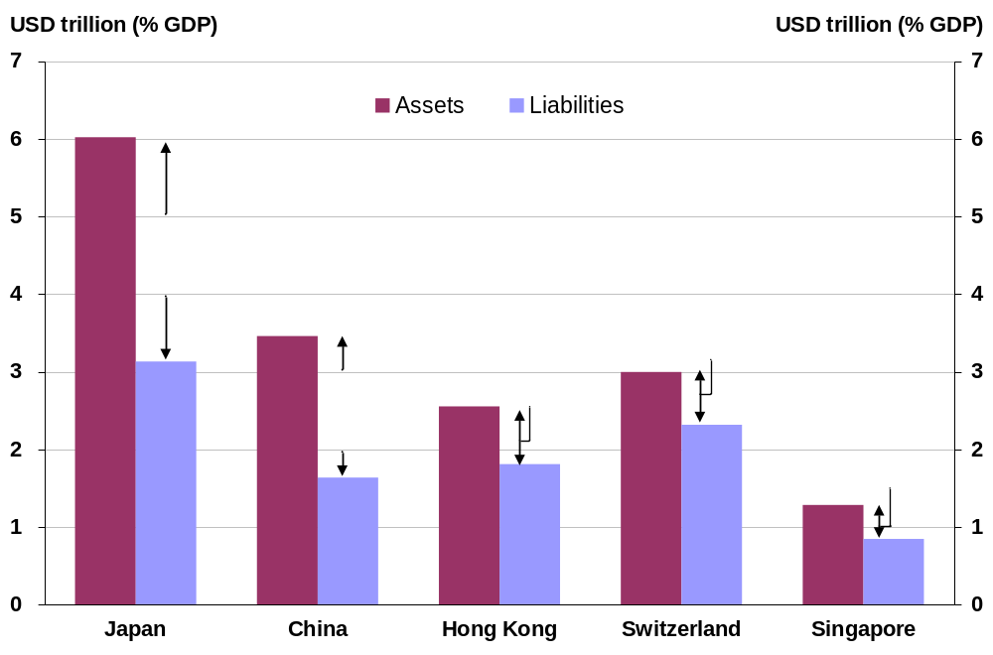
Hong Kong’s competitive edge as global hub for wealth and assets
International investment positions:
assets and liabilities
As at end-2009, Hong Kong’s international investment position (IIP) assets reached US$2.6 trillion or 12 times of GDP. Meanwhile, the net IIP assets stood at US$740 billion or 3.5 times of GDP.

Slide 10
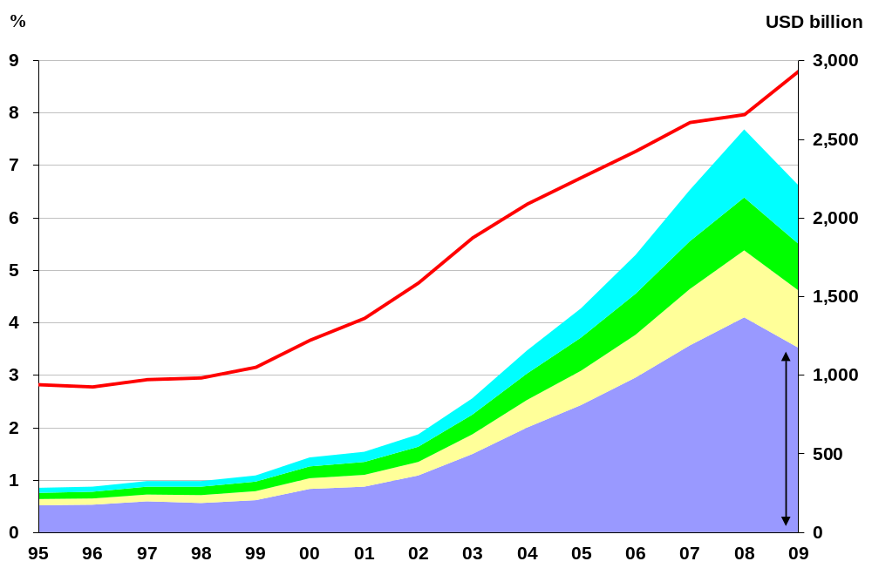
Huge potential for RMB as a currency for trade settlement
Mainland’s trade with major
trading partners
22,059
Mainland China is the world’s second largest trading economy after the US, accounting for 9% of global trade. Of which, Asia accounts for more than half of Mainland’s trade. Hence, the potential for RMB as a currency for trade settlement is huge.

Slide 11
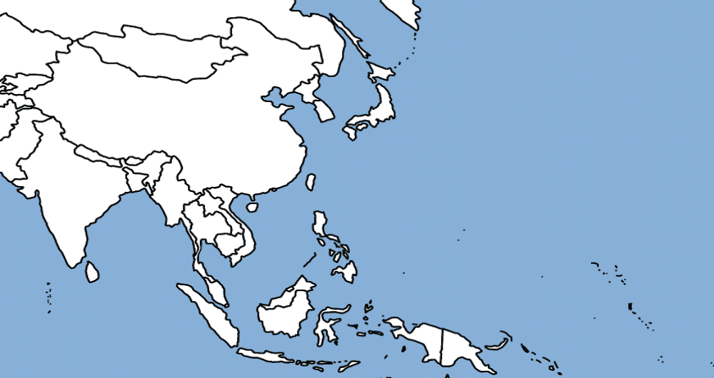
Asia is Mainland’s largest trading partner
Korea
2003: 20 bn
2009: 54 bn
(+167%)
Figures represent Mainland’s exports in US dollar.
Figures in ( ) represent the growth rate.
Japan
2003: 59 bn
2009: 98 bn
(+65%)
ASEAN
2003: 31 bn
2009: 1,06 bn
(+244%)
Growth of Mainland’s exports to Asia has been robust. During 2003-09, Mainland’s exports to Japan, Korea and ASEAN increased by 65%, 167 and 244% respectively. This suggests that there is ample scope for a wider use of RMB for trade settlement in the region.

Slide 12
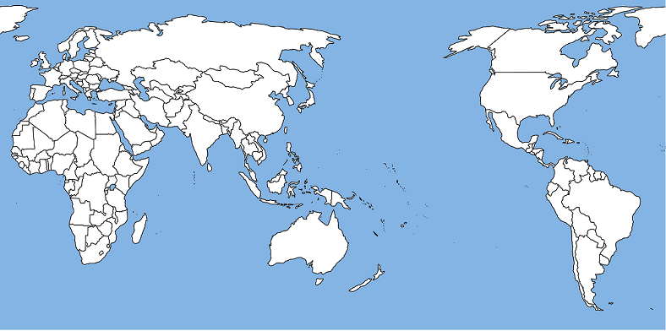
Mainland’s trade with regions outside Asia is also growing strongly
Eastern Europe
2003: 12 bn
2009: 40 bn
(+231%)
Central Asia
2003: 2 bn
2009: 17 bn
(+710%)
Latin America
2003: 12 bn
2009: 57 bn
(+380%)
Australia
2003: 6 bn
2009: 21 bn
(+230%)
Figures represent Mainland’s exports in US dollar.
Figures in ( ) represent the growth rate.
In recent years, Mainland’s exports to regions outside Asia has been increasing significantly. During 2003-09, Mainland’s exports to Australia, Eastern Europe, Latin America and central Asia rose by two to seven times. With the rapid expansion of Mainland’s trade with the emerging economies, there is also ample scope for a wider use of RMB for international trade settlement.

Slide 13
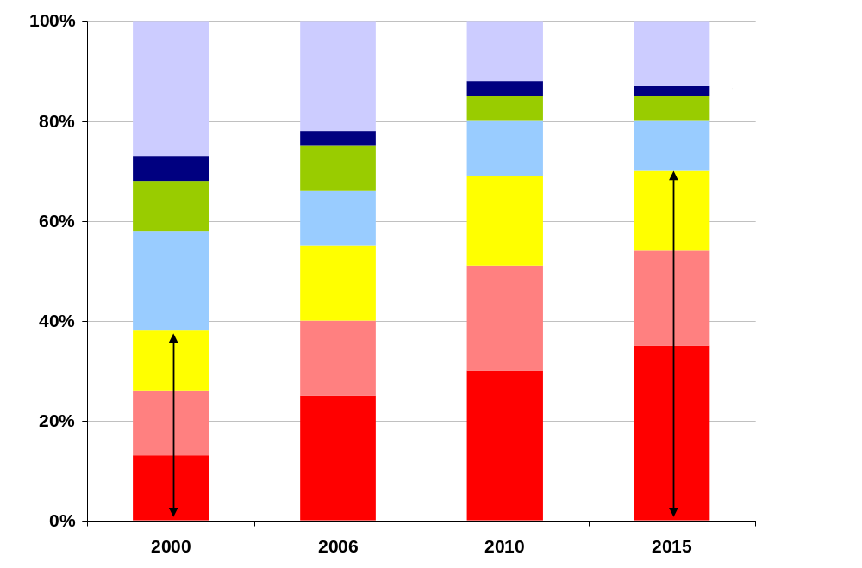
China is the key source of growth of global economy
Sources of global economic growth
As projected by the IMF, more than one-third of global growth would be contributed by Mainland China by 2015. It is expected that the importance of Mainland China in the global economy and financial system will also increase accordingly.

Slide 14
External use of RMB
Prospects of HK as an offshore RMB centre
Hong Kong is an established international financial centre, and also an important centre of capital and funds
With Mainland as the hinterland and its international links, Hong Kong is the ideal window, springboard and testing ground for the external use of RMB
Given the rapid growth of China’s cross-border trade and investment flows, there is huge potential for the Hong Kong offshore RMB platform to contribute and support real economic activities in China and the region
The offshore RMB market in Hong Kong is also linking up with the sizable onshore financial market in the Mainland, paving the way for China to link up with the international capital markets

