Slide 1
HONG KONG MONETARY AUTHORITY
What Has Been Done to Reaffirm Hong Kong’s Position as a Regional Wealth Management Hub
15 December 2010

Slide 2
Hong Kong:
Highly internationalised financial market
Ranked No. 3 in the City of London's Global Financial Centres Index
World’s 15th and Asia’s 3rd largest banking centre
70 of the world’s largest 100 banks operate in Hong Kong

Slide 3
Status of Hong Kong as a Wealth Management Hub
Attractions
Rule of law
Independent judiciary
Simple and low tax regime
Free flow of information and capital
Stable and fully convertible currency
Highly internationalized financial market

Slide 4
Gateway to Mainland China
Bridge to the rest of the world
Robust regulatory framework
Pool of talented financial intermediaries
Abolition of estate duty
Exemption of offshore funds from profits tax

Slide 5
Recent Developments
Internationalisation of Renminbi (RMB)
Revision of RMB Clearing Agreement

Slide 6
Results
Launch of wide range of RMB denominated financial products, for example:
  RMB certificates of deposits
  RMB bonds
  RMB structured deposits
  RMB insurance products
  RMB investment funds
Establishment of Hong Kong as an offshore RMB market

Slide 7
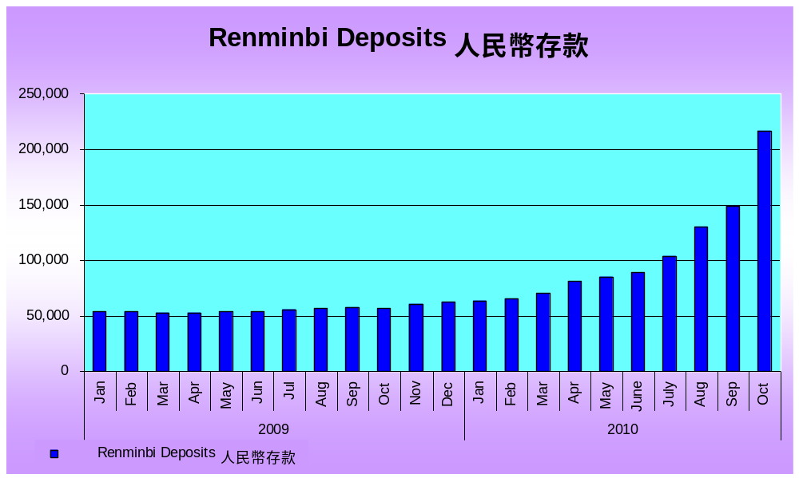
Renminbi Deposits in Authorized Institutions in Hong Kong
資料來源︰香港金融管理局 Source: HKMA

Slide 8
Trade Transactions Settled in RMB
  Substantial expansion of RMB trade settlement scheme in June 2010, whereby companies in 20 provinces and cities in Mainland China can settle their current account transactions with any parts of the world in RMB
  Amount of trade transactions settled through banks in Hong Kong has increased:
(RMB million yuan) | Average for the first half of 2010 | Jul 2010 | Aug 2010 | Sep 2010 | Oct 2010
Remittances for RMB cross-border trade settlement | 4,500 | 10,345 | 38,555 | 29,956 | 68,622
資料來源︰香港金融管理局 Source: HKMA

Slide 9
New Measure for OTC Derivatives Market
Improve transparency and reduce counterparty risks
Hong Kong to follow G20 recommendation:
  Trade Repositories (TR) for standardised OTC derivative contracts to be provided under Central Moneymarkets Unit of Hong Kong Monetary Authority (HKMA)
  Central Counterparty Clearing facilities (CCP) for OTC derivatives contracts to be launched by Hong Kong Exchanges and Clearing Ltd
  A link to be developed between TR and CCP

Slide 10
Conduct of Intermediaries
Conduct of intermediaries plays an important role
Misconduct or lack of fitness and properness will lead to mis-selling and result in disgruntled customers
An effective regulatory framework is necessary to ensure proper business conduct and protect investors

Slide 11
Key Regulatory Standards
Securities and Futures Commission (SFC)
  promulgates regulatory standards for the securities market
  new measures to enhance investor protection after Lehman incident
HKMA
  the frontline regulator of securities business conducted by banks
  requested banks to implement a number of additional regulatory measures after Lehman incident

Slide 12
Key Regulatory Standards
    Financial Planners should act with:
    honesty and fairness
    diligence
    competence
    Financial Planners should:
    know your client
    make adequate disclosure
    perform product due diligence

Slide 13
HKMA’S Additional Regulatory Measures
    Physical segregation of banks’ retail securities business from their ordinary banking business
    Audio-recording of the sales process and ancillary arrangements
    Pre-Investment Cooling-off Period in sales of derivative products to retail customers with less sophistication, e.g. elderly and first-time buyer
    Mystery shopping programme to test sales procedures

Slide 14
HKMA’S Additional Regulatory Measures
In view of the buoyant market demand for RMB products and exchange-traded funds (ETFs) , the HKMA has issued circulars to ensure proper disclosure in the banks’ marketing and selling of these two types of products:
  Selling of RMB Deposit, Investment and Insurance Products (16 September 2010)
  Synthetic ETFs and Related Products (03 September 2010)

Slide 15
Conclusion
  As a wealth management hub, Hong Kong is enjoying numerous opportunities brought by the development of RMB business and other products in the market
  HKMA to continue to work with other financial regulators to enhance the regulatory framework relating to sale of financial products

