Slide 1

Hong Kong’s Expanding Role as an Offshore RMB Centre
Goldman Sachs Global Macro Conference
Peter Pang
Deputy Chief Executive
Hong Kong Monetary Authority
22 February 2011

Slide 2
Mainland’s Phenomenal Growth Propels
Wider External Use of RMB
390
1,198
5,879
115
3
474
1990
41
2000
2,973
GDP, US$ bn
Trade, US$ bn
FDI, US$ bn
106
2010
Illustration not to scale

Slide 3
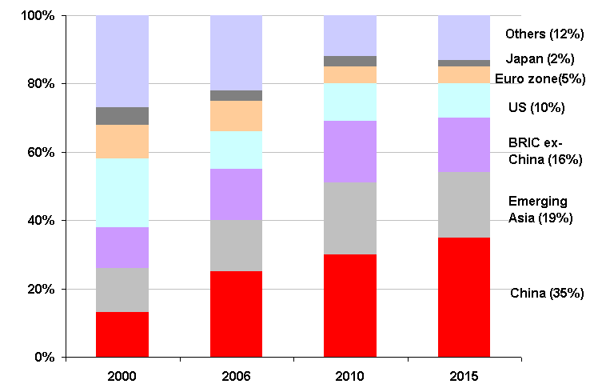
This Trend is Likely to Continue
Sources of global economic growth
As projected by the IMF, more than one-third of global growth would be contributed by Mainland China by 2015. It is expected that the importance of Mainland China in the global economy and financial system will also increase accordingly.

Slide 4
Mainland’s Global Economic Activities Drive
Expansion of Hong Kong’s RMB Business
Investment
Wealth management
Trade settlement
Financing
Retail
2004
2007
2009
2010
2011
Personal RMB business
RMB bonds
RMB Trade Settlement Pilot Scheme
Enlarged Trade Pilot Scheme
RMB wealth management products
Access to Mainland’s bond market
Case approval of RMB FDI
Overseas direct investment in RMB

Slide 5
Hong Kong’s Head Start as an
Offshore RMB centre
RMB trade settlement centre
Investment opportunities encourage RMB trade settlement
Net RMB trade inflows enlarge RMB liquidity pool
Three key components mutually
reinforcing
RMB wealth management centre
RMB financing centre
Diversification of RMB financial products

Slide 6
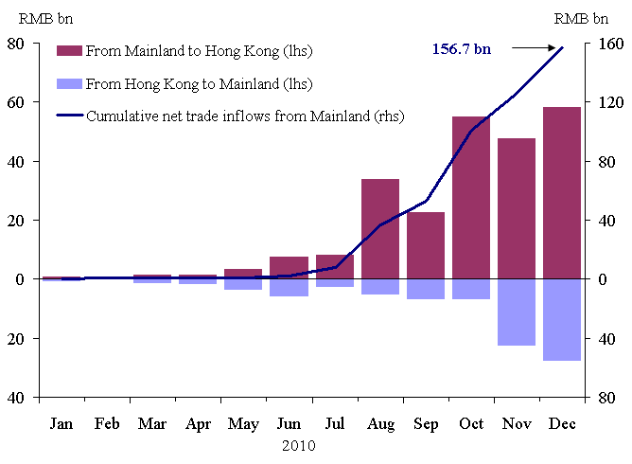
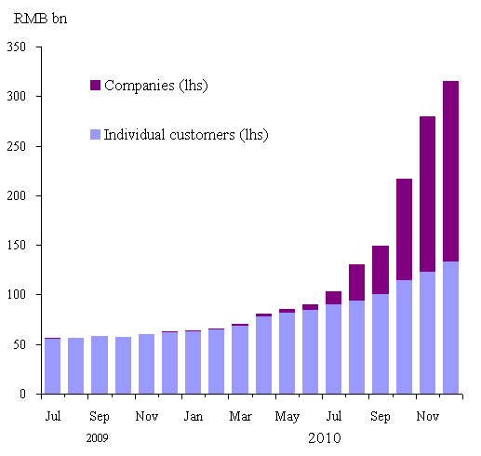
Trade Settlement –
Key Driver of Expansion of RMB Pool
Net RMB trade settlement
RMB deposits in HK
Notes:
For reference
Reasons for why Mainland had a net outflow of RMB trade settlement despite its significant net exports to the world:
Mainland importers have a natural source of RMB and will tend to be use RMB for trade settlement easily.
Mainland exporters that are eligible to use RMB for trade settlement is subject to the relevant Mainland approval. The number of eligible Mainland enterprises has just been substantially increased from some 360 to over 67,000 in Dec last year.

Slide 7
Trade Settlement –
Key Driver of RMB Financing
Venezuelan Model
HK
Overseas
Mainland
Issuance of RMB Certificates of deposits / bonds
Venezuelan project company
Mainland exporters of oil drilling equipment and tankers
RMB trade settlement
China Development Bank, HK Branch
RMB loan
Mainland importer of oil products
Loan repayment in RMB
RMB trade settlement

Slide 8
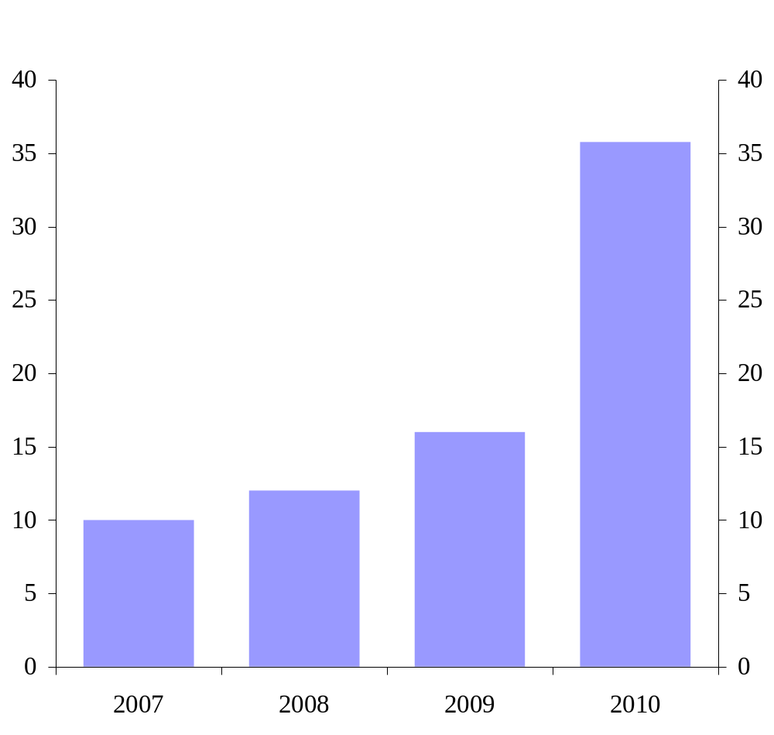
Trade and FDI - Key Drivers of
RMB Bond Market Development
RMB bond issuance in HK
Expansion of issuers: from Mainland financial institutions to HK corporation (Hopewell Highway Infrastructure), multinationals (McDonald’s) and international financial institutions (Asian Development Bank and World Bank)
Tenors: from 2 - 3 years to up to 10 years
Funding cost: currently lower than that in the onshore market

Slide 9
The Next Development Focus –
RMB Direct Investment
Further reinforcing two-way cross border flow of RMB and the link between offshore RMB market with China’s real economic activities
RMB trade settlement by Mainland importers
RMB trade settlement by Mainland exporters
Mainland
RMB Outward Direct Investment
Hong Kong
RMB Foreign Direct Investment

Slide 10
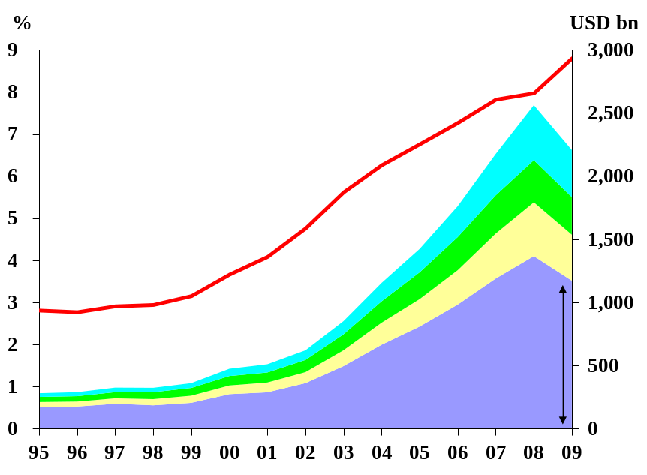

Potential Growth in RMB Trade Settlement
Mainland’s trade with
major trading partners
Mainland accounts for 8.8% of global trade
Mainland’s RMB trade settlement (RMB 506 bn) about 2.5% of Mainland’s total trade in 2010 (RMB 20,100bn)
HK accounts for about 75% of Mainland’s RMB trade settlement in 2010 (RMB 506bn)
What if: Mainland’s RMB trade settlement = 10% of Mainland’s total trade?
RMB 2,010 bn of China trade will be settled in RMB
RMB 1,507 bn will be settled through HK (4 times of 2010 actual: RMB 369 bn)

Slide 11
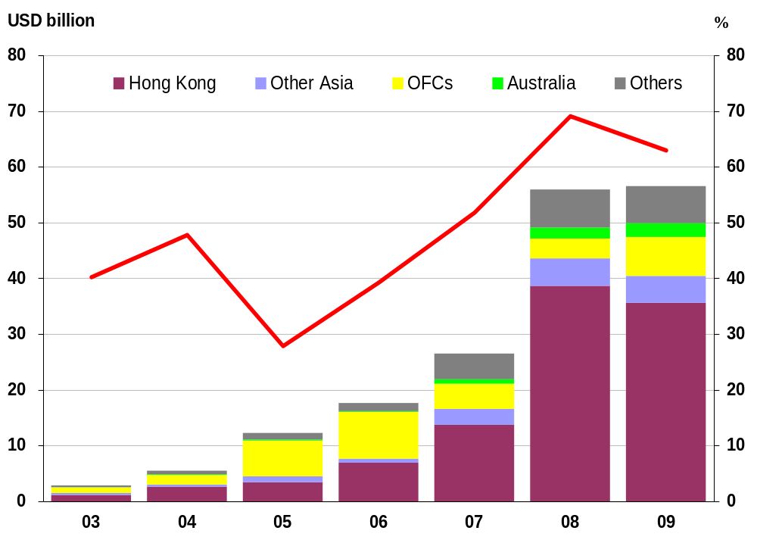
Business potential from
Mainland’s ODI
Mainland’s ODI
2009: Mainland’s total ODI amounted to US$ 57bn (RMB 390 bn) or 1.1% of GDP (Japan: 1.5%; US: 1.8%)
Over 60% of ODI (US$ 36 bn) invested in or through Hong Kong
Mainland policy and global environment favour rapid expansion of ODI activities by Mainland entities
*
What if: Mainland’s ODI at 1.5% of GDP? US$ 74bn (RMB 500 bn) in or through HK
Mainland’s ODI at 1.8% of GDP? US$ 90 bn (RMB 610 bn) in or through HK
Notes:
Reference:
Mainland authorities have in various occasions (e.g. the proposal for recommending “12-5” policy framework issued in Oct 2010*) mentioned about its full support for Mainland enterprises “going global”, including their direct investment overseas.
Extract from 中共中央关于制定国民经济和社会发展第十二个五年规划的建议（2010年10月18日中国共产党第十七届中央委员会第五次全体会议通过）
（48）加快实施“走出去”战略。按照市场导向和企业自主决策原则，引导各类所有制企业有序到境外投资合作。….扩大人民币在跨境贸易和投资中的作用。做好海外投资环境研究，强化投资项目的科学评估。提高综合统筹能力，完善跨部门协调机制，加强实施“走出去”战略的宏观指导和服务。维护我国海外权益，防范各类风险。

Slide 12
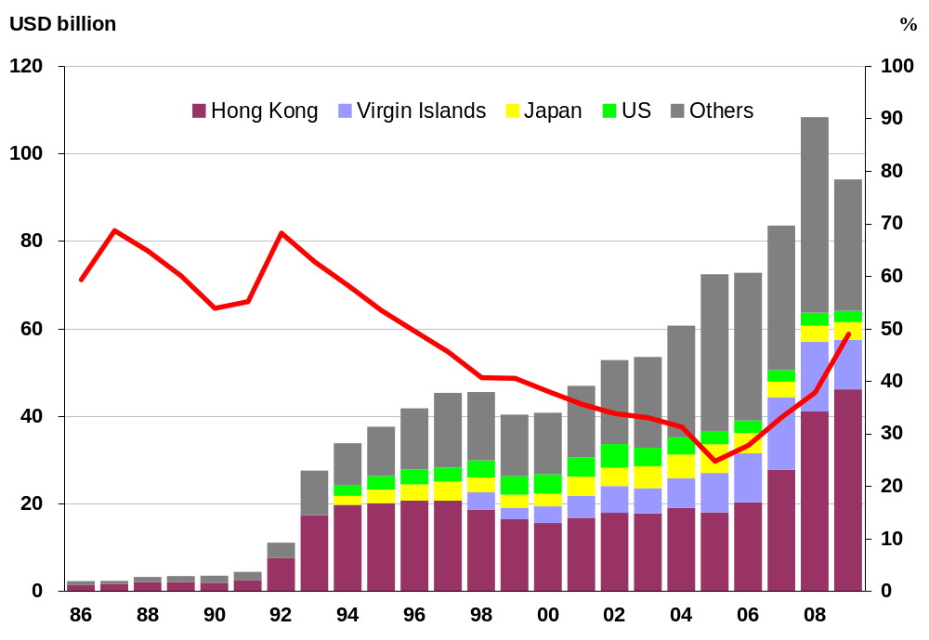
Business Potential from
Mainland’s FDI
FDI to Mainland
2009: HK’s investment of US$ 46 bn (or RMB 300 bn) accounted for nearly 50% of Mainland’s total FDI
2010: FDI into Mainland financed by RMB bond issuance in HK was only about RMB 1.58 bn (1.5% of Mainland’s FDI)
Huge growth potential after formalization of RMB FDI
What if: 10% of Mainland’s total FDI financed by RMB bonds in HK?
About US$ 10 bn (or RMB 66 bn)

Slide 13
Why Hong Kong
  Multi-currency and multi-functional financial platform
  Buy / sell RMB of reasonable size
  Unique RMB RTGS clearing platform outside Mainland
  Unique RMB conversion window
  Growing and largest pool of RMB liquidity outside of Mainland
  The only RMB bond market outside Mainland
  Dual channel for trade settlement: Clearing Bank and a large network of Correspondent Banks
  Increasing range of RMB financial products outside Mainland

