Slide 1

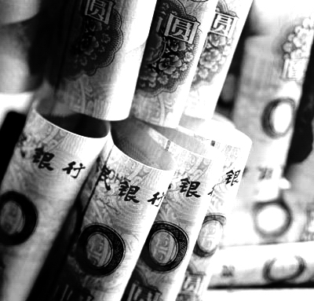

Bauhinia - Chatham House
Research Conference
Hong Kong's Development as the Offshore RMB Business Centre
13 June 2011
Norman T.L. Chan
Chief Executive
Hong Kong Monetary Authority

Slide 2

China’s Growth Story :
World’s Second Largest Economy
In US$ bn
5,879
1,198
261
1979
2000
2010

Slide 3
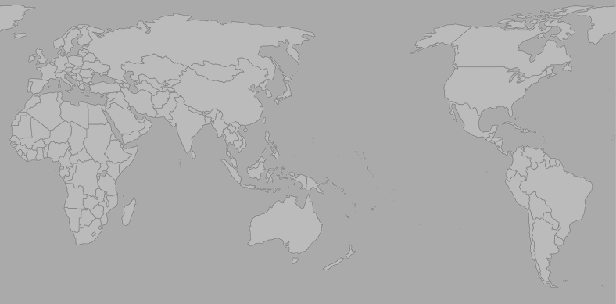
China’s Growth Story :
World’s Second Largest Trading Nation
177
121
16
14
1
1
167
264
Central Asia
42
42
102
283
36
29
9
37
3
Japan
1
22
Eastern Europe
52
Western Europe
154
138
US
22
17
2010
ASEAN
91
92
China’s Imports
China’s Exports
5
7
Latin America
2000
(In US$ bn)
3

Slide 4
China’s Growth Story :
Contributing 35% of Global Economic Growth by 2015
Share of Global Growth 2000 – 2015
China
BRICS ex China
Emerging Asia
US
Euro zone
Japan
Others
100%
80%
60%
40%
China: 35%
20%
0%
2000
2005
2010
2015*
* IMF projections

Slide 5
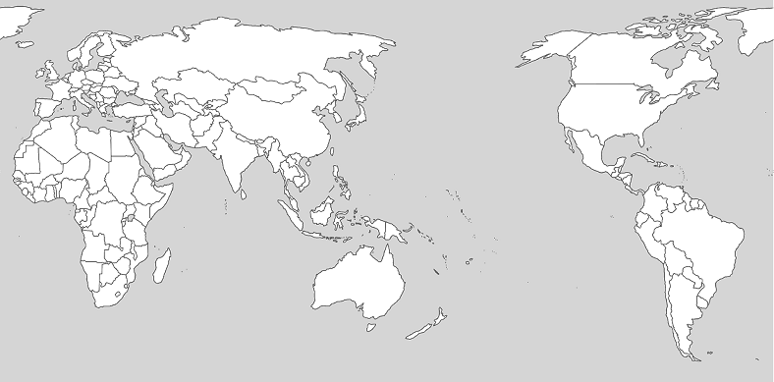
Hong Kong’s Intermediary Role
in China’s Trade
Mainland China’s Trade in 2010 : US$ 3 trillion
Hong Kong
Re-export trade with Hong Kong
US$ 436bn
Hong Kong’s Offshore trade
US$ 422bn
30% Intermediated through HK : US $ 858 billion
5

Slide 6
Hong Kong as Gateway for Investing in China
China’s Foreign Direct Investments (FDI)
USD bn
USD bn
120
120
FDI from HK
100
100
FDI from other places
80
80
60
60
40
40
20
20
0
0
2000
2001
2002
2003
2004
2005
2006
2007
2008
2009
2010
7

Slide 7
Hong Kong as Gateway for China’s
Overseas Direct Investments
China’s Overseas Direct Investments (ODI)
USD bn
USD bn
70
70
ODI to HK
60
60
ODI to other places
50
50
40
40
30
30
20
20
10
10
0
0
2000
2001
2002
2003
2004
2005
2006
2007
2008
2009
2010

Slide 8
Hong Kong as Overseas Fund Raising Centre for Mainland Companies
Hong Kong Stock Market :
Fund Raising by Mainland Companies
USD bn
USD bn
70
1993-2010 : USD380 bn in total
70
60
60
IPOs
50
Other fund raising
activities
50
40
40
30
30
20
20
10
10
0
0
93
94
95
96
97
98
99
00
01
02
03
04
05
06
07
08
09
10

Slide 9
Internationalisation of RMB :
A New Era for China’s Growth Story
China’s trade settled in RMB since 2009
1H 2010 : 0.7% → 2H 2010 : 4% → 1Q 2011 : 7%
New rules promulgated in January 2011 to allow use of RMB in China’s ODI
RMB FDI allowed on case-by-case basis (new rules under consideration)
Permission granted to offshore monetary authorities and banks in Hong Kong to access Mainland RMB interbank bond market
RMB QFII under consideration

Slide 10
Hong Kong as Offshore RMB Centre
for Asia and Beyond
2010
China’s RMB trade settlement:
RMB 506 bn yuan
1Q 2011
China’s RMB trade settlement:
RMB 360 bn yuan
73% handled by
banks in Hong Kong
RMB 370 bn yuan
86% handled by
banks in Hong Kong
RMB 311 bn yuan

Slide 11
Hong Kong as Offshore RMB Centre
for Asia and Beyond
RMB bn
RMB bn
600
600
Corporates incorporated
overseas = 16%
Corporate customers
500
500
Personal customers
400
400
300
300
200
200
100
100
0
0
Jul
Sep
Nov
Jan
Mar
May
Jul
Sep
Nov
Jan
Mar
2009
2010
2011

Slide 12
Hong Kong as Offshore RMB Centre
for Asia and Beyond
RMB Bond Issues in Hong Kong
Recent Issuers :
Banks
2007
10 bn by 3 issuers
China Development Bank
China Export and Import Bank
Bank of China
VTB (Russian commercial bank)
UBS
ANZ
HSBC
2008
12 bn by 4 issuers
2009
16 bn by 4 issuers
Corporations
Volkswagen
Unilever
Caterpillar
McDonald’s
Hopewell Highways
2010
36 bn by 16 issuers
International organisations
Jan-May
2011
28 bn by 28 issuers
World Bank
Asian Development Bank
International Finance Corporation

Slide 13
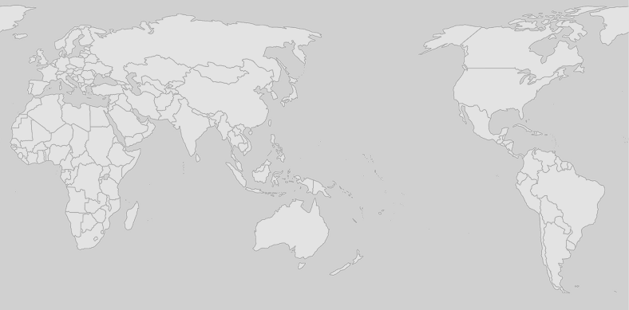
China’s Growth Story and Hong Kong’s Role :
The Future
RMB internationalisation signifies a New Era of rapid growth in China’s trade and investment links with the world
AND
Hong Kong is part of China’s growth story in this New Era

