Slide 1


Hong Kong:
The Premier Offshore Renminbi Business Centre
- What does it mean for Hong Kong’s banking industry and its practitioners
Peter Pang
Deputy Chief Executive
27 September 2011

Slide 2

Outline
Significance of HK’s development as the premier offshore RMB business centre
How to capture the opportunities arising from the internationalization of the RMB
The role of the HKIB

Slide 3
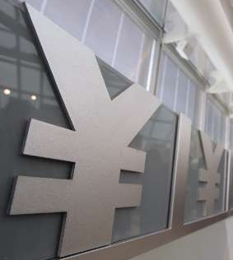
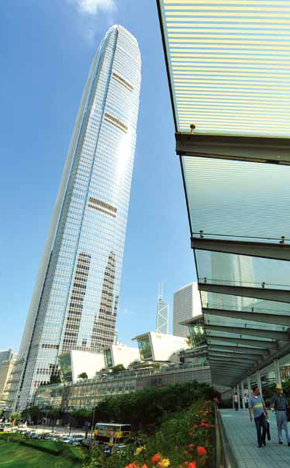
Significance of HK’s Development as the Premier Offshore RMB Business Centre
RMB: a prospective major global currency
  Currency of 2nd largest economy and trading nation – catching up on US
  Potential to become a major international currency and reserve currency
  Gradual liberalization process creates opportunity for offshore RMB business
HK has significant competitive advantage
  Policy support
    China’s Twelfth Five-Year Plan supports development of HK as the offshore RMB business centre
  First-mover advantage
    Significant lead in trade settlement, RMB liquidity, CNH market and bond issuance
  Home bias
    HK market preferred by Mainland fund-raisers, investors, financial institutions and enterprises

Slide 4
Offshore Centre for a Global Currency:
London Experience
Vastly expanded capacity in international financial intermediation
Expanded range of financial products and size of financial markets
The largest FX centre (37% of global FX market turnover)
 | USD-denominated amount / turnover | Total amount / turnover in UK | %
Bank claims on & liabilities to non-UK residents | 4,363 | 11,186 | 39
Bonds and notes outstanding | 779 | 2,056 | 38
OTC interest rate derivatives | 186 | 1,235 | 15
(2010 figures in USD billion)
Sources: (1) BIS Triennial Central Bank Survey – Report on global foreign exchange market activity
(2) ECB, BOE

Slide 5
Capturing RMB Opportunities –
To Secure an Enabling Policy Framework
RMB Trade Settlement Centre
Global hub for RMB trade settlement, with banks in HK handling 84% of Mainland’s trade settled in RMB
Policy support:
  In August 2011, the RMB trade settlement scheme was expanded to cover the entire Mainland
RMB Financing Centre
Centre for “dim-sum” bonds
Policy support:
  Use of RMB for Mainland’s overseas direct investment
  Formalization of the use of RMB in foreign direct investment into Mainland in progress
RMB Wealth Management Centre
An expanding range of RMB products and services to meet different needs
Policy support:
  HK banks allowed to invest in Mainland’s interbank bond market
  RQFII in the process of implementation

Slide 6
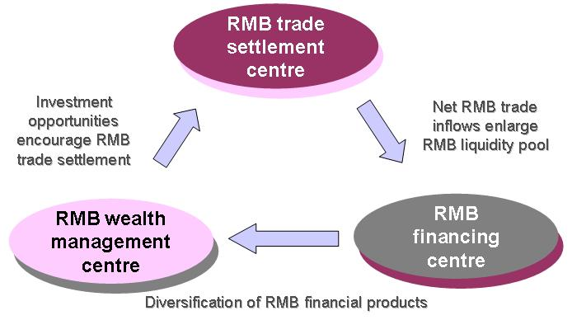
Capturing RMB Opportunities –
To Enhance Circulation of RMB
Expanded Trade Settlement Scheme
RQFII &
Mainland’s interbank bond market
FDI

Slide 7
Capturing RMB Opportunities –
To Build Critical Mass
London’s experience: Important to build critical mass quickly
  Concentration of financial products, market liquidity and financial intermediaries create inertia to conduct financial transactions through the established centre
  London maintains its status as the premier IFC in Europe despite speculation of its possible replacement by Frankfurt upon introduction of the Euro
HKMA roadshows
  To raise awareness of policy-makers, financial institutions and enterprises
Need to be followed through by banks’ direct marketing
  Leveraging on:
    Relationship with clients – banks and enterprises
    Global network of operations

Slide 8

Capturing RMB Opportunities –
To Expand Our Global Network
180 participating banks in HK’s platform forming a global payment network covering more than 30 countries in five continents
  Banks with global network can use HK as a hub to serve customers worldwide
HK can also serve as a hub to support offshore RMB business in other places:
  Largest pool of offshore RMB funds
  Centre for RMB financing
  Most efficient offshore RMB payment and settlement platform in Asian time zone

Slide 9

Capturing RMB Opportunities –
To Provide One-Stop Service
Core services are already in place
  RMB trade settlement
  RMB financing through bonds and bank credit
  RMB forex transactions supported by CNH market, RMB DFs and NDFs
More sophisticated RMB products under development
  RMB exchange-traded products
  RMB commodities contracts
  RMB interest rate derivatives and risk management products

Slide 10
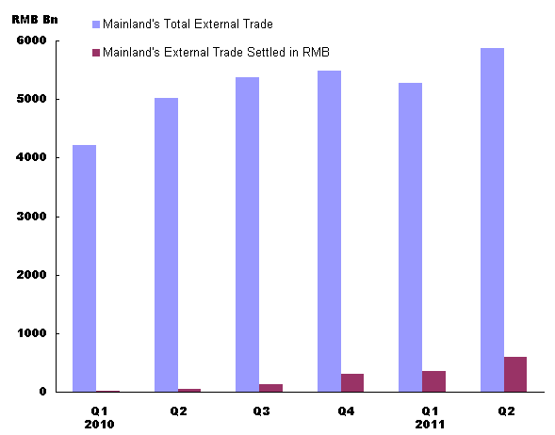
Potential for Growth: RMB Trade Settlement
  Progress to date
  Potential
Mainland’s Total Trade
Mainland’s Trade Settled in RMB
% of Mainland’s trade settled in RMB (1H of 2011): 8.6%
RMB trade settlement scheme expanded to cover the entire Mainland in August
% of trade settled in local currency:
  Japan: 32%
  EU: 50-60%
  US: 80-90%
Footnote: - 2009 figures for Japan and US
- 2007 figures for EU
- Sources are from IMF, ECB,
MOF Japan and HKTDC

Slide 11
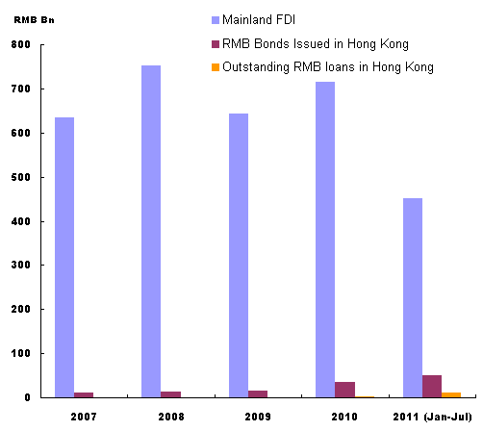
Potential for Growth: RMB Financing
  Progress to date
  Potential
Mainland FDI
RMB bonds issued in HK
Outstanding RMB loans in HK
Promulgation of RMB FDI rules will boost demand for RMB financing
Expansion of RMB bond issuance by MOF and Mainland enterprises
Attractive funding costs due to ample RMB liquidity in HK

Slide 12
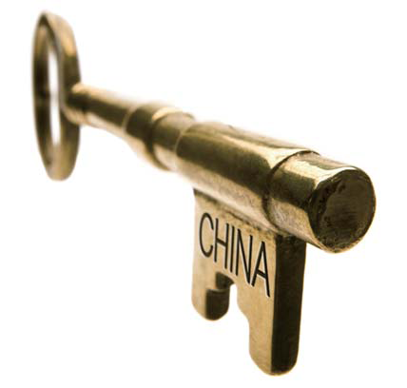
Potential for Growth: RMB wealth management
  Progress to date
  Potential
RMB products presently available in major asset classes:
  Cash (RMB deposits)
  Fixed Income (RMB bonds)
  Equity (REIT listed in Apr 2011)
  Insurance (Insurance plans and products)
  Derivatives (Offshore deliverable RMB options)
Arrangements for banks to invest in Mainland’s interbank bond market and RMB QFII support development of RMB wealth management products
More RMB exchange-traded products
RMB commodities contracts

Slide 13
Important Roles of Banks – the 5 Ps
Product
  Need to proactively expand the range of RMB-denominated financial products
Platform
  Leverage on HK’s superb RMB clearing platform, with a unique linkage with Mainland’s payment system, to offer a one-stop, multi-functional and multi-currency service
Price discovery
  Spot USD/CNY (HK) fixing serves as a reference rate for the pricing of RMB products in the offshore market
  Benchmark yield curve for offshore RMB bonds in HK to be fully developed
Prudent risk management
  RMB product innovation to be in compliance with regulatory requirements to ensure safe and orderly development
  Accompanied by banks’ risk management and internal controls
People
  People with the right set of skills and knowledge to proactively develop and prudently run RMB businesses

Slide 14
Role of HKIB
People factor is key to business development. Need the right people to develop new RMB products and businesses, market them properly to the clients, and manage the related risks
HKIB has an important role in the development of HK’s offshore RMB business:
  Offers continuous professional development program to strengthen members’ knowledge base and equip them with the necessary skills
  Updates members on new business trends by hosting more seminars and sharing sessions on offshore RMB business

