Slide 1

Conversational Chatbot
TEAM: Shiva Krishna Tarun Goud
Manoj Reddy

Slide 2


PROBLEMS TARGETED:-
Depression Stress Lonliness

Slide 3
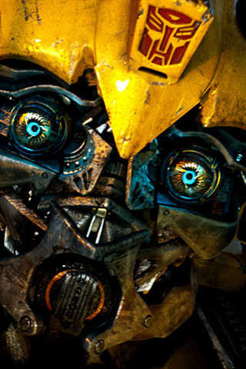
SOLUTION
BUMBLE BEE
A Personal Chatbot
We keep you in a conversation, always!

Slide 4
FEATURES:-
Generative Model based
Long /Short conversations
Open Domain - addresses Wide Variety of conversations.
Bot knows English grammar (Dataset is trained for 2000 iterations).

Slide 5

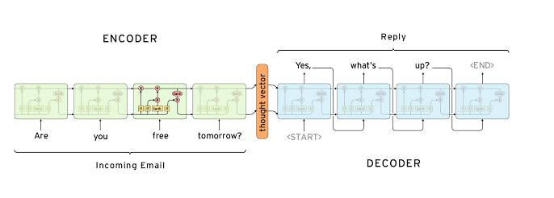
Architecture

Slide 6
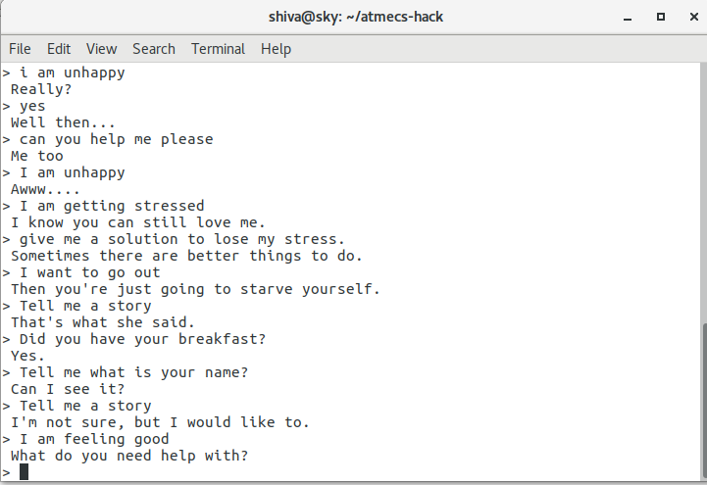
A sample chat

Slide 7
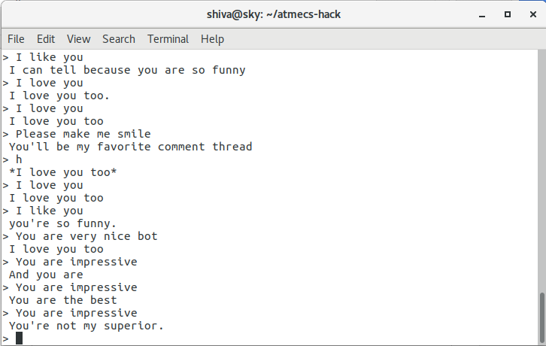

Slide 8
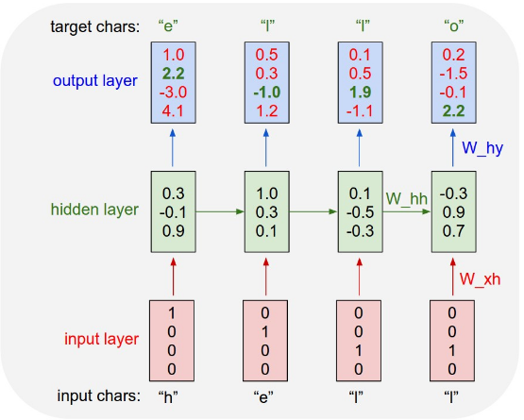
Working of char by char classifier

Slide 9
FUTURE IMPROVEMENTS
Incorporating Context
Coherent personality
Attention and Intention.

