Slide 1
P22 PROJECT
Fake News Detection
TEXT
Clean + preprocess
↓
TF-IDF
10,000 features
NLP + Classical ML + Deep Learning
↓
BiLSTM
Attention model
↓
LIAR Dataset • REAL / FAKE Classification
BERT
bert-base-uncased
MENTOR
GROUP 2
Binary
Fake News
Detection
Geethika
• Sumit Reddy
• Samruddhi Vijay Patil
• Nigar Saiyad
• Mekala Shivkumar
NLP • Classification • PyTorch • Transformers

Slide 2
S L I D E 02
Objective
Build and evaluate an automated REAL / FAKE news classifier using the LIAR dataset.
Goals of the Project
Prepare the LIAR data
Define the target
Perform quality checks, EDA and model-specific preprocessing.
Map six truthfulness labels into REAL and FAKE.
Compare models
Use balanced metrics
Evaluate Logistic Regression, Linear SVM, BiLSTM + Attention and BERT.
Use Precision, Recall, F1 and F1-Macro with validation-based model selection.
Analyze learning behavior
Prepare deployment artifacts
Track validation F1 and training/validation loss for deep models.
Save models, tokenizers, vectorizers and results for deployment.
P22 • Objective and evaluation plan

Slide 3
S L I D E 03
Dataset Description
The project uses the LIAR dataset with the original six truthfulness labels.
TRAIN
VALIDATION
TEST
LABELS
10,240
1,284
1,267
6
statements • 14 columns
statements • 14 columns
statements • 14 columns
original LIAR labels
Original Labels
Dataset Characteristics
• true • mostly-true • half-true
• barely-true • false • pants-fire
• Text statements plus speaker / subject / party metadata
• Train / validation / test splits kept separate
Quality Snapshot
• No duplicate rows; no empty statements; all six labels present in every split.
• Missing values occur mainly in metadata columns such as job, state and context.
LIAR split sizes are taken directly from the notebook outputs.

Slide 4
S L I D E 04
Data Quality & Cleaning
Quality checks were performed independently on Train, Validation and Test.
No duplicates
No empty statements
0 duplicate rows in Train, Validation and Test.
0 empty statements in all three splits.
No missing labels
Metadata gaps
All labeled records have a target label.
Missing values mainly occur in job, state, context and some count fields.
Class imbalance
Split integrity
pants-fire is the smallest original class; accuracy is therefore not used alone.
No records removed solely from initial quality checks; splits remain separate.
Quality conclusion: the dataset is structurally suitable for NLP modeling.

Slide 5
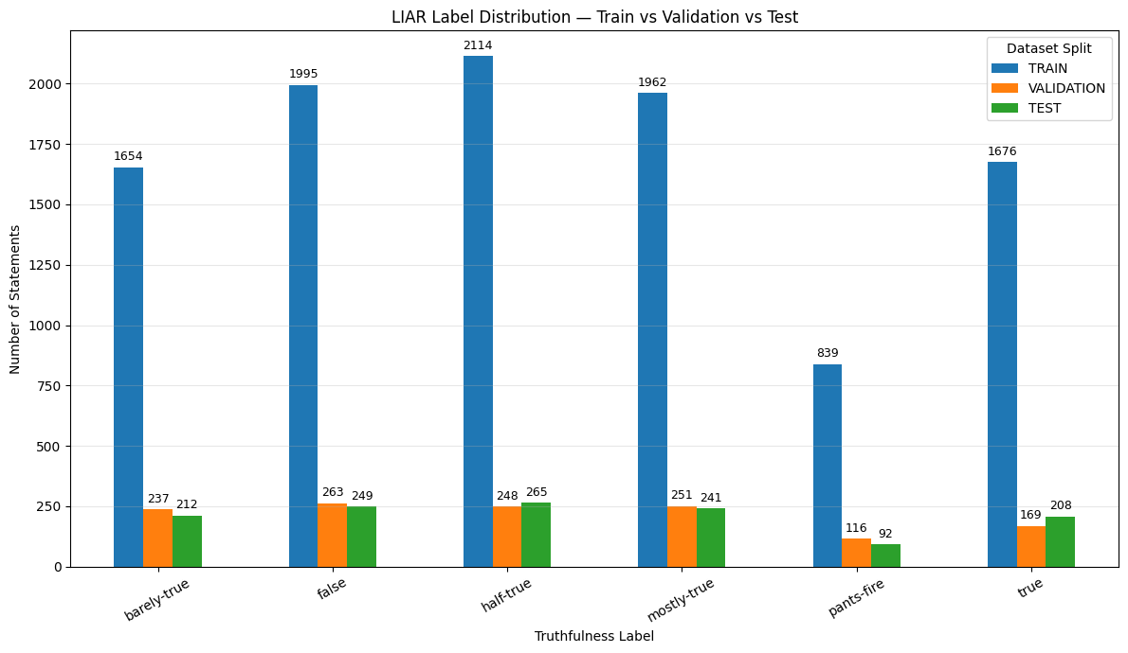
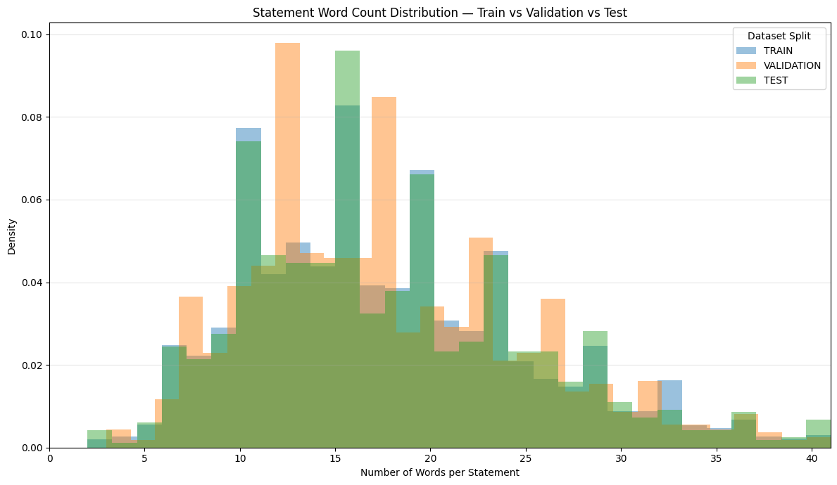
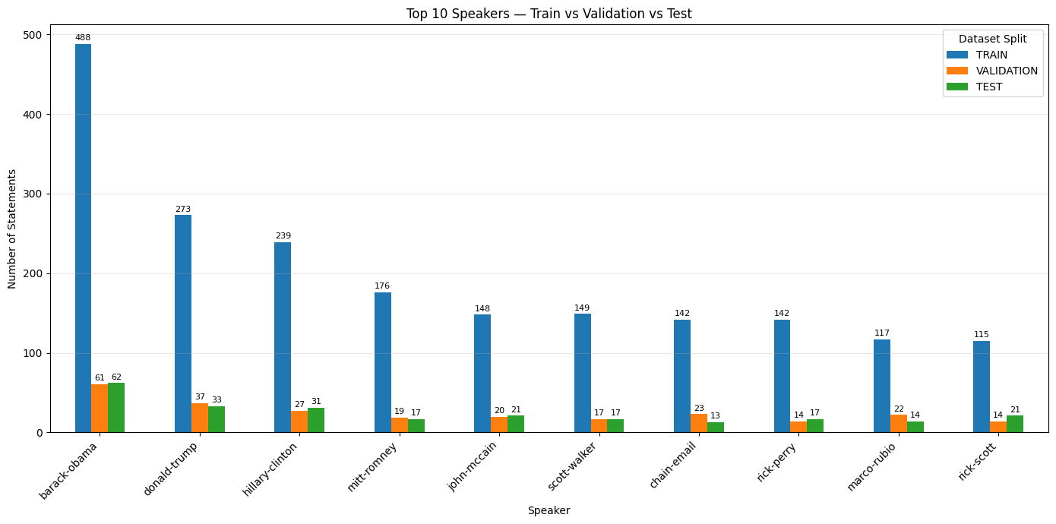
S L I D E 05
Exploratory Data Analysis (EDA)
EDA examined label distribution, statement length and dataset characteristics before modeling.
Train / Validation / Test label distribution
Focused word-count distribution
Top speaker frequencies
Label distribution
Statement length
Speaker / topic signal
All six labels occur in every split; half-true is largest in Train/Test, while pants-fire is smallest.
Most statements are concentrated around the 5–30 word range; longer observations are retained rather than deleted automatically.
Speaker and subject distributions vary across splits, so metadata can introduce predictive shortcuts if used directly.
EDA supports model-aware preprocessing rather than conventional numerical outlier removal.

Slide 6
S L I D E 06
Target Definition
The original six-class LIAR labels are preserved; a separate binary target is used for classification.
true
→
REAL
mostly-true
→
REAL
half-true
→
REAL
barely-true
→
FAKE
false
→
FAKE
pants-fire
→
FAKE
TRAIN
VALIDATION
TEST
5,752 / 4,488
668 / 616
714 / 553
REAL / FAKE
REAL / FAKE
REAL / FAKE
Binary target: true / mostly-true / half-true → REAL; barely-true / false / pants-fire → FAKE.

Slide 7
S L I D E 07
Text Cleaning & Model-Specific Processing
A common cleaning stage is followed by different representations for each model family.
Common text cleaning
TF-IDF → Classical ML
BiLSTM → Sequence model
• Lowercase text consistently
• Remove URLs and unwanted characters
• Preserve meaningful words and numerical information
• Store result separately as cleaned_statement
• TF-IDF token-based feature extraction
• 10,000 maximum features
• Unigrams + bigrams
• Used by Logistic Regression and Linear SVM
• Training vocabulary only
• Integer sequences + padding
• 95th-percentile sequence length = 33
• Embedding → BiLSTM → Attention
BERT → Contextual representation
Why preprocessing differs
• bert-base-uncased tokenizer
• Subword token IDs + attention mask
• Maximum sequence length = 128
• Pre-trained BERT + binary classification head
• TF-IDF directly creates numerical features; BiLSTM needs padded sequences; BERT uses its own subword tokenizer.
• Stopword removal and lemmatization were not applied globally.
Model-specific preprocessing avoids forcing one representation onto all architectures.

Slide 8
S L I D E 08
Feature Engineering
Three lightweight numerical features were added to complement TF-IDF text features.
caps_ratio
exclamation_count
question_mark_count
Mean ≈ 0.046 across Train and Validation; ≈ 0.046 Test.
Mean ≈ 0.0071 Train; 0.0062 Validation; 0.0039 Test.
Mean ≈ 0.0073 Train; 0.0062 Validation; 0.0111 Test.
Uppercase proportion in the original statement.
Count of ! characters.
Count of ? characters.
Feature interpretation
Final classical feature space
• Punctuation features are rare across the dataset.
• Most statements have low capitalization ratios.
• 10,000 TF-IDF features + 3 engineered features = 10,003 features.
• The engineered features were evaluated empirically rather than assumed to be predictive.
Engineered features are used only in the TF-IDF + engineered-feature experiments.

Slide 9
S L I D E 09
Model Preparation
The project uses a common binary target but model-specific feature representations.
Cleaned text
→
TF-IDF
10,000 features
→
＋ 3 engineered
features
→
Classifier
Classical ML setup
Reproducibility
• Logistic Regression and Linear SVM
• 5-fold GridSearchCV
• C ∈ {0.01, 0.1, 1.0, 10.0}
• class_weight ∈ {None, balanced}
• Primary selection metric: F1-Macro
• Project random seed = 42
• Model random state = 42
• Deep learning configuration also reports random state = 42
• GPU used for PyTorch deep-learning training in the notebook
The notebook explicitly uses F1-Macro as the primary model-selection metric.

Slide 10
S L I D E 10
Classical ML Experiments
Four experiments were evaluated using 5-fold cross-validation and validation metrics.
Model
Features
Val F1 Macro
Val Accuracy
Best parameters
Logistic Regression
TF-IDF Only
0.6141
0.6145
C=1.0, balanced
Logistic Regression
TF-IDF + Engineered
0.6261
0.6262
C=0.1, balanced
Linear SVM
TF-IDF Only
0.6188
0.6192
C=0.1, balanced
Linear SVM
TF-IDF + Engineered
0.6203
0.6207
C=0.1, balanced
Observation
Adding the three engineered features raised Logistic Regression validation F1-Macro from 0.6141 to 0.6261; the Linear SVM change was smaller.
Validation results shown here are from the notebook; no test-set leaderboard is reported.

Slide 11
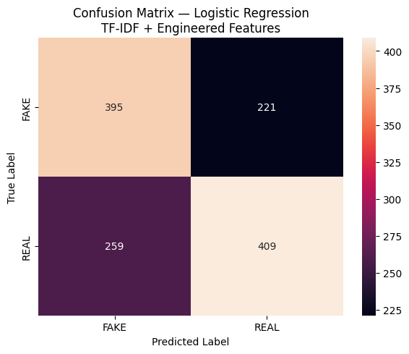
S L I D E 11
Classical ML Evaluation
The notebook identifies Logistic Regression + TF-IDF + engineered features as the top classical configuration by validation F1-Macro.
ACCURACY
PRECISION FAKE
RECALL FAKE
F1 MACRO
62.62%
60.40%
64.12%
62.61%
validation
validation
validation
validation
Best parameters
• C = 0.1
• class_weight = balanced
• 5-fold CV F1-Macro = 0.6101
Class-level result
• FAKE: precision 0.60, recall 0.64, F1 0.62
• REAL: precision 0.65, recall 0.61, F1 0.63
Validation confusion matrix
Validation support: 616 FAKE and 668 REAL statements.

Slide 12
S L I D E 12
BiLSTM + Attention
A PyTorch sequence classifier learns contextual word representations and applies multi-head self-attention.
Input
33 tokens
Embedding
128-d
BiLSTM
128 hidden / direction
4-head
Attention
Classifier
REAL / FAKE
→
→
→
→
Model configuration
Training configuration
• Vocabulary size: 18,199
• Embedding dimension: 128
• BiLSTM hidden dimension: 128 per direction
• Dropout: 0.30
• BCEWithLogitsLoss
• Adam, learning rate 0.001
• 20 epochs, batch size 64
• Best model retained by validation F1-Macro
Training and validation were executed with PyTorch on CUDA in the notebook.

Slide 13
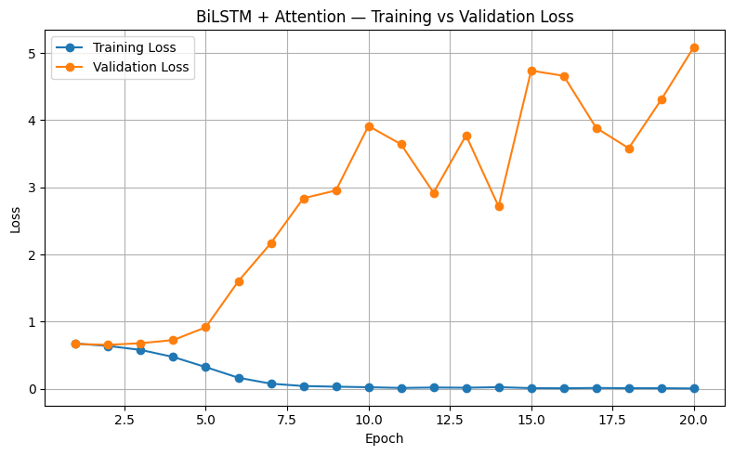
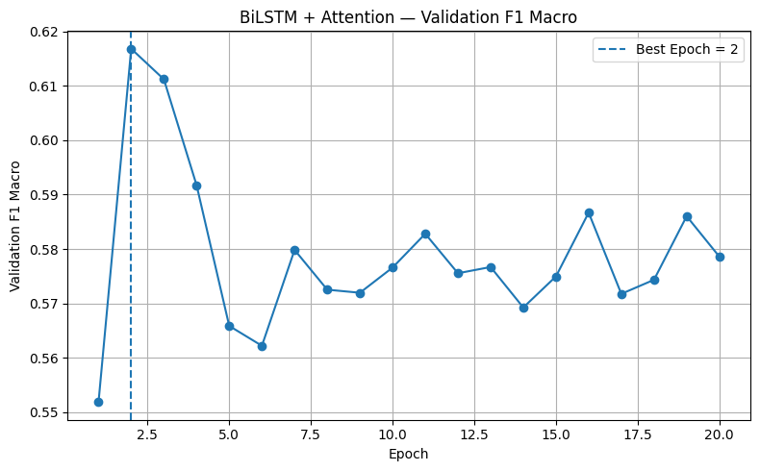
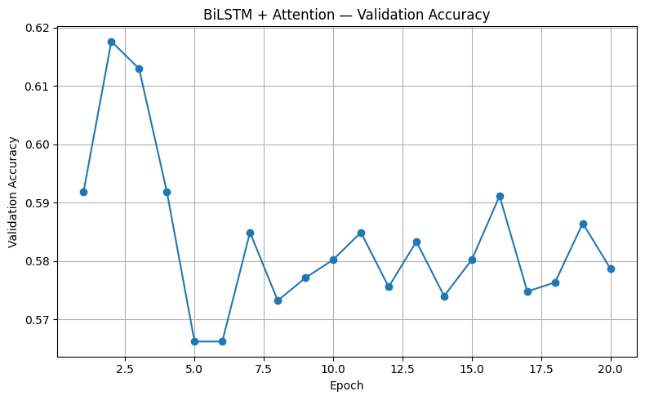
S L I D E 13
BiLSTM + Attention Results
The best validation F1-Macro occurred at epoch 2; later epochs show clear overfitting behavior.
Training vs validation loss
Validation F1-Macro
Validation accuracy
BEST EPOCH
ACCURACY
F1 FAKE
F1 MACRO
2
61.76%
59.98%
61.68%
best validation F1
validation
validation
validation
Observed behavior
Training loss keeps falling while validation loss rises sharply after the early epochs, indicating overfitting. The best weights were retained from epoch 2.
BiLSTM validation confusion matrix: [[368, 248], [243, 425]].

Slide 14
S L I D E 14
BERT Fine-Tuning
The project fine-tunes the pre-trained bert-base-uncased model for two-class classification.
Cleaned text
BERT tokenizer
max length 128
BERT base
12-layer encoder
2-class head
FAKE / REAL
→
→
→
Training configuration
Model selection
• 5 epochs, batch size 16
• AdamW, learning rate 2e-5
• 3,200 total training steps
• 320 warmup steps; linear warmup + decay
• Validation F1-Macro tracked after each epoch
• Best epoch = 3
• Best validation F1-Macro = 0.6224
• Best state retained for later evaluation / deployment
BERT training used CUDA in the notebook and a two-label classification head.

Slide 15
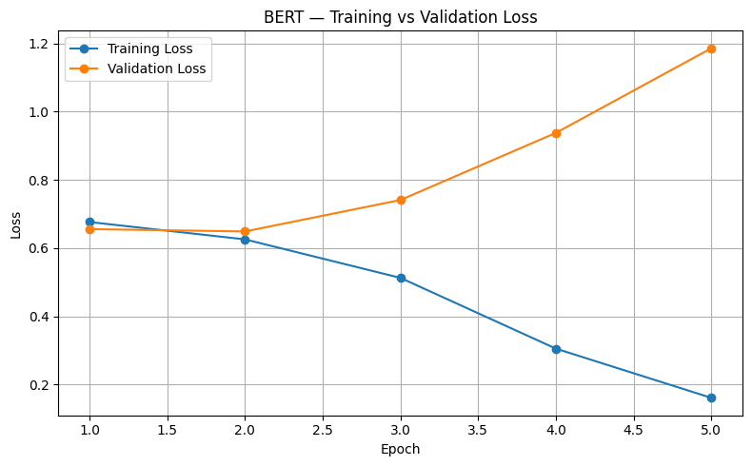
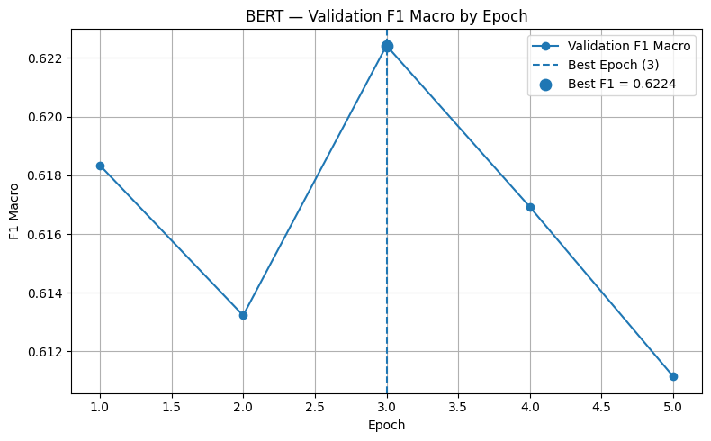
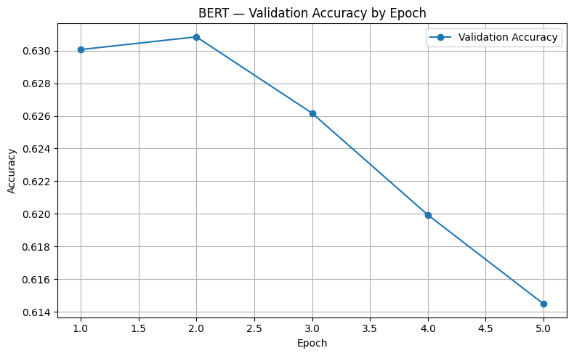
S L I D E 15
BERT Results
BERT reaches its best validation F1-Macro at epoch 3, after which validation performance declines.
Training vs validation loss
Validation F1-Macro
Validation accuracy
BEST EPOCH
ACCURACY
F1 FAKE
F1 MACRO
3
62.62%
58.48%
62.24%
best validation F1
validation
validation
validation
Observed behavior
Training loss falls substantially across epochs while validation loss rises after epoch 2; epoch 3 is retained because it has the highest validation F1-Macro.
BERT validation confusion matrix: [[338, 278], [202, 466]].

Slide 16
S L I D E 16
Final Model Comparison
The notebook’s final leaderboard compares the three deployment models using validation metrics.
Model
Val Accuracy
F1 FAKE
F1 Macro
ROC–AUC
Logistic Regression
62.62%
62.20%
62.61%
0.6769
BERT
62.62%
58.48%
62.24%
0.6748
BiLSTM + Attention
61.76%
59.98%
61.68%
0.6563
How to read this leaderboard
The notebook ranks the three deployment models by Validation F1-Macro. Logistic Regression + engineered features has 0.6261, BERT 0.6224, and BiLSTM + Attention 0.6168. The test split is not used in this final leaderboard.
Final comparison is validation-based; ROC–AUC is also calculated on the validation split.

Slide 17
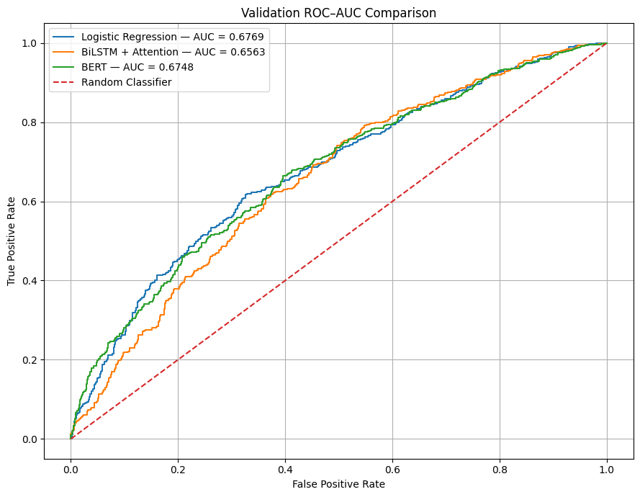
S L I D E 17
Validation ROC–AUC Comparison
ROC curves were calculated for the three deployment models using FAKE as the positive class.
LOGISTIC REGRESSION
0.6769
ROC–AUC
BERT
0.6748
ROC–AUC
BILSTM + ATTENTION
0.6563
ROC–AUC
Validation ROC curves
ROC labels: FAKE = 1; REAL = 0. All three score arrays contain 1,284 validation samples.

Slide 18
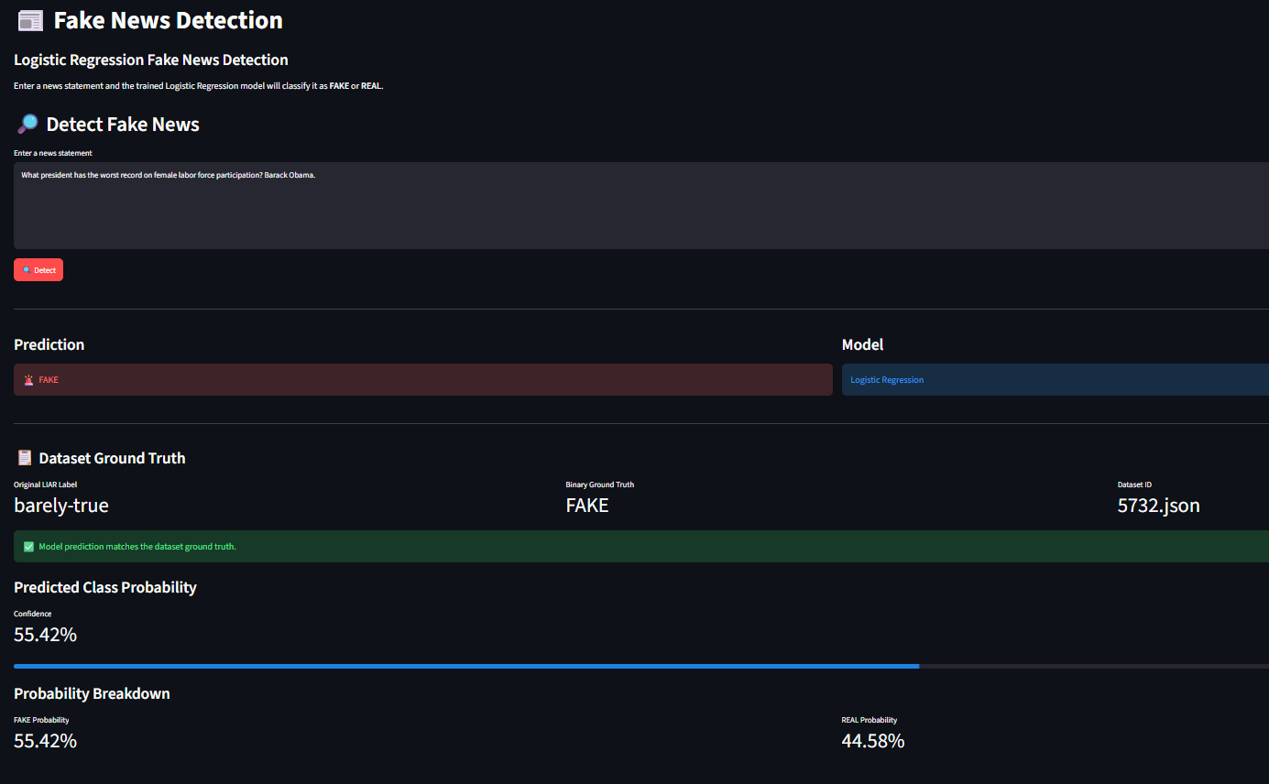
S L I D E 18
Deployment Preparation
Deployment-ready model artifacts were verified after saving and copying them into the deployment directory.

Slide 19
S L I D E 19
Conclusion
P22 establishes an end-to-end binary fake-news classification pipeline from LIAR data to saved deployment artifacts.
Data pipeline
Classical ML
• 12,791 total statements across Train / Validation / Test
• EDA, quality checks and binary target creation
• Model-specific text preprocessing
• TF-IDF with 10,000 features
• Three engineered numerical features
• Logistic Regression and Linear SVM with 5-fold tuning
Deep learning
Validation results
• PyTorch BiLSTM + 4-head Attention
• Fine-tuned bert-base-uncased
• Best checkpoints selected using validation F1-Macro
• LR + engineered: F1-Macro 0.6261; ROC–AUC 0.6769
• BERT: F1-Macro 0.6224; ROC–AUC 0.6748
• BiLSTM + Attention: F1-Macro 0.6168; ROC–AUC 0.6563
Next steps
• Run a final held-out test evaluation for the selected deployment model.
• Complete and validate the Streamlit UI against the saved artifacts.
• Investigate generalization and robustness beyond the LIAR validation split.
P22 • Questions & Discussion

Slide 20
S L I D E 20
Problems Faced & Future Work
The notebook reveals several practical modeling challenges and clear next steps.
Class imbalance
Overfitting in deep models
Original LIAR labels are uneven; F1-Macro is used to give equal importance to REAL and FAKE.
BiLSTM validation performance peaks early; BERT validation loss rises after the early epochs.
Model differences
Validation-only final comparison
TF-IDF, sequence models and BERT require different preprocessing and artifacts.
The final leaderboard uses validation metrics; a final held-out test evaluation remains important.
Future robustness
Assess performance on new sources, and distribution shifts beyond LIAR.
These points are derived from the notebook’s observed training behavior and saved deployment workflow.

