Slide 1
ADITYA UNIVERSITY | DEPARTMENT OF AIML
HEART DISEASE
PREDICTION USING SVM
MACHINE
LEARNING
SECOND REVIEW PRESENTATION
Guided by: Dr. R. Suneetha
Presented by:
G. Charan Reddy (24B11AI114) • D. Shiva Kumar Reddy (24B11AI076)
B. Srinu (24B11AI053) • P. Mahammadi Rafi (24B11AI347)
PROJECT REVIEW • 2026

Slide 2
A
ADITYA UNIVERSITY
Project Overview
Problem statement, proposed solution and main objectives
Problem
Solution
Outcome
Analyze multiple patient-related clinical features to classify a record into a target category.
Train and compare Linear, Polynomial and RBF Support Vector Machine models.
Integrate the selected model into a Gradio website for interactive predictions.
Objectives
• Prepare and explore the heart disease dataset.
• Compare model performance using accuracy, precision, recall and F1-score.
• Provide a simple interface for entering patient features and viewing a prediction.
2

Slide 3
A
ADITYA UNIVERSITY
Dataset Description
Dataset structure and target variable used in the project
3030
14
13
1
Initial records
Total columns
Input features
Target column
Input features
Target variable
age, sex, cp, trestbps, chol, fbs, restecg,
thalach, exang, oldpeak, slope, ca, thal
target
0 = No heart disease
1 = Heart disease
Initial dataset checks: 559 missing values across columns; 1 duplicate row(s) identified.
3

Slide 4
A
ADITYA UNIVERSITY
Data Preprocessing
Steps used to prepare the data before model training
01
Inspect
Check dataset shape, columns, data types, summary statistics and target distribution.
02
Clean
Remove duplicate records and impute missing input values using median values.
03
Explore
Review class distribution, feature distributions, potential outliers and correlations.
04
Split
Use an 80:20 stratified train-test split.
05
Scale
Apply StandardScaler to standardize features before SVM training.
4

Slide 5
A
ADITYA UNIVERSITY
Project Workflow
End-to-end flow from raw data to web prediction
Dataset
CSV
Preprocessing
Train-test
split
SVM model
training
Gradio
website
The fitted scaler and selected classifier must be reused in the website with the same 13-feature order used during training.
5

Slide 6
A
ADITYA UNIVERSITY
SVM Model Development
Three kernel types are trained and compared
Linear SVM
Polynomial SVM
RBF SVM
Creates a linear decision boundary. It serves as the baseline model for comparison.
Uses a polynomial kernel to represent nonlinear relationships between input features.
Uses a radial basis function kernel to learn more complex nonlinear patterns.
SVM aims to find a decision boundary that separates the target classes using the supplied features.
6

Slide 7
A
ADITYA UNIVERSITY
Model Evaluation Metrics
How the classifiers are compared
Accuracy
Precision
Fraction of all predictions that are correct.
Of the cases predicted positive, how many are truly positive.
Recall
F1-score
Of the actual positive cases, how many the model identifies.
Harmonic mean of precision and recall.
Confusion matrices provide a breakdown of correct and incorrect predictions for each class.
7

Slide 8
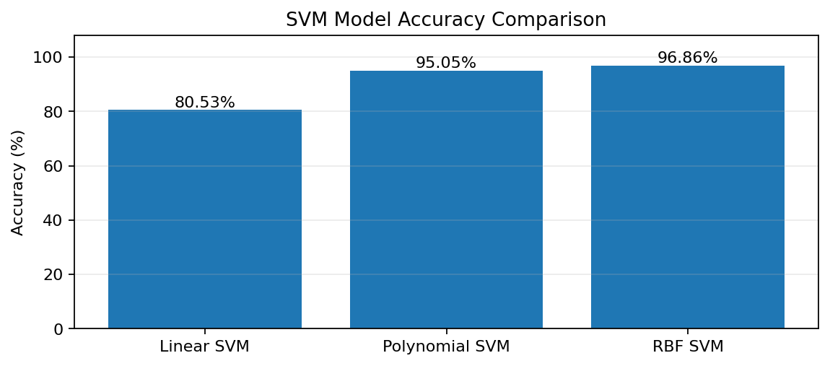
A
ADITYA UNIVERSITY
Model Comparison Results
Recorded test-set metrics from the current notebook experiment
Model | Accuracy | Precision | Recall | F1-score
Linear | 80.53% | 78.22% | 89.49% | 83.47%
Polynomial | 95.05% | 93.16% | 98.20% | 95.61%
RBF | 96.86% | 95.64% | 98.80% | 97.19%
Best recorded model: RBF SVM
Accuracy: 96.86% | F1-score: 0.9719
8

Slide 9
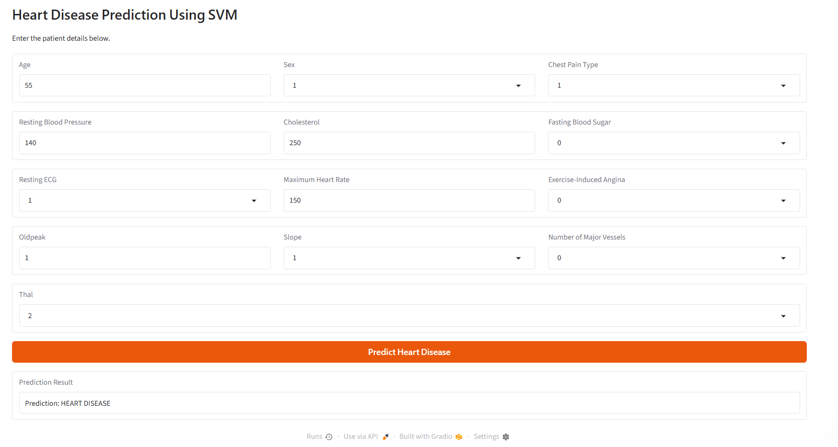
A
ADITYA UNIVERSITY
Website Interface
Gradio application for entering patient medical features
The form accepts 13 input features and displays the model's predicted class.
9

Slide 10
A
ADITYA UNIVERSITY
Website Prediction Workflow
What happens after the user clicks “Predict Heart Disease”
1
2
3
4
5
Enter patient
features
Arrange features
in training order
Scale using the
saved scaler
Predict using
RBF SVM
Display the
predicted class
The output is a model prediction only and should not be interpreted as a medical diagnosis.
10

Slide 11
A
ADITYA UNIVERSITY
Current Status & Future Improvements
Completed workflow and recommended refinements
Completed
Future Improvements
✓ Dataset loading and exploration
✓ Missing-value and duplicate handling
✓ Visual analysis and feature scaling
✓ Three SVM kernels trained and compared
✓ RBF SVM selected by F1-score
✓ Gradio prediction interface created
• Fit imputation on training data only
• Ensure preprocessing avoids data leakage
• Recheck outlier handling consistently
• Validate on an independent dataset
• Add clearer input validation and explanations
• Communicate limitations responsibly
Reported scores reflect the current experiment and do not establish clinical reliability.
11

Slide 12
CONCLUSION
Heart Disease Prediction Using SVM
This project demonstrates an end-to-end machine-learning workflow: data preparation, SVM kernel comparison, evaluation, and a Gradio-based prediction interface.
RBF SVM achieved the best recorded F1-score (0.9719) in the current experiment.
THANK YOU • QUESTIONS?

Slide 13
A
ADITYA UNIVERSITY
References
Tools and research resources used in the project
• Cortes, C. and Vapnik, V. (1995). Support-Vector Networks. Machine Learning, 20, 273–297.
• Pedregosa, F. et al. (2011). Scikit-learn: Machine Learning in Python. Journal of Machine Learning Research, 12, 2825–2830.
• Scikit-learn documentation: https://scikit-learn.org/
• Gradio documentation: https://www.gradio.app/docs
• Project dataset and Google Colab implementation used for the current experiment.
Thank you
13

