Slide 1

IBM SKILLS BUILD ARTIFICIAL INTELLEGENCE

Slide 2
Name : P.Shiva Kumar Goud Email : shivak05p@gmail.com GitHub Link: https://github.com/shivakumar1536/IBM_SKILLBUILD Colab Link: https://colab.research.google.com/drive/1PAXBk96GdNByXr0h5mhZIXPfST0xpcbb?usp=sharing

Slide 3
AICTE ID : STU6475993dd5adf1685428541
College Name : Madanapalle Institute of Technology and Science
College State : Andhra Pradesh
Internship Domain : Artificial Intelligence
Internship Start date : 18-08-2023
Internship End date : 22-09-2023
Contact:+919963070423

Slide 4
PROJECT TOPIC
Here we are going to deal with the dataset of the sentimental analysis of restaurant reviews.
We are going to analyse the given dataset,we will clean,and preprocess the dataset inorder to train the model
Once we trained the model,we will go for metrics report to find model efficiency.

Slide 5
Analysis of superstore dataset
Introduction
Working with dataset
Model Training
Metrics prediction
Overall Analysis

Slide 6
Introduction
In the given Dataset, we have the two features which are the feedback and the models rating.
Based on the given feedback,Wheather it is a positive or negative, it will takes the values of 0’s and 1’s.

Slide 7
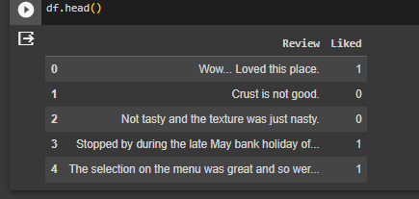
Working with Sentimental Analysing of Restaurant Reviews dataset

Slide 8
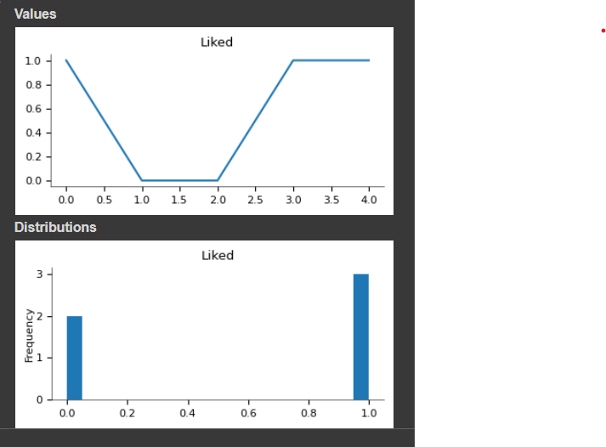
Graphical Classification of Given Dataset

Slide 9
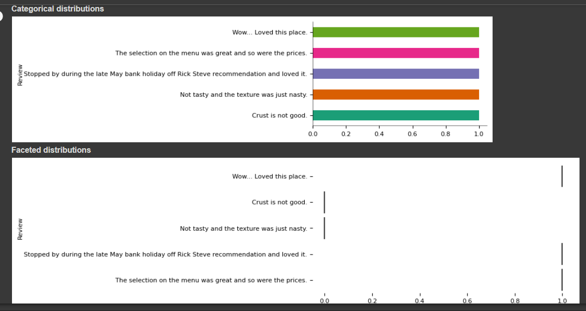
Visualizing the Sentimental Analysing of Resturant Reviews Dataset

Slide 10
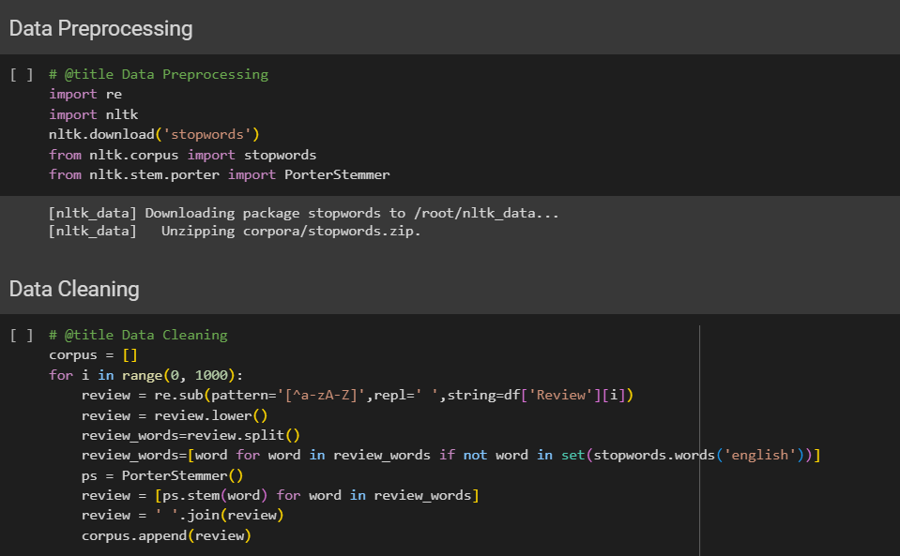
Data Preprocessing And Data Cleaning

Slide 11
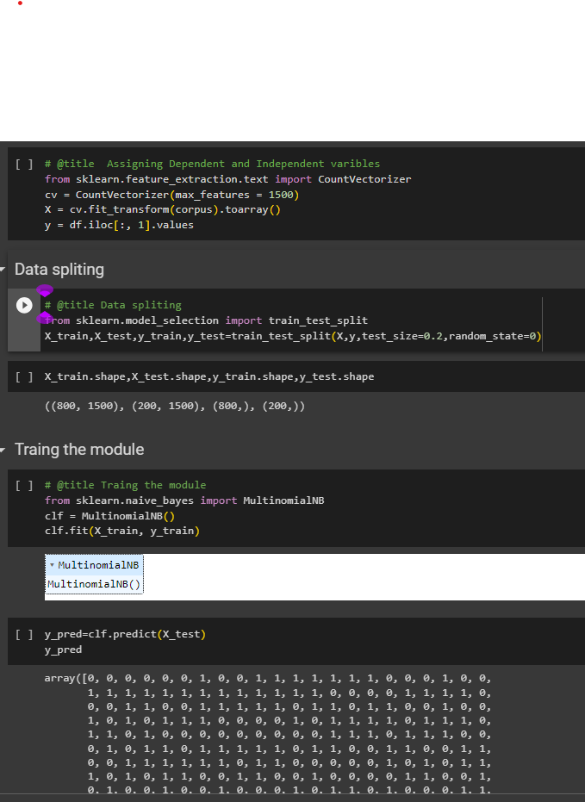
Data Splitting,Model Training,Predictions for Test Data
Here data is splitted into train and test datasets
Later we have trained the naives bayes classifier
Then we predicted the values for the test dataset using the trained model

Slide 12
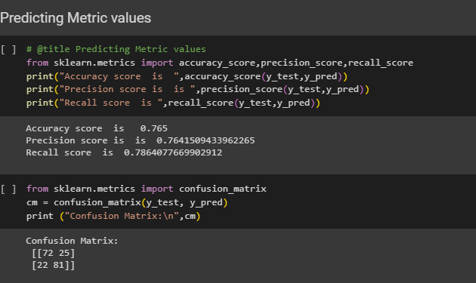
Metric Values Prediction

Slide 13
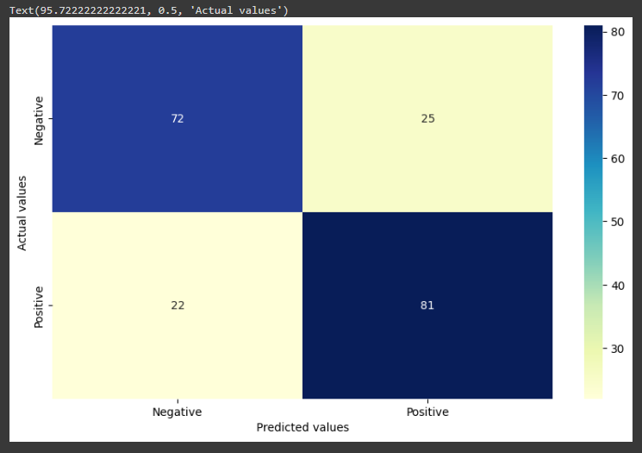
Confusion Matrix

Slide 14
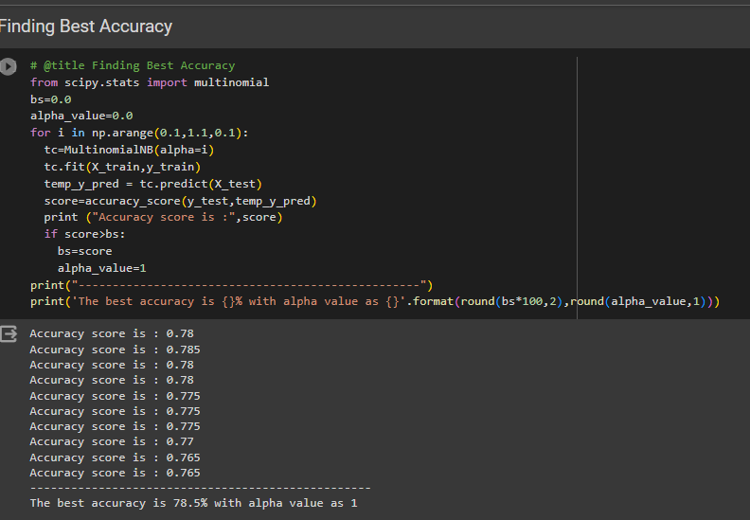
Finding Best Accuracy

Slide 15
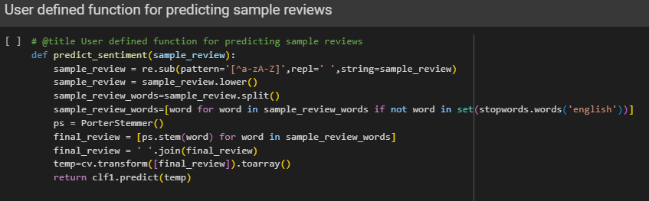
User Defined Function for User Input Feedback

Slide 16
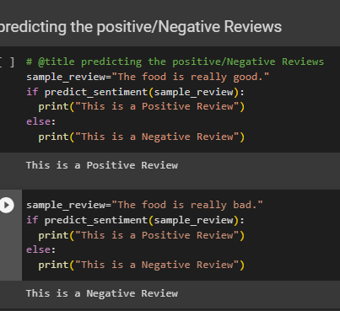
Positive/Negative Reviews predictions for User Input

Slide 17
Conclusion
Finally, we have analysed the given restaurant reviews dataset and we implemented the model for it after preprocessing.
Later we predicted the trained model accuracy and tried for the best accuracy with the hyper tuning cross validation technique.
For the given input feedback , the model successfully predicted whether it is positive or negative feedback.

