Slide 1
INTERNSHIP PROJECT
PROJECT TEAM ID: PTID-CDA-MAR-23-138
PROJECT ID: PRDA-01
PROJECT NAME: PROFIT ANALYSIS
MEMBER NAME: P SHIVA KUMAR REDDY
TOOLS USED: SQL, EXCEL, POWERBI

Slide 2
ABOUT THE DATASET
This dataset holds data from 50 startups in New York, California, and Florida. The features in this dataset are R&D spending, Administration Spending, Marketing Spending, location features, and Profit.

Slide 3
DATA SET INFORMATION:
R&D spending: The amount which startups are spending on Research and development. Datatype: Numerical
Administration spending: The amount which startups are spending on the admin panel. Datatype: Numerical
Marketing spending: The amount which startups are spending on marketing strategies. Datatype: Numerical
State: To which state that particular startup belongs. Datatype: Categorical(Nominal)
Profit: How much profit that particular startup is making. Datatype: Numerical
Transformation
1. Creating another column specifying startup no. from 1 to 50

Slide 4
Regression analysis for prediction of Profit
Multilinear regression prediction line equation is
Profit = 0.805715*x1+-0.02682*x2+0.027228*x3+50122.19
Prediction Model accuracy =95.07 %
Where
x1 : R&D spending
x2 : Administration spending
x3 : Marketing spending

Slide 5
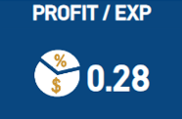
KPI’s FOR DASHBOARD
1)Total startups (Count of startups) Will change depending on filters
2)Total R&D spending (Sum of R & D by the startup)
3)Total Administration spending (Sum of Administration spending by the startup)
4)Total Marketing spending (Sum of marketing spending by the startup)
5)Total Profit (Sum of profit earned by the startup)
6) Profit/Expenditure ratio

Slide 6
EXPECTED CHART REQUIREMENTS FOR DASHBOARD
Top 5 startups with high profit (BAR CHART)
Last 5 startups with least profit (BAR CHART)
Total expenditure by total profited generated (DONUT CHART)
Sum of Administration, Marketing, R&D Spend by Specific startup (STACKED COLUMN CHART)
Total expenditure by total profited generated for each startup (LINE CHART)
FILTERS : State , Startup No.
MAKING PAGES; HOME & DETAIL ANALYSIS
In the detail analysis page, creating line chart between Total expenditure, R&D Expenditure, Administration Expenditure, Marketing expenditure and Profit .To know relationship between each of the categories producing profit.
Used Profit/Expenditure ratio as one of the KPI on this page and created a bar chart between startup no’s and profit /expenditure ratio . To see which startup is producing max profit compared to its investment

Slide 7
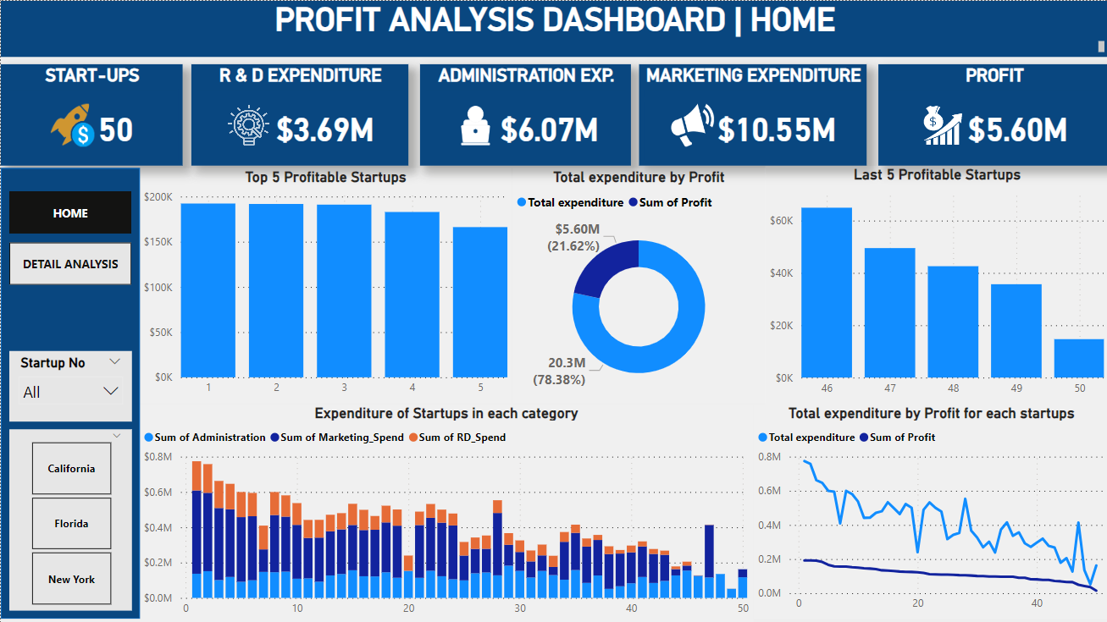

Slide 8
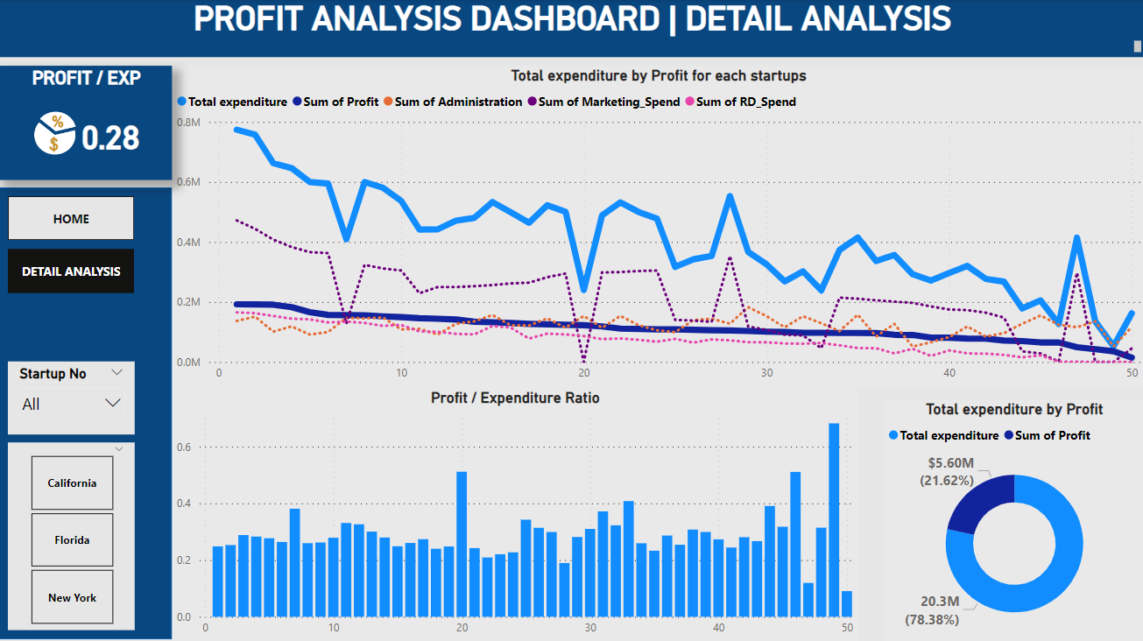

Slide 9
INSIGHTS FROM DASHBOARD
The top 6 profitable startups have spent maximum expenditure compared to 50 startups and even in that total expenditure the majority they have spent is on marketing followed by R & D, followed by Administration.
In general terms the least profitable startups have spent lowest expenditure and with varying distribution in all the three categories, spending almost nil in marketing. These startups expenditure was done majorly in only administration
Looking at the linear relationship through line charts. Except for few rare cases total expenditure is directly changing to profit generated. As expenditure increase so does profit.
Overall looking at the line chart it can be concluded that the profit varies linearly either because of R & D spent or because of amount spent on marketing (the graph is varying similar like total expenditure).
The amount spent on Administration is almost in same range for all 50 startups making it least factor affecting profit generated.

Slide 10
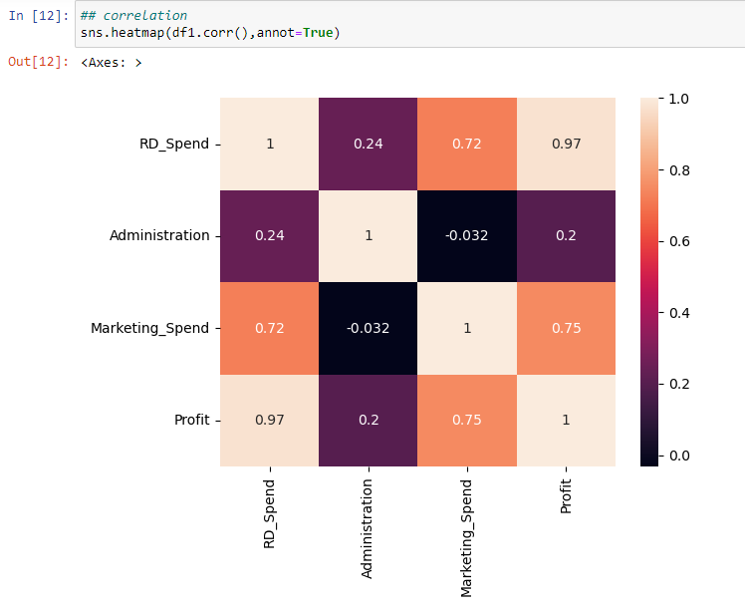
CONFIRMATION THROUGH CORRELATION FACTOR
With correlation factor of R&D_spend to profit- 0.97, Marketing to Profit-0.75 and least Administration to profit -0.2.

Slide 11
SUGGESTION FROM MY SIDE TO COMPANY
The major features out of the three-expenditure affecting Profit are Expenditure on Marketing and R&D Expenditure. So, startups should primarily focus on their Marketing and R&D. And managing their Administration expenditure to their sufficient requirement only, until and unless it’s a startup with their primary factor of producing profit from their administration only (services providing company through working staff).

