Slide 1
Brand ID wise Plan Amount
File created on: 25-04-2019 01:22:10
Description of "Brand Wise"
Brand ID, Serial No, Sold Plan ID and Source. Color shows details about Brand ID. Size shows sum of Plan Amount. The marks are labeled by Brand ID, Serial No, Sold Plan ID and Source.

Slide 2
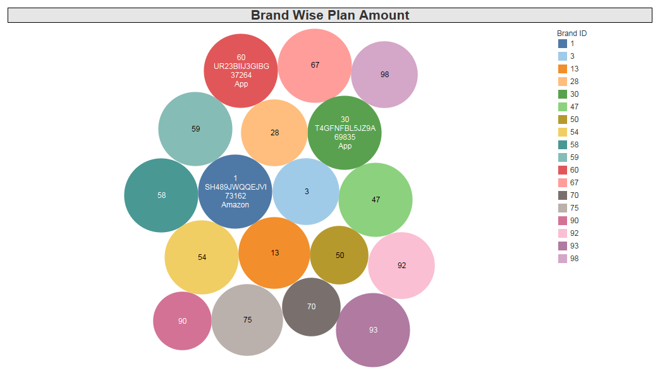

Slide 3


