Slide 1


Home Credit Default Risk
Predictive Analytics Final Project
Anupam Shandilya Jashyant Sikhakolli Pahal Patangia
Pardha Pitchikala Shiva Pabbathi Zheming Lian

Slide 2
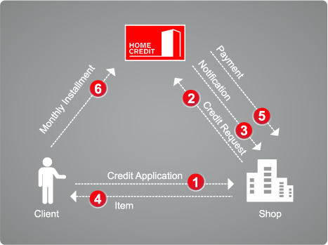
Introduction
Home Credit Group is an international consumer finance provider with operations in 9 countries.
Focus on responsible lending primarily to people with little or no credit history.

Slide 3
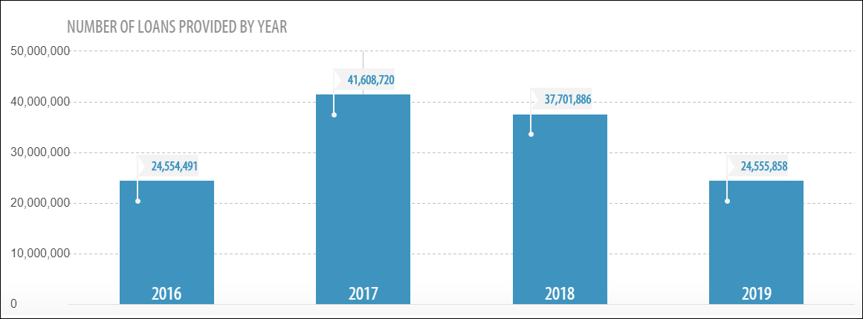
Portfolio Overview

Slide 4
Problem Statement
Loan Applicants
Able to pay
Unable to pay
Approved
Rejected
Approved
Rejected

Slide 5
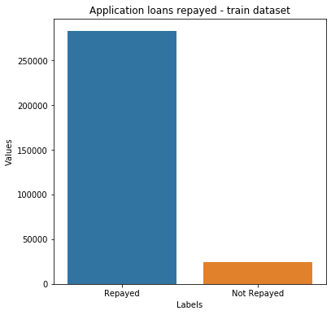
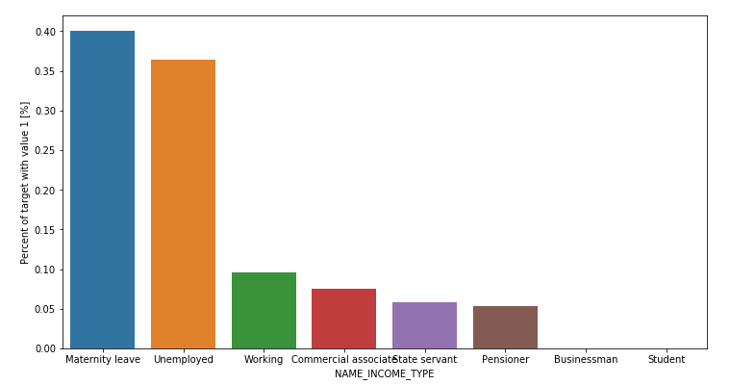
Data Exploration
Income Type vs Loan unpaid

Slide 6
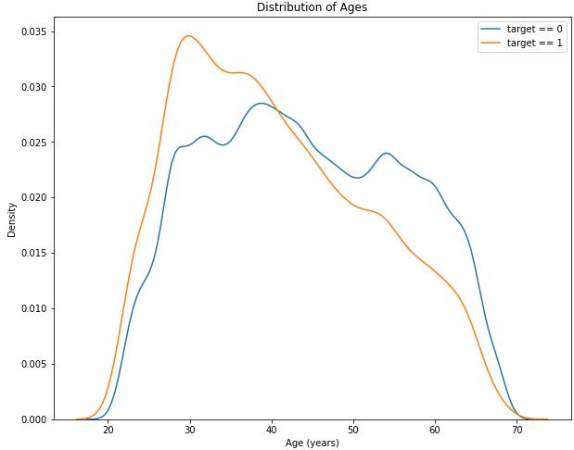
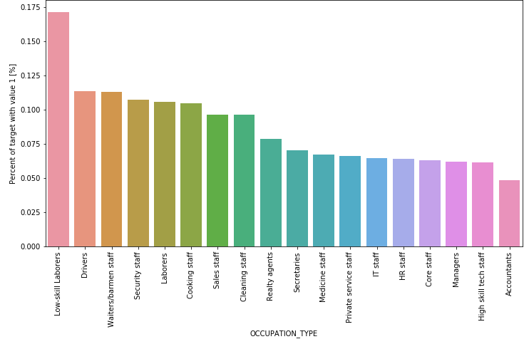
Data Exploration
Occupation Type vs Loan unpaid

Slide 7
Feature Engineering
Combination of raw features by are better predictors in separating the good customers and bad customers.
Loan Value to Income Ratio
Number of credit lines in the past (loans/cards)
Credit Card Bal {1-6} / Credit Card Bal {7-12}
No. of times payment missed in last 12 months
Percentage of children in family
Credit Card Utilization (Balance % Credit Limit)
Maximum delinquency in the last 6 months
Percentage of remaining loan term

Slide 8
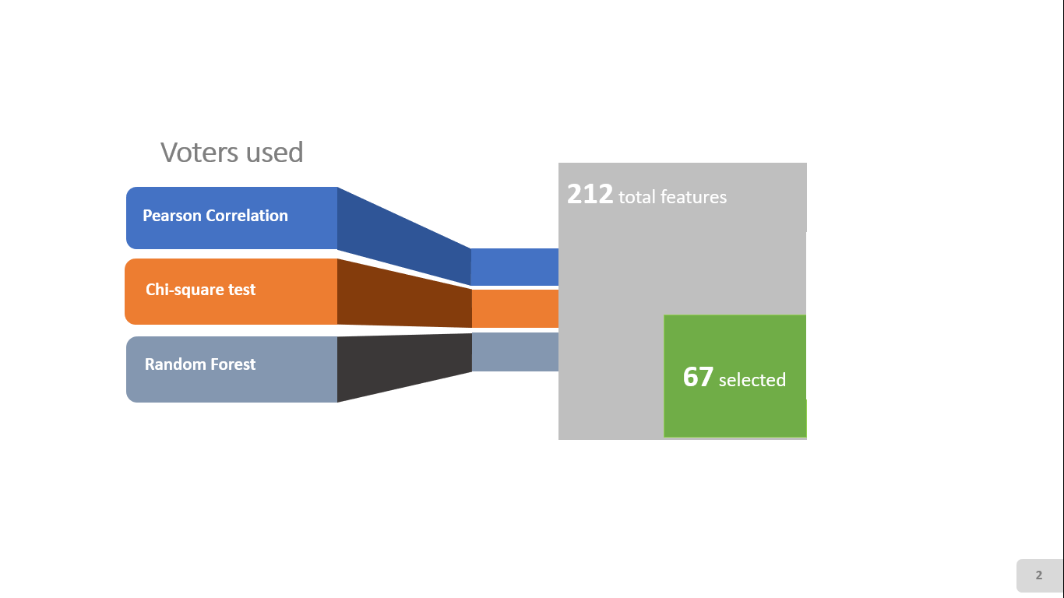
Feature Selection

Slide 9
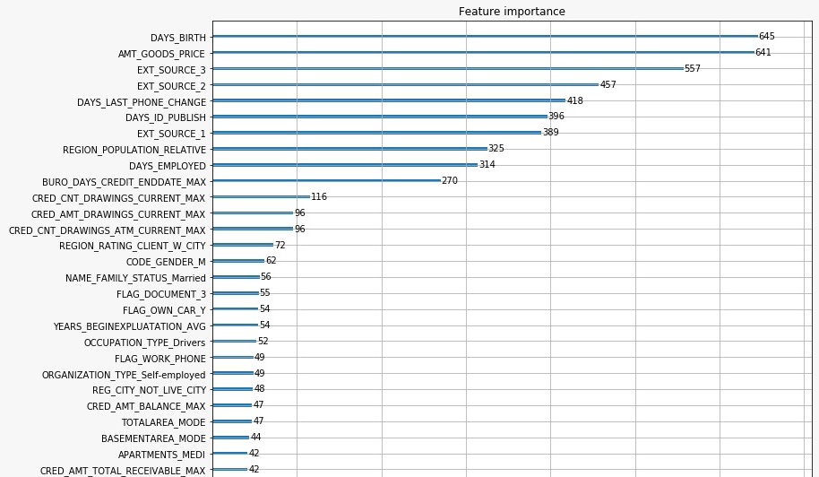
Feature Importance
TOP 5 FEATURES :
Age
Price of Goods
Score from External Source
Days Employed
Days Credit History Information

Slide 10
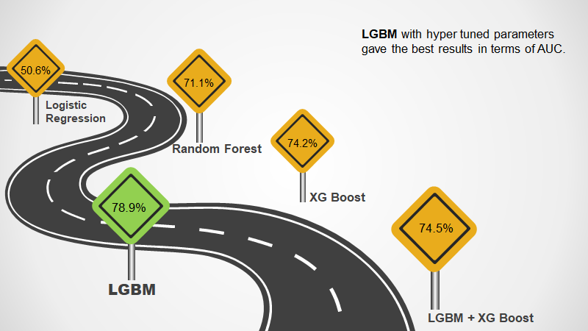
Model Exploration
76.1

Slide 11
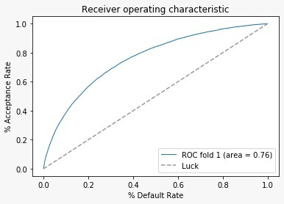
Operating Point - Risk Return Trade Off

Slide 12
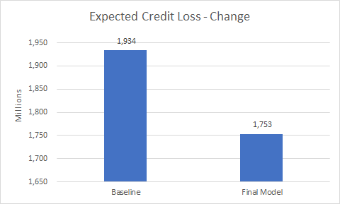
Reduction in Bad Debt Losses
The chosen model reduces the expected credit loss by in the test sample
Expected Credit Loss = Probability of Default * Loan Amount for each customer
9.34% reduction in expected credit loss with the new model

Slide 13
THANK YOU

