Slide 1
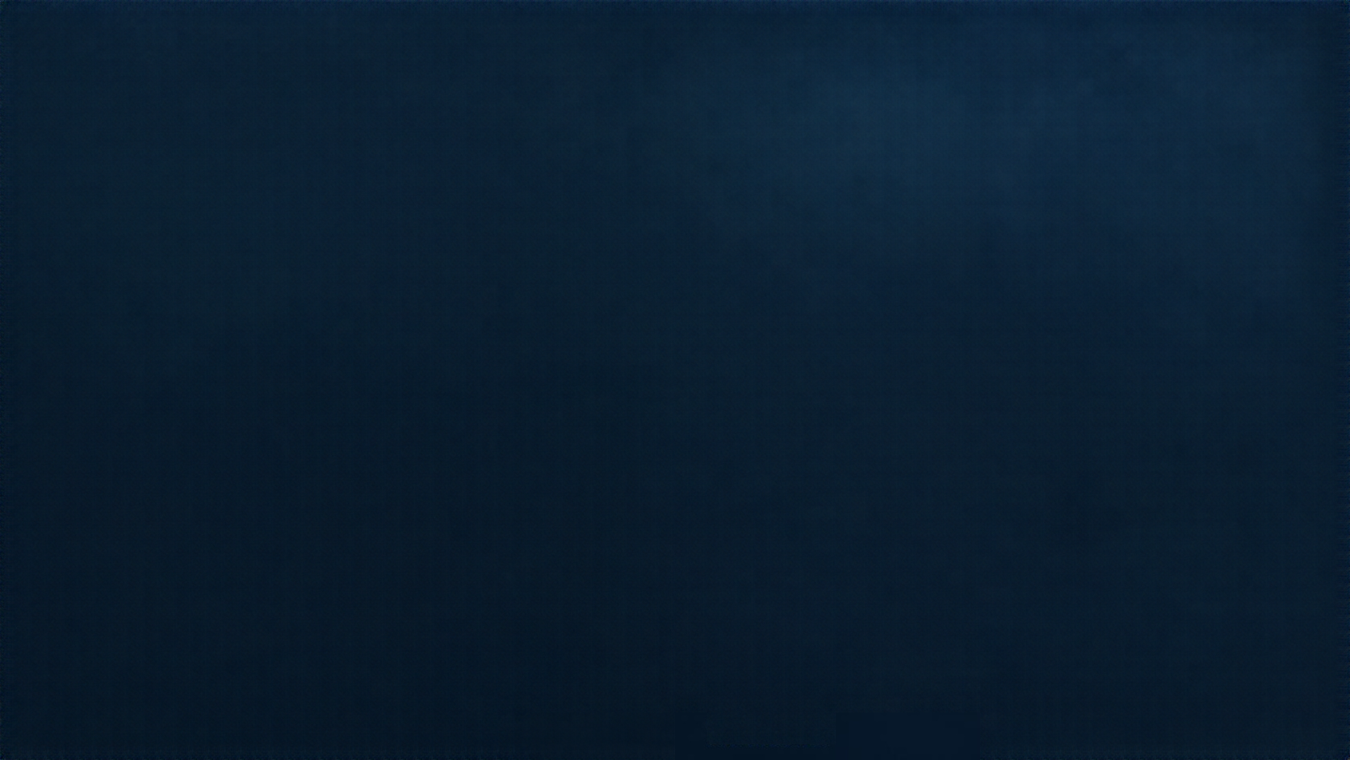

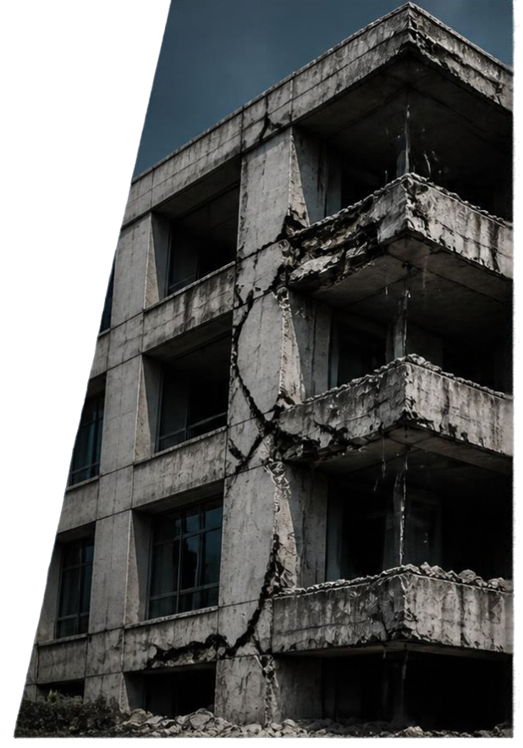
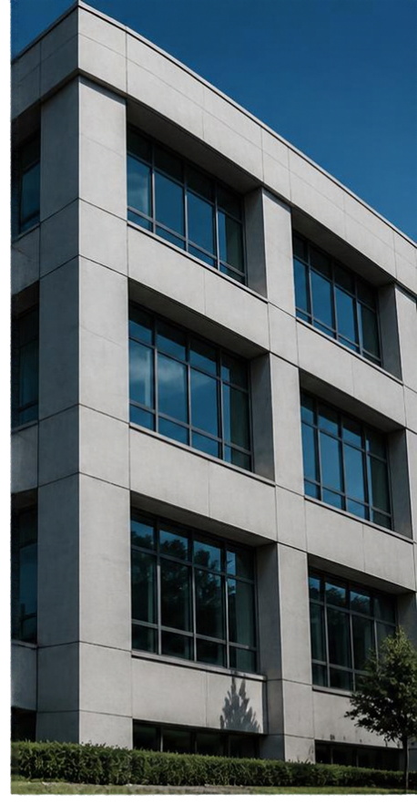

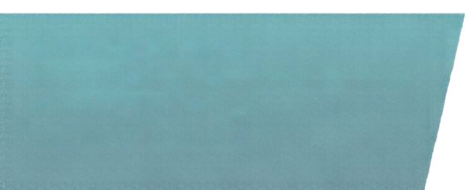

STRUCTURAL DAMAGE IMAGE CLASSIFICATION
Reproducing Machine Learning and Deep Learning Approaches with an Additional ResNet50 Experiment
Domain: Computer Vision and Image Classification
Task: Binary classification — Damaged / Undamaged
Presented by: Shivakumara gp ,shyam santhosh
Department: Computer Science and Engineering
Institution: PES University, Bengaluru
Academic project presentation
DAMAGED
UNDAMAGED

Slide 2
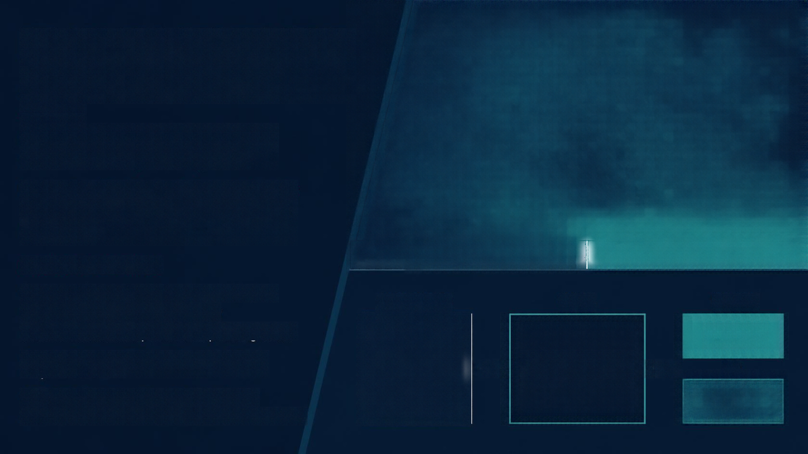
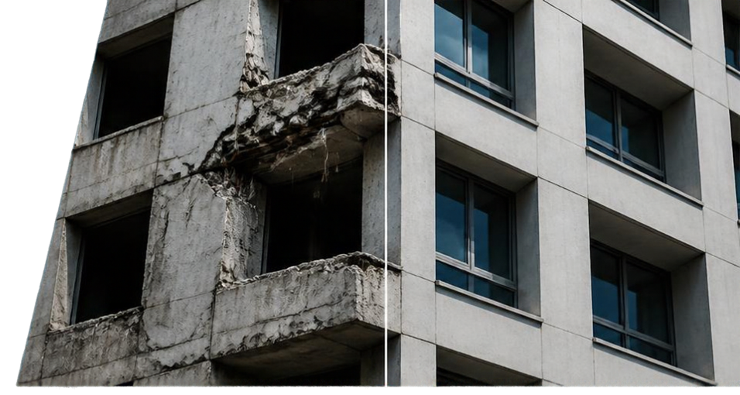



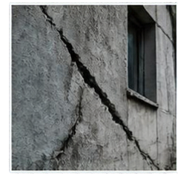
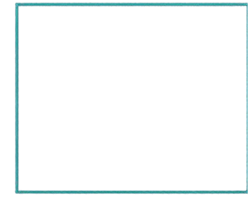



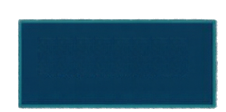
PROBLEM STATEMENT AND OBJECTIVES
Manual structural damage assessment is time-consuming and subjective.
Image classification models can automate distinguishing damaged vs. undamaged structures.
DAMAGED
UNDAMAGED
PROJECT OBJECTIVES
Study an existing structural damage recognition project
INPUT IMAGE
MODEL
OUTPUT
Implement six reference approaches locally
Evaluate classical ML and pretrained deep-learning models
DAMAGED
Compare reference and local results, noting dataset and protocol caveats
Machine Learning /
Deep Learning Model
OR
Add ResNet50 experiment for additional evaluation
UNDAMAGED
Analyze strengths, weaknesses, and limitations of approaches

Slide 3
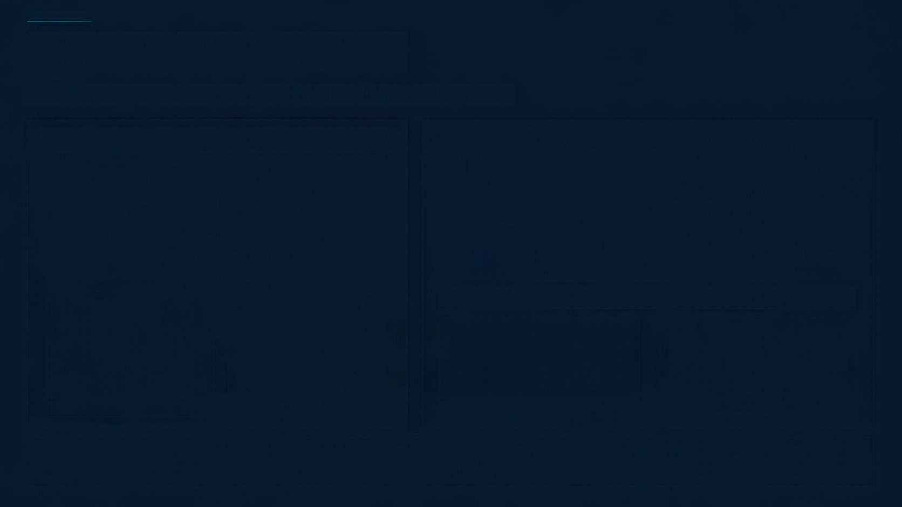
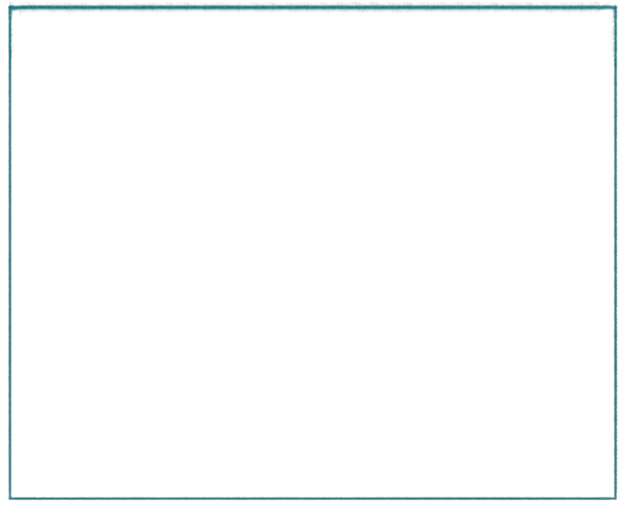

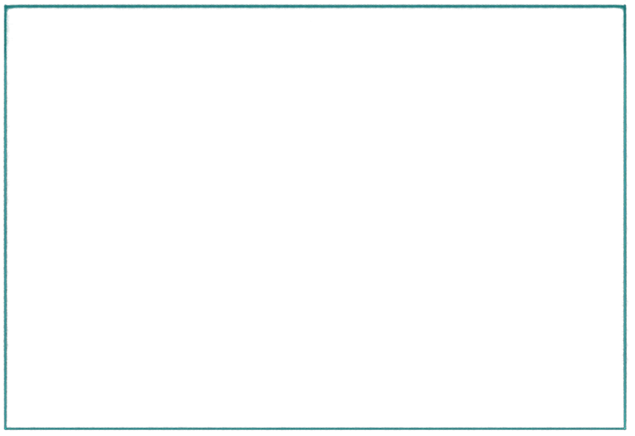

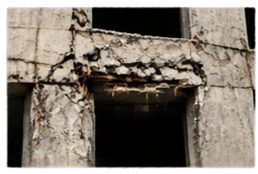
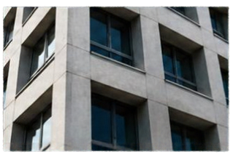
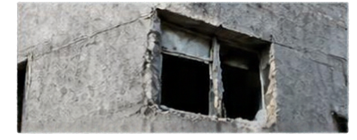
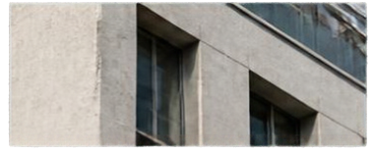




DATASET DESCRIPTION
Two datasets are used for damage state classification of structures.
REFERENCE DATASET
LOCAL DATASET
5913
labeled images
Source: PEER Hub ImageNet (Phi-Net), Task 2 Damage State
Training
Test
2727
3186
11,811
images
1460
images
Damaged
Undamaged
6,282
5,529
745
715
1,479
additional unlabeled images
Damaged
Undamaged
Damaged
Undamaged
Label mapping: 0 = Damaged, 1 = Undamaged
DAMAGED EXAMPLE
UNDAMAGED EXAMPLE
DAMAGED EXAMPLE
UNDAMAGED EXAMPLE
The local dataset is related to, but not confirmed identical to, the reference dataset. Results are not directly comparable.

Slide 4
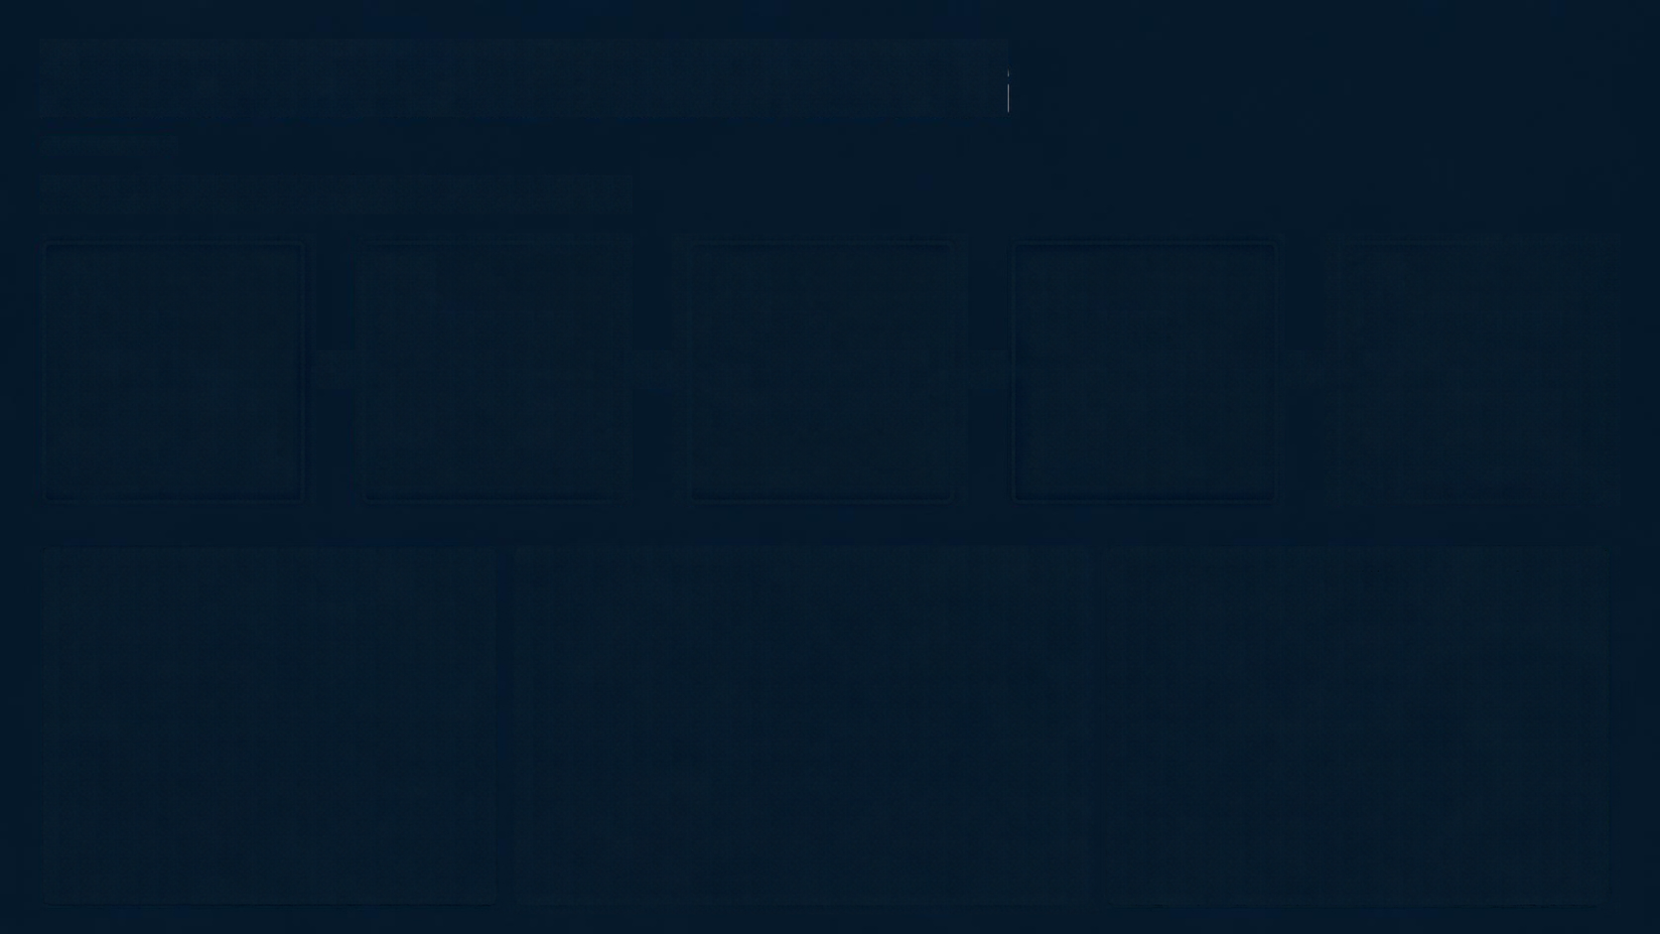









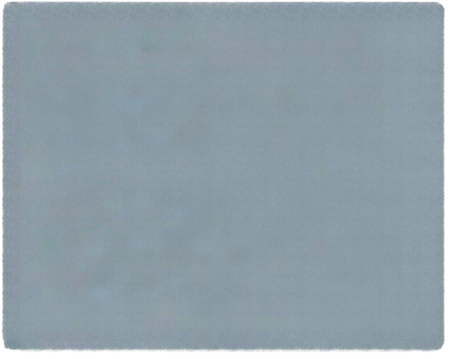
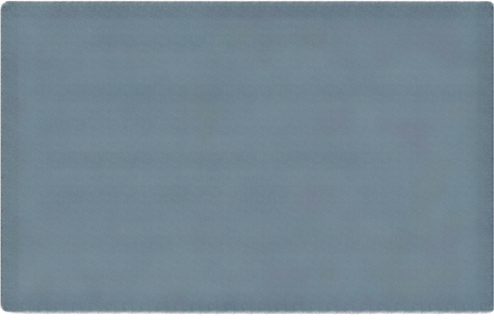

METHODOLOGY AND PREPROCESSING
Our end-to-end workflow from data to evaluation
01
02
03
04
05
DATASET
PREPROCESSING
TRAINING
VALIDATION
TEST EVALUATION
load datasets
verify labels, shapes,
and class distribution
resize images
normalize pixel values
prepare model inputs
train classical ML and neural network models
monitor validation loss select best NN checkpoints
evaluate on test set
compute accuracy, precision, recall, F1, and confusion matrices
DATA SPLITS
PREPROCESSING & MODELS
IMPLEMENTATION & HARDWARE
Stratified 10% validation split
Random seed 42
Classical models & NumPy Tiny CNN: 32×32 input, scaled x/128 – 1
Implemented with NumPy
and TensorFlow/Keras as appropriate
MobileNetV1 & ResNet50: 224×224 input InceptionV3: 299×299 input
10,630 fit images
CPU only
(no RTX 3050 GPU)
1,181 validation images
1,460 test images
Frozen ImageNet backbones with trainable linear classification head

Slide 5

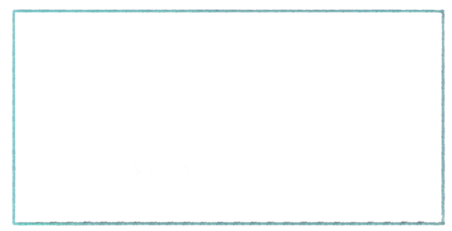
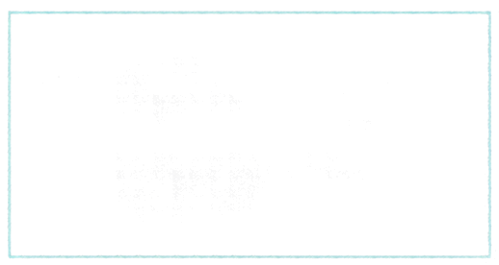
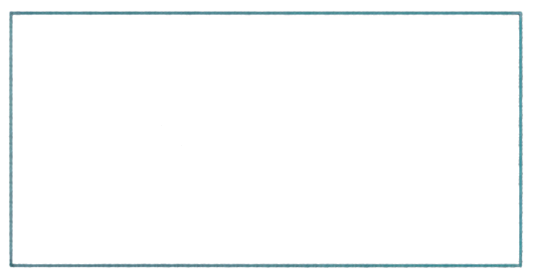

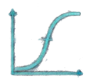
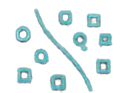
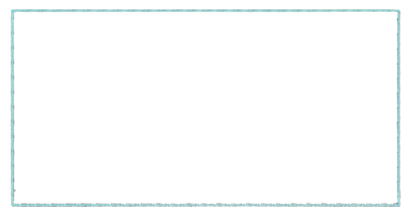
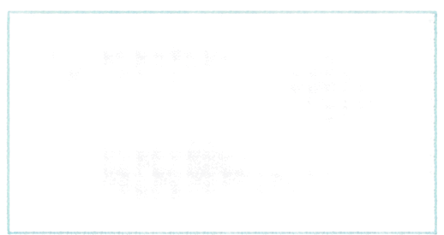
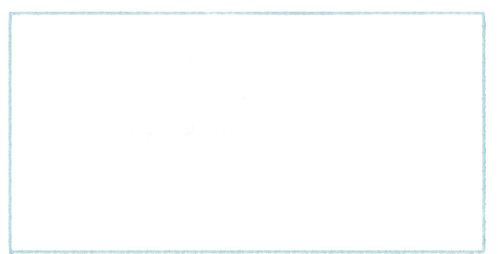
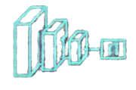
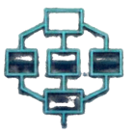

REFERENCE APPROACHES REPRODUCED
Six reference methods implemented locally to establish baseline comparisons.
01
02
03
K-Nearest Neighbors
(KNN)
Logistic
Regression
RBF Support
Vector Machine
(SVM)
k=5, similarity on image
feature vectors.
Mini-batch Adam optimizer,
L2 regularization.
NumPy-based SMO
approximation.
04
05
06
MobileNetV1
InceptionV3
InceptionV3
layer-288 features
+ RBF SVM
Frozen pretrained features
+ trainable linear head.
Frozen backbone +
trainable classification head.
Spatially averaged intermediate features, classified by RBF SVM.
Local classical implementations are NumPy approximations and may differ from original code.

Slide 6
REFERENCE VS. LOCAL RESULTS
Reference scores are reported as published; local results use the PEER Hub Phi-Net dataset.
REFERENCE APPROACH
REFERENCE EVALUATION ACCURACY
LOCAL VALIDATION
LOCAL TEST
KNN (k = 5)
53.7% / 52.9%*
59.10%
55.27%
Logistic Regression
54.7%*
59.02%
59.79%
RBF SVM
50.7%*
65.20%
61.30%
MobileNetV1
67.0% paper / 67.7% poster
84.17%
82.40%
InceptionV3
83.0%†
82.64%
81.16%
InceptionV3 layer-288 + SVM
75.0% validation
71.30%
69.32%
NOTES ON REFERENCE RESULTS
INTERPRETATION
* The paper’s main protocol does not clearly describe a separate held-out test set; evaluation split attribution is uncertain.
† The paper abstract calls 83.0% a test score, while the poster labels it validation.
• Local pretrained CNNs perform better than the classical baselines in this experiment.
• Dataset, implementation, and evaluation-protocol differences mean these scores are not a direct apples-to-apples comparison.

Slide 7
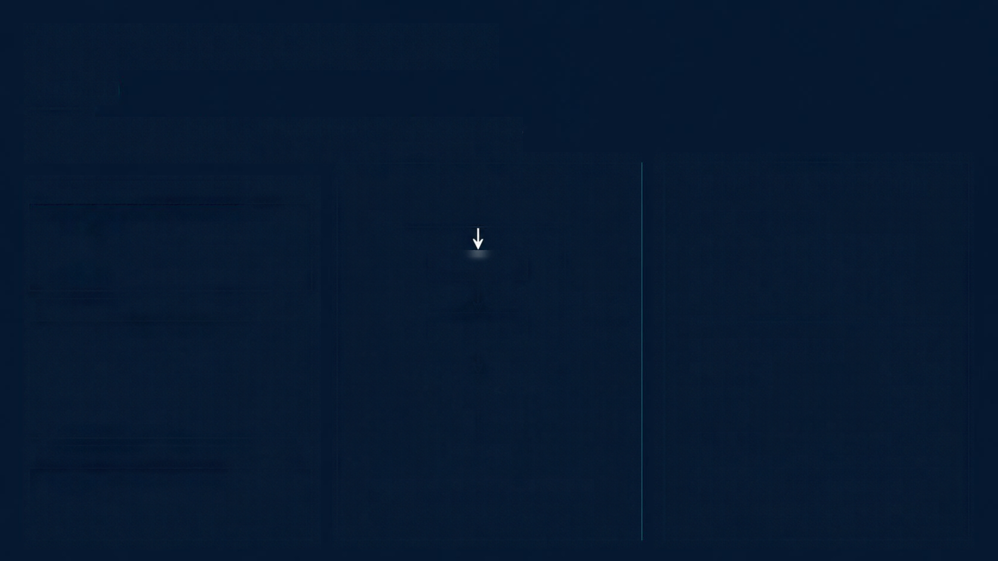


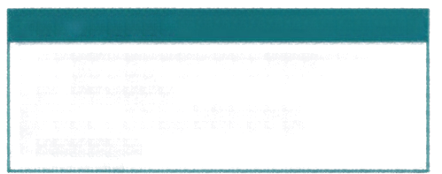



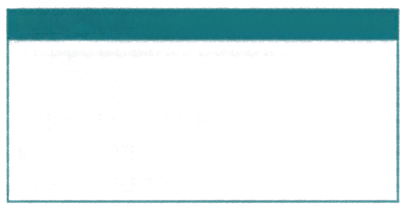




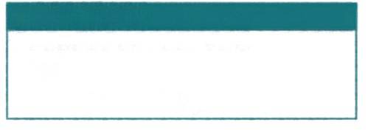
ADDITIONAL EXPERIMENT
ResNet50
ResNet50 delivers the highest local test accuracy among eight approaches in the current dataset and setup.
WHY RESNET50?
RESIDUAL BLOCK
RESULTS (LOCAL EVALUATION)
Residual connections enable very deep networks and stable training
x
TEST ACCURACY
83.77%
Provides an additional pretrained CNN
for comparison
Weight Layer
ReLU
Shortcut
Connection
(Identity)
LOCAL SETUP
Pretrained ImageNet ResNet50 backbone
Input size: 224×224
Weight Layer
VALIDATION ACCURACY
84.17%
Frozen backbone; trainable linear head
PRECISION
81.51%
Validation checkpoint selection
RECALL
88.19%
Separate test evaluation
ReLU
F1-SCORE
84.72%
INTERPRETATION
F(x) + x
Result is empirical for current dataset
and setup
Residual learning allows information to flow through shortcut connections.
ResNet50 achieved the highest local
test accuracy among eight approaches.
Not universal proof of superiority

Slide 8
OVERALL LOCAL RESULTS
Test accuracy across all eight approaches
MODEL
TEST ACCURACY
ResNet50
KNN (k = 5)
ResNet50
83.77%
PREDICTED
PREDICTED
Damaged
Undamaged
Damaged
Undamaged
MobileNetV1
82.40%
657
88
479
266
Damaged
Damaged
InceptionV3
81.16%
ACTUAL
ACTUAL
InceptionV3 layer-288 + SVM
69.32%
149
566
387
328
RBF SVM
61.30%
Undamaged
Undamaged
Logistic Regression
59.79%
Rows = actual class; columns = predicted class.
Rows = actual class; columns = predicted class.
NumPy Tiny CNN
57.88%
KNN (k = 5)
55.27%
KEY TAKEAWAYS
• ResNet50, MobileNetV1, and InceptionV3 achieved the highest local test accuracies.
• Classical methods and the small NumPy CNN performed less strongly on this dataset.
Each confusion matrix represents 1,460 test images.
Best local test accuracy: ResNet50 (83.77%).

Slide 9
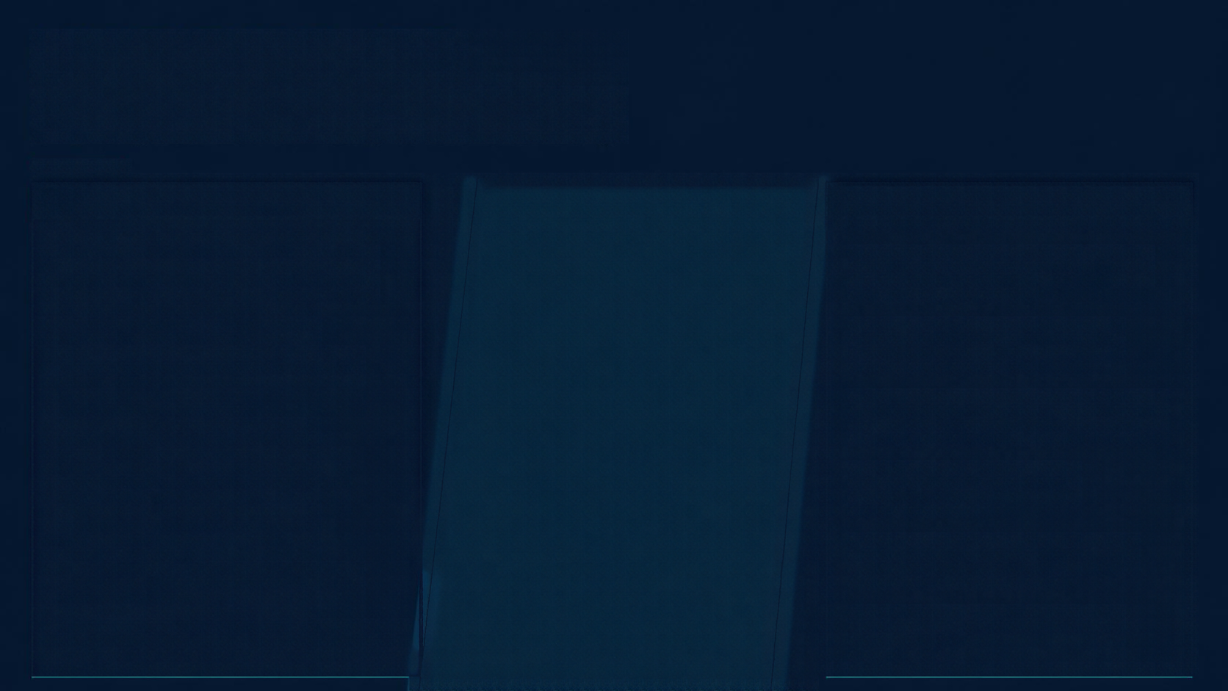


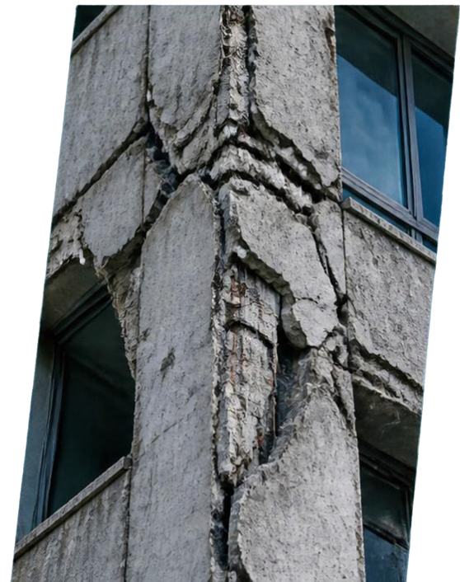


LIMITATIONS AND FUTURE IMPROVEMENTS
CURRENT LIMITATIONS
FUTURE IMPROVEMENTS
Local dataset differs from reference dataset
Verify preprocessing and normalization against original dataset
Reference evaluation split attribution unclear
NumPy classical approximations may
differ from original methods
Implement data augmentation and controlled fine-tuning
Some classical experiments use 2,500-row subsets for RBF SVM and
intermediatefeature SVM
Test robustness across different buildings, image conditions, and damage types
Transfer-learning backbones frozen;
no end-to-end fine-tuning performed
No augmentation used in transfer-learning experiments
Validate externally to assess generalization
Experiments run on CPU; no RTX 3050
GPU acceleration
Investigate class-specific error costs and confidence calibration
Preprocessing assumptions and differences may affect results
Accuracy alone insufficient to capture operational risk in structural damage assessment
Utilize GPU acceleration for training and inference

Slide 10

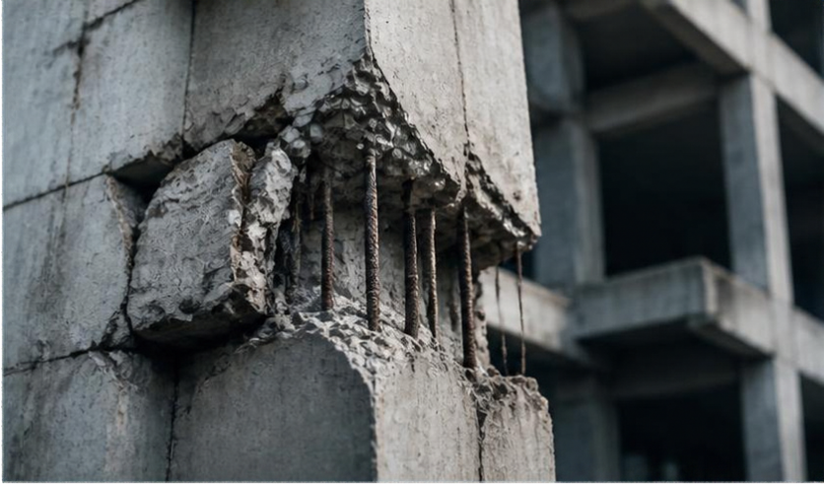



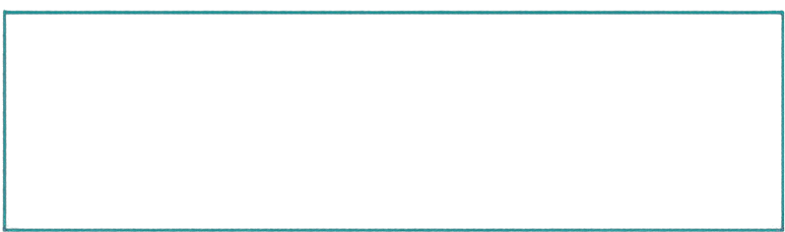
CONCLUSION AND REFERENCES
Six reference approaches implemented and evaluated locally
BEST MODEL
Classical ML methods provide baseline performance
ResNet50
Pretrained CNNs achieved higher test accuracy locally
83.77%
Transfer learning proved useful for this classification task
REFERENCES
TEST ACCURACY
Direct comparison with reference paper limited by dataset and protocol differences
1
https://cs229.stanford.edu/proj2018/report/39.pdf
2
https://cs229.stanford.edu/proj2018/poster/39.pdf
Further validation needed before real-world structural safety applications
3
https://github.com/jatron/structural-damage-recognition
4
PEER Hub ImageNet (Phi-Net), Task 2 Damage State
THANK YOU

