Slide 1
Is Pay Consistent Across Roles and Gender?
Rs 13.26L
Women (avg)
Rs 14.15L
Men (avg)
Salary Band & Pay Gap Analysis
HR & Workforce Analytics (DA-23)
10,500 employees | 8 roles | 9 departments | 12 cities
Notes:
Good morning. My project is the Salary Band and Pay Gap Analysis for an HR team. The business question is simple: is pay consistent across roles and gender? I analysed 10,500 employees across 8 roles and 12 cities. As a quick preview, on average women earn 13.26 lakh and men earn 14.15 lakh, a gap of about 6 percent. In the next five minutes I will show how I found this, where the gap is biggest, and what HR should do about it.

Slide 2



The problem HR wants solved
A company with 10,500 employees suspects that pay is unfair across roles, departments and gender. HR needs data to build fair salary bands and fix any gap.
Do men and women earn the same?
Are salary bands consistent across roles?
Data used
10,500 employees after cleaning, 13 columns: gender, department, role, city, experience, salary, rating. Synthetic dataset with Indian names.
Where are the biggest gaps?
Notes:
The company suspects that pay is not fair across roles, departments and gender. HR wants to know three things: first, do men and women earn the same? Second, are salary bands consistent across roles? And third, where are the biggest gaps? I used a dataset of 10,500 employees with Indian names. It is a synthetic dataset I created for this project, with realistic problems like missing values and duplicates, so I could practise the full analysis process.

Slide 3





How I solved it: five steps
1. Clean
2. Query
3. Explore
4. Visualise
5. Recommend
Excel
SQL
Python
Power BI
Report
10,750 to 10,500 rows; 250 duplicates removed; 3,900+ missing values handled
10 queries on 4 tables using JOIN, CTE and window functions
8 charts, correlations and a regression to test the gap
5 filters, 5 KPI cards and 6 visuals on one page
7 insights and 5 actions with a cost estimate
Notes:
I followed five steps. One: in Excel I cleaned the data. I removed 250 duplicate rows, fixed over 3,900 missing values and standardised labels, like Male, M and male into one value. Two: I wrote ten SQL queries on four tables using JOINs, a CTE and window functions. Three: in Python I made eight charts and ran a regression to test whether the gap has a hidden explanation. Four: I built a Power BI dashboard with filters and KPI cards. Five: I wrote insights and recommendations with a cost estimate.

Slide 4
Women earn less in every role
6.2%
overall pay gap
8 of 8
roles show a gap
Rs 88,000
average gap per woman each year
Notes:
This is my main finding. The chart shows average salary for each of the 8 job roles. Orange is women and navy is men. Men earn more in every single role, from Intern to Director. The overall gap is 6.2 percent, which is about 88,000 rupees per woman every year. I also checked with SQL, comparing men and women inside the same role, and the gap ranges from 4 percent at Team Lead to almost 9 percent at Manager. So it is not just because women hold junior roles.

Slide 5
The gap is widest in Customer Support and Finance
~20%
gap in hot spots: Customer Support in Jaipur and Data Science in Bengaluru
1.7%
gap in IT, the closest to equal pay
42.8%
of the lowest-paid quarter are women, vs 37.4% of the top quarter
Notes:
Now, where is the gap biggest? By department, Customer Support has a 12 percent gap and Finance 10 percent. IT is almost equal at 1.7 percent. My SQL query that joined four tables found smaller pockets with a gap near 20 percent, for example Customer Support in Jaipur and Data Science in Bengaluru. Also, women are 42.8 percent of the lowest-paid quarter of employees but only 37.4 percent of the top quarter. So women are not missing from senior roles; they are paid less within the roles.

Slide 6


Pay rules are weak, and the gap is not explained
6.5%
0.00
4.6x
gap remains after controlling for role, experience, performance, department and city
correlation between performance rating and salary: pay ignores performance
widest salary band in one role; 368 people earn over 1.5x their role average
Notes:
This slide explains why the gap matters. First, I ran a regression in Python that controls for job level, experience, performance, department and city. Women still earn 6.5 percent less, so the gap is not explained by any factor in the data. Second, the correlation between performance rating and salary is zero, so pay is not rewarding good performance. Third, salary bands are very wide: in one role the highest paid earns up to 4.6 times the lowest. And 368 employees earn more than one and a half times the average for their role.

Slide 7
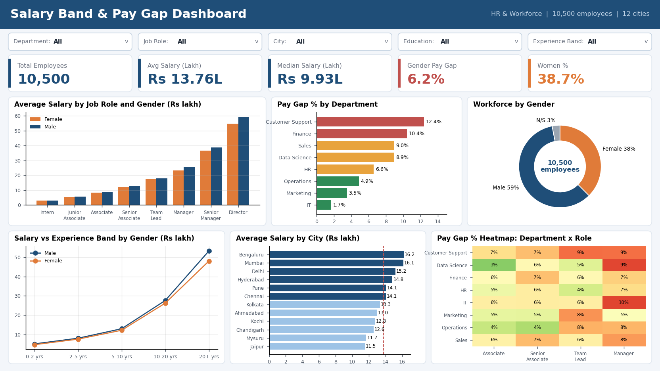
Power BI dashboard for HR leaders
5 filters
Department, role, city, education, experience
5 KPI cards
Employees, average and median salary, gap %, women %
6 visuals
Role, department, gender, experience, city, heatmap
Try it: choose IT and the gap falls to 1.7%; choose Customer Support and it rises to 12.4%.
Notes:
This is my Power BI dashboard. At the top are five filters, so HR can look at any department, role or city. Then five KPI cards: total employees, average salary, median salary, the gender pay gap and the share of women. Below are six visuals. One colour code is used everywhere: orange for women and navy for men. I can show it live: if I choose IT the gap falls to 1.7 percent, and if I choose Customer Support it rises to 12.4 percent. I did not add a gender filter because the gap measure already compares men and women.

Slide 8



Five actions for HR
Pay equity adjustment
Raise women paid below male peers, starting with Manager, Director, Customer Support, Finance
Estimated cost
Rs 36 crore
a year, about 2.5% of payroll
Target
Gap from 6.2% to under 2% in 12 months
Tighter salary bands
About 25% either side of a midpoint; review the 368 employees above 1.5x
Link pay to performance
Merit matrix: higher raises for rating 5, none for ratings 1 and 2
Fair hiring and promotion rules
Offers from band midpoint; HR approval above 90% of band max
City tiers and monitoring
Fixed city differentials; review the dashboard every quarter
Notes:
Based on the findings I recommend five actions. One, a pay equity adjustment for women paid below their male peers. This costs about 36 crore rupees a year, which is 2.5 percent of payroll. Two, tighter salary bands, about 25 percent either side of a midpoint. Three, a merit matrix so performance is rewarded. Four, fair hiring and promotion rules. Five, city pay tiers and a quarterly review using the dashboard. My target is to bring the gap from 6.2 percent to under 2 percent within a year.

Slide 9
Pay is not consistent, but it is fixable
Not consistent
Women earn 6.2% less, in every role
Not explained
Gap stays 6.5% after controls; pay ignores performance
Fixable
Rs 36 crore a year closes it, and the dashboard tracks progress
Thank you. Questions?
Notes:
To conclude: pay is not consistent. Women earn 6.2 percent less in every role. The gap is not explained by role, experience or performance, and pay does not reward performance. But it is fixable: around 36 crore rupees a year closes the gap, and the dashboard lets HR track progress every quarter. Thank you. I am happy to answer questions.

