Slide 1
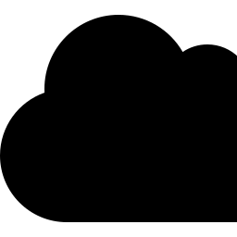
THE EVOLUTION OF
Cloud Computing
From mainframe time-sharing to the AI-driven cloud — six decades of infrastructure reinvention
A journey through five defining eras of modern computing infrastructure

Slide 2


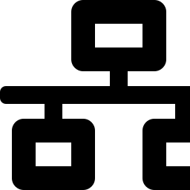

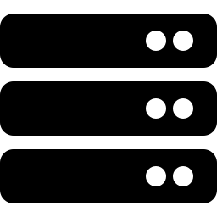
1950s–60s
Mainframe Time-Sharing
01
Organizations rented processing time on centralized mainframes; multiple users accessed one machine remotely, the earliest form of shared computing resources.
The Origins
1969
ARPANET
1950s – 1990s
The precursor to the internet connected research computers, laying the networking foundation that remote, shared computing would eventually depend on.
Before the term "cloud" existed, the core idea was already taking shape: share expensive computing resources across many users instead of owning them outright.
1970s
Virtual Machines
IBM's VM/370 operating system let one physical mainframe run multiple isolated virtual environments — the direct ancestor of today's cloud virtualization.
1999
Salesforce & SaaS
Salesforce launched enterprise software delivered entirely over the web, proving businesses would pay for applications they never had to install.

Slide 3
02 · THE BIRTH OF THE CLOUD
The 2000s: Cloud Goes Commercial
The decade the cloud became a real product — not just a concept — with pay-as-you-go infrastructure available to anyone with a credit card.
2002
2008
Amazon Web Services (internal)
Google App Engine
Amazon began building internal infrastructure services to standardize how its own teams provisioned computing and storage.
Google entered the market with a Platform-as-a-Service offering, letting developers deploy code without managing servers.
2006
2010
AWS EC2 & S3 Launch
Microsoft Azure
Amazon publicly launched Elastic Compute Cloud and Simple Storage Service — widely seen as the birth of modern IaaS cloud computing.
Microsoft launched Windows Azure, bringing enterprise customers already invested in Microsoft tools into the cloud.
By 2010, three models had crystallized: IaaS (infrastructure), PaaS (platform), and SaaS (software) — a framework still used to describe cloud services today.

Slide 4
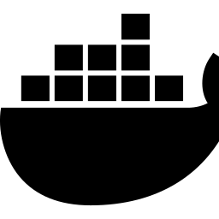

03 · SCALE & STANDARDIZATION
The 2010s: Containers, Kubernetes & Hyperscale
Docker (2013)
Kubernetes (2014)
Hyperscale Growth
Multi-Cloud & Hybrid
Containerization let developers package applications with all dependencies into portable, lightweight units — solving the "it works on my machine" problem for good.
Google open-sourced its internal container-orchestration system, giving the industry a standard way to deploy, scale, and manage containerized applications.
AWS, Azure, and Google Cloud invested billions in global data centers, driving prices down and making enterprise-grade infrastructure accessible to startups.
Enterprises began deliberately spreading workloads across multiple providers and on-premises systems to avoid vendor lock-in and improve resilience.
94%
$250B+
3
of enterprises used cloud services by 2019
global public cloud market size by end of decade
hyperscalers came to dominate: AWS, Azure, GCP

Slide 5




04 · THE MODERN CLOUD
The 2020s: Serverless, Edge & Everywhere Computing
Cloud computing matured from a place workloads run into an invisible layer woven through nearly every digital product.
Serverless Computing
Functions-as-a-Service (AWS Lambda, Azure Functions) let developers run code without provisioning or managing servers at all — paying only for execution time.
Edge Computing
Processing moved closer to end users and devices, reducing latency for IoT, gaming, and real-time applications by computing near the data source.
Cloud-Native Security
Zero-trust architectures and identity-based access became standard as organizations secured distributed, multi-cloud environments by default.
Sustainable Cloud
Providers committed to carbon-neutral and carbon-negative data centers, with efficiency becoming a competitive differentiator, not just a cost concern.

Slide 6

05 · THE NEXT INFLECTION POINT
AI & Cloud Convergence
The rise of generative AI has reshaped what cloud infrastructure needs to deliver — turning compute-intensive AI workloads into the cloud's biggest growth driver.
Managed AI Platforms
Amazon Bedrock, Azure AI Foundry, and Google Vertex AI let businesses build on foundation models without managing any underlying infrastructure.
AI-Optimized Chips
GPU-First Infrastructure
Custom silicon — AWS Trainium, Google TPUs, Azure Maia — emerged alongside GPUs to cut the cost of training and serving AI at scale.
Cloud providers now race to build massive GPU clusters, purpose-built for training and running large AI models at scale.
Inference at the Edge
Smaller, distilled models increasingly run closer to users, blending cloud training with edge inference for speed and privacy.

Slide 7
06 · LOOKING AHEAD
Six Decades in Review — and What's Next
1950s–90s
2000s
2010s
2020s
Now →
Shared
Mainframes
Public Cloud
Launches
Containers &
Hyperscale
Serverless
& Edge
AI-Native
Cloud
Sustainable Data Centers
Quantum-Cloud Hybrid
Sovereign & Distributed Cloud
Carbon-aware computing and renewable-powered facilities become a baseline expectation, not a differentiator.
Early quantum computing services are accessed via the cloud, complementing classical infrastructure for specialized problems.
Data-residency rules push providers toward regional, sovereign, and increasingly decentralized infrastructure models.

