Slide 1
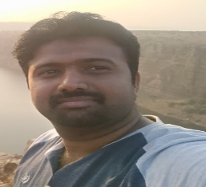
Pen Profile – Sr. Tester
Name : Shiva Kumar SJ
Role : E2E Sr. Quality Analyst / Sr Testing Engineer.
M: +91 9538788599
Email : SS00341822@techmahindra.com
EXPERTISE
Good Knowledge in Functional testing , SQL, Core Java.
Good practices in E2E Functional Testing, System testing, integration testing , Regression testing and Acceptance Testing.
Expertise in Test Planning, Test Approach, Test Case Development, and Manual Testing.
Hands on experience of using Bug Tracking Tool : Seibel, HP Quality Center 11.0 & JIRA and Test case Tool like Test link, qtest, QC 12.0.
Tech Mahindra,
RMZ Eco World, Bangalore
PROFESSIONAL BACKGROUND
SELECTED EXPERIENCES
Sr. Quality Analyst with 7.4 years of experience in the areas of software testing in both web and windows based applications.
Multiple domain experience which includes Ecom,Banking and Telecom
Worked as Model lead and individual contributor for the Cloud Voice, Generic Number and Commitment plan in BT projects
Hands on experience in preparation of Test Cases ,Test Plan , Test Strategy, Execute test cases with both manual and automation, Reporting as well as managing the defect in HPQC.
Involved in Interface and System integrated testing to ensure all the upstream and downstream applications are properly working.
Knowledge in SQL queries.
Hands on experience and good knowledge of SDLC, Agile Testing.
Good Management skills in managing internal resources, Tracking and chasing with component in Defect Management.
Good Communication, Presentation, Interpersonal skills and zeal to learn new technologies
Worked as Sr. Quality Analyst in Telecom domain by following agile and Waterfall methodology.
Involved in Creating test cases for the User stories.
Prepare Daily Sanity report and daily Execution status reports, defect analysis, test summary report and Sign off documents.
Execution of NF and Regression test Execution pack.
Triage the LIVE & Functional defects with the Component Developer Team and make sure that issue is resolved within the timelines.

