Slide 1


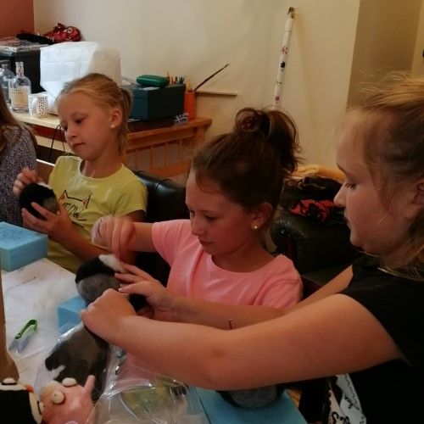
Concept
To create an OOP-based web application, with utilisation of supporting tools, methodologies, and technologies, that encapsulates all fundamental and practical modules covered during training.

Slide 2
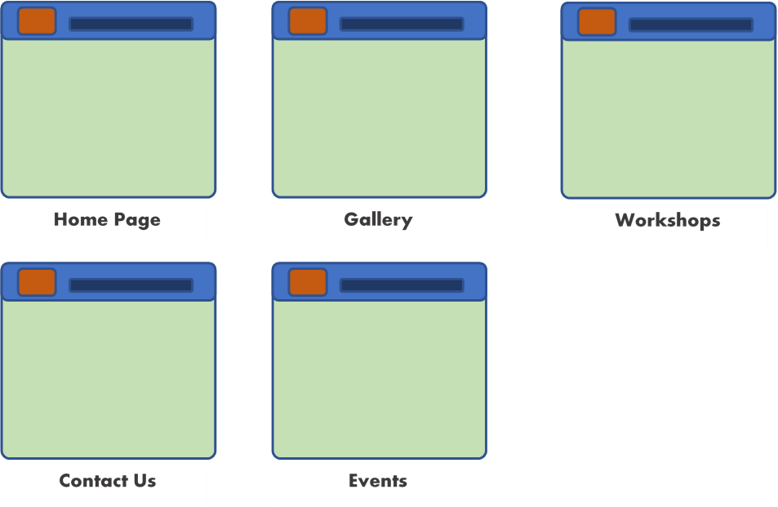
Website:

Slide 3
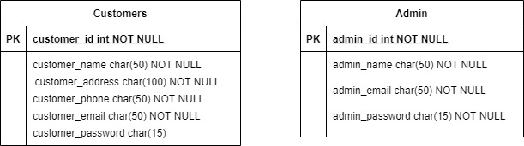
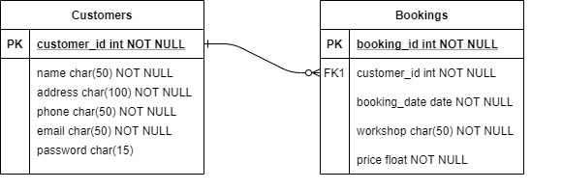
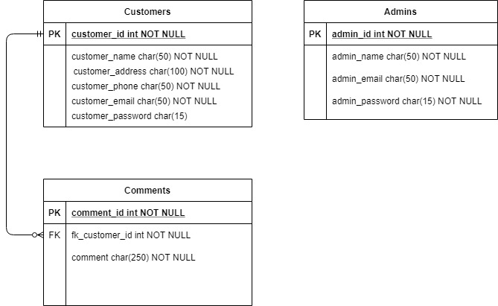
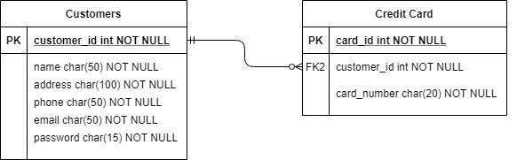
Database:

Slide 4
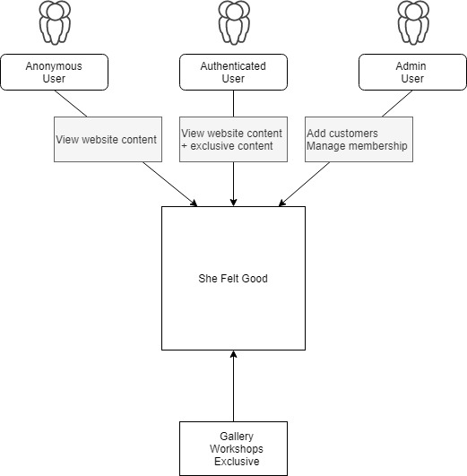
Context:

Slide 5
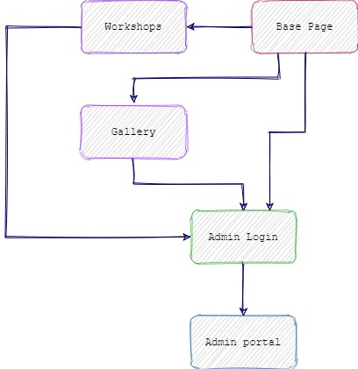
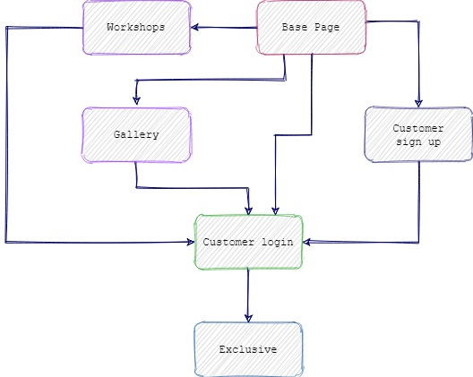

Slide 6
Should Have
Sensible package structure (back-end) and folder structure (front-end)
Test coverage of the src/main/java folder at 80% or above
A completed project management board, including user stories, acceptance criteria, and estimations with story points/MoSCoW
A completed README.md explaining how to use your hobby system
A folder for your testing reports
Adherence to best practice (e.g. OOP principles, SOLID, refactoring)
Must Have
CRUD functionality following the Enterprise Architecture Model
Unit testing for the project back-end
Integration testing for the project front-end
Test coverage of the src/main/java folder
GitHub repository utilising the Feature-Branch Model - the master branch must compile
Code pushed to your personal and trainer’s SonarQube
A fat .jar deployed to your trainer’s Nexus
A working .gitignore for ignoring build-generated files and folders
A completed risk assessment (utilising a matrix)
An ERD and/or a UML diagram for your Minimum Viable Product
A project management board,
A copy of, or link to, your presentation
A 20 minute presentation
Could Have
A master Jenkins pipeline job
A dev Jenkins pipeline job
Won’t Have
Not even conceivable …

Slide 7
Must Have
Index
Sign up: Customer
Sign in: Customer/admin
Exclusive
Admin portal
CRUD functionality
Should Have
Sensible package structure
Could Have
Workshops
Comments
Won’t Have
Bookings form

Slide 8
Risk Matrix:
Risk Category | Score | Ranking | Risk Mitigation Strategy
1) Lack of planning | 8 | H | Project plan with Kanban board and continously update. Establish clear goals.
2) Unrealistic schedule | 5 | M | Make sure your allow adequate time for planning, design, testing, and documentation.
3) Hardware/ Software failure | 6 | H | Ensure virus software installed and working. Make sure all software programs are installed and tested early on in the project.
4) Scope creep | 7 | H | Make sure each stage of the project is well planned and documented, and includes scheduled time for the design process.
5) Tutor support | 4 | M | Make sure all channels of communitcation are used to ensure support.
6) Illness/unexpected events | 6 | H | Plan for disruptions. Ensure Kanban board is well planned and is adjusted for any unforeseen circumstances.
7) Broadband/wifi connection | 7 | H | Make sure there is a backup system in place, like a mobile hotspot, or a community space that supplies free wifi connection.
8) Complexity of communication | 5 | M | Simplify complex ideas
9) Unrealistic expectations/inexperience | 3 | L | Consider cutting out some program features. Plan skills workshopping time.
10) Natural/manmade disasters | 3 | L | Ensure back-up systems are in place.
 | 5 | M

Slide 9
Risk Matrix:
Risk Category | Score | Ranking | Risk Mitigation Strategy
1) Lack of planning | 8 | H | Project plan with Kanban board and continously update. Establish clear goals.
2) Unrealistic schedule | 6 | H | Make sure your allow adequate time for planning, design, testing, and documentation.
3) Hardware/ Software failure | 5 | M | Ensure virus software installed and working. Make sure all software programs are installed and tested early on in the project.
4) Scope creep | 8 | H | Make sure each stage of the project is well planned and documented, and includes schecduled time for the design process.
5) Tutor support | 4 | M | Make sure all channels of communitcation are used to ensure support.
6) Illness/unexpected events | 6 | H | Plan for disruptions. Ensure Kanban board is well planned and is adjusted for any unforeseen circumstances.
7) Broadband/wifi connection | 8 | H | Make sure there is a backup system in place, like a mobile hotspot, or a community space that supplies free wifi connection.
8) Complexity of communication | 5 | M | Simplify complex ideas
9) Unrealistic expectations/inexperience | 5 | M | Consider cutting out some program features. Plan skills workshopping time.
10) Natural/manmade disasters | 3 | L | Ensure back-up systems are in place.
 | 6 | H

Slide 10
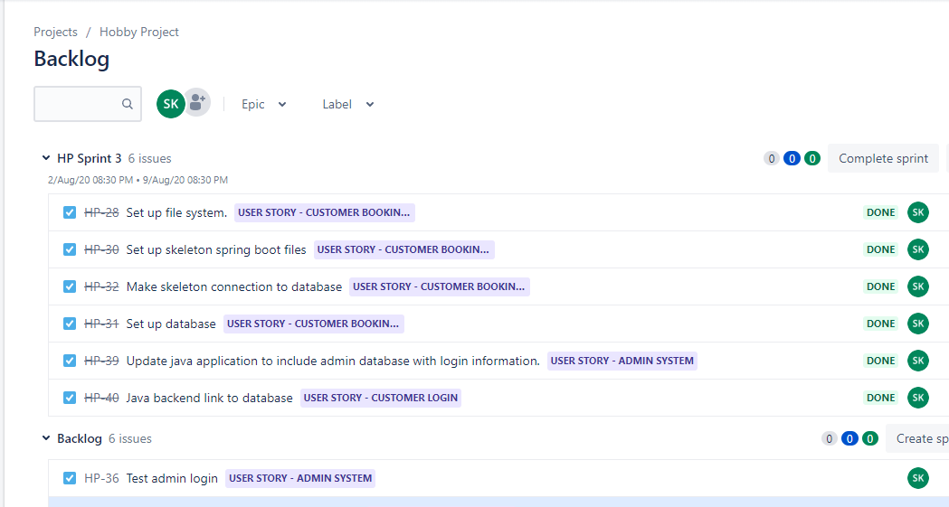
Sprint plan:

Slide 11
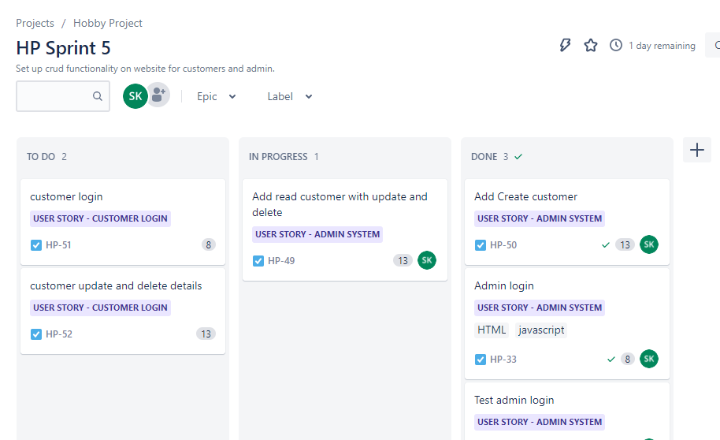

Slide 12
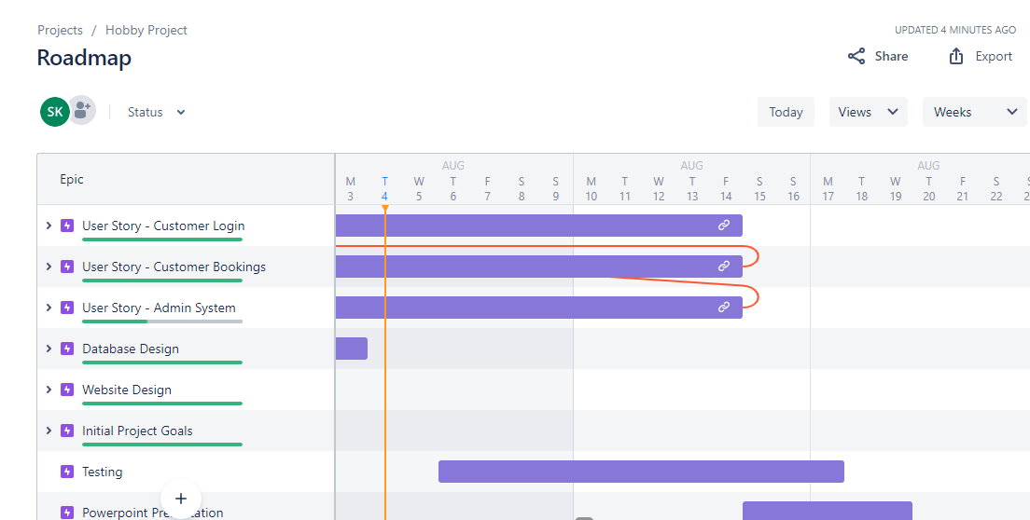

Slide 13











Introduction
Consultant Journey

Slide 14
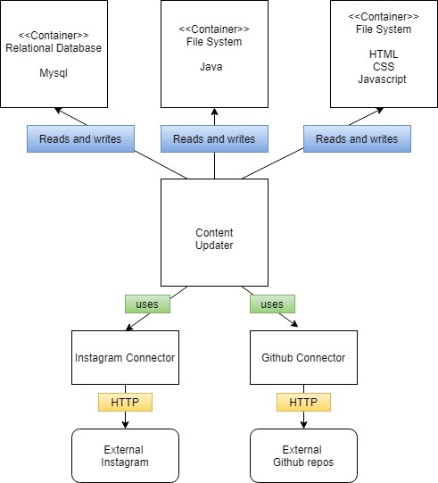
Components:

Slide 15
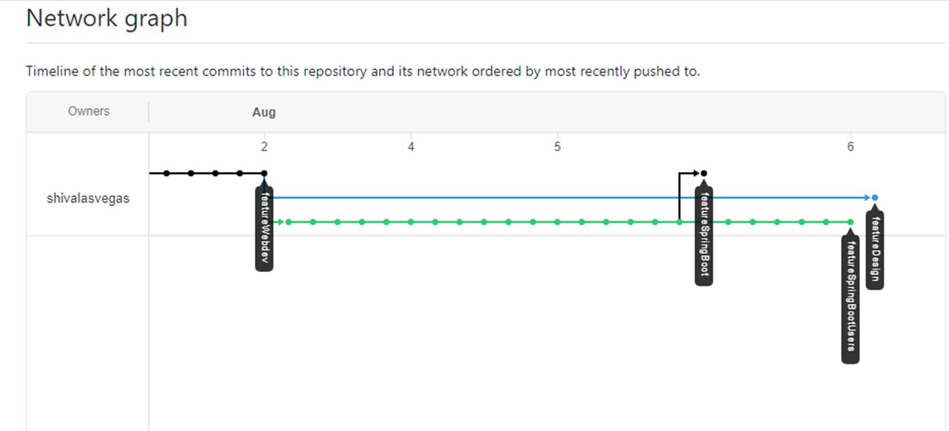
Git

Slide 16
Testing:

Slide 17
Demonstration:

Slide 18

Conclusion:

Slide 19
Questions:

