Slide 1
ims Project
QA Academy
Shiva King

Slide 2
Contents
Introduction (design brief)
Design ideas (ERD)
Risk assessment
Jira board
Demonstration
Testing
Improvements
Questions

Slide 3









Introduction
Inventory Management System
To create a functional application, using supporting tools, methodologies, and technologies, that encapsulates all fundamental modules covered during training.

Slide 4
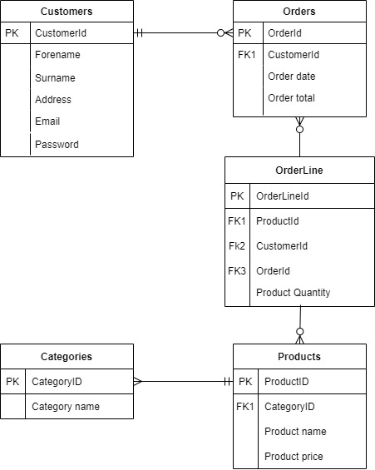



Design ideas

Slide 5
Risk Matrix
Risk Category/Questions for Consideration | Identified Risks (Notes)
1) Lack of planning
 | Project is poorly planned.
2) Unrealistic schedule
 | The project becomes larger than orginally specified i.e. there is unplanned work that is added to the schedule.
3) Hardware/ Software failure
 | Can hardware handle the workload and is it sufficiently secure? Is software compatible?
4) Scope creep
 | Project is poorly designed, planned, managed and controlled.
5) Tutor support
 | Tutors may have time off due to sickness, or may be busy with other students.
6) Illness/unexpected events
 | Covid-19 or other factors may come into play with unavoidable time off, which could delay the project.
7) Broadband/wifi connection
 | Remote working relies on a good broadband connection for communitcation and file sharing.
8) Complexity of communication
 | Remote working makes it more difficult to explain complex problems.
9) Unrealistic expectations/inexperience
 | The goals of the project are not within programmer's coding capabilities.
10) Natural/manmade disasters
 | Natural/manmade disaster's may prevent the project from being completed.

Slide 6
Risk Matrix
Risk Category | Score | Ranking | Risk Mitigation Strategy
1) Lack of planning | 8 | H | Project plan with Kanban board and continously update. Establish clear goals.
2) Unrealistic schedule | 5 | M | Make sure your allow adequate time for planning, design, testing, and documentation.
3) Hardware/ Software failure | 6 | H | Ensure virus software installed and working. Make sure all software programs are installed and tested early on in the project.
4) Scope creep | 6 | H | Make sure each stage of the project is well planned and documented, and includes schecduled time for the design process.
5) Tutor support | 4 | M | Make sure all channels of communitcation are used to ensure support.
6) Illness/unexpected events | 6 | H | Plan for disruptions. Ensure Kanban board is well planned and is adjusted for any unforeseen circumstances.
7) Broadband/wifi connection | 4 | M | Make sure there is a backup system in place, like a mobile hotspot, or a community space that supplies free wifi connection.
8) Complexity of communication | 5 | M | Simplify complex ideas
9) Unrealistic expectations/inexperience | 3 | L | Consider cutting out some program features. Plan skills workshopping time.
10) Natural/manmade disasters | 3 | L | Ensure back-up systems are in place.

Slide 7
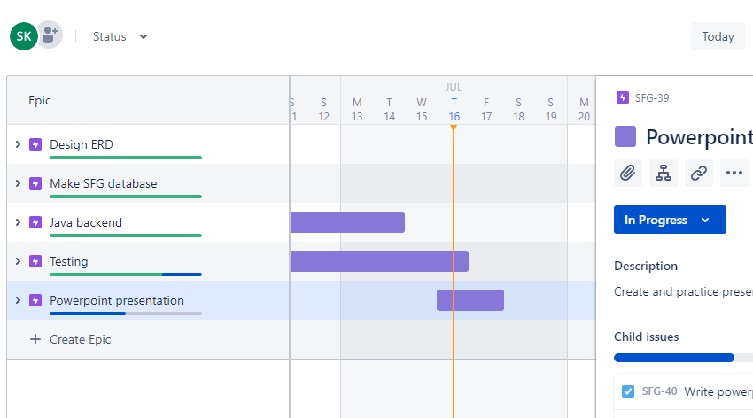
Jira Board Kanban New Gen

Slide 8
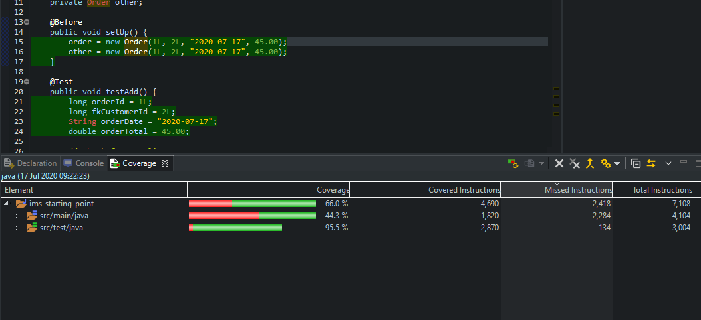
Testing

Slide 9
Demonstration

Slide 10

Improvements
Testing testing testing!
Exception handling
Functionality
User friendly

