Slide 1
Team 3: Megalodon

Slide 2
Project: Game Shop
Members:
1. Nguyễn Phát Đạt
2. Dương Ngọc Nguyên Phương
3. Nguyễn Văn An
4. Hà Vũ Đạt
5. Nguyễn Hữu Sơn

Slide 3
OVERVIEWS
Classification | Content
Service | Display various games with recommended options, payment method, discount, feedback.
Background | We’re trying to combine user-friendly and aesthetically-pleasing features, ensure your account privacy.
Purpose | Help customer easy to search game product, providing qualified games for customer with many different competitive level of price.
Expectation | Increasing approaching ability with many type of clients, help save the time and effort for shop’s owner, increasing profit and earning for shop.
Main functions | + Login/Register/Logout. + Manage Game Products + Cart (Buy, Edit), Payment + Search + Statistics, Manage users, Category, comments, Blog (News)
Targeted clients | Concerned objects
Service channel | Web, Internet
Publishing time | 23/07

Slide 4
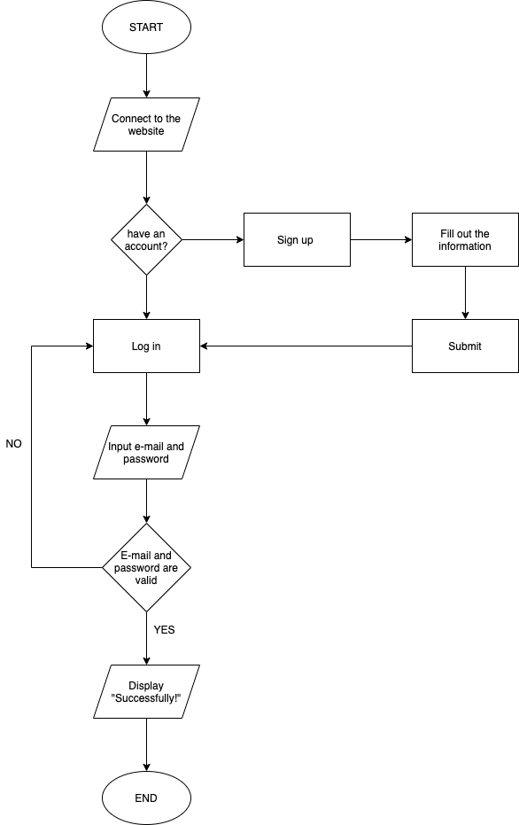
FLOWCHART
LOGIN

Slide 5
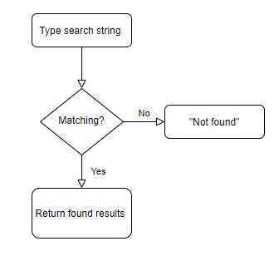
FLOWCHART
SEARCHING

Slide 6
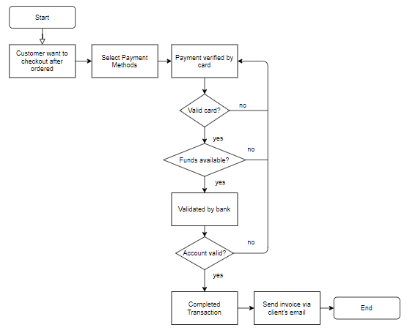
FLOWCHART
PAYMENT

Slide 7
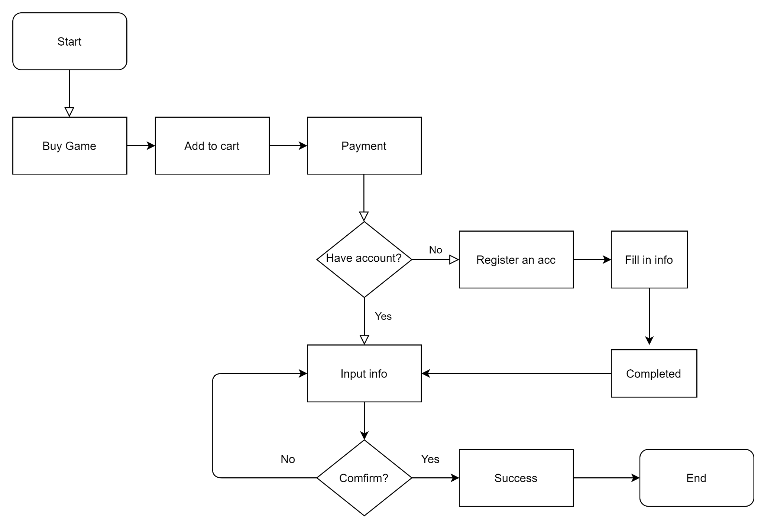
FLOWCHART
BUY GAME

Slide 8
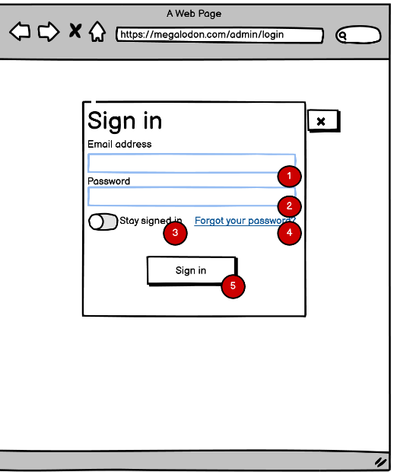
Story board
Description:
Input email account to login: Typing gmail Admin account, employee gmail account.
Input password to login: Typing Admin password or employee password.
Button to save account and password: Used to save accounts and passwords on the local computer.
The link for forgot password case: Go to a web page and restore the former password.
Sign in Button: Used to login with suitable account and password go to indexAdmin page.

Slide 9
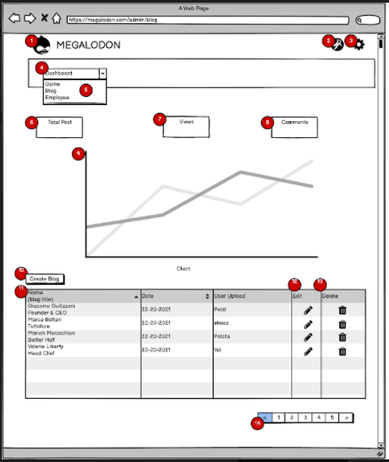
Story board
Description:
Web logo: Click it to go to Admin Index page.
User Info: forwarding to user information page
Logout: log out current user.
DashBoard bar: drop menu items list down.
SubMenu:
Game: forwarding to Game management.
Blog: forwarding to Blog management.
Employee: forwarding to Employee management.
Total post: show total number of Posts.
Views: show total number of views.
Comments: show total number of comments.
Chart displays views by month.
Create Blog: go to New Blog page.
Table List Blog: display Blog List
Edit: go to edit corresponding Blog.
Delete: remove selected Blog.
Paging for showing Blog list by table.

