Slide 1
Microservices - Using Istio Service Mesh
AJINKYA PRABHU
SHIVAM DIXIT
SAURAV PANIGRAHI
AISHMITA KAKKAR
MENTOR
AMRISH PANDE

Slide 2
PROBLEM STATEMENT
Create a microservice architecture based application.
Develop UI for stock ticker
Two microservices required- one connecting to Google finance, other to Yahoo finance to pull stocks
One intermediate service that communicates with the two.
Use Istio framework as mesh service

Slide 3
TECHNOLOGIES USED
JAVA 8 FOR MICROSERVICE ARCHITECTURE
ANGULAR 8 FOR USER INTERFACE
DOCKER FOR CONTAINERISING
KUBERNETES FOR ORCHESTRATION
ISTIO MESH FRAMEWORK

Slide 4
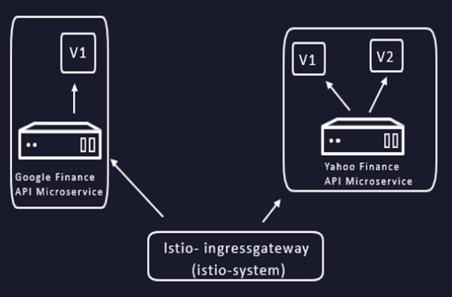
MICROSERVICE ARCHITECTURE
Created two microservices.
One service connects to Google finance to pull stock quotes while the other connects to Yahoo finance or any service alike.
Created a third intermediate service that communicates with these two services.
The UI will communicate only with this third service to display the stock information.

Slide 5
Angular Dashboard

Slide 6
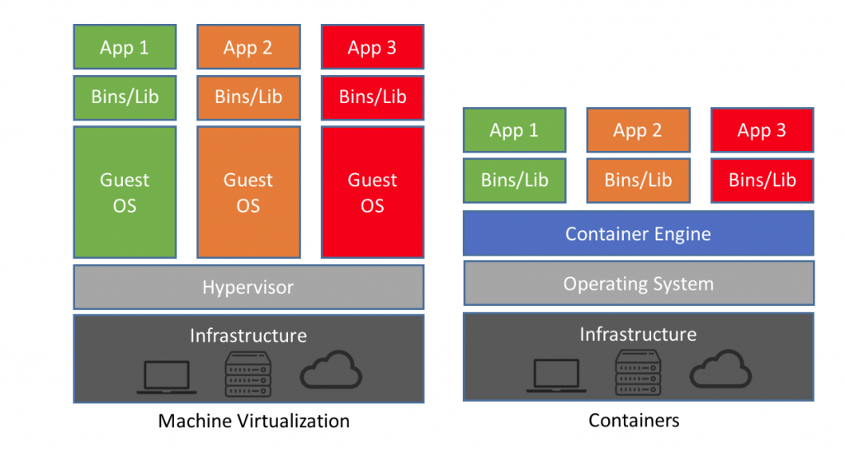
DOCKER
Containers help package all dependencies of our service and provide isolation for execution and independent orchestration of service.

Slide 7
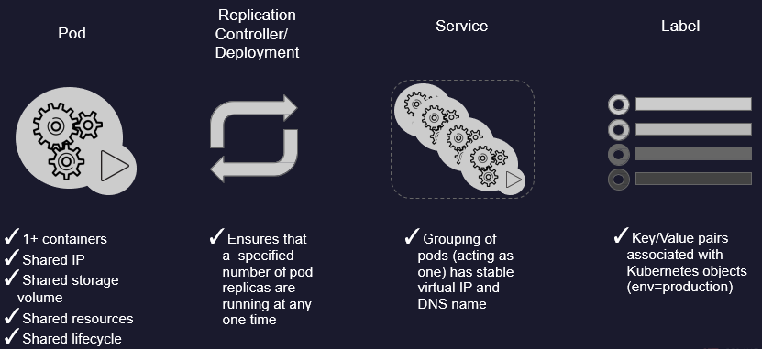
Container orchestration- Kubernetes

Slide 8
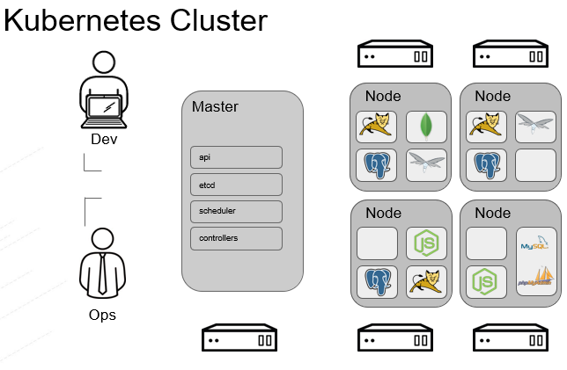

Slide 9
What is Istio?
Automatic load balancing for HTTP, gRPC, WebSocket, and TCP traffic.
Fine-grained control of traffic behavior with rich routing rules, retries, failovers, and fault injection.
Automatic metrics, logs, and traces for all traffic within a cluster, including cluster ingress and egress.
A pluggable policy layer and configuration API supporting access controls, rate limits and quotas.
Secure service-to-service communication in a cluster with strong identity-based authentication and authorization.

Slide 10
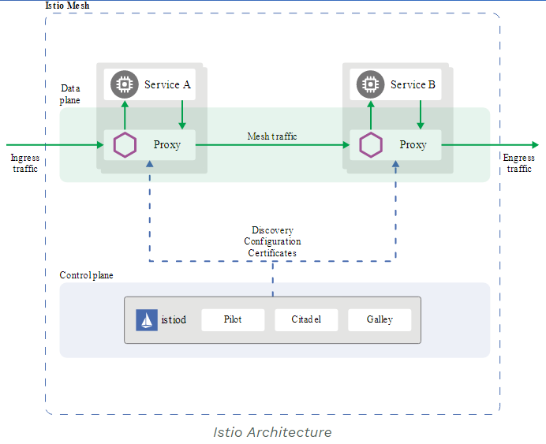
ISTIO Concepts
Data Plane:
Composed of a set of intelligent
proxies (Envoy) deployed as sidecars.
These proxies mediate and control all
network communication between
microservices along with Mixer,
a general-purpose policy and telemetry hub.
Control Plane:
Manages and configures the proxies to route traffic. Additionally, the control plane configures Mixers to enforce policies and collect telemetry.
Proxy: Based on Envoy, mediates inbound and outbound traffic for all Istio-managed services.
Pilot: Configures Istio deployments and propagate configuration to the other components of the system.
Citadel: Secures the service-to-service communication and provides a key management system to manage keys and certificates.

Slide 11
Demo

Slide 12
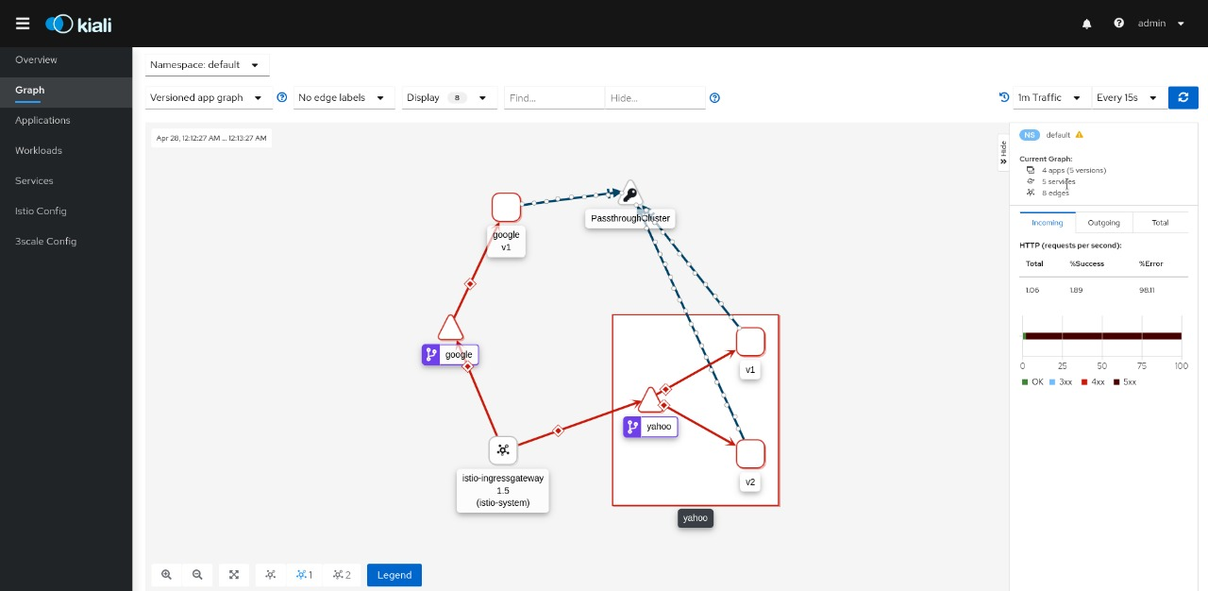
Kiali Dashboard representation of Service Mesh

Slide 13
HOW ROUTING CONTROL ACHIEVED
gateway.yml
apiVersion: networking.istio.io/v1beta1
kind: Gateway
metadata:
name: stock-gateway
spec:
selector:
istio: ingressgateway
controller
servers:
- port:
number: 80
name: http
protocol: HTTP
hosts:
- ""
---
apiVersion : networking.istio.io/v1alpha3
kind: VirtualService
metadata:
name: proxy-virtual
Spec:
hosts:
- “*”
gateways:
- stock-gateway
http:
- match:
- headers:
api-type;:
exact: yahoo
route:
- destination:
host: yahoo
subset: v1
port:
number: 8080
weight:50
-destination:
host: yahoo
subset: v2
port:
number: 8080
weight: 50
-match:
- headers:
api-type:
exact: google
route:
- destination:
host: google
port:
number: 8081

Slide 14
API Objects in Service Mesh
There are different API Objects used in Service Mesh
Virtual Service defines a set of traffic routing rules to apply when a host is addressed
Destination Rule defines rules that apply to traffic intended for a service after the step of routing.

Slide 15
Istio Virtual Service v/s Kubernetes Service
Istio's virtual service provides a lot of external features such as traffic management, load balancing, pod to external communication, routing , url restructuring.
Kubernetes simply acts as a container management system.
Kubernetes is a logical set of pods and defined as an abstraction on top of pods which provides single DNS name or IP.
Why Virtual Service ?
Istio Virtual Service is kind of abstract thing, which tries to add an interface to the actual implementation like the service in Kubernetes
It defines a set of traffic routing rules to apply to a kubernetes service or subset of service based on the matching criteria.

Slide 16
ISTIO- RESILIENCY+FAULT TOLERANCE CIRCUIT BREAKER+POOL EJECTION+RETRY

Slide 17
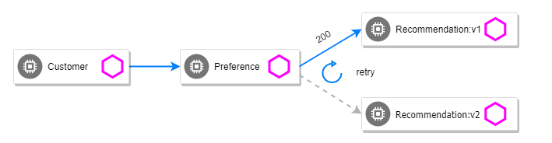
Shift from v2 to v1 using Circuit Breaker configuration.
Proxy
Yahoo

Slide 18
1) CIRCUIT BREAKER
The circuit breaker opens and disconnects the electrical current flow.
Instead of overwhelming the degraded service, open the circuit and reject further requests.
CREATING DESTINATION RULE
apiVersion: networking.istio.io/v1alpha3
kind: DestinationRule
metadata:
name: stockserver
spec:
hosts:
- "*"
gateways:
- stock-gateway
trafficPolicy:
connectionPool:
http:
http1MaxPendingRequests: 1 maxRequestsPerConnection: 1

Slide 19
2) Pool Ejection/ Outlier Detection
Identifying badly behaving cluster hosts and not sending any more traffic to them for a cool-off period
For HTTP services, hosts that continually return 5xx errors for API calls are ejected from the pool for a pre-defined period of time.
For TCP services, connection timeouts or connection failures to a given host counts as an error when measuring the consecutive errors metric
ADDING ON TO DESTINATION RULE
http:
http1MaxPendingRequests: 1000 maxRequestsPerConnection: 1 0 outlierDetection:
consecutiveErrors: 3
interval: 5m
baseEjectionTime: 15m

Slide 20
3) RETRY
If one pod returns an error (e.g., 503), retry for another pod.
simulate transient network errors- JAVA
Route rule -
istioctl create -f istiofiles/route-rule-recommendation-v2_503.yml \ -n tutorial
ADDING ON TO DESTINATION RULE
trafficPolicy:
connectionPool:
http:
http1MaxPendingRequests: 1 maxRequestsPerConnection: 1
outlierDetection:
consecutiveErrors: 1
interval: 1s
baseEjectionTime: 3m
maxEjectionPercent: 100
retries:
attempts: 3
perTryTimeout: 2s

Slide 21
FUTURE SCOPE IN BLACKROCK
Service Mesh can help with segmentation of services as per business segments and this aligns with our API design guidelines (by API council)
Service Mesh supports gRPC, telemetry, Role based access control ( RbAC) as envisioned in the API design guideline.
Azure Service Fabric Mesh uses Envoy sidecar proxy and provides request routing and traffic shifting feature as demonstrated.
Target state of Aladdin architecture

Slide 22
LEARNINGS & CHALLENGES
Microservice functioning
Features of angular
Deep dive into functioning of
Docker
Kubernetes
Istio
It took time to figure out how to create Docker image for our project. Explored Multistage builds.
Explored Docker Desktop, GKE and minikube approach, finally minikube worked for us.
High Learning curve.
Explored Angular async-await and promises concepts to handle delay in API return.

Slide 23
THANK YOU!

