Slide 1

REAL ESTATE PRICE PREDICTION USING MACHINE LEARNING ALGORITHMS
By : Shivam Tripathi (181500675)
Shubham Singh(181500698)

Slide 2
INTRODUCTION
Housing prices are an important reflection of the economy, and housing price ranges are of great interest for both buyers and sellers. In this project. house prices willbe predicted given explanatory variables that cover many aspects of residential houses. Ascontinuous house prices, they will be predicted with various regression techniques asindividual price ranges,they will be predicted with classification methods. The goal of thisproject is to create a regression model and a classification model that are able to accuratelyestimate the price of the house given the features.
The House price forecasting is an important topic of real estate. The literatureattempts to derive useful knowledge from historical data of property markets. Machine learning techniques are applied to analyze historical property transactions in Banglore todiscover useful models for house buyers and sellers. Revealed is the high discrepancybetween house prices in the most expensive and most affordable suburbs in the city of Banglore.

Slide 3
TOOLS AND LIBRARY USED
Numpy and Pandas : for analysing and manipulating data
Matplotlib and Seaborn : for plotting the graph
Scikit learn :for creating machine learning model
Python flask for HTTP server
UI : HTML, CSS, and JavaScript

Slide 4
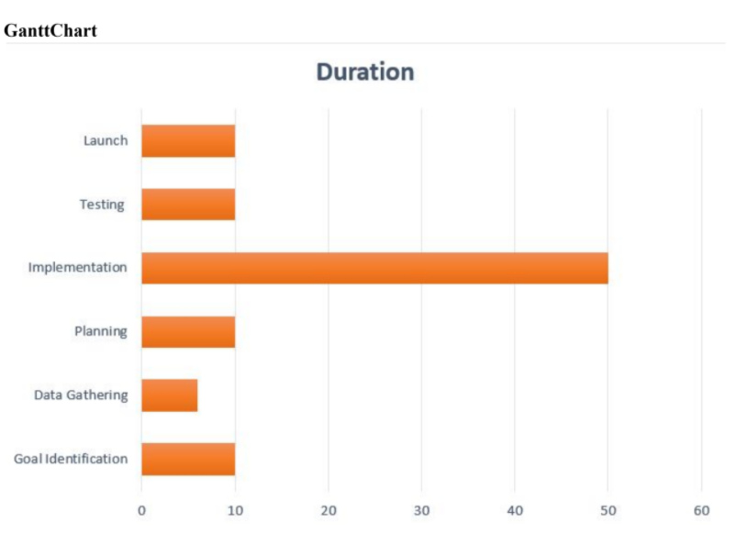
GHANTT CHART

Slide 5
METHODOLOGY
Data Collection
Data Cleaning
Feature Engineering
Outlier Removal
Data Split
Data Modeling
Model Building
Result
Model Testing
HTML/CSS/JavaScript for UI

Slide 6
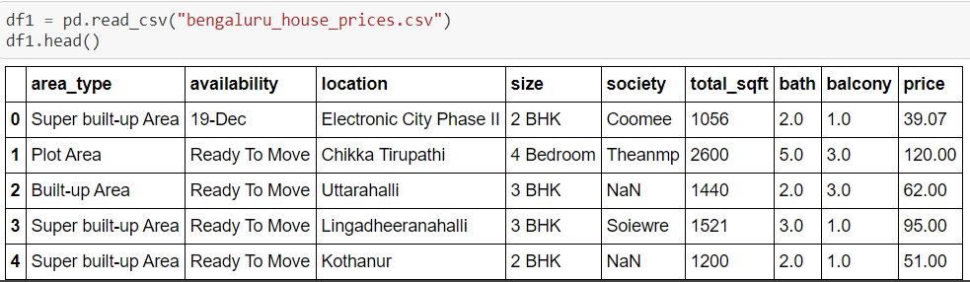
DATA COLLECTION
We gathered our data from kaggle website. According to the information provided along with this dataset .
Link of Dataset : https://www.kaggle.com/amitabhajoy/bengaluru-house-price-data
Code:

Slide 7
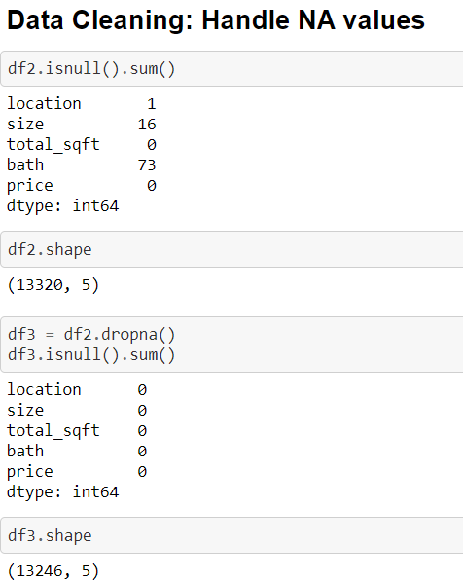
DATA CLEANING
Banglore Housing dataset requires one of the most important data preprocessing procedure which is cleaning . Our data need to clean by :
Removing duplicate rows.
Removing missing values.
Filtering out the features which are not relevant to our data analysis.

Slide 8
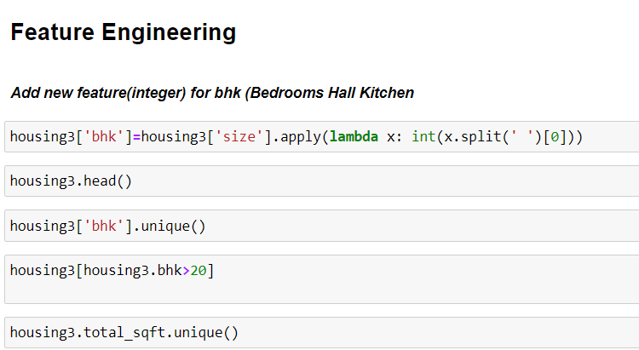
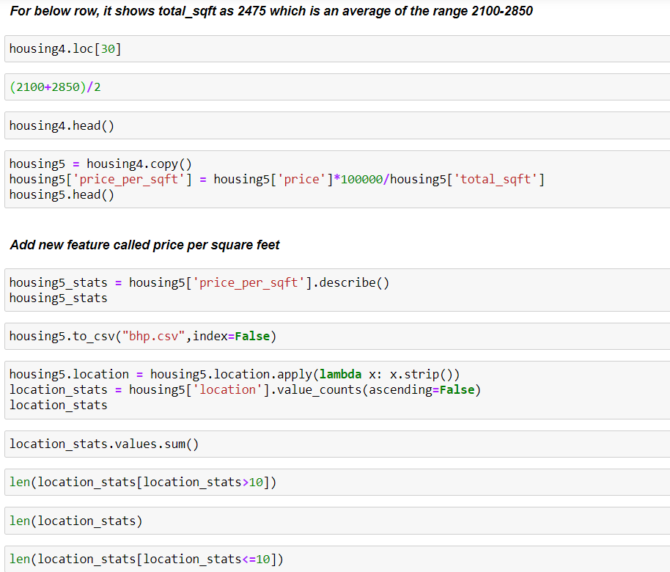
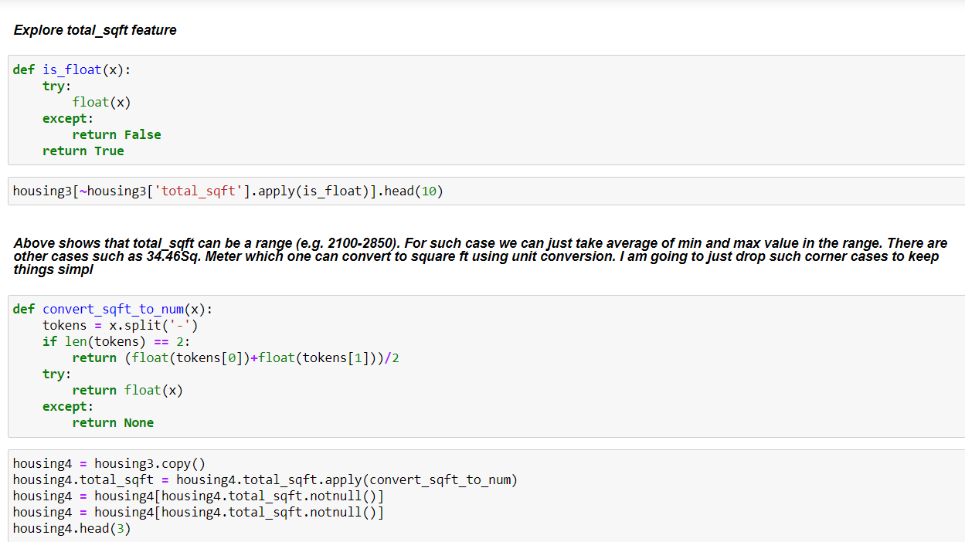
FEATURE ENGINEERING

Slide 9
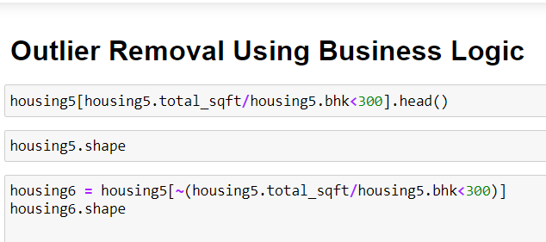
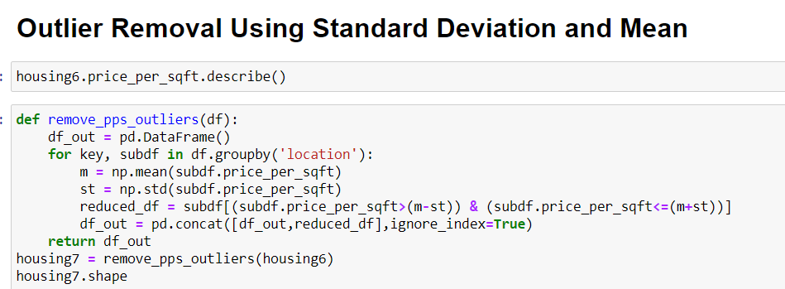
OUTLIER REMOVAL

Slide 10
DATA SPLITING
We divided our Data set randomly into a training set and test set .

Slide 11
DATA MODELLING
We have implemented and compared machine learning regression model like :
Linear Regression
Lasso
Decision Tree

Slide 12
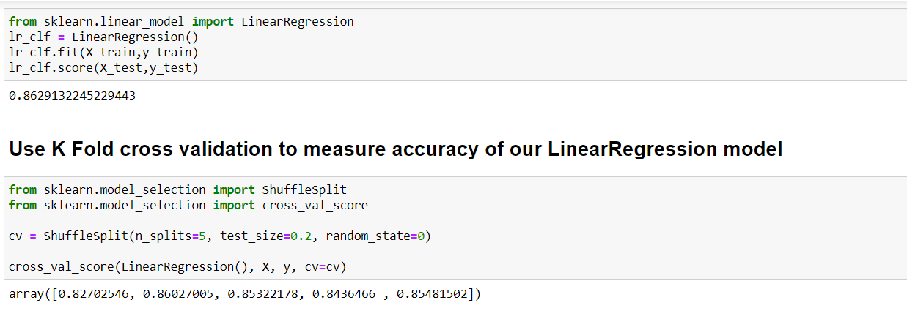
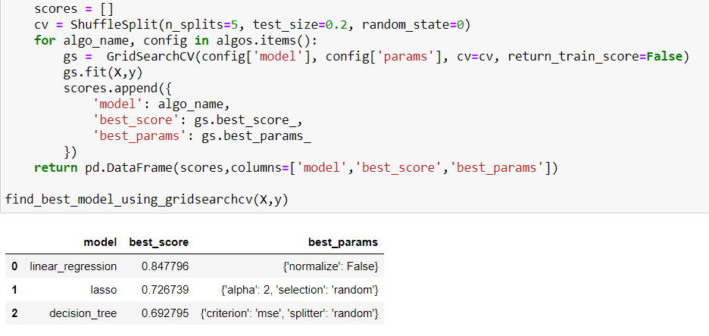
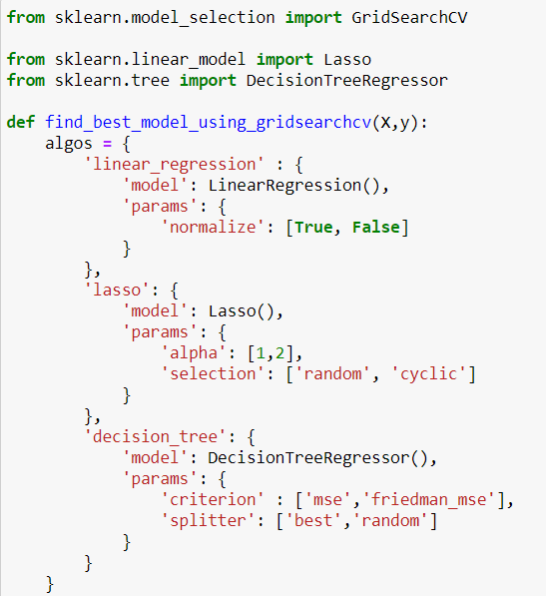
MODEL BUILDING

Slide 13
RESULT
Model Applied | Accuracy
Linear Regression | 0.8477
Lasso | 0.7267
Decision Tree | 0.6927

Slide 14
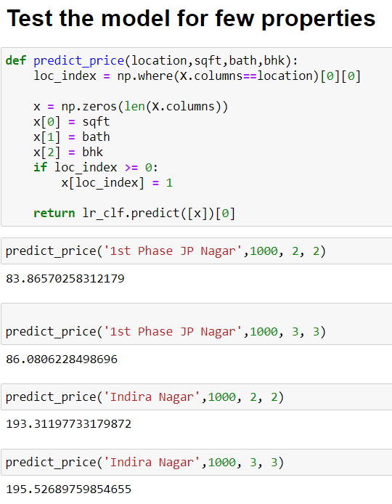
MODEL TESTING

Slide 15
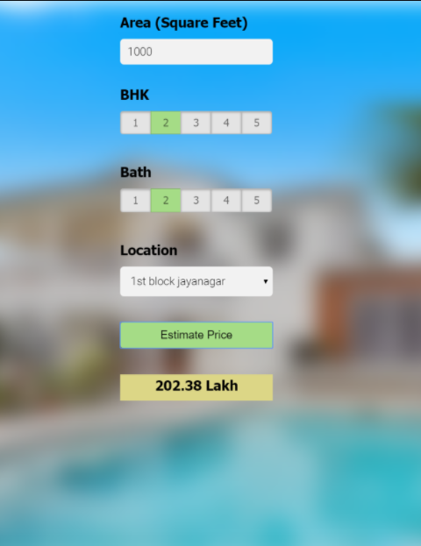
CLIENT PAGE

Slide 16
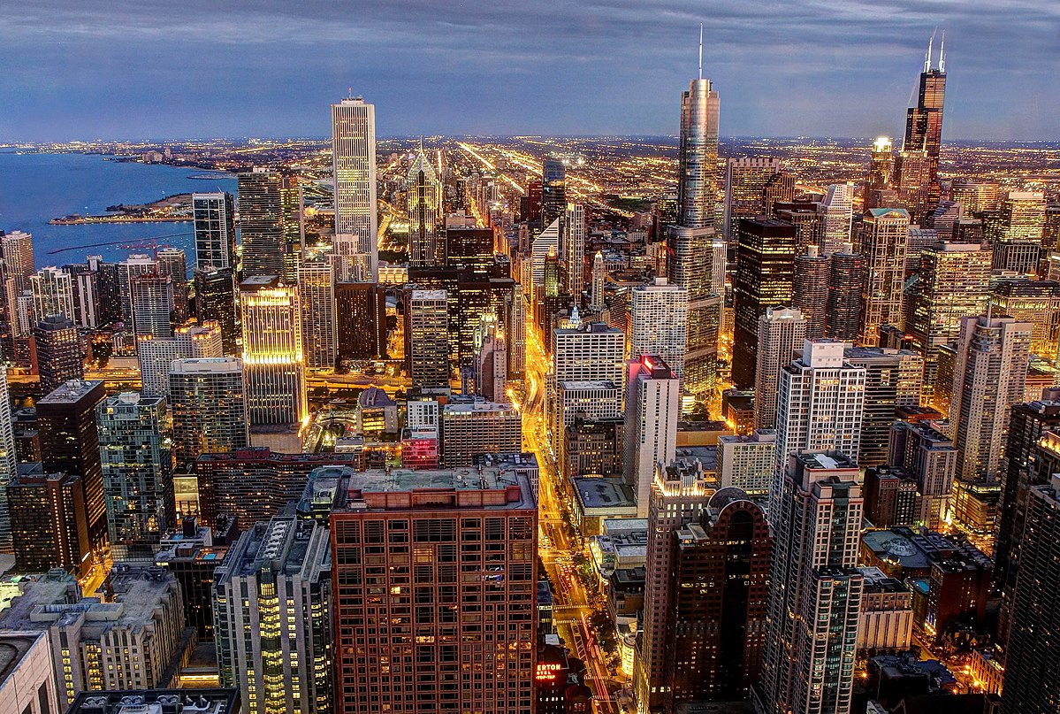
THANKYOU

