Slide 1
CSE4082 - ROBOT VISION PROJECT
REVIEW 1

Slide 2
INTRODUCTION
PROJECT TITLE : Realtime Photogrammetry
OUR TEAM
NAME | REGISTRATION NUMBER
Neha Ragesh Nambiar | 20BRS1110
Shivam Akhouri | 20BRS1095
Suraj Shah | 20BRS1122
Meher Shrishti Nigam | 20BRS1193
Sai Samyuktha N | 20BRS1114

Slide 3
TABLE OF CONTENTS
01.
02.
03.
PROBLEM STATEMENT
SCOPE OF THE PROJECT
NOVELTY OF THE PROJECT
04.
05.
06.
DESIGN
Methodology identified
RESEARCH GAP

Slide 4
01.
PROBLEM STATEMENT

Slide 5
PROBLEM STATEMENT
To render 3D models from images taken up as screenshots of a video
Given any image, a mesh map is produced for evaluation, but it can be faulty hence major noise metrics needs to be followed
In real- time solutions, the device used to capture images might be faulty hence there’s a need to plan for a better network geometry to ensure that the images obtained are of high resolution
In present day technology, photogrammetry provides accurate results when the image background is smooth, but it’s tough to capture such images every time, therefore proper digital image processing needs to be done before advancing onto the evaluation process

Slide 6
02.
SCOPE OF THE PROJECT

Slide 7
SCOPE OF THE PROJECT
Photogrammetry is the Science of surveying from Photogram, which is a photo with almost no distortion or known distortion. Thus, it has wide application in surveying where one can’t go physically.
This method has lots of Scope in GIS Application Industry. Some of the are listed below:
GPS and Location Based Services Industry,
Medical Imaging application for displaying real-time 3D picture of body parts, such as brain or stomach or lung or heart.
Location Based Android or iOS Application Development Industry
Lidar based Application, mainly for Terrain processing
Off terrain assets mapping like forest, Electric distribution and maintenance etc.
Sonar based application to process underwater profiles for analysis.
In Utility Sector for Asset Management, mainly preparing as Built drawing, planning, implementation.

Slide 8
SCOPE OF THE PROJECT
Augmented Reality application, where Real-time data can be draped over underground Data for quick Analysis, which otherwise not possible.
Vehicle based survey with Geo-Tagged Video for Fast Survey and also some time help to survey in harsh condition.
Drone based survey or Mapping in case of Disaster or for recovery or rescue application.
Application development and customization around existing open-Source application.
Fast and Automated Data preparation for Robotics and Driverless applications.
Precision agriculture by Applying Kalaman State filter to accurately predict position from reading several sensor inputs.

Slide 9
03.
NOVELTY OF THE PROJECT

Slide 10
NOVELTY OF THE PROJECT
Photogrammetry refers to the 3D rendering of images. Photogrammetry is used in surveying and mapping by using photography. To measure distance between any two (or more) objects we can use photogrammetry.
There are very few libraries wherein images are being taken from the videos and then their 3D sculpting is being done. But these are not available to the general public and a lot is being researched on.
The novelty in our project lies in creating a model that is capable of rendering 3D images from the images captured by truing videos and also make it publicly available for future enhancements

Slide 11
NOVELTY OF THE PROJECT
Photogrammetry can be applied to the field of Medicine - especially Surgeries that require in-depth understanding of the patient’s internal body condition. The MRI scan images could be developed into a 3D model and the problem could be visualized for further treatment as in the case of Brain tumor treatment and other sensitive internal organs related problems
This is not just limited to study the patient. Medical students can also use this technology to visualize a situation and practice surgery
3D visualization of mathematical concepts, graphs and other diagrams in science would effectively increase the interest of children to learn more in the field of Education.

Slide 12
NOVELTY OF THE PROJECT
Photogrammetry can also be used in entertainment field - for example, instead of visiting the aquarium or the zoo, people could visualize the 3D image and feel the experience at the comfort of their home
Archaeology is a domain that deals with delicate historical structures that are the only means to study about the past and hence, they are to be protected. Photogrammetry could be used to create and visualize a 3D model that could be studied by anyone - without the risk of damage to the object.
A common use case of Photogrammetry is in the visualization of buildings, historical structures / other places of importance.

Slide 13
04.
DESIGN

Slide 14
DESIGN
The design of the project will consist of an ML model which will do the pre-processing of the videos, extract images and then make the 3D model. The following will be done by using TensorFlow and keras layers. An algorithm called Structure-from-Motion or SfM is designated for this, in which we will develop further by integrating the same for videos.
The main focus will be on developing the model, and further development can be done into an Application or a Web App.
The project has various use cases and its design can be modified accordingly to fit each use case, including the Medical Industry, City Planning, VFX in movies and so on. For the medical industry, the model can be tweaked to pick up the smallest details, for city planning it can be modified for faster processing of wide areas

Slide 15
05.
METHODOLOGY IDENTIFIED

Slide 16
Methodology - TRADITIONAL METHOD
In a traditional photogrammetric pipeline, the meshing step interpolates a surface over the input 3D points. This is usually disjointed from the 3D point cloud generation DIM but can potentially leverage and take advantage of additional information from the previous steps of the workflow, i.e., visibility constraints and photo-consistency measures which are generally not considered in popular meshing algorithms as Poisson Dense point clouds can be heavily affected by poor image quality or textureless areas, resulting in high frequency noise, holes and uneven point density. These issues can be propagated during the mesh generation process.
Volumetric approaches for surface reconstruction based on depth maps are well-established, time-efficient methods for depth sensors, also known as RGB-D, and might be a valid approach also for pure image-based approaches.

Slide 17
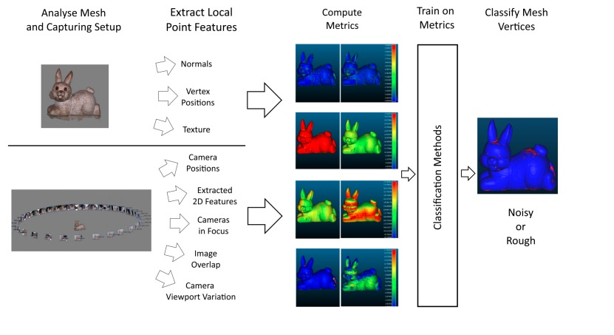

Slide 18
Proposed Reconstruction methods
Method 1:
Surface generation and refinement are incorporated in the 3D reconstruction pipeline. The mesh is generated after depth maps and dense point clouds are estimated and is subsequently refined considering visibility information (i.e., image orientation) to optimize a photo-consistency score over the reconstructed surface.
Method 2:
Surface generation is disjoint from the image-based 3D reconstruction procedure. The dense point cloud, as obtained from Method 1, is converted to a mesh model without the use of any visibility constraints or photo-consistency checks.
Method 3:
Given the image poses, a mesh model is generated from the depth maps produced in Method 1, employing a volume integration approach. Again, in this method, visibility and photo consistency information are not taken into consideration while reconstructing the surface.

Slide 19
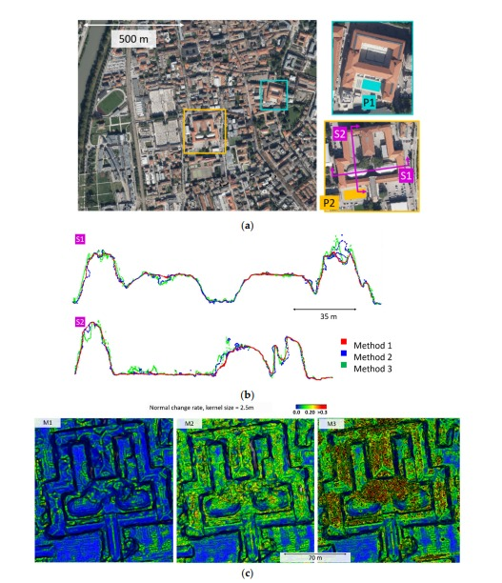
Google earth early phase development results:

Slide 20
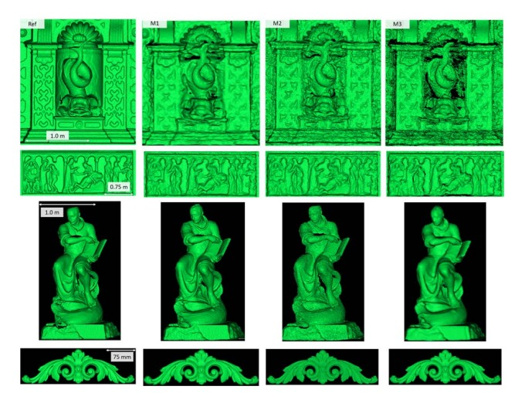
Sculpture modelling from walls of old temples and buildings:

Slide 21
Noise metrics to be kept in mind while evaluation
Noise manifests as either clumped together high frequency vertices or flat patches and holes—when the initial feature detection and matching methods in the SfM pipeline do not produce enough correct matches, the produced 3D surfaces can end up with overlapping or missing parts. These manifest in geometrical surface errors.
SfM noise normally comes from smooth, monochrome colored surfaces—monochrome surfaces normally lack robust features like edges and angles, while smooth and transparent surfaces, produce reflections, which change with the view direction, making correct feature matching impossible.
Noise is present on parts of the object that have not been seen from enough camera positions—SfM needs to gather information of the object from multiple directions, to provide a correct geometrical representation of the micro and macro shape of the surfaces. Not enough camera variation can lead to 3D surface “guessing” and deformed patches. An example of this can be seen in Figure 3c, where one object obscures another surface from being seen by the cameras resulting in noise.

Slide 22
Noise metrics to be kept in mind while evaluation
4. Noise is present on parts of the object that have been seen from enough camera positions, but were not in focus—surface features need to be extracted and matched, but if parts of the object are blurred and out of focus, not enough information can be extracted from them.
5. Noise is present on parts of the object that have been seen from enough camera positions, but those positions were not diverse enough—if all the capturing positions are from the same direction, not enough information can be extracted for the shape of the surface.

Slide 23
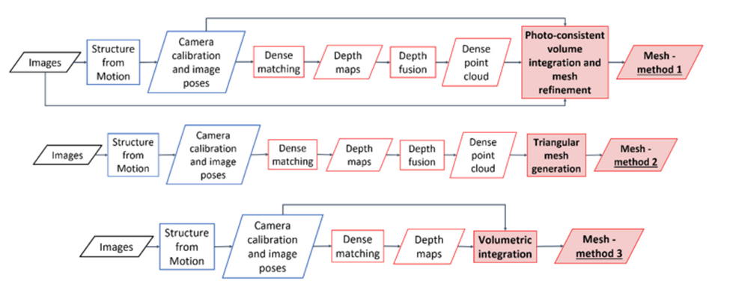

Slide 24
06.
RESEARCH GAP

Slide 25
RESEARCH GAP
There’s no such publicly available model which would render 3D models from videos
This technology can make high impacts in Marine exploration as well as Space Technology. This can be achieved when the real time photogrammetry provides results having less errors
Though the current state-of-the-art SfM algorithms can handle the diverse and complex distribution of images in large-scale Internet photo collections, they frequently fail to produce fully satisfactory results in terms of completeness and robustness.

Slide 26
Thank you

