Slide 1
Category review: Chips
August 2019
Retail Analytics | Strategic recommendation for the FY20 chip category plan

Slide 2
Notes:
To view Privacy video explaining how important data privacy is to Quantium, please click here: https://www.youtube.com/watch?v=Zq1QDAkoRzU
or here Q:\Company Reference\Brand & Design\Brand videos\Q Privacy.mp4
At Quantium, we believe that data is the behavioural footprint of humanity and that it has to be treated with the utmost care and responsibility.
Histories, attitudes, indeed lives are stored within it in ways that aren’t always apparent – and that’s what makes its potential so powerful.
To work with it responsibly, sensitively, we set ourselves the highest data privacy protection and governance standards.
We have spent 17 years perfecting privacy-by-design and secure-by-design principles. Central to this is not holding any personally identifiable information about people –
we neither receive it, and put the necessary protections in place to be unable to decipher it.
Every aspect of handling data is safeguarded: from its de-identification, to its encryption – data security is paramount and of the highest grade.
We pride ourselves on gaining the trust of iconic organisations around the world through years of securely working with their data,
and in turn the trust that builds with their stakeholders.

Slide 3
Executive summary
Target Mainstream Young Singles/Couples and roll out the new store layout — both are proven, data-backed growth levers for the FY20 chip plan.
1
2
3
A large, high-value
segment
The trial worked
Clear next steps
Mainstream Young Singles/Couples is our single biggest customer base (11% of all customers) and pays a statistically-proven 9.1% more per packet than Budget/Premium peers (p < 0.0001).
2 of 3 trial stores (77 and 88) show a significant uplift in both sales and customer numbers during the trial period — a clean, repeatable result.
Prioritise Tyrrells, Doritos, Kettle and Twisties in range and promotion for this segment, roll out the layout more broadly, and clarify store 86's pricing/promo activity before generalising.

Slide 4
Agenda
Category insights
01
Who buys chips, what drives sales, and where the growth opportunity is
Trial store performance
02
Did the new layout work? Store-by-store results
Recommendations & next steps
03
What we suggest doing about it

Slide 5
01
Category insights

Slide 6
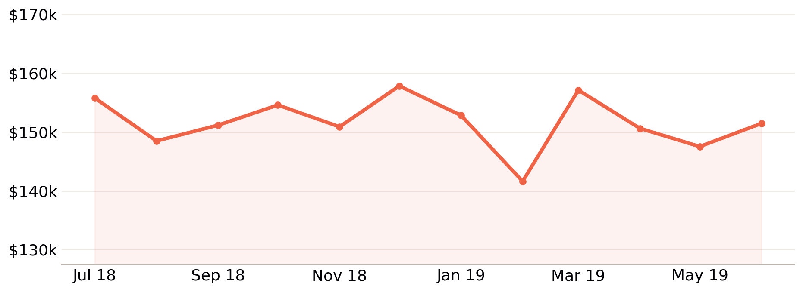
A stable, year-round category
$1.82M
Total chip sales, Jul 2018 – Jun 2019
Monthly sales are steady all year (no seasonal decline), with one clear spike in the week before Christmas. Chips are a reliable, dependable category — the opportunity here is about which customers to grow, not fixing a declining trend.

Slide 7
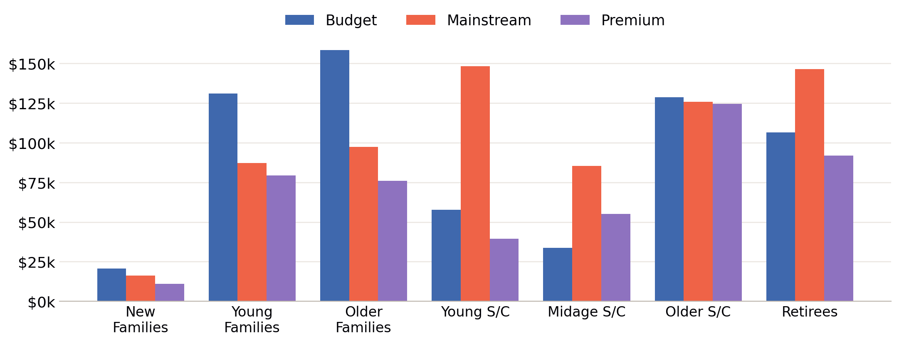
Two different stories explain who drives sales
VOLUME
REACH
Families (any tier) buy 8.7–9.3 packets per customer, every trip — the highest of any lifestage. This is what drives Budget - Older Families to the top of the sales chart.
Mainstream Young Singles/Couples and Retirees buy far fewer packets each, but there are simply more of these customers than any other segment — the largest customer base in the category.

Slide 8
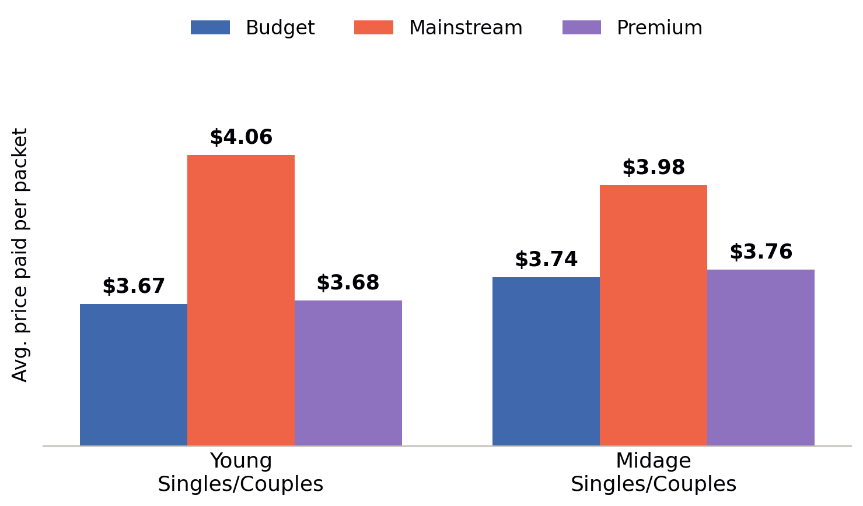
Mainstream shoppers pay more for the same category
+9.1%
More paid per packet by Mainstream vs.
Budget/Premium Young & Midage Singles/Couples
(t = 38.1, p < 0.0001)
This premium is specific to Young and Midage Singles/Couples — it does not hold for Mainstream Retirees, who pay about the same as their Budget/Premium peers. The willingness to pay more is a targeted, not a blanket, opportunity.

Slide 9
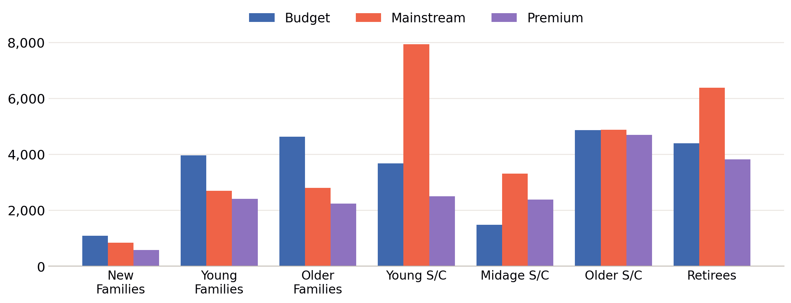
Young Singles/Couples & Retirees are our largest customer base
Mainstream Young Singles/Couples (7,930 customers) and Mainstream Retirees (6,382) are, by a clear margin, the two largest customer segments buying chips today — the foundation of the “reach” opportunity.

Slide 10
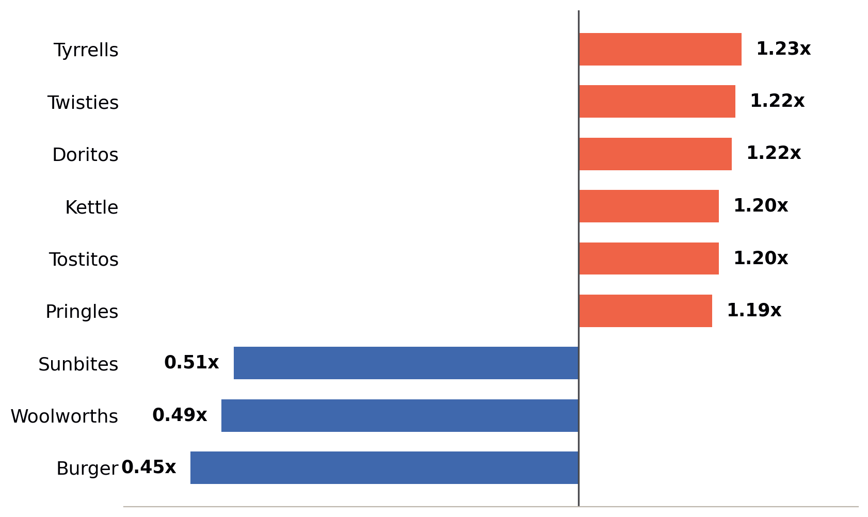
The target segment has clear, actionable brand preferences
1.2x+
Over-indexing on Tyrrells, Twisties, Doritos,
Kettle, Tostitos & Pringles
Mainstream Young Singles/Couples buy recognised, mainstream snack brands well above their share — and under-buy home-brand and lower-profile options (Woolworths, Burger Rings, Sunbites). Range and promotion should lean into the six brands on the left.

Slide 11
02
Trial store performance

Slide 12
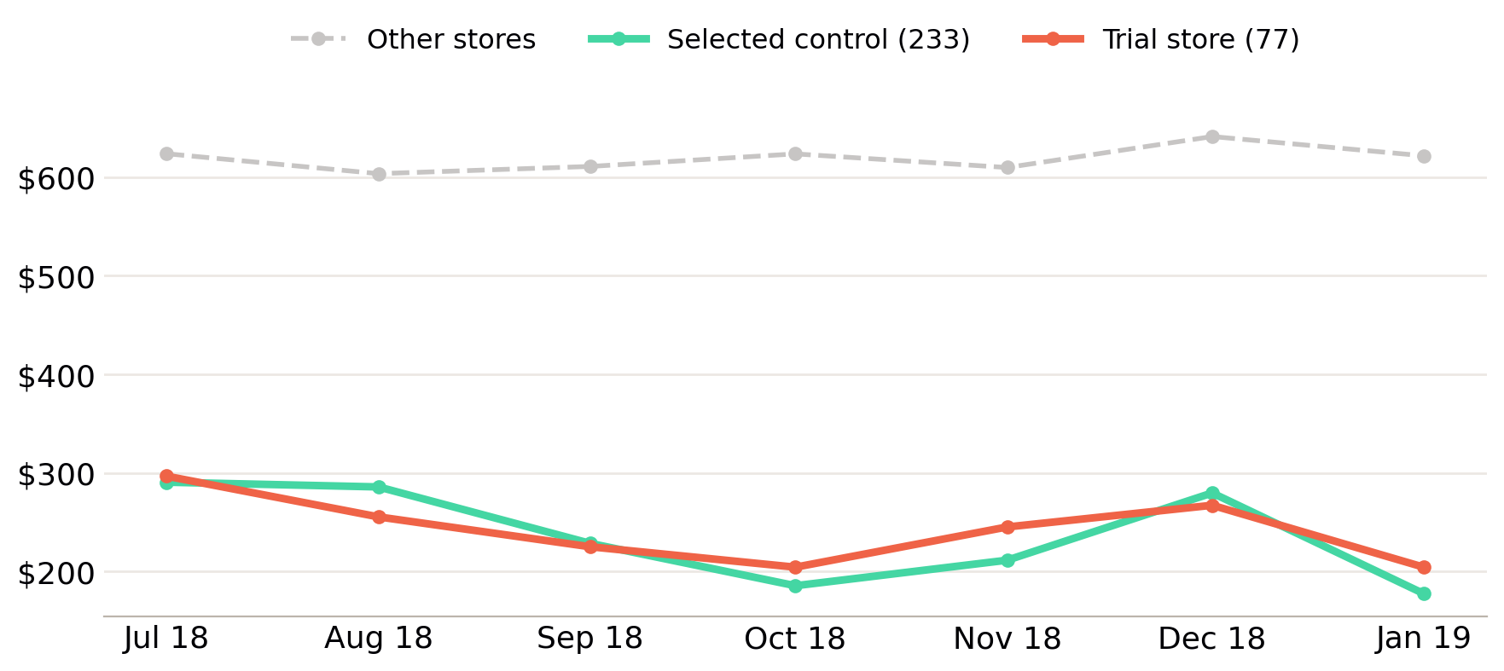
Matching each trial store to a lookalike control
233 · 155 · 237
Control stores selected for trial
stores 77, 86 and 88
For each trial store, we scored every other full-year store on how closely its pre-trial monthly sales and customer counts tracked the trial store (correlation + magnitude similarity). The closest match becomes the control — store 233 for trial store 77, shown here.

Slide 13
2 of 3 trial stores show a significant uplift
Trial store | Control store | Sales | Customers | Verdict
77 | 233 | Significant (Mar, Apr) | Significant (Mar, Apr) | Positive
86 | 155 | Not significant (1 of 3 months) | Significant (all 3 months) | Mixed — investigate
88 | 237 | Significant (Mar, Apr) | Significant (Mar, Apr) | Positive
Stores 77 and 88 show a clean, statistically significant uplift in both sales and customer numbers. Store 86 saw significantly more customers every month, but that didn't reliably convert into more revenue — worth a conversation with the Category Manager before generalising the result.

Slide 14
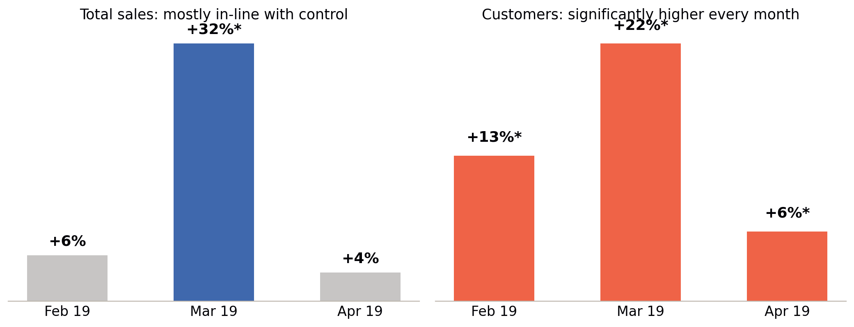
Store 86: more customers, but not more revenue
?
Was a different promotion or price
point running in store 86?
Customer visits rose significantly every single trial month — the layout is clearly pulling more people in. But sales didn't rise by nearly as much, which usually points to a lower average basket value. Before treating this as a weaker result, it's worth checking whether a discount or different offer ran alongside the layout change in this store.

Slide 15
Recommendations & next steps
Target Mainstream Young Singles/Couples
1
Our largest, highest-value customer base — lead category strategy with this segment front of mind.
Prioritise Tyrrells, Doritos, Kettle, Twisties, Tostitos & Pringles
2
Shift range and promotional space toward the brands this segment already over-indexes on.
Roll out the new layout more broadly
3
Stores 77 and 88 show a clean, significant uplift in sales and customers — the core hypothesis is well supported.
Clarify store 86 with the Category Manager before rolling out further
4
Confirm whether pricing/promo differences explain the customer-vs-sales gap, so the rollout plan reflects the true effect.

