Slide 1
Amazon Sales Analysis
Overview of Sales Data and Insights

Slide 2
Introduction
This presentation provides an analysis of Amazon sales data, including sales by region, item type, sales channel, order priority, and trends over time. Key insights and recommendations will be highlighted.

Slide 3
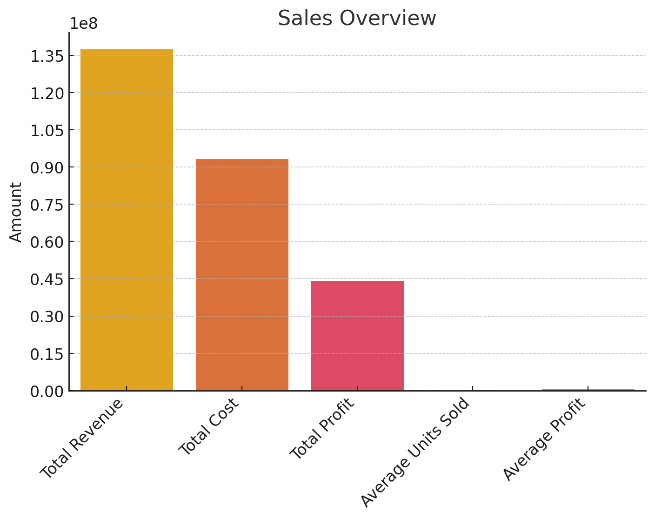
Sales Overview

Slide 4
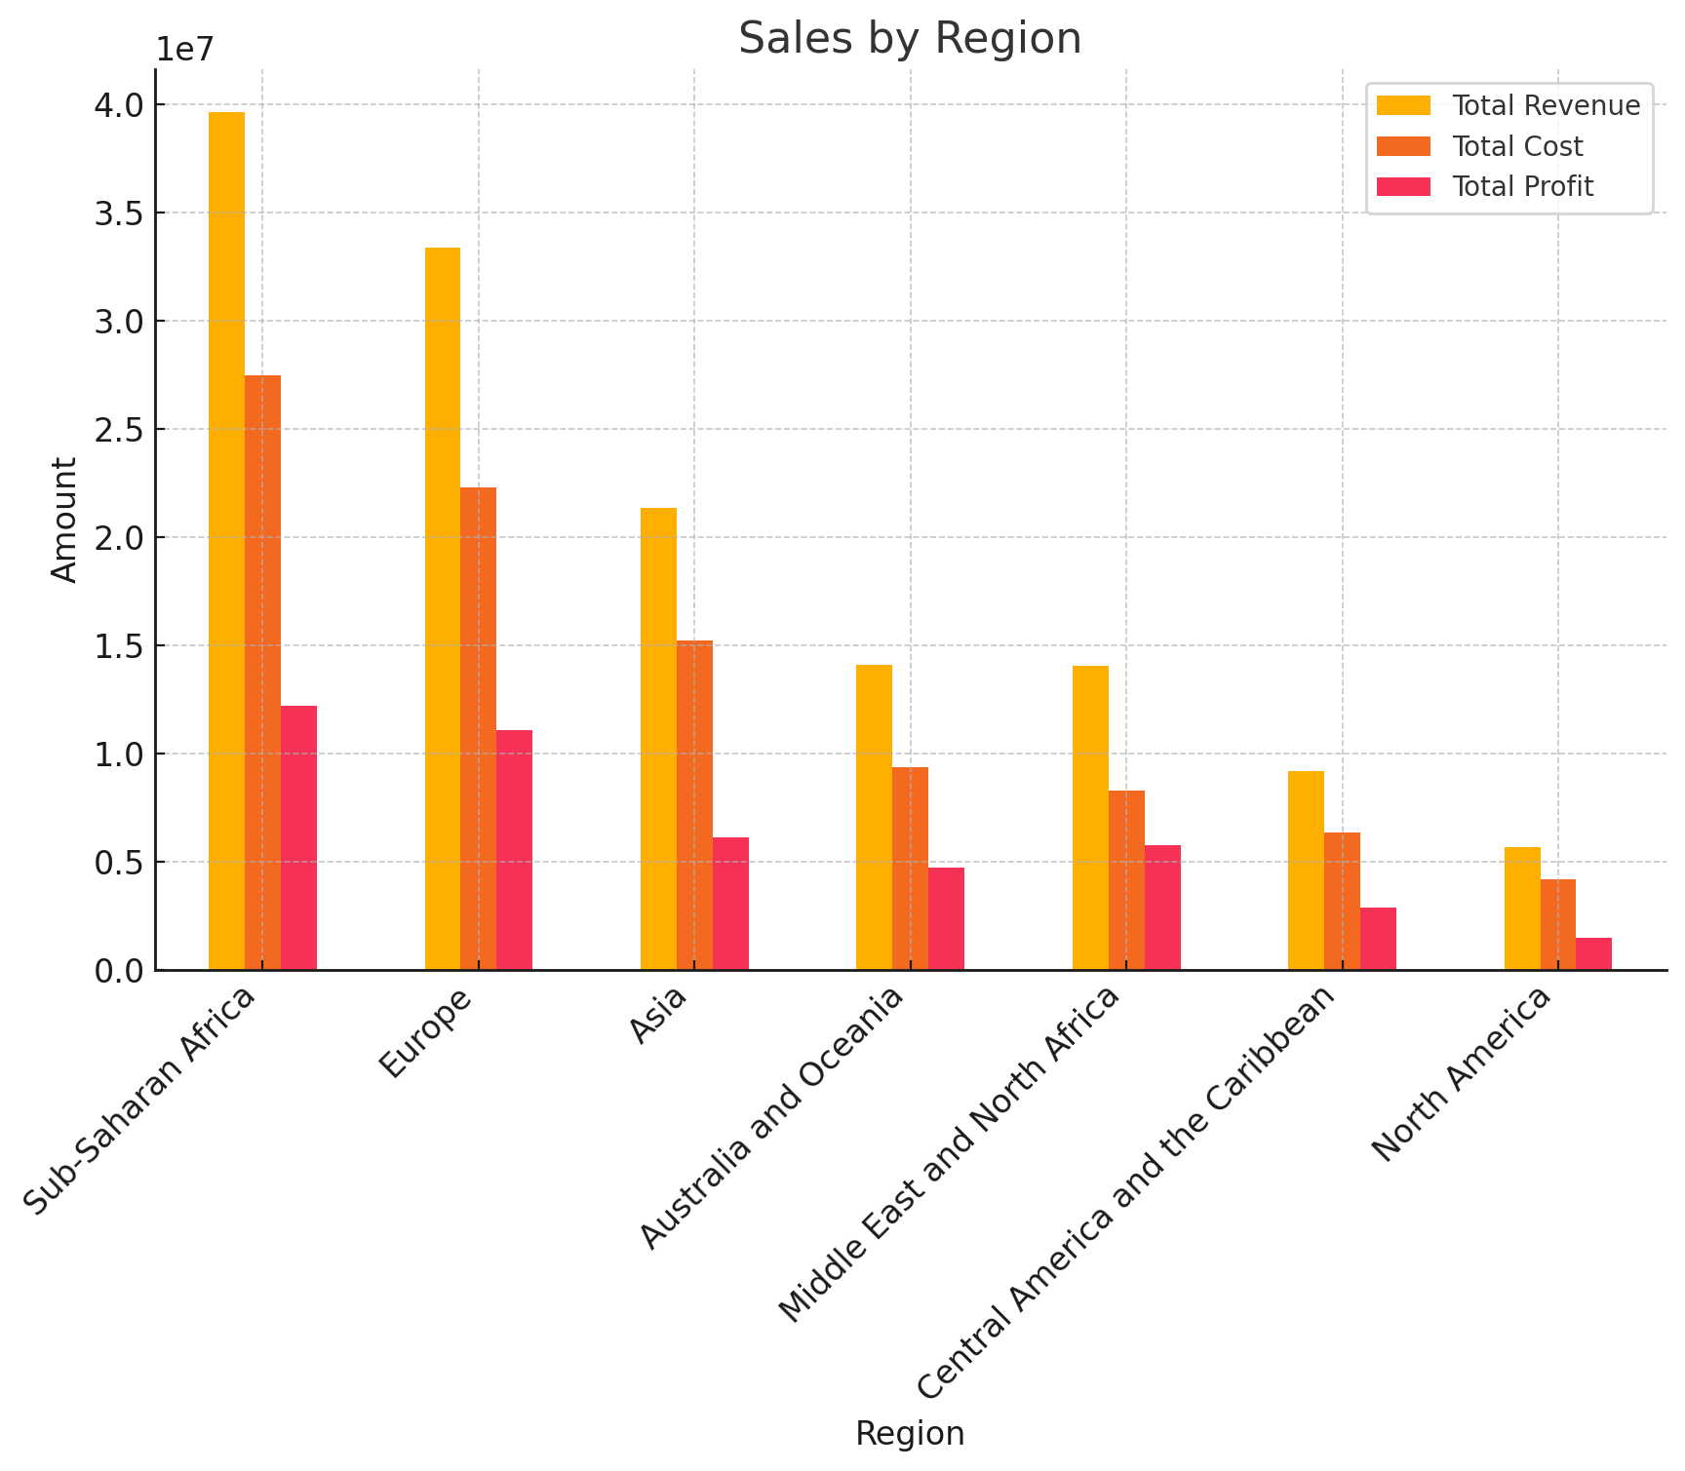
Sales by Region

Slide 5
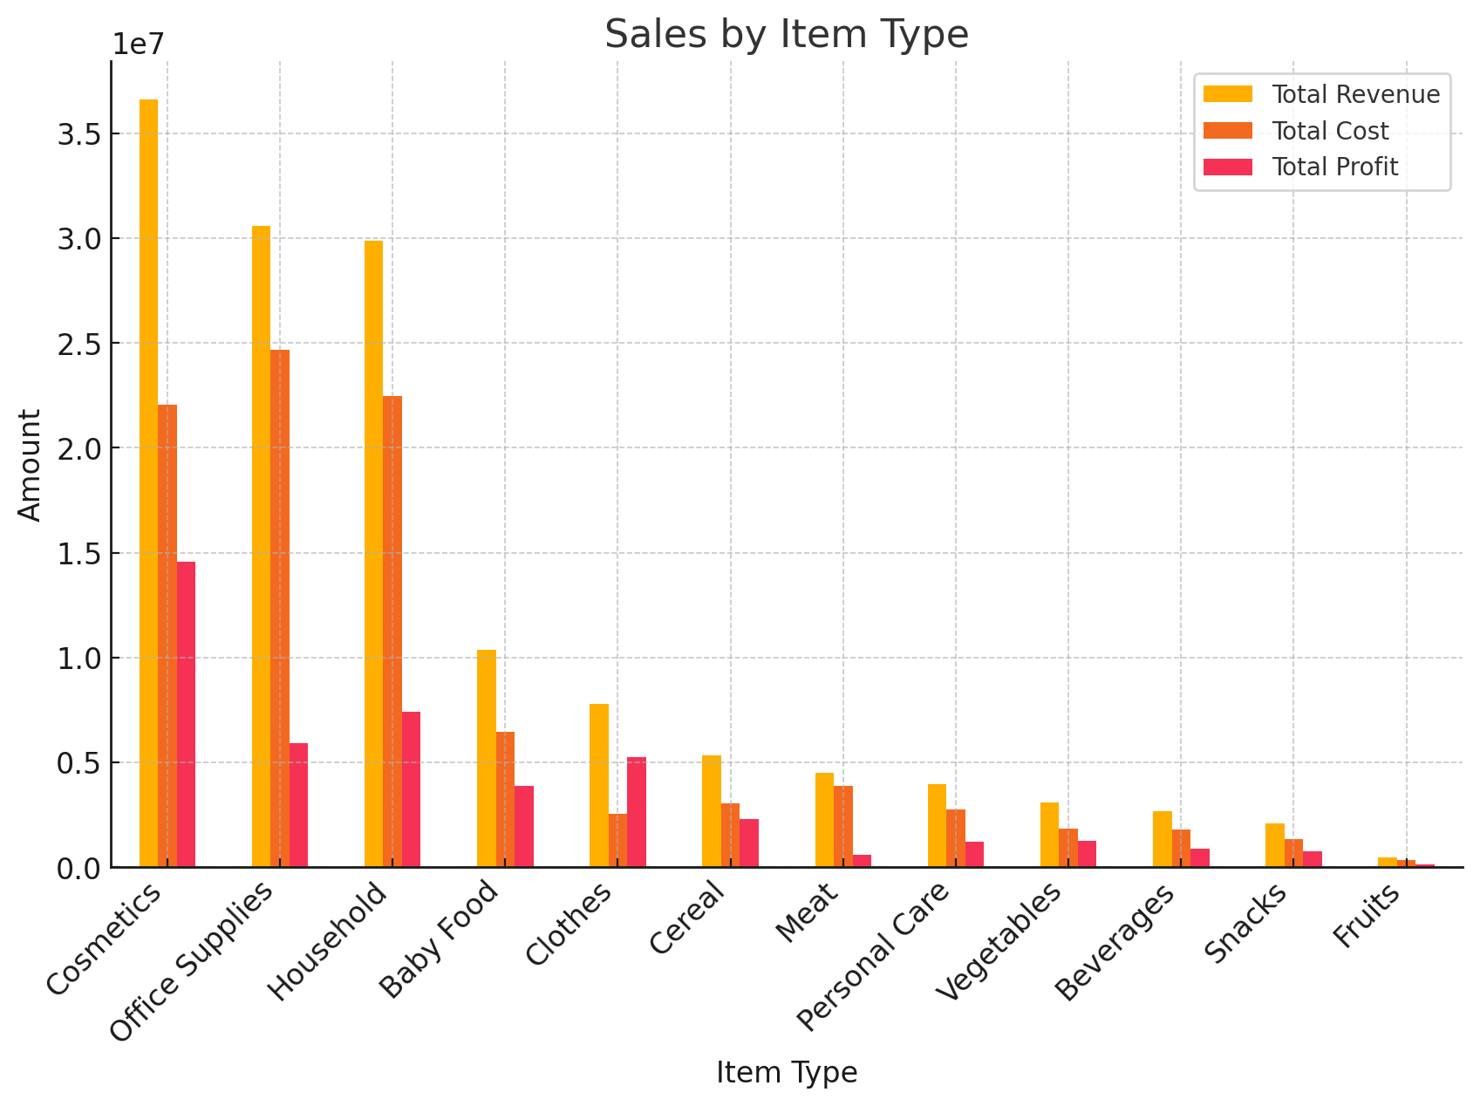
Sales by Item Type

Slide 6
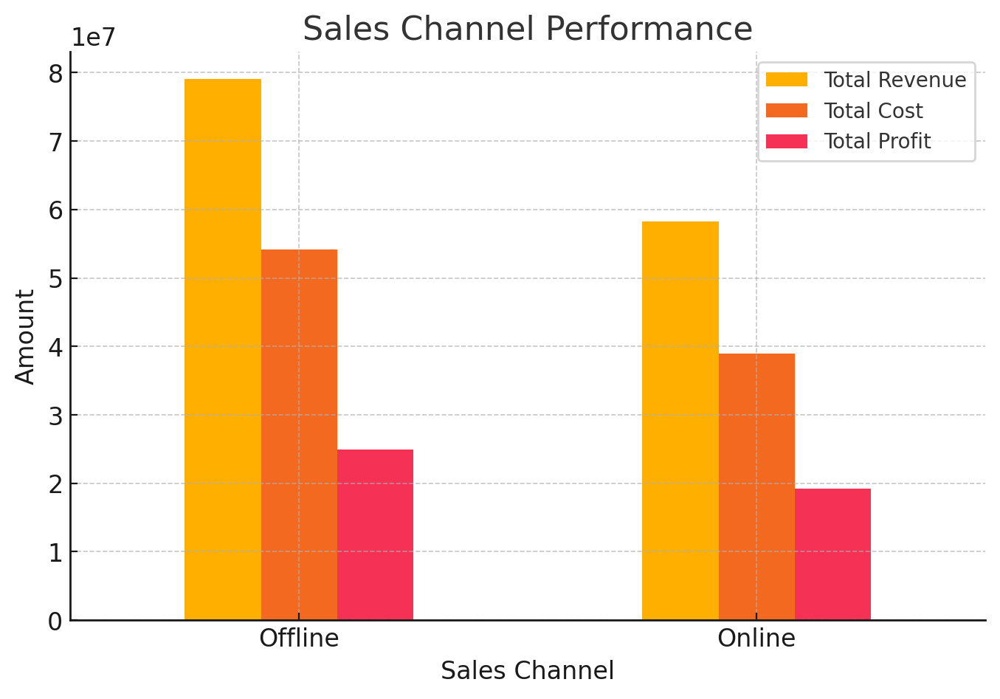
Sales Channel Performance

Slide 7
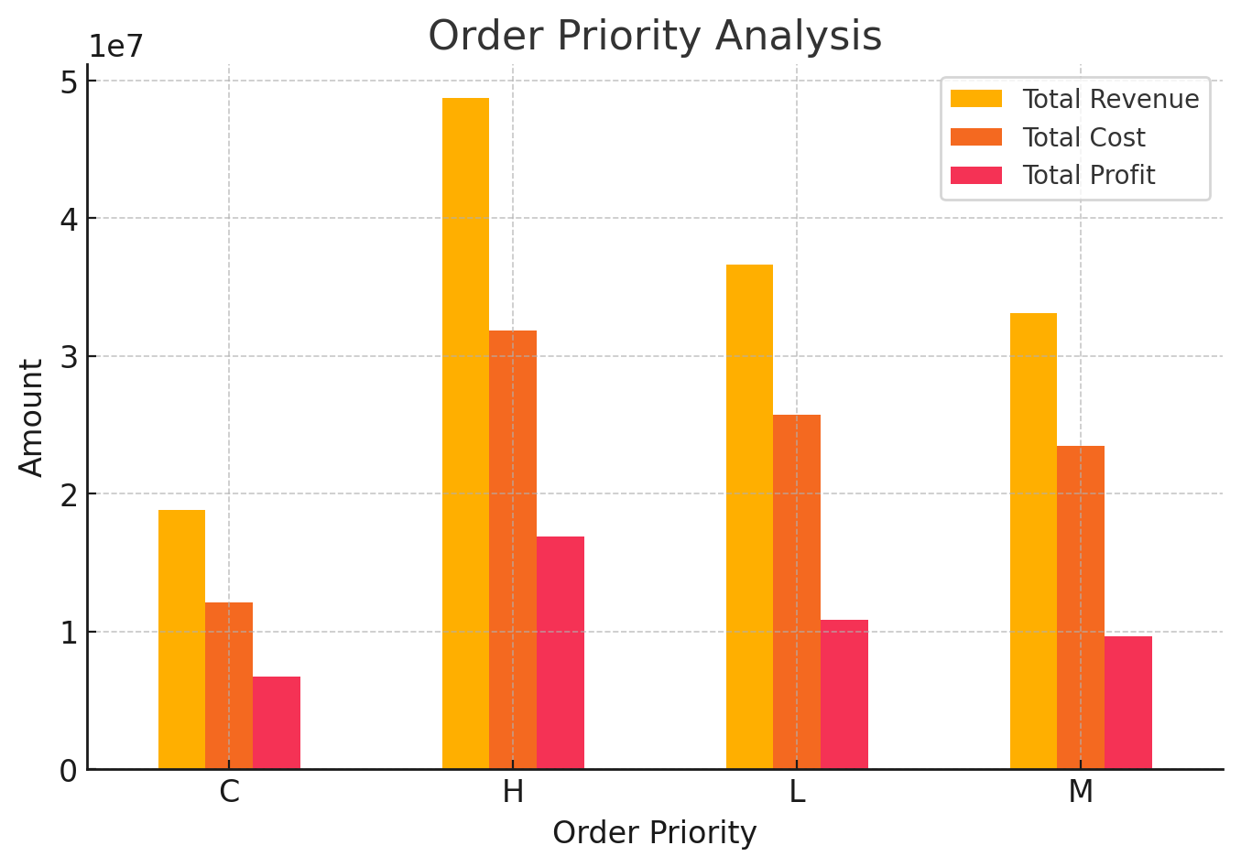
Order Priority Analysis

Slide 8
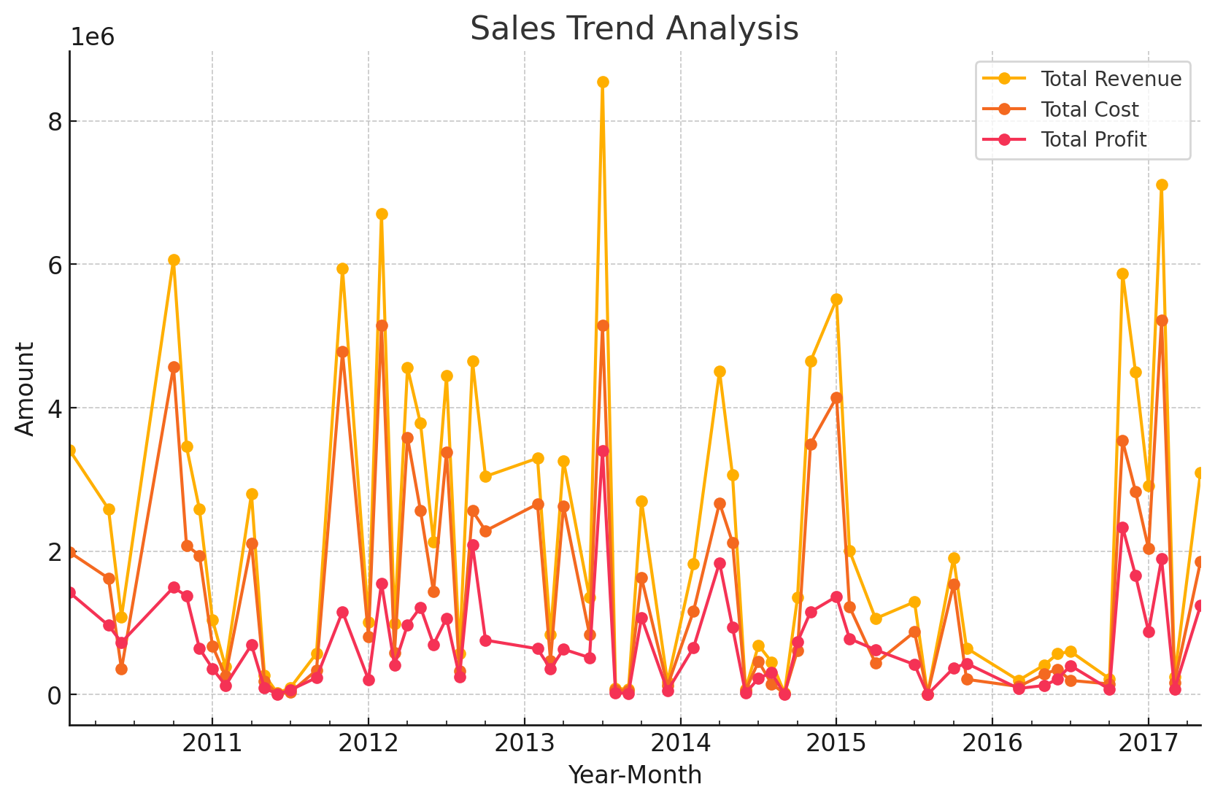
Sales Trend Analysis

Slide 9
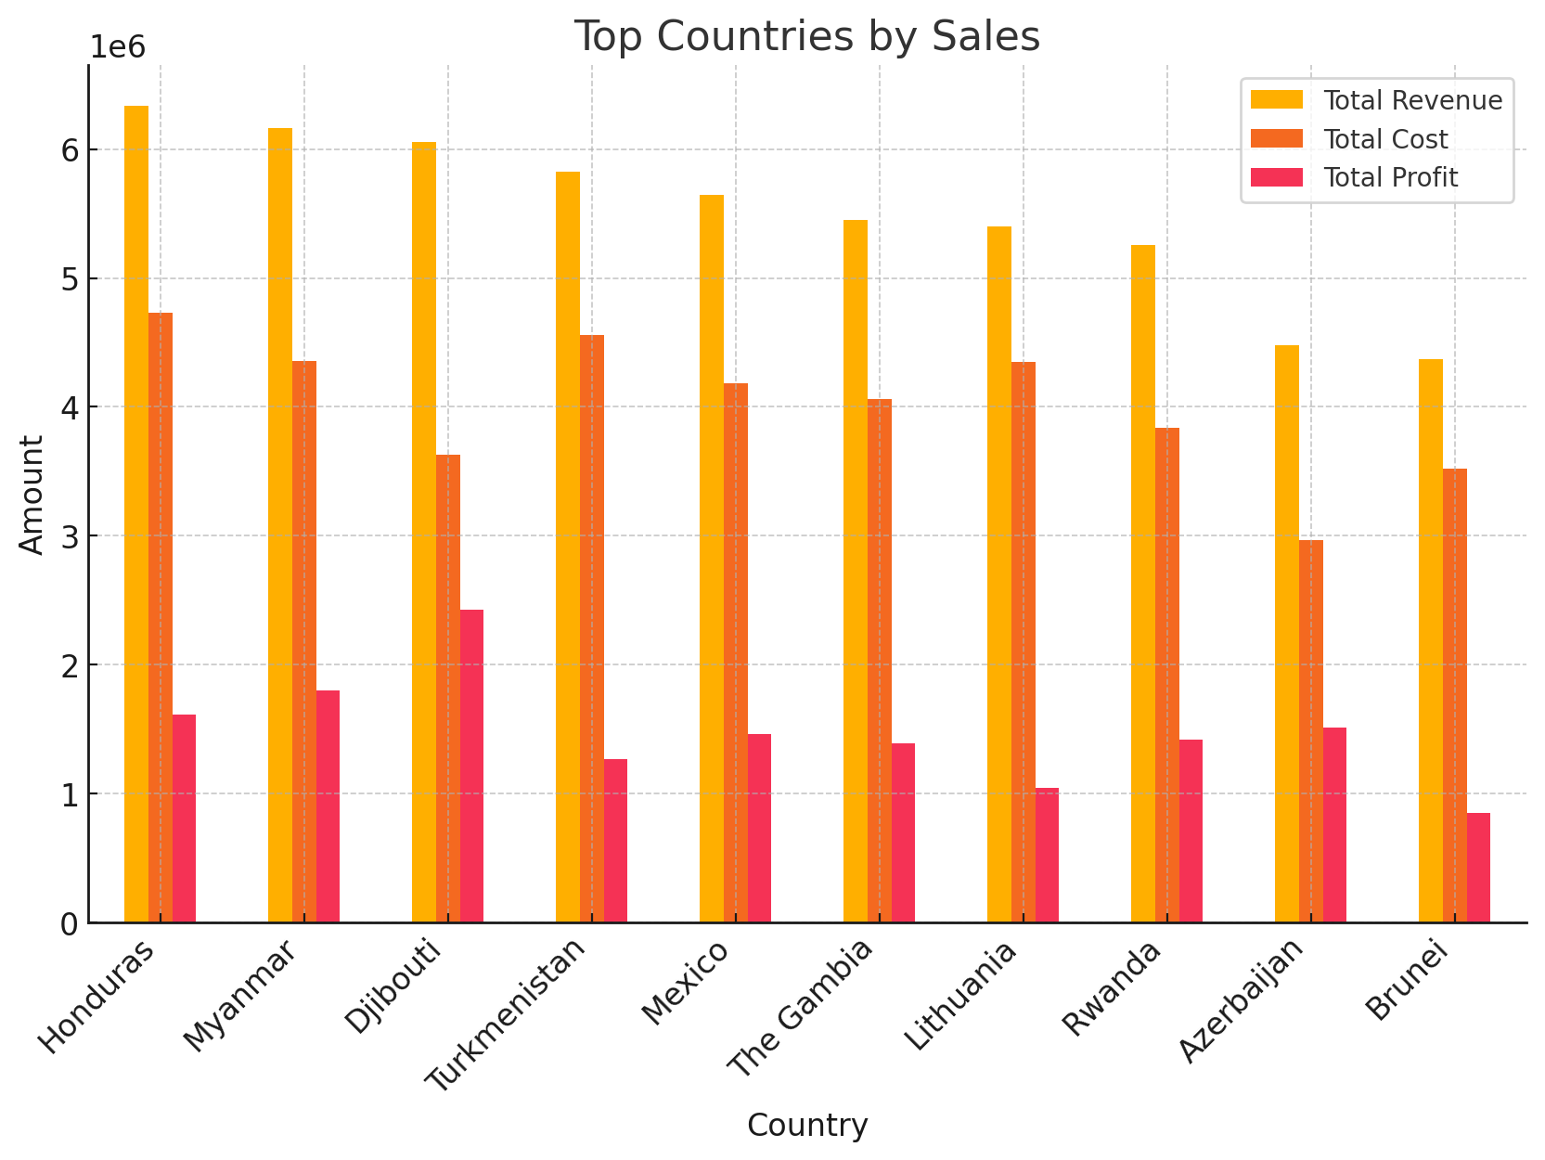
Top Countries by Sales

Slide 10
Conclusion
This analysis provides a comprehensive view of Amazon sales data, highlighting key regions, item types, and trends. The data reveals significant insights into sales channels and order priorities, providing valuable information for strategic decision-making.

