Slide 1
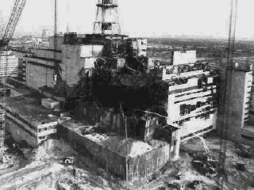
Chernobyl disaster
The worst manmade disaster in human
history
Shivam Kumar 20051252 (F - 10)

Slide 2
Reactor Plant Scenario
As the reaction occurs, the uranium fuel becomes hot
The water pumped through the core in pressure tubes removes the heat from the fuel
The water is then boiled into steam
The steam turns the turbines
The water is then cooled
Then the process repeats

Slide 3
Day of disaster
Prior to the explosion the power was cut to the power station to stimulate a power failure. Emergency generators did power up to continue the flow of cold water to keep the nuclear fuel cool. However, because of the time delay between power failure and the generators kicking and because of a power surge once the generators did kick in overheating occurred leading to a series of explosions. It was reactor 4 that experienced the series of explosions releasing radioactive fuel and radioactive material into the atmosphere and surrounding area.
The radiation levels in the worst hit areas of the reactor building were estimated to be 5.6 roentgens (a unit of measurement for exposure to radiation) per second, which is the equivalent to more than 20,000 roentgens and hour. A lethal dose of radiation is around 500 roentgens over 5 hours, so in some areas workers received lethal doses in minutes.

Slide 4
External fires around the plant were extinguished within 5 hours, but fires within the reactor continued until 10th May 1986. Helicopters were used to drop sand, clay and lead onto the reactor, but also firefighters on the ground were used. The firefighters were not warned about the dangers of radiation and most of them died later because of radiation poisoning.
Despite the massive radiation leak the nearby town of Pripyat was not evacuated for over 24 hours. The town had a population of around 50,000 at the time of the accident. When the evacuation warning eventually came, people were told that it would only be temporary and that they should leave all their belongings behind.
However, a 30km exclusion zone still exists around the town, although some older residents have now chosen to move back.
•
As well as causing a massive radiation leak around the plant, a radioactive cloud was also released into the atmosphere. The USSR authorities did not notify the world straight away of the accident and it was actually another power station in Sweden that first detected the cloud. The cloud contained 400 times more radioactive material than the Hiroshima bomb that hit Japan. All of Europe received fallout from the cloud, although it is estimated that up to 50% fell on Russia, Belarus and the Ukraine.

Slide 5
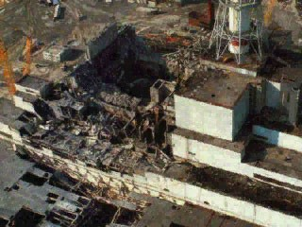
Summary of Facts
April 26, 1986:
Chernobyl nuclear power plant
Operator errors cause a reactor explosion
Explosion releases 190 tons of radioactive gasses into the atmosphere
Fire starts that lasts 10 days
People:
7 million lived in contaminated areas; 3 million were children
Wind:
Carries radiation far distances

Slide 6
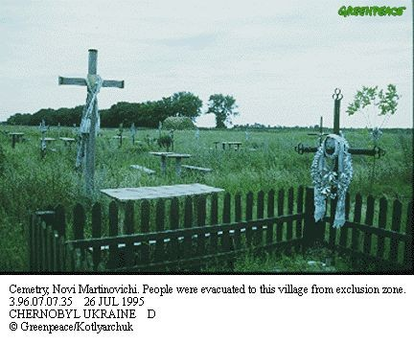
Direct Casualties
5.5 million people still live in contaminated areas
31 people died in 3 months of radiation poisoning
134 emergency workers suffered from acute radiation sickness
25,000 rescue workers died since then of diseases caused by radiation
Cancer afflicts many others
Increased birth defects, miscarriages, and stillbirths

Slide 7
Indirect Casualties
By the year 2000 there were 1800 case of thyroid cancer in children and adolescent
High number of suicide and violent death among Firemen, policemen, and other recovery workers

Slide 8
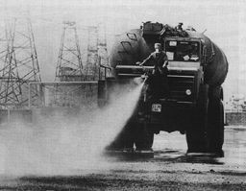
Environment Impact
Areas still impacted today:
Soil
Ground Water
Air
Food
Crops
Livestock

Slide 9
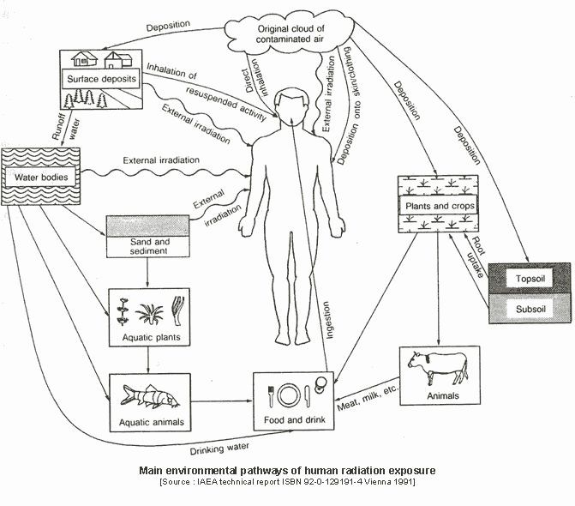

Slide 10
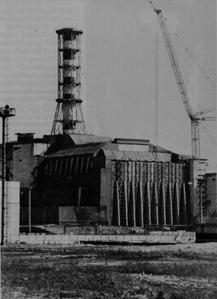
Problems Today
The Sarcophagus
After the disaster, a huge cement box was built around the radioactive material
It is falling apart!
According to a 2003 report by the Russian Atomic Energy Minister, Alexander Rumyantsev, "the concrete shell surrounding the Chernobyl nuclear reactor is in real danger of collapsing at any time."
A new Sarcophagus is scheduled to be completed in 2009

