Slide 1
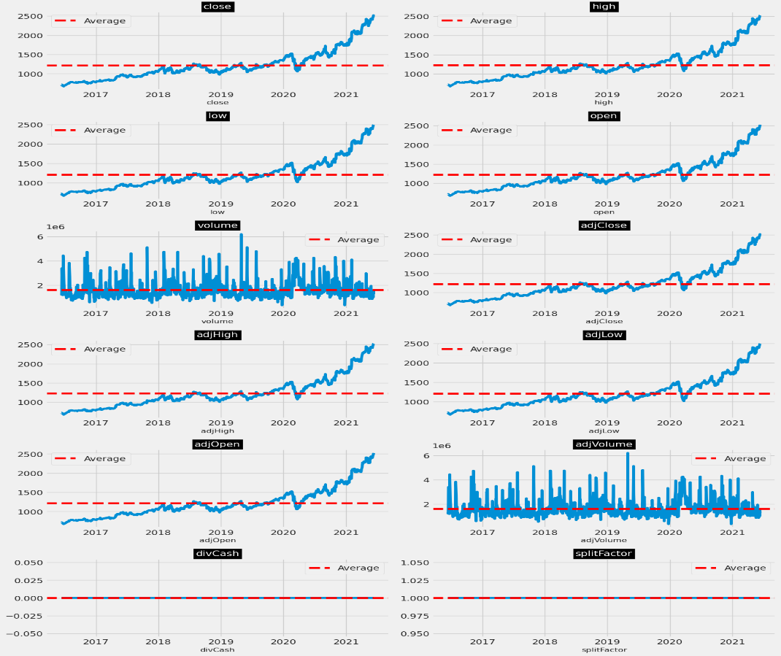
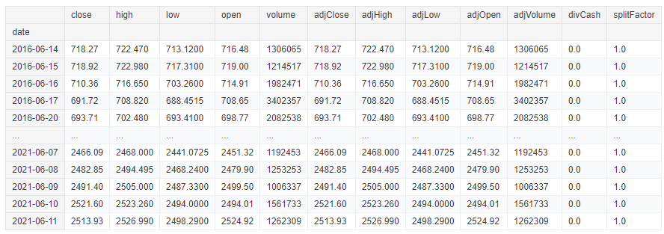
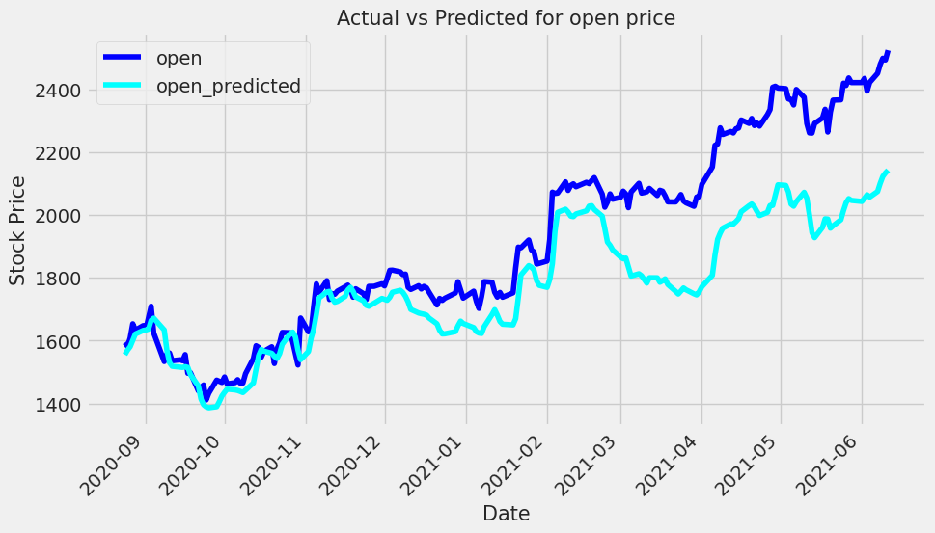
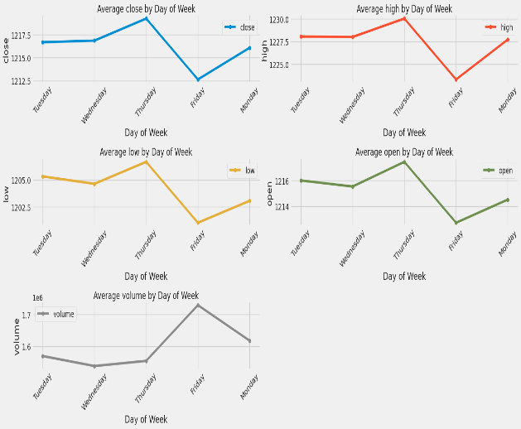
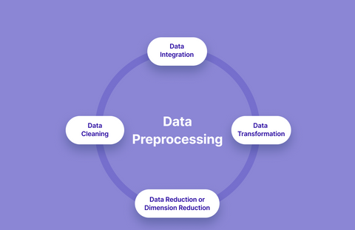
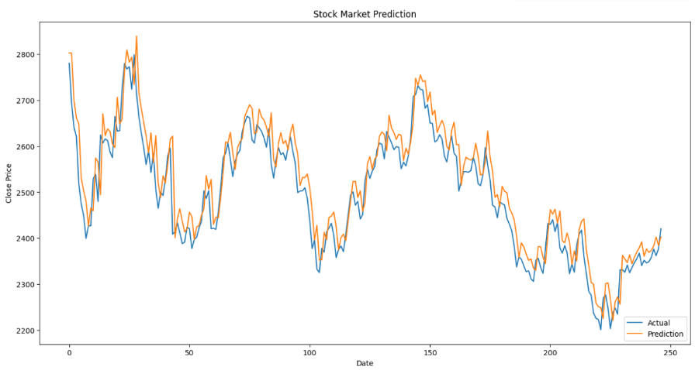
STOCK PRICE PREDICTION
PROBLEM STATEMENT
FEATURE SELECTION
PREDICTION MODEL
DATA VISULIZATION
Predicting stock prices is crucial for investors and businesses. Accurate models can aid in making informed decisions about buying and selling stocks. We use Long Short-Term Memory (LSTM), ARIMA
(AutoRegressive Integrated Moving Average), and Moving Average models to forecast stock prices and compare their effectiveness.
HISTORICAL PRICE PREDICTION TRADING VOLUME MOVING AVERAGE
LSTM: A type of recurrent neural network well-suited for time series forecasting.
ARIMA: A statistical model used to analyze and forecast time series data.
Moving Average: A simple technique that smoothens stock prices by averaging over a set number of previous data points.
MODEL REPORT
DATA SOURCE
Collected data: Yahoo Finance, Alpha Vantage, or Quandl. Kaggle and structured sources.
MODEL EVALUATION
DATA PREPROCESSING
The models implemented in this study—LSTM, ARIMA, and Moving Average— demonstrate their capability to predict stock prices based on historical data.
TensorFlow Documentation on LSTM
KAGGLE.COM
Time Series Analysis: Forecasting and Control. (ARIMA)
SHIVAM PAWAR
1032233919
ABHISHK NAUGAN
1032230866
ADITYA SRIVASTAVA 1032222268
VARIABLES
CONCLUSION
REFERENCES
GROUP MEMBERS
Day of the Week:
(Monday, Tuesday, etc.)
Stock Movement Direction(Up/Down)
Event-Based Variables (Earnings report day)
CATEGORI CAL
VARIABLES
RSI
MACD
CP&OP
CONTI NOUS
VARIABLES

