Slide 1
Program: B.Tech, Semester-8, Fourth Year Subject Code: CSD0804 (MAJOR PROJECT)
PROJECT :ABODE
Submitted By: SHIVAM JAIN(BETN1CS19057)
ABHISHEK BAJPAI (BETN1CS19004)
ABHISHEK SINGH RAJPOOT (BETN1CS19005)
Project Guide-: Harshita Chaurasia Mam

Slide 2
Outlines
Brief Intro
Problem St.
INTRODUCTION
FEATURES
ADVANTAGES
GOALS OF PROPOSED SYSTEM
TECH USED

Slide 3
Brief Intro
ABODE
As the word abode means providing accommodation meeting client needs in any place at any time at the best price.
If you plan on taking advantage of one of our great flight deals, you will definitely need accommodations.
Abode is accommodations of the “sharing economy”, allows you to find places to stay directly from individuals in thousands of cities around the world.
The host will often be happy to welcome you, to tell you about the best things to do in his city, etc. It allows you to get to know the place you visit even more authentically and to meet someone who really lives there.

Slide 4
Problem Statement
The problem statement of Abode is to provide a platform where people can rent out their properties or spare rooms to travelers who are looking for accommodations. The company aims to create a safe and trusted community where hosts and guests can connect and have positive experiences. Some of the challenges that Abode faces include ensuring the safety and security of both hosts and guests, managing the quality of listings, and dealing with regulatory issues in different cities and countries. Overall, Abode goal is to make travel more affordable, authentic, and accessible for everyone.

Slide 5
INTRODUCTION
The hotel industry did not consider Abode a threat. Both the industry and Abode claimed they were serving different markets and had different underlying business models. Over the years, as Abode become more successful and grown to being larger than the companies in the hotel industry, the rhetoric has changed. The hotel industry began to realize they had something to worry about.
A stage of denial was followed by the American Hotel & Lodging Association (AH&LA) attacking Airbnb by sponsoring research to demonstrate its negative impacts on the economy and lobbying governments to impose taxes and regulations on home sharing. The association is arguing for a level playing field between home sharing and hotels (and rightly so). The next stage of this battle involves competition and integration. Not only are hotels looking to add home sharing-like attributes and experiences to their properties, to more effectively compete with Abode

Slide 6

FEATURES
Vendor login
Admin is the one who administers the system and input updates.

Slide 7
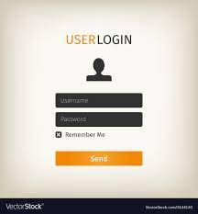
User login:
In order to rent a accommodation amenities which have been listed by vendor will be available to user .

Slide 8
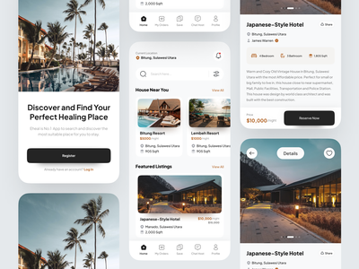
Explore Your Stay
The system contains data set from all locations to rent out ,with flexibility of sharing .

Slide 9
ADVANTAGES
Low(er) cost. The first (and most obvious) benefit of staying in an Abode is that it's usually cheaper than a hotel.
Live like a local. Another great benefit of Abode is that it's a more personal experience than a hotel. ...
Flexibility.
Book at-home services.

Slide 10
GOALS OF PROPOSED SYSTEM
1) Planned approach towards working
: - The working of the system will be well planned and organized. The data will be stored properly in data stores, which will help in retrieval of information as well as its storage.
2) Accuracy
: - The level of accuracy in the proposed system will be higher. All operation would be done correctly and it ensures that whatever information is coming from the system is accurate.
3) Reliability
: - The reliability of the proposed system will be high due to the above stated reasons. The reason for the increased reliability of the system is that now there would be proper storage of information.

Slide 11
4) No redundancy
: - In the proposed system utmost care would be that no information is repeated anywhere, in storage or otherwise. This would assure economic use of storage space and consistency in the data stored.
5) Immediate Retrieval of Information
: - The main objective of proposed system is to provide for a quick and efficient retrieval of information. Any type of information would be available whenever the user requires.
6) Immediate storage of information
: - In manual system there are many problems to store & update the large amount of information.

Slide 12
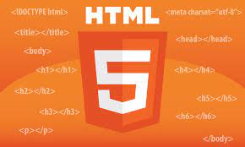
Technologies Used
This project will be an Internet application to be developed in following tools and technologies.
a) HTML AND CSS
HTML is the standard markup language for Web pages.
With HTML you can create your own Website.
With CSS, you can control the color, font, the size of text, the spacing between elements, how elements are positioned and laid out, what background images or background colors are to be used, different displays for different devices and screen sizes, and much more!

Slide 13

Javascript
JavaScript is a lightweight, interpreted programming language. It is designed for creating network-centric applications. JavaScript is very easy to implement because it is integrated with HTML. It is open and cross-platform.

Slide 14

React
What is ReactJS used for?
The React. js framework is an open-source JavaScript framework and library developed by Facebook. It's used for building interactive user interfaces and web applications quickly and efficiently with significantly less code than you would with vanilla JavaScript.

Slide 15
Node Js
Node.js is an open-source, cross-platform JavaScript runtime environment and library for running web applications outside the client's browser. Ryan Dahl developed it in 2009, and its latest iteration, version 15.14, was released in April 2021. Developers use Node.js to create server-side web applications, and it is perfect for data-intensive applications since it uses an asynchronous, event-driven model.
As NodeJs do not need to wait for an API to return data , so for building real time and data intensive web applications, it is very useful. It is totally asynchronous in nature that means it is totally non-blocking.

Slide 16
MySQL
MySQL tutorial provides basic and advanced concepts of MySQL. Our MySQL tutorial is designed for beginners and professionals.
MySQL is a relational database management system based on the Structured Query Language, which is the popular language for accessing and managing the records in the database. MySQL is open-source and free software under the GNU license. It is supported by Oracle Company.
MySQL is a Relational Database Management System (RDBMS) software that provides many things, which are as follows:
It allows us to implement database operations on tables, rows, columns, and indexes.
It defines the database relationship in the form of tables (collection of rows and columns), also known as relations.
It provides the Referential Integrity between rows or columns of various tables.
It allows us to updates the table indexes automatically.
It uses many SQL queries and combines useful information from multiple tables for the end-users.

Slide 17
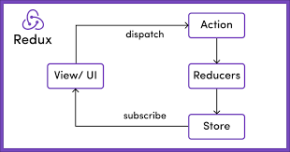

REDUX/FLUX
Redux is a predictable state container for JavaScript apps. As the application grows, it becomes difficult to keep it organized and maintain data flow. Redux solves this problem by managing application’s state with a single global object called Store. Redux fundamental principles help in maintaining consistency throughout your application, which makes debugging and testing easier.

Slide 18
FAQS
1. HOW OUR PROJECT STAND APART?
- our software is very user friendly and follows a trend in accommodation industry.
2. How it will be beneficial for us?
- it is us many rooms for frontend and backend operations which will enhance our skills.
3. Estimated time to complete this project.
-: 30+ hrs on weekly for 3 month.
4. What tools it requires?
- namely vs code ,postman ,React Js, CSS, JavaScript, REDUX.

Slide 19


