Slide 1
Local Obstacle Avoidance Trajectory Generation using Dijkstra Algorithm
Project for MEEN 689: Decision Making for Autonomous Vehicles
by Shivam Vashi (334003552)

Slide 2
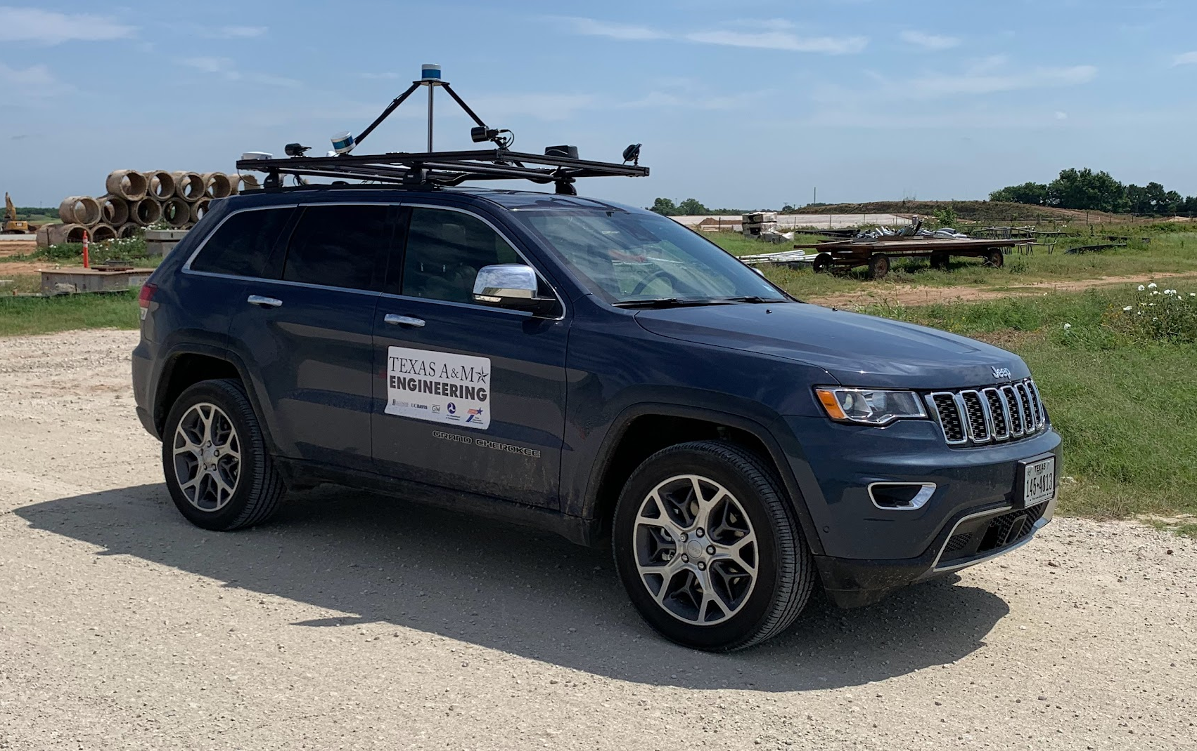
Problem
How do we generate a trajectory that avoids obstacles along a given global trajectory (Lane Centerline) ?

Slide 3
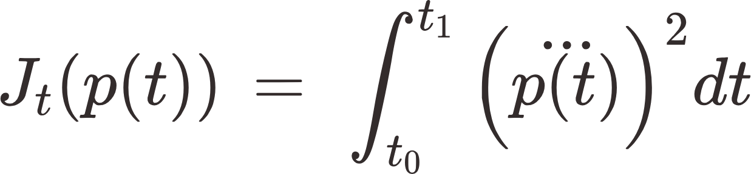
Literature
Optimal Trajectory Generation for Dynamic Street Scenarios in a Frenet Frame [1]
The paper provides an algorithm to generate jerk-minimizing local trajectories that avoid obstacles while obeying lane-width constraints.
Formulation- The requirement is to minimize a cost which is a function of Jerk (J_{t}), time to reach the global path (T) and the end state (p₁) given by-
Where, Jerk term-
and all the coefficients (k) are weightages for corresponding terms.

Slide 4
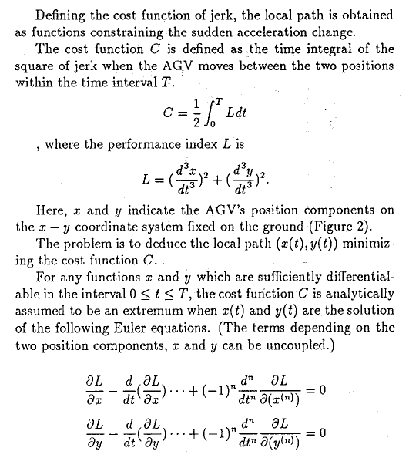
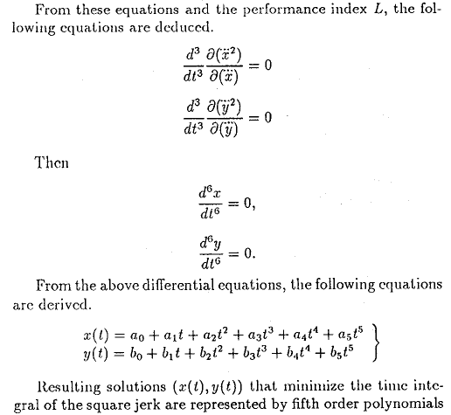
How to Minimize the Jerk term (J_{t})?
One of the citations [2] prove that quintic (5th degree) polynomials minimize the jerk term (J_{t})

Slide 5
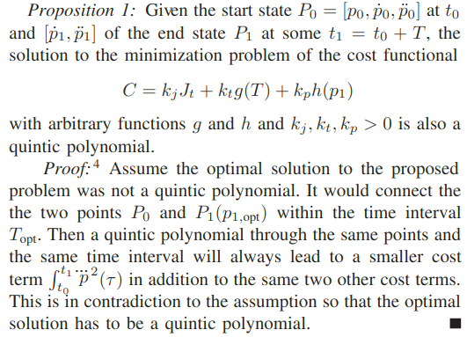
Optimal Solution of the Cost Function
The paper then proves that quintic (5th degree) polynomials also minimize the Cost function defined earlier.

Slide 6
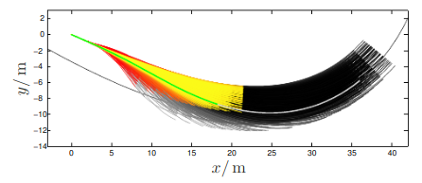
Literature (Contd.)
To find the optimal solution, a set of quintic polynomials with varying values of T and p₁ is generated and then the trajectories that violate vehicle constraints (maximum velocity, acceleration, and curvature) and obstacle collisions are filtered out. Out of the remaining trajectories, the one that minimizes the cost (C) is chosen (shown in green)
Colormap of the cost C for the set of local trajectories. Green is lowest and Red is highest
Note that the end of each local trajectory has a lateral velocity of zero. This can be changed but the computation time would drastically increase because of an additional variable.

Slide 7
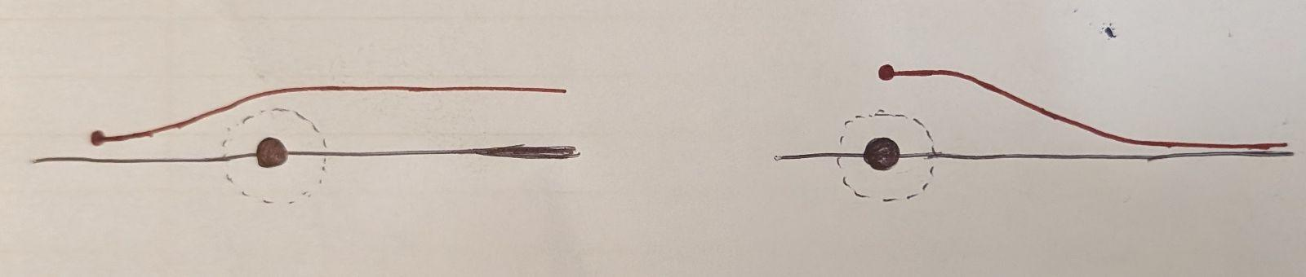
Shortcomings
Since the end of each local trajectory in the set has a lateral velocity of zero, the local trajectories generated before avoiding an obstacle will never converge to the global trajectory until the replanning occurs after passing the obstacle. This implies that we must replan as frequently as possible to ensure optimality.
Since the algorithm generates all possible local trajectories from the current position, the computation time would explode if a local trajectory until the end of the global trajectory is to be designed.
Local Path
Vehicle
Global Path Segment
Obstacle

Slide 8
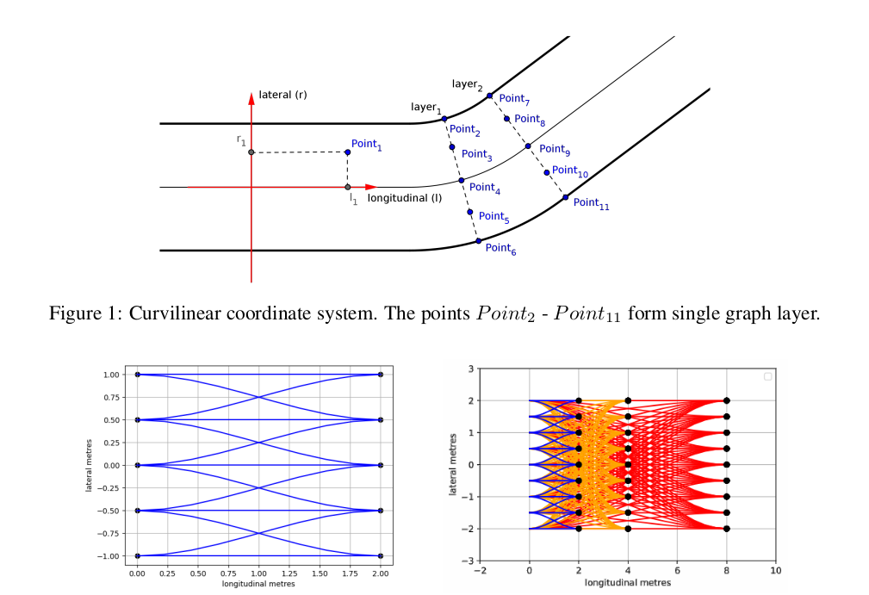
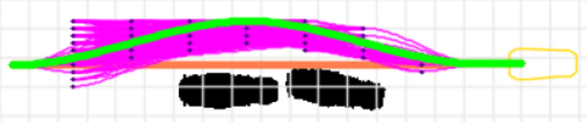
Alternative
Local Path Planning Algorithm for Autonomous Vehicle Based on Multi-objective Trajectory Optimization in State Lattice [3]
The paper provides a Graph Based Method to creating a State Lattice where every edge is a Cubic Polynomial. It suggests using Dijkstra Shortest Path Algorithm on the Graph to find the optimal local path for obstacle avoidance.
Cost Function for the edges

Slide 9
Shortcomings
Viable Solution
No optimality between the node layers (edges) as there is no particular reason for the use of cubic polynomials.
Use the Quintic Polynomial Local Path Generation scheme from [1] to create the edges of the graph and obtain the optimal path using the Dijkstra’s method as described in [3].

Slide 10
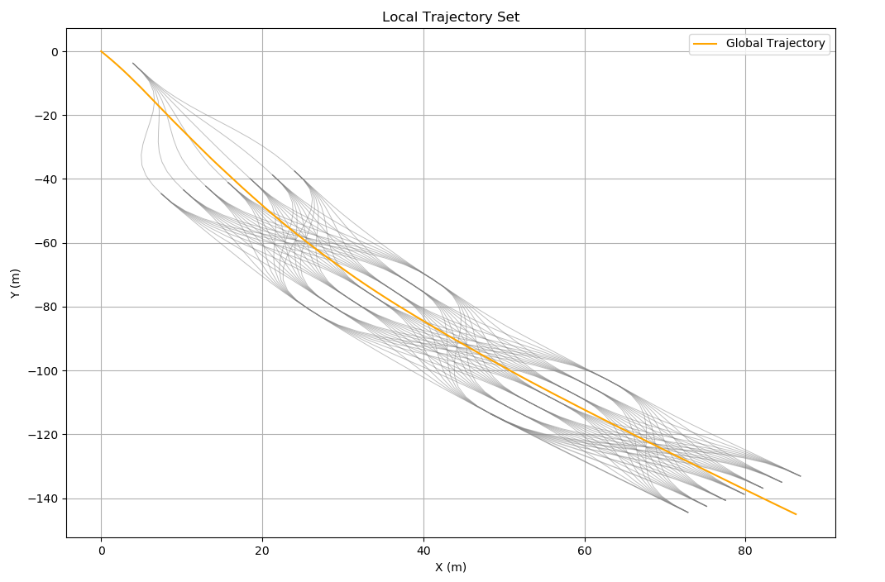
Algorithm
From the initial vehicle state, for a given planning time (T), maximum road width, and increment of the road width, a set of quintic polynomial local trajectories are generated as described in [1]. The end points of each local trajectory become the start state for the next iteration. We can thus generate a desired number of ‘node layers’ as shown-
Initial Position
Layer 1
Layer 2
Layer 3
Layer 4

Slide 11
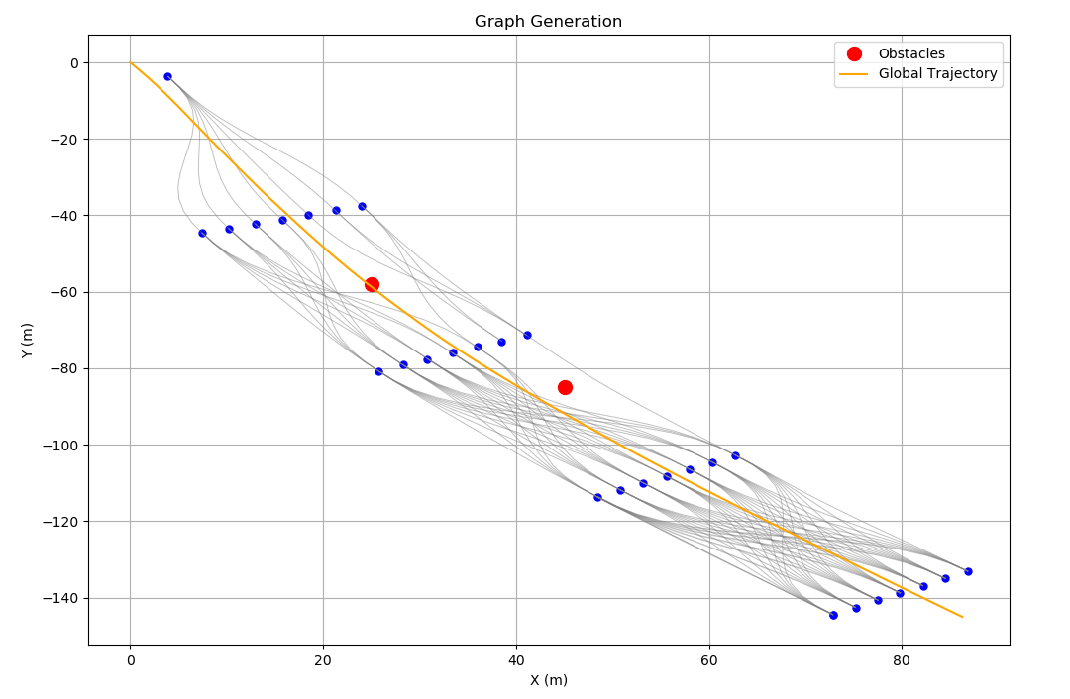
Algorithm (Contd.)
The paths that violate the vehicle constraints and obstacle collisions are removed from the set. From the remaining trajectories, each local trajectory is added as an edge with its end points as nodes in a Graph (G). Recall that the weight/cost of the edge is defined as the cost (C) given in [1]-

Slide 12
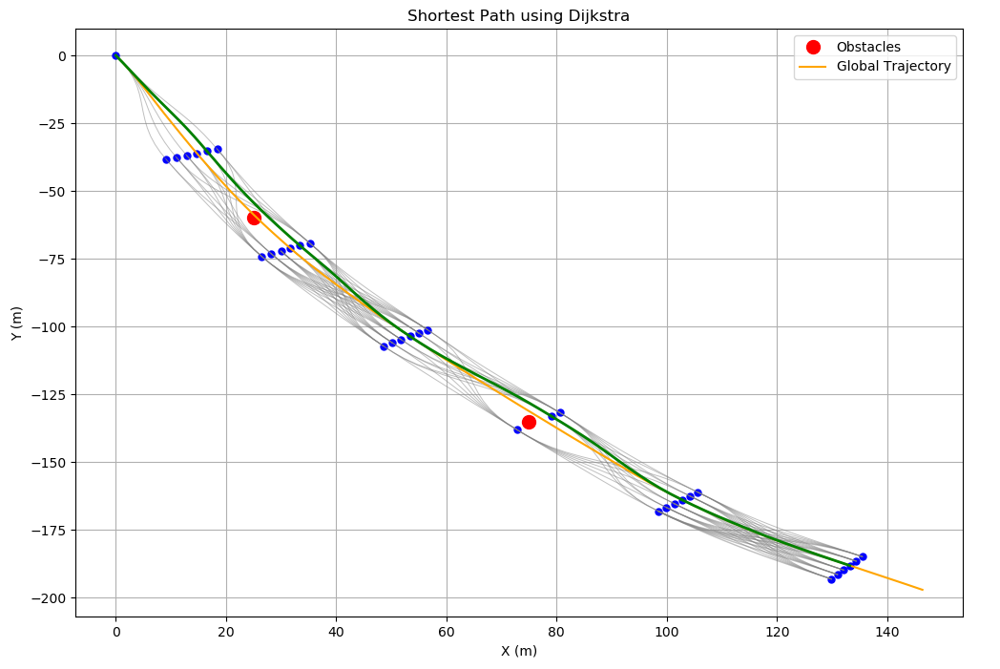
Algorithm (Contd.)
Finally, the Shortest Path is obtained using Dijkstra’s method.

Slide 13
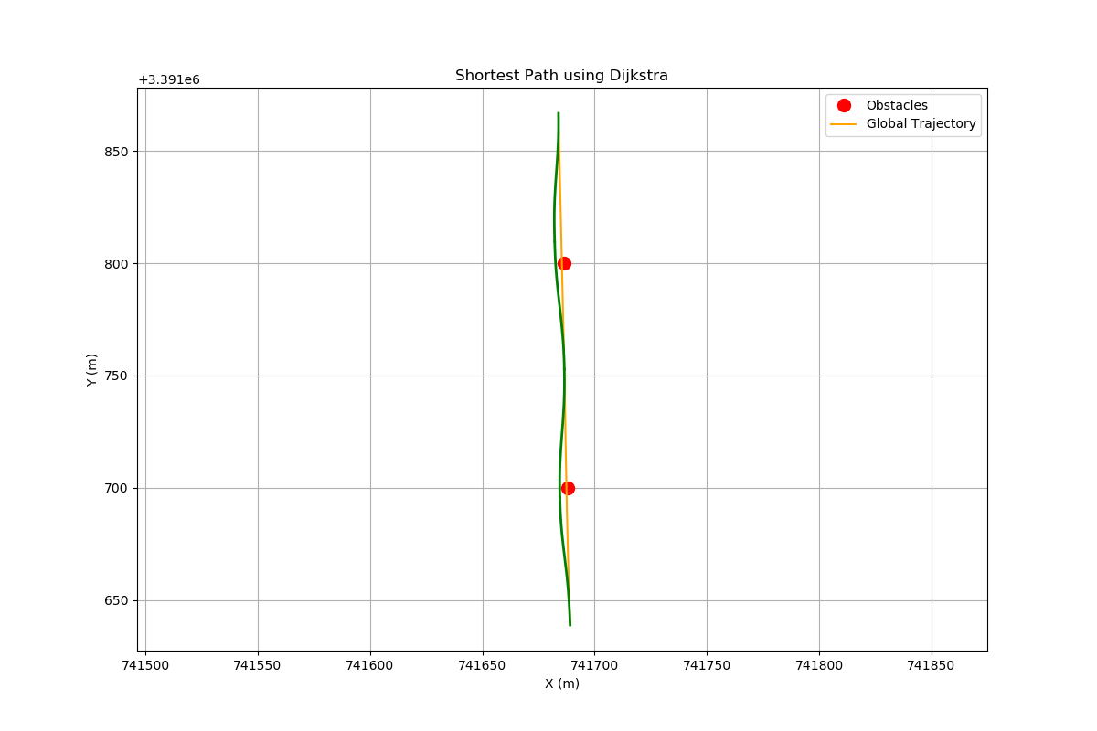
Results (Deployment on a Self-Driving SUV)

Slide 14
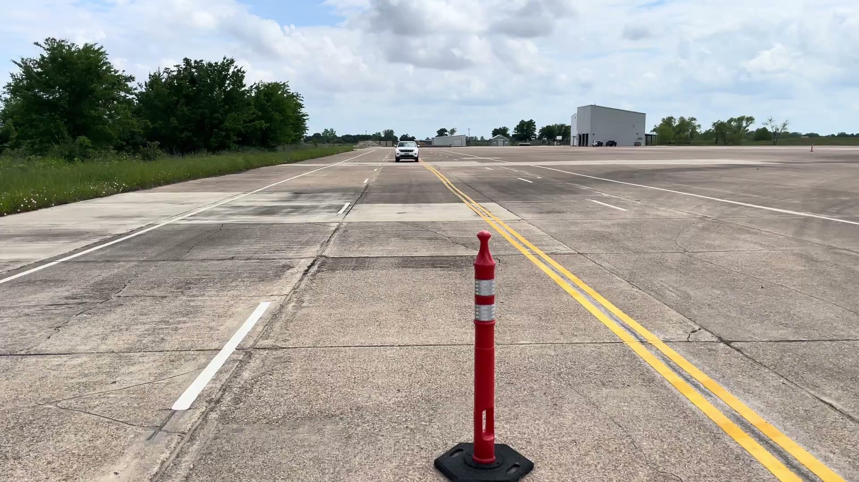
Results (Deployment on a Self-Driving SUV)

Slide 15
Conclusion
Questions?
The graph search method from [3] is upgraded by incorporating the path generation technique outlined in [1]. This enhancement introduces jerk-minimizing edges in the graph, contrasting with the previous method's reliance on cubic polynomials without considering any optimality features.

Slide 16
References
[1] M. Werling, J. Ziegler, S. Kammel and S. Thrun, "Optimal trajectory generation for dynamic street scenarios in a Frenét Frame," 2010 IEEE International Conference on Robotics and Automation, Anchorage, AK, USA, 2010, pp. 987-993, doi: 10.1109/ROBOT.2010.5509799.
[2] A.Takahashi, T.Hongo, Y.Ninomiya, and G.Sugimoto. Local path planning and motion control for AGV in positioning. In IEEE/RSJ International Workshop on Intelligent Robots and Systems ’89. The Autonomous Mobile Robots and Its Applications. IROS’89.
Proceedings., pages 392–397,1989.
[3] Kornev, Ivan & Kibalov, Vladislav & Shipitko, Oleg. (2020). Local Path Planning Algorithm for Autonomous Vehicle Based on Multi-objective Trajectory Optimization in State Lattice.

Slide 17
Thank You!

