Slide 1
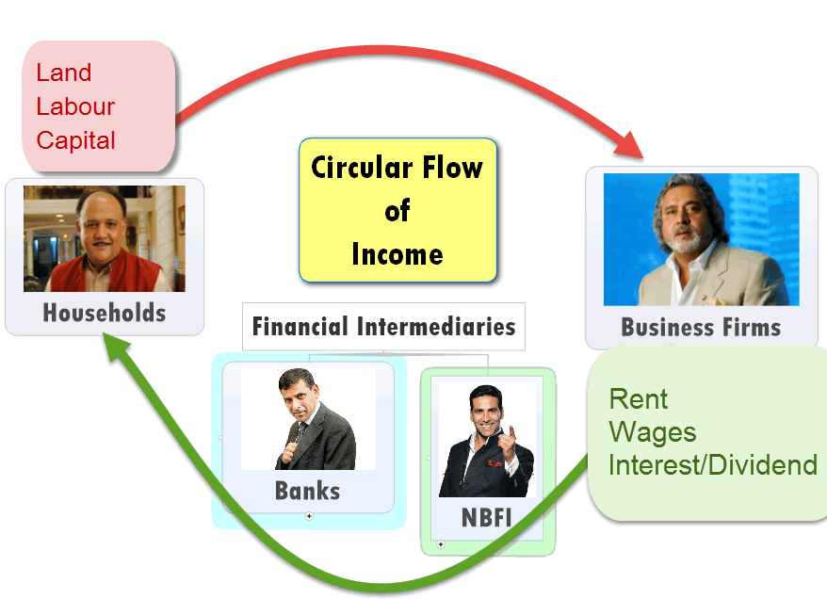
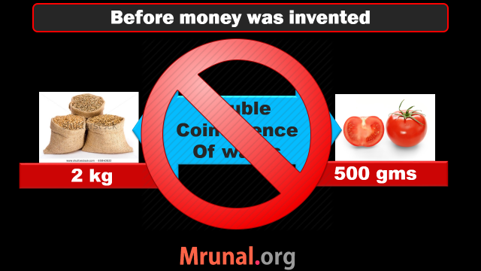
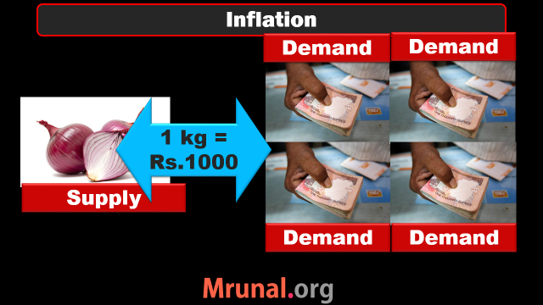

Slide 2
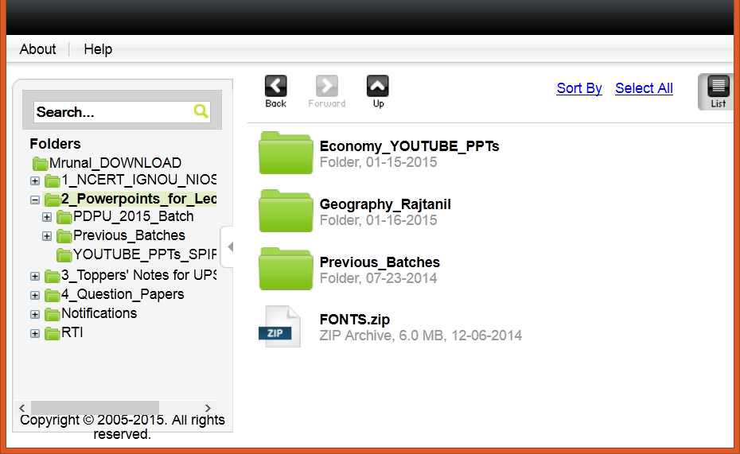

Slide 3
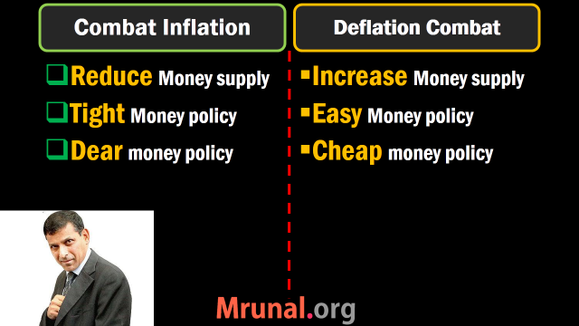

Slide 4
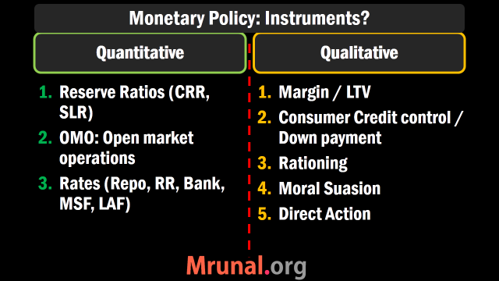

Slide 5

All clients can borrow short term loans from RBI @this interest rate. can’t use SLR securities though!
Have to set aside this much cash in reserve
=no income
Long term loan from RBI
Bank Rate 8.75
MSF
8.75
Repo 7.75
RR 6.75
SLR 22%
CRR 4%
NDTL
Only for Sch. Commercial banks can borrow from RBI @this Interest rate. Can even use SLR securities
What RBI pays to its clients for short term loans
Banks have to keep this much in cash, gold, G-sec & other RBI approved securities

Slide 6
Monetary Policy
Quant. Tool | Inflation fight Tight/Dear | Deflation fight Easy/Cheap
CRR, SLR | Increase | Decrease
OMO | Sell | Buy
Policy RATE | Increase | Decrease

Slide 7
Quantitative Tools Measures of Money supply
Reserve money
Broad money
Narrow Money
M0, M1, M2, M3, M4..?

Slide 8
M0: reserve money, High powered money
Components | Billion Rupees in Aug'14
i) Currency in Circulation | 13610
ii) Bankers' Deposits with RBI | 3567
iii) Other' Deposits with RBI | 97
Total M0: Reserve Money | 17274

Slide 9

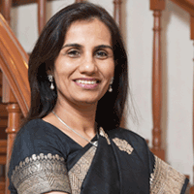


M2
M4
= M3+ Post office (TOTAL)
= M1+ Post office (Only Savings)
M3
Broad
Money
Currency
with Juntaa
DEMAND
DEPOSITS
TIME
DEPOSITS
M1: NARROW
Liquidity: M1 > M2 > M3 > M4

Slide 10
Monetary Policy: Instruments?
Quantitative, General, Indirect
Qualitative, Selective, Direct
Reserve Ratios (CRR, SLR)
OMO: Open market op.
Policy rate

Slide 11
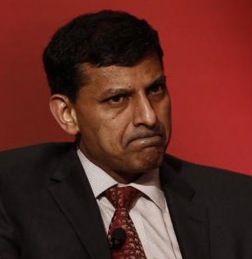

Loan to Value ratio: 60%
Loan Customer
Gold worth Rs. 1 Lakh
Lends Rs.60,000 only

Slide 12
Loan to Value ratio: 60%=> 85%
Loan Customer
Gold worth Rs. 1 Lakh
Lends Rs.85,000 only
To combat
Deflation/
Recession

Slide 13

Monetary Policy: Qualitative=> Margin
Loans against Securities (shares/bonds)
Recession=> 65%=>85%
Selective, Direct

Slide 14
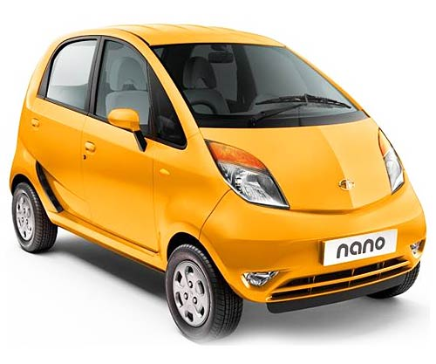
Consumer Credit controls
Qualitative
Fight Deflation, Recession
Downpayment: 30%=>10%
Reduce each installment:
10,000 x 10 => 1000 x 100
Selective, Direct
E.g.Commercial vehicle

Slide 15
Monetary Policy: Instruments?
Quantitative, General, Indirect
Qualitative, Selective, Direct
Reserve Ratios (CRR, SLR)
OMO: Open market op.
Policy rate
Margin requirement / LTV (Akshay Kumar)
Consumer credit control (Nano car)

Slide 16

Monetary Policy: Qualitative: Rationing
Ceiling on total loans in each sector.
Planned economy
PSL: 40% =>60%
Selective, Direct

Slide 17
Priority Sector lending (annual)
Target | Desi (+Foreign 20)
Overall PSL target | 40% of net loans given

Slide 18
Priority Sector lending (annual)
Target | Desi (+Foreign 20) | Foreign <20
Overall PSL target | 40% of net loans given | 32%

Slide 19
Priority Sector lending
Target | Desi (+Foreign 20)
Agro | 18%
Weaker sections | 10%
Remaining categories under PSL* | Whatever left to reach the 40% target
Overall PSL target | 40% of net loans given
*Housing loans, Edu, small industries

Slide 20
Priority Sector lending
Target | Desi (+Foreign 20) | Foreign <20
Agro | 18% | No specific targets
Weaker sections | 10% | No specific targets
Remaining categories under PSL* | Whatever left to reach the 40% target | No specific targets
Overall PSL target | 40% of net loans given | 32%
*Housing loans, Edu, small industries, export
Notes:
As percent of ANBC or Credit Equivalent of Off-Balance Sheet Exposure, whichever is higher)

Slide 21
Mock Question UPSC CSAT 2013
Priority sector lending by Banks in India Constitutes the lending to
Agriculture
Micro and small enterprises
Weaker section
All of above.
Right answer

Slide 22
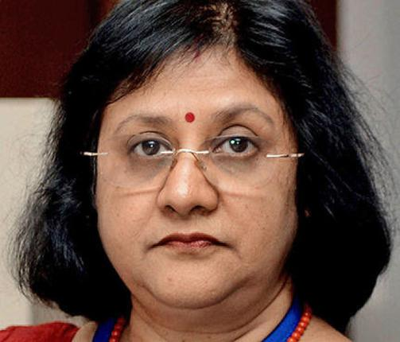
Desi + Foreign banks 20 Branches or More
PSL
If targets not met?
Remaining $$ to RIDF
Rural infra. Development fund
NABARD manages
State governments get infra. Loan
Bank earns interest + principal

Slide 23

Foreign banks <20 Branches
PSL
If targets not met?
Remaining $$ to SEDF
Small enterprises development fund
SIDBI manages
lending to state industrial fin.corp.

Slide 24
PSL: What if targets not met?
Desi (+Foreign 20) | Foreign bank <20
Remaining $$ to RIDF | To SEDF
Rural infra. Development fund | small enterprises development fund
NABARD manages | SIDBI manages
NABARD pays interest to bank | Same by SIDBI
State governments get infra. Loan | Similar case: state industrial fin.corp.

Slide 25
PSL applies to whom?

Slide 26
Banking institutions
Commercial
Urban
Coop.
Public sector
Private Banks
Foreign Banks
RRB
State
Central
PACS
NO PSL
PSL rule applies
40% | 32%
Depending on Branches

Slide 27
Monetary Policy: Instruments?
Quantitative, General, Indirect
Qualitative, Selective, Direct
Reserve Ratios (CRR, SLR)
OMO: Open market op.
Policy rate
Margin requirement / LTV (Akshay Kumar)
Consumer credit control (Nano car)
Credit Rationing (Stalin, PSL)

Slide 28
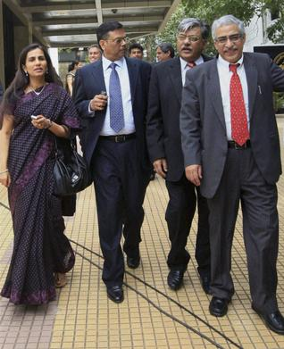

Monetary Policy: Qualitative
Moral Suasion
Direct Action

Slide 29
MCQ (UPSC-1995)
Which of the following is not an instrument of selective credit control?
Regulation of consumer credit
Rationing of credit
Margin requirements
Cash reserve ratio
Right answer
1. Skip 2. Attempt 3. Mark n Review

Slide 30
MCQ (2012)
RBI Acts as banker’s bank. This would imply which of the following?
Other banks retain their deposits with RBI
RBI lends funds to commercial banks in the times of need.
RBI advises commercial banks on monetary matters.
Correct Statement
Only 2 and 3
Only 1 and 2
Only 1 and 3
1, 2 and 3.

Slide 31
MCQ (2012)
RBI Acts as banker’s bank. This would imply which of the following?
(CRR) Other banks retain their deposits with RBI.
RBI lends funds to commercial banks in the times of need.
RBI advises commercial banks on monetary matters.
Correct Statement
Only 2 and 3
Only 1 and 2
Only 1 and 3
1, 2 and 3.

Slide 32
MCQ (2012)
RBI Acts as banker’s bank. This would imply which of the following?
(CRR) Other banks retain their deposits with RBI.
(Repo, Bank) RBI lends funds to commercial banks in the times of need.
RBI advises commercial banks on monetary matters.
Correct Statement
Only 2 and 3
Only 1 and 2
Only 1 and 3
1, 2 and 3.

Slide 33
CSAT 2012
RBI Acts as banker’s bank. This would imply which of the following?
(CRR) Other banks retain their deposits with RBI.
(Repo) RBI lends funds to commercial banks in the times of need.
(Moral Suasion) RBI advises commercial banks on monetary matters. [Ref: Money-banking E.Narayan Nadar]
Correct Statement
Only 2 and 3
Only 1 and 2
Only 1 and 3
1, 2 and 3 (Test series “A”, Q75, Ans.D)

Slide 35
NEXT
Banking evolution
Nationalization
Narsimhan Committee
New bank licenses, small-bank payment bank
Financial inclusion: PM-JDY, KVP etc.

