Slide 1
FACE DETECTION AND RECOGNITION
Team 50 - TechWrenchers
Submitted by :-
Shivam Thakur
Ridhima Arora
Tanya Gupta
Chirag kapoor

Slide 2
Contents -
Abstract
Introduction
Applications
Live Demo
Future Scope

Slide 3
abstract
Face is the primary focus of interaction with society, identity, emotion, age etc. It is also useful for judging gender, size and some other characteristics of the person. The system uses two techniques- face detection and recognition. The face detection is performed on provided url's of images without any application field in mind. Processes utilized in the system are skin like region segmentation, facial feature extraction and face image extraction on a face candidate. The tested system has acceptable performance to recognize faces within intended limits.

Slide 4
introduction
Everyday actions are increasingly being handled electronically, instead of pencil and paper or face. Thus to reduce workhand efforts further, we're imploring the scope of azure cognitive services in order to bring out features of person in the picture.
Using this feature, we can thus detect the emotional changes in a person's facial expressions using the API - FACE provided by MS-Azure.
We can further rate their happiness scale and emotional well being on a decided range of no.s.

Slide 5
applications
Useful for checking emotion responses of users/employees automatically.
Helps on extracting facial features of users/employees and represents that in a numerical, comparative and statistical form.
By various AI models implemented in the azure cognitive face, it also guesses the age of the given person in picture
Thus , overall reduces the manual workload

Slide 6
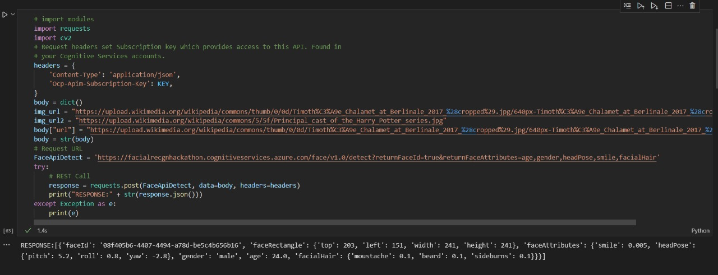
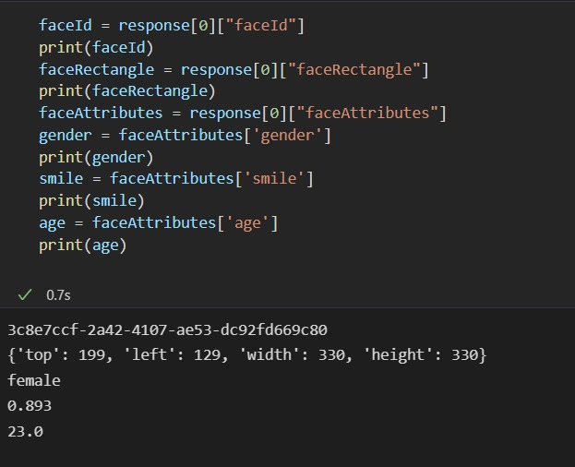
Live demo

Slide 7

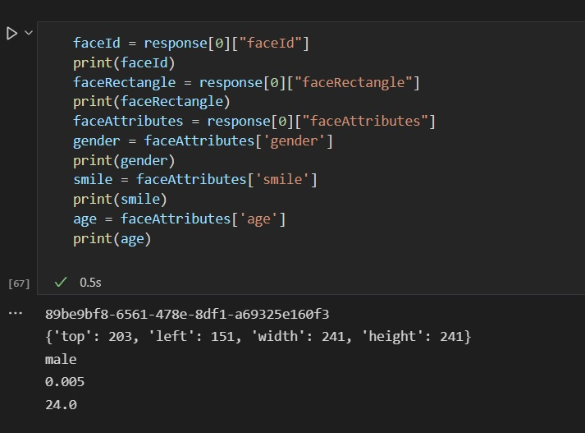
Live demo

Slide 8

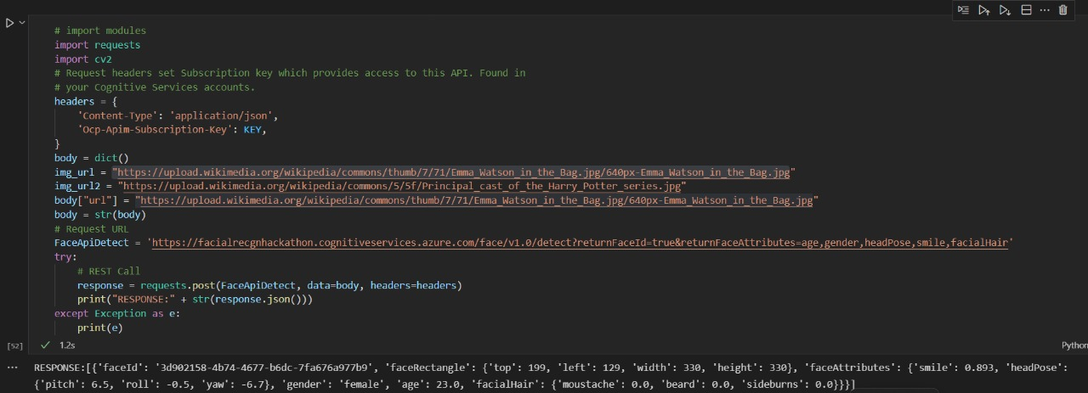
Live demo

Slide 9
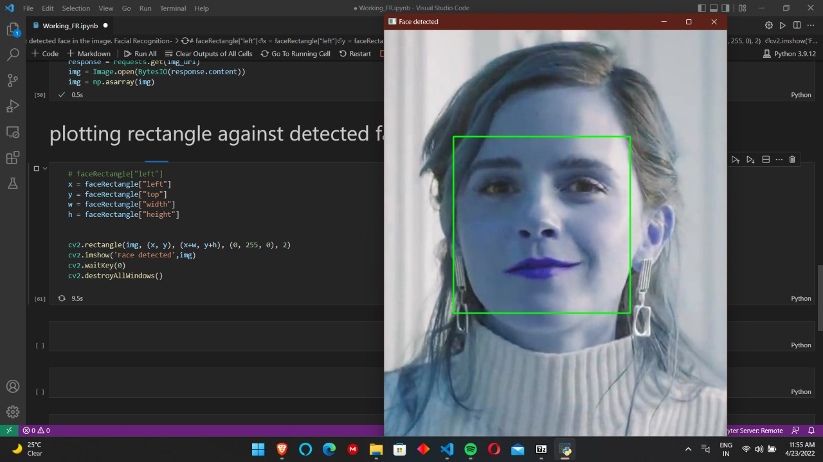
Live demo

Slide 10
Future scope
This system can further be enhanced by adding other useful features like checking uniform code of employees in the office.
We can further extend the working of this project by executing same operations on multiple frames to execute it on a video
The program can be used to detect incidences of horror in the workplace, via different inputs from sensors and facial expressions of people, and can respond to the concerned authorities on time.
This system can also be used to maintain a soft-portfolio, working of every employee digitally where-in features like - working hours can be monitored and stored

Slide 11
Thank You

