Slide 1
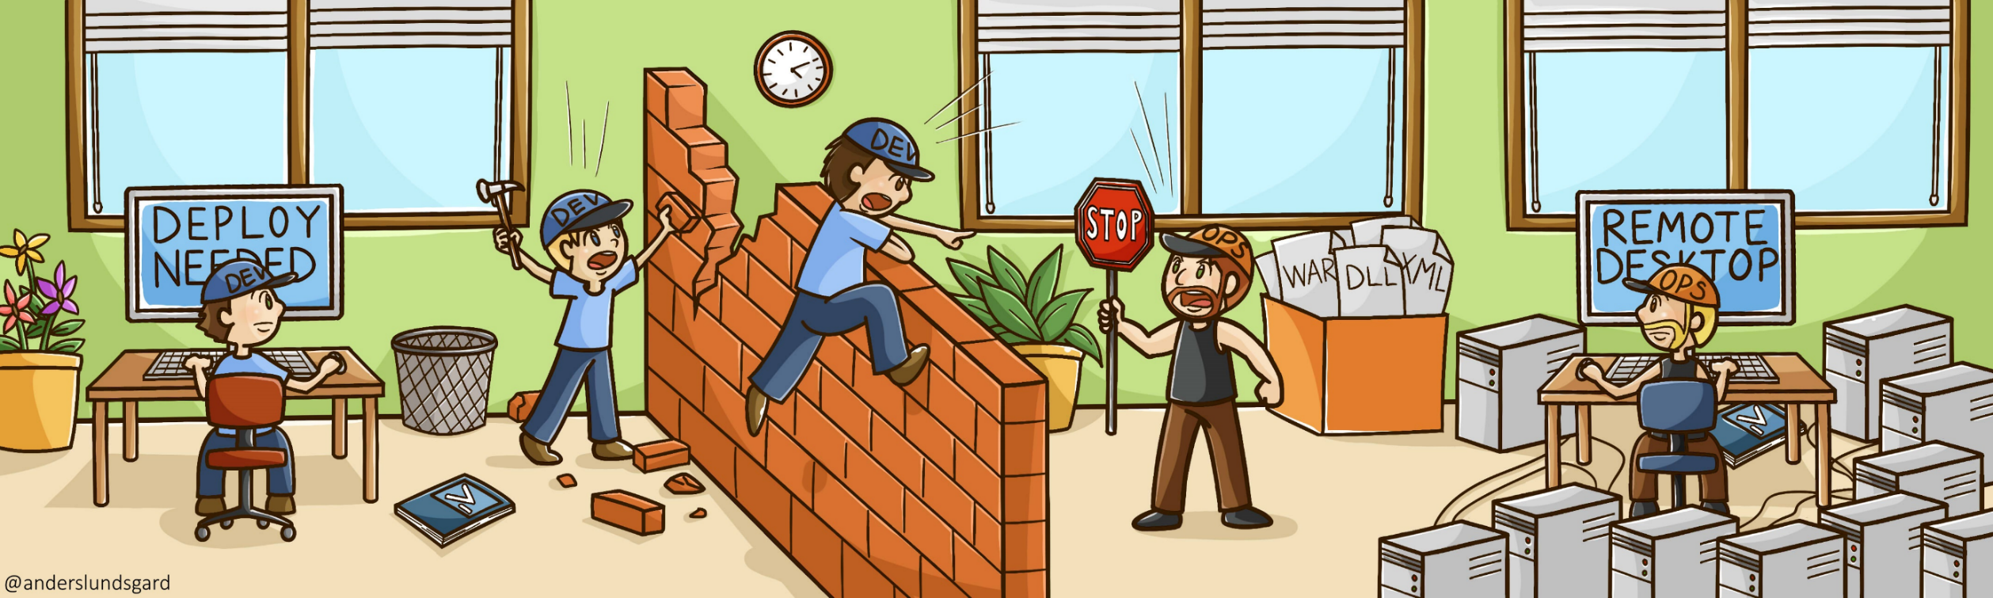
Addressing Challenges in Growing Organization
Dev
Dev
Ops

Slide 2
What We will talk about
Something about SkilRock Technologies
Our DevOps movement
Technological Transistion
Cultural Transistion
Final takeaways

Slide 3
Back in Days...

Slide 4
Required a lot of coordinating roles

Slide 5
Unclear responsibilities

Slide 6
No Common Code for Different Client

Slide 7
Mannual and Time Taking Release and Deployment Process

Slide 8
Slow Feature Delievery to ClientRepetetive Regression Testing

Slide 9
Repetetive Regression Testing

Slide 10
No Data Base Versioning Structure

Slide 11
Starting Steps In the Movement
Building a continuous integration system
Deployment automation
Improving culture & collaboration
Infrastructure automation
Monitoring of applications
Monitoring of infrastructure
Test automation
Version control

Slide 12
What is DevOps ?
“DevOps is development and operations collaboration”
“DevOps is treating your infrastructure as code”
“DevOps is using automation”
“DevOps is feature switches”
“DevOps is small deployments”

Slide 13
Back in the days...
Required a lot of coordinating roles
Unclear responsibilities
No Common Code for Different Client
Mannual and Time Taking Release and Deployment Process
Slow Feature Delievery to Client
Repetetive Regression Testing
No Data Base Versioning Structure

Slide 14
Technical Transition
Common Code For All Clients
Behavior Driven Development (BDD)
Test Driven Devlopment (TDD)
Automated Provisioning
Data Base Versioning
Build Automation
Artifact Management
Automated Deployment on QA
Automated Functuional Testing
Efficient Application Monitoring

Slide 15

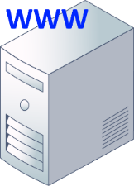

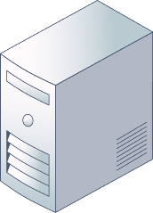
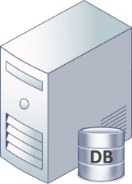
Current Product Delievery Model
2 week
sprint
With in minutes
Versioning
Code
Database
Pull & Push several times a day
CI
AT
D
D
Version Control
Continuous Integration
Server
Automation Test
Server
Deploy
Server
Target Servers
(QA, Staging)

Slide 16
Tool stack
SCM
Gitlab CE
Agile
JIRA
CI
Jenkins
Maven
Gradle
Repository Manager
Nexus OSS
Unit Testing
JUnit
Mockito
Functional Test Automation
Selenium
Appium
Cucumber
Provisioning and Configuration Management
Ansible
Monitoring
Nagios, Jconsole, ELK
CI

Slide 17
Cultural Transition
Team Autonomy
Cross Funstional Teams
Self Deciplined and Responsible Teams
Refinement Sessions

Slide 18
Transformation don’t happen over night…
Still mostly reactive work
Working on breaking old roles / habbits
Improving existing CI, CD and implementation for other Projects
Getting everybody onboard

Slide 19

Final takeaways
DevOps is a journey,
not a destination

Slide 20
