Slide 1
finance
File created on: 7/28/2025 3:59:10 AM

Slide 2
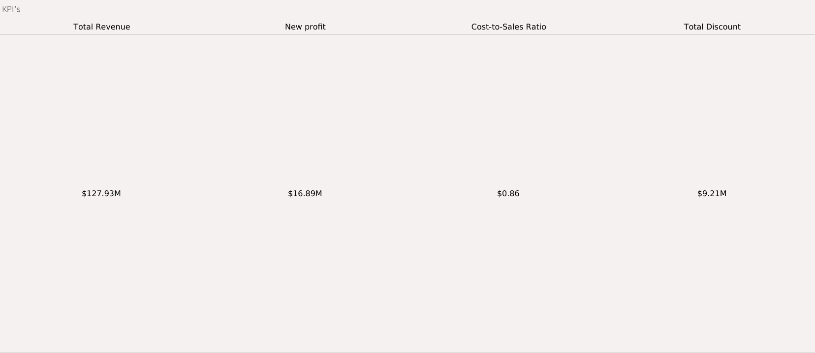

Slide 3
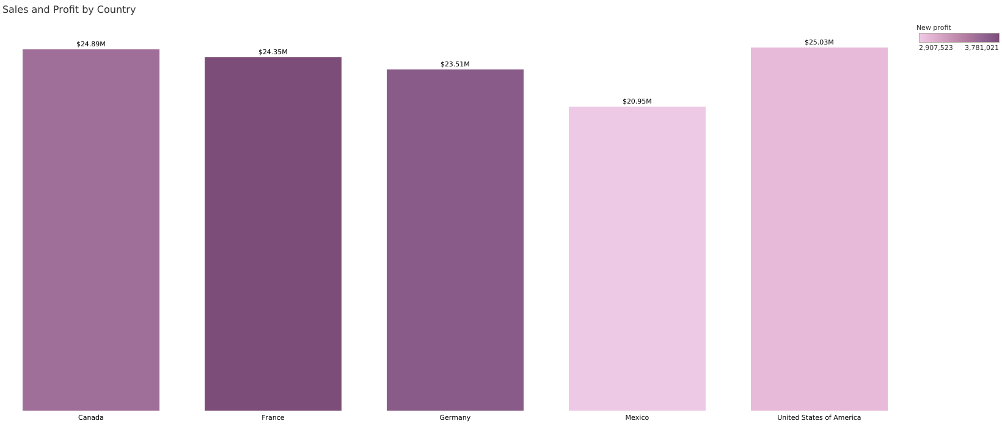

Slide 4
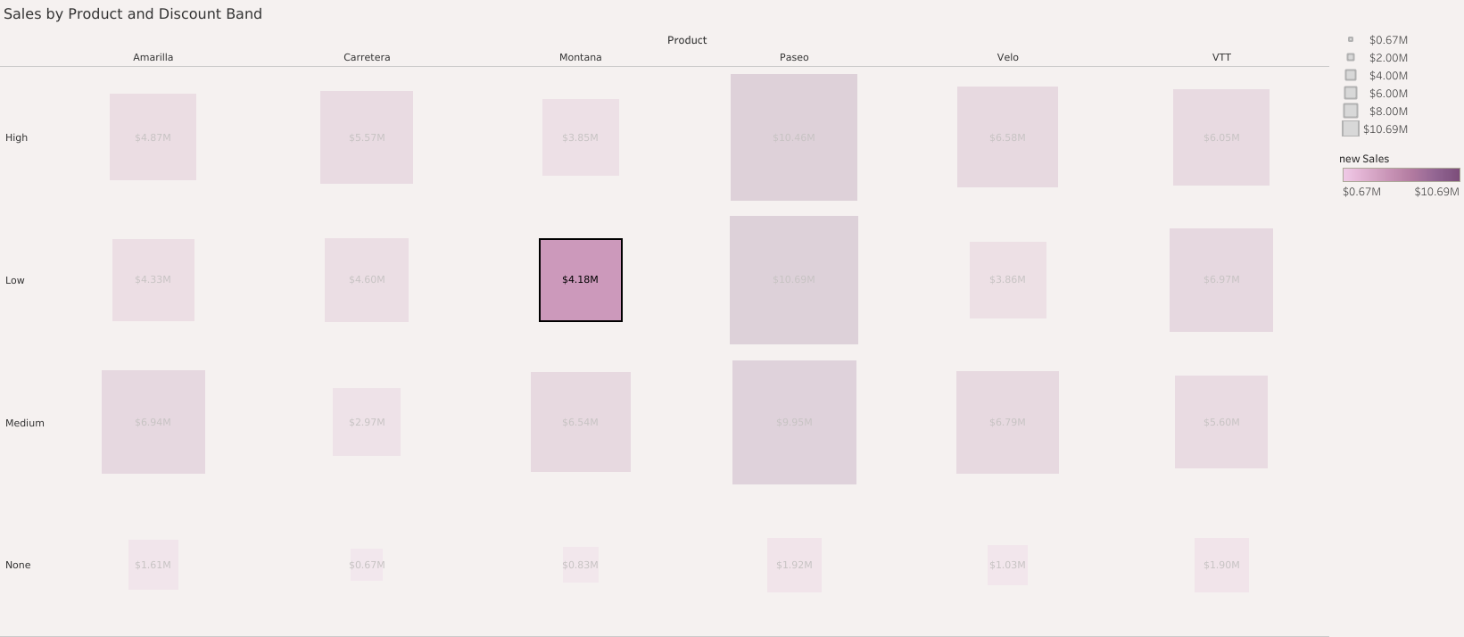

Slide 5
