Slide 1
hr
File created on: 7/27/2025 10:35:37 AM

Slide 2
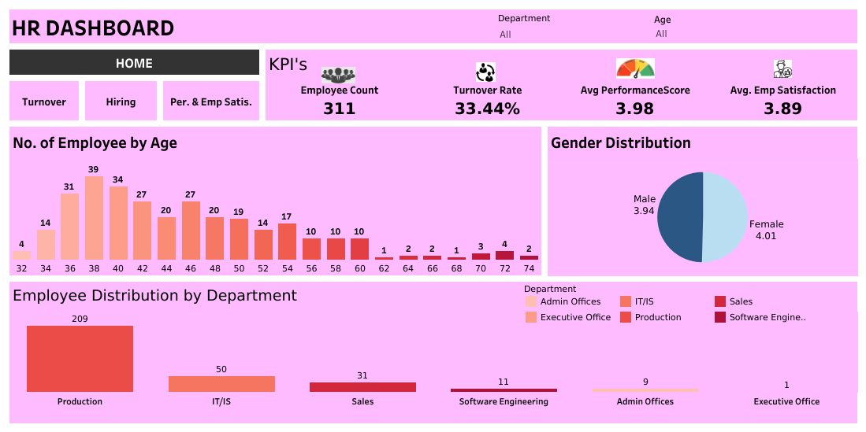

Slide 3
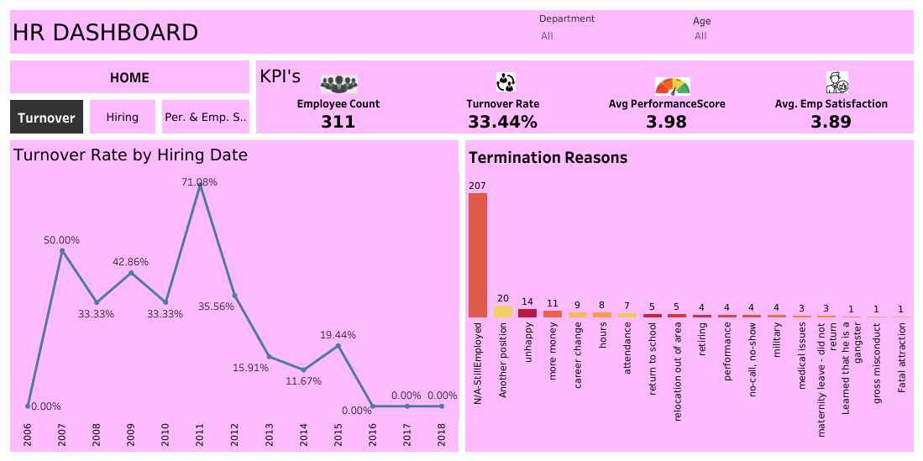

Slide 4
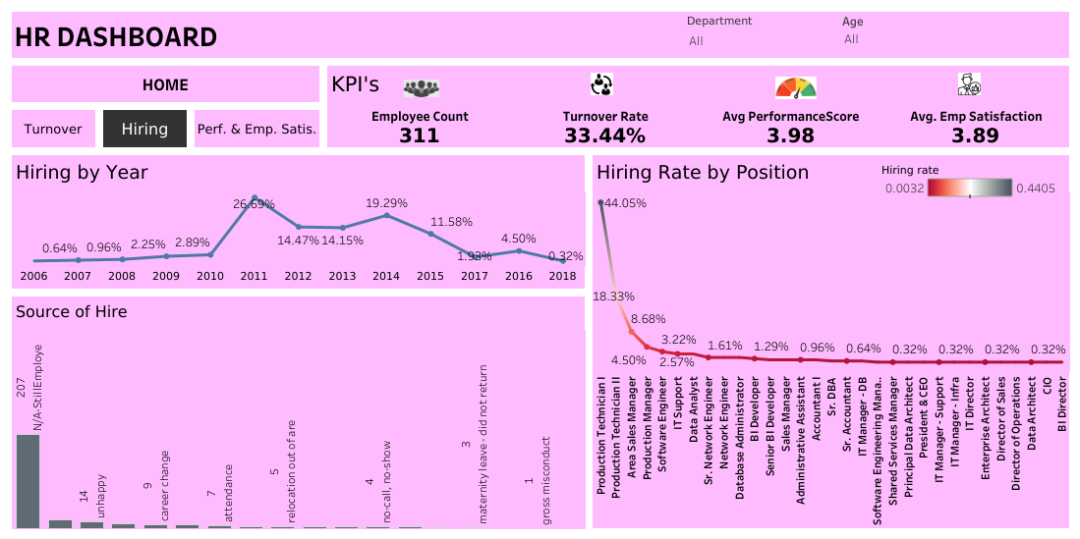

Slide 5
