Slide 1


CV Building Workshop
IDEATE INNOVATE INSPIRE

Slide 2

What is a CV?
Stands for Curriculum Vitae.
Marketing Document, where you market yourself!
Most flexible and convenient way to make applications.
Application Form
There is no “one best way” to construct a CV!
What is a CV?

Slide 3
Making a CV : L-P-E Model
Making a CV
Learning
Planning
Execution

Slide 4
Making a CV : Learning
Making a CV
Know the startup
Internship Position Details
Recipient Executive Details
Mind specified guidelines
Follow Standard format

Slide 5
Making a CV : Planning
Making a CV
Jot down all the related information.
Filter, get the information that can be fit in.
Filter again, lack of space/repetition.
Prioritize related points.

Slide 6
Making a CV : Execution
Making a CV
Try to use a standard format.
Write an effective objective.
Be precise.
Give brief description of important points.
Proof Read.

Slide 7
Making a CV : Do’s and Don’t’s
Making a CV
Do
Provide contact details
Formal Font, size 9-10
Don’t
Use “I”. Write in Passive.
Use Photograph
Use tables
Colored/Glossy font
Highlight important information
Cite non-quantifiable achievements.

Slide 8
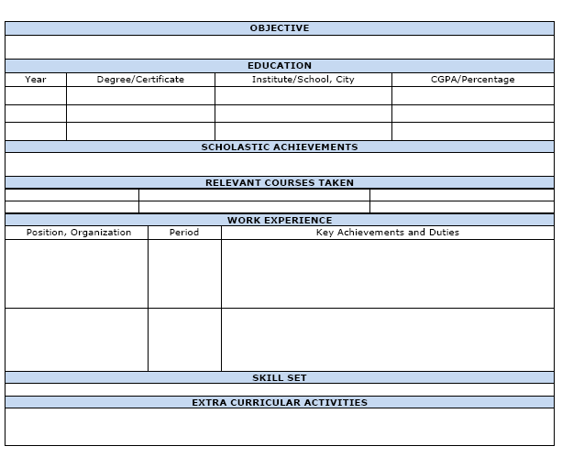
Standard Format
Step-by-Step

Slide 9
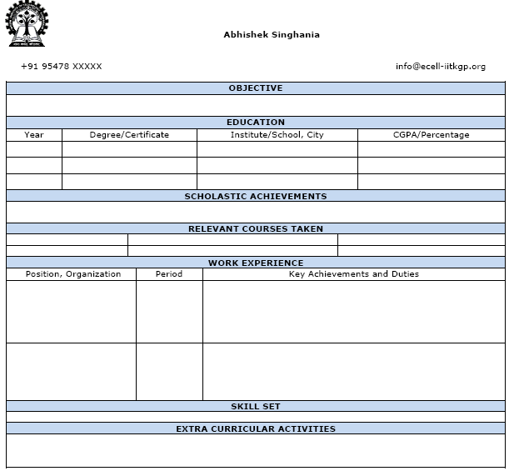
Standard Format + Personal Details
Step-by-Step
Include
1.Name
2.Contact Number
3.Address
4.Email ID
5. Date of Birth
Do not include a photograph, unless specified.

Slide 10
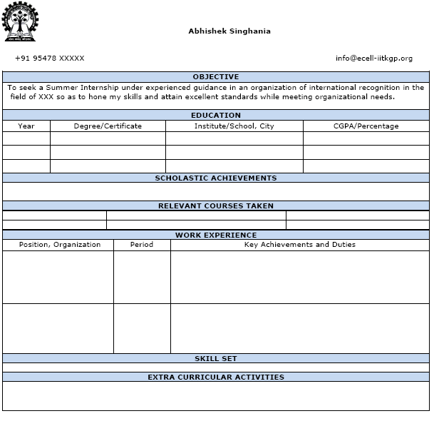
Standard Format + Personal Details + Objective
Step-by-Step
Objective
Generally a one-liner. Start with “To”. Write in Passive. Be precise but exhaustive.

Slide 11
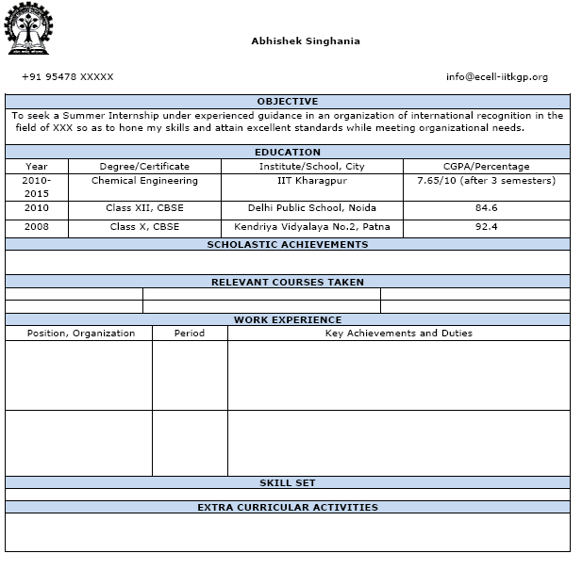
Standard Format + Personal Details + Objective + Educational Details
Step-by-Step
Include:
1.Class X 2.Class XII 3.CGPA(until now)

Slide 12
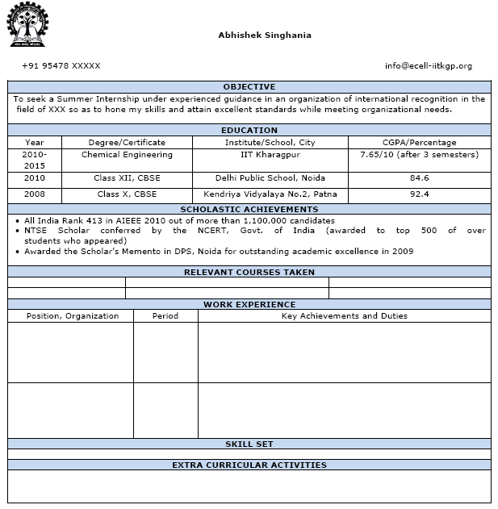
Standard Format + Personal Details + Objective + Educational Details + Scholastic Achievements
Step-by-Step
Include: Olympiad Ranks National/State Level Engineering Entrance Ranks Academic Scholarships Other academic records

Slide 13
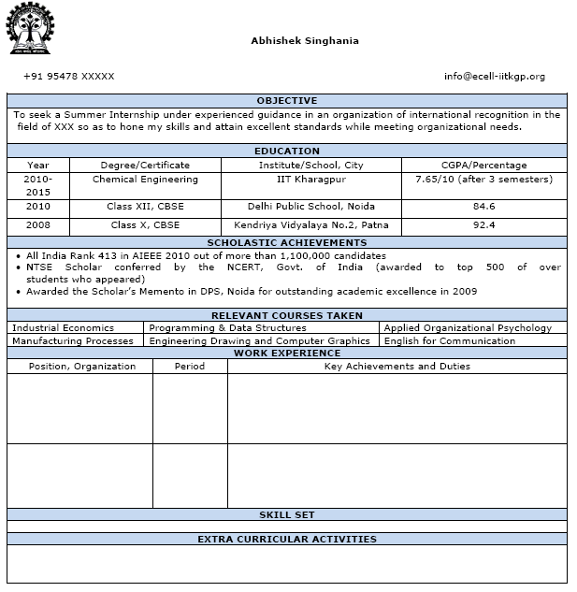
Standard Format + Personal Details + Objective + Educational Details + Scholastic Achievements + Relevant Courses
Step-by-Step
<Optional Field>
Include Courses undertaken in College. Include courses completed in online learning classes. <Certificate MUST> Include as many relevant courses.

Slide 14
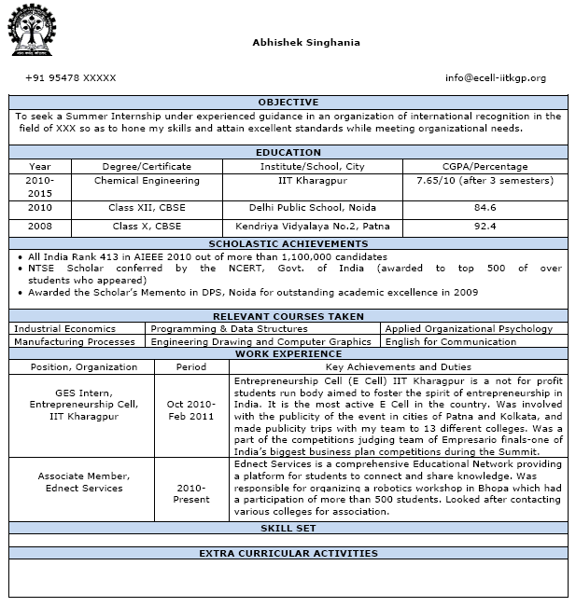
Standard Format + Personal Details + Objective + Educational Details + Scholastic Achievements + Relevant Courses + Work Experience
Step-by-Step
1.Use “Action Words” e.g. He gave a speech.<-> He delivered a speech. E.g. If you work in a restaurant. You work in a team, provide quality service, deal tactfully with complaints. 2.Relate skills to the job at hand. E.g. Finance <-> Analytical Skills. Marketing <-> Exposure to negotiaition/persuading activities.

Slide 15
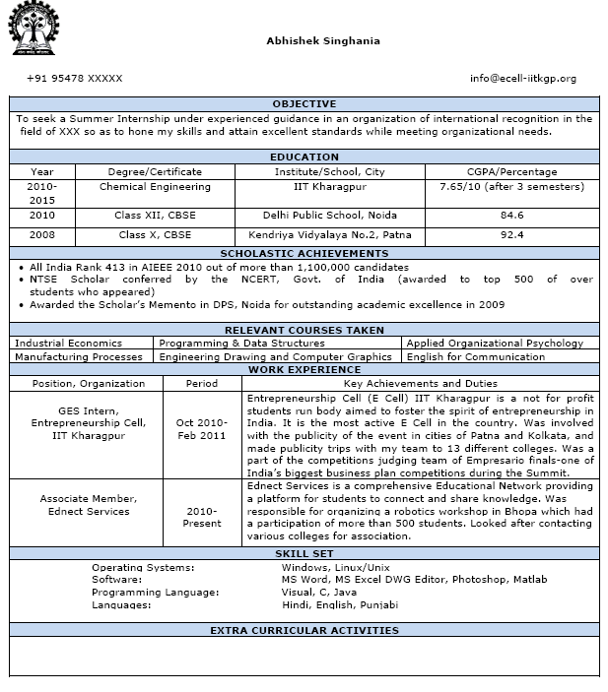
Standard Format + Personal Details + Objective + Educational Details + Scholastic Achievements + Relevant Courses + Work Experience + Skill Set
Step-by-Step
<Optional>
1.Languages. 2.Programming Languages. 3.Computing knowledge. 4.Technical knowhow.
<Certificate may not be required>

Slide 16
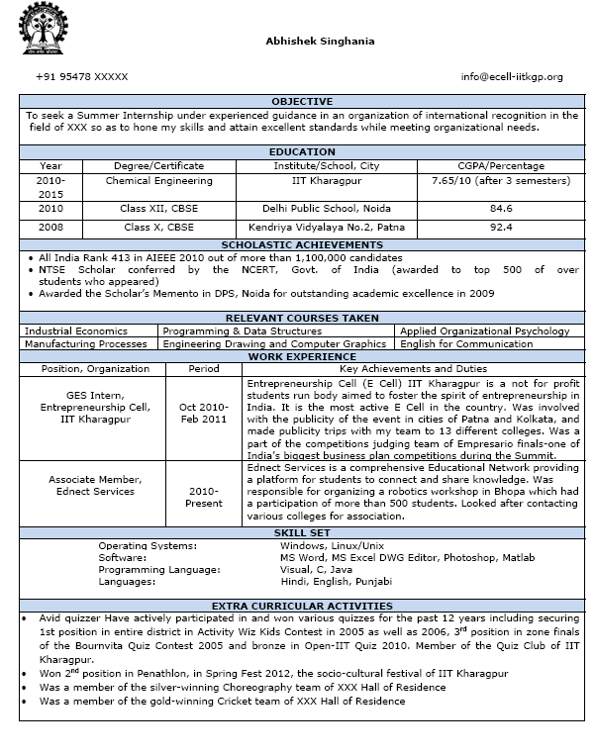
Standard Format + Personal Details + Objective + Educational Details + Scholastic Achievements + Relevant Courses + Work Experience + Skill Set + Extra-Curricular Activities
Step-by-Step
Short and to the point. Don’t put solitary hobbies , e.g. Watching TV, Reading. Show a range on interests. Out of the ordinary hobbies. Interests relevant to the job. An evidence of leadership and team skills is a boost.

Slide 17
Tips for a good CV: 1.Craft your CV specific to the job. 2.Carefully and clearly laid out content. 3.Informative but concise. 4.Accurate in spelling and grammar. 5.Try to fit in a page.

Slide 18

Thank You!
THANK YOU!

