Slide 1

Secure Campus Network Framework (SCNF)
APEX UNIVERSITY, JAIPUR
Introduction
Student Name: SHIVAM SWARAJ Roll No: 23CA2691054
Program Name: BCA (CS) Semester: 5th
Group Project: NO Group Code: S

Slide 2
Introduction
Introduction
Importance of campus network security
Need for secure, segmented networks
Increasing cyber threats in educational institutions

Slide 3
Project Objectives
Design a secure campus network
Implement VLAN-based segmentation
Use DHCP for automatic IP allocation
Apply security controls
Demonstrate ethical hacking concepts

Slide 4
Project Overview
Secure Campus Network Framework (SCNF)
In this project, I designed a secure campus network.
I implemented this project step by step using networking, cybersecurity, and management concepts.
I will explain how I built it and what tools I used.

Slide 5
What Problem Is Solved
Campus networks contain sensitive data.
Without security, any user can access other departments.
Manual IP configuration is not scalable.
There is a need for segmentation, automation, and security.

Slide 6
How I Planned the Project
I divided the campus into departments.
Each department was treated as a separate network.
I planned VLANs and IP ranges.
I followed Software Project Management concepts.

Slide 7
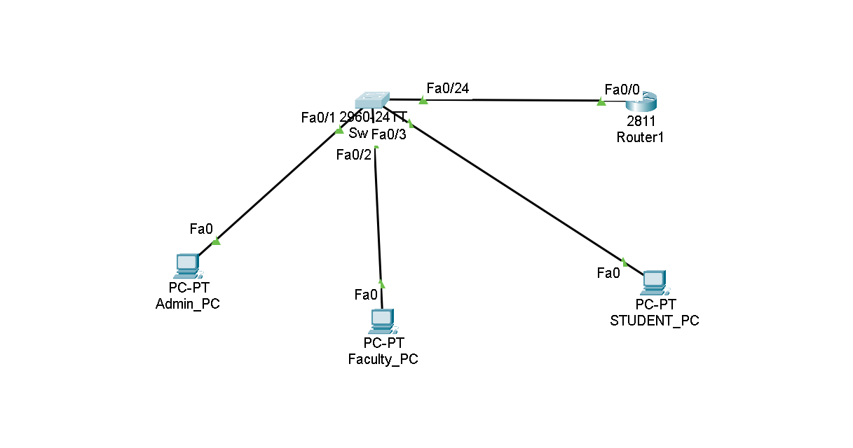
Campus Structure I Designed
Admin Block
Faculty Block
Student Labs
Server Room

Slide 8
Step-by-Step Network Implementation
Step 1: Created network topology in Cisco Packet Tracer
Step 2: Added router, switch, PCs, and server
Step 3: Created VLANs for each department
Step 4: Assigned switch ports to VLANs
Step 5: Configured IP addressing
Step 6: Implemented DHCP for automation
Step 7: Enabled inter-VLAN routing

Slide 9
VLANs & IP Addressing
VLAN 10 → Admin
VLAN 20 → Faculty
VLAN 30 → Students
Each VLAN has a separate IP network.
“VLANs help in isolation and security.”

Slide 10
DHCP & Routing
DHCP automatically assigns IP addresses.
Router-on-a-Stick is used for inter-VLAN routing.
Router subinterfaces act as gateways.
This reduced manual work and improved scalability

Slide 11
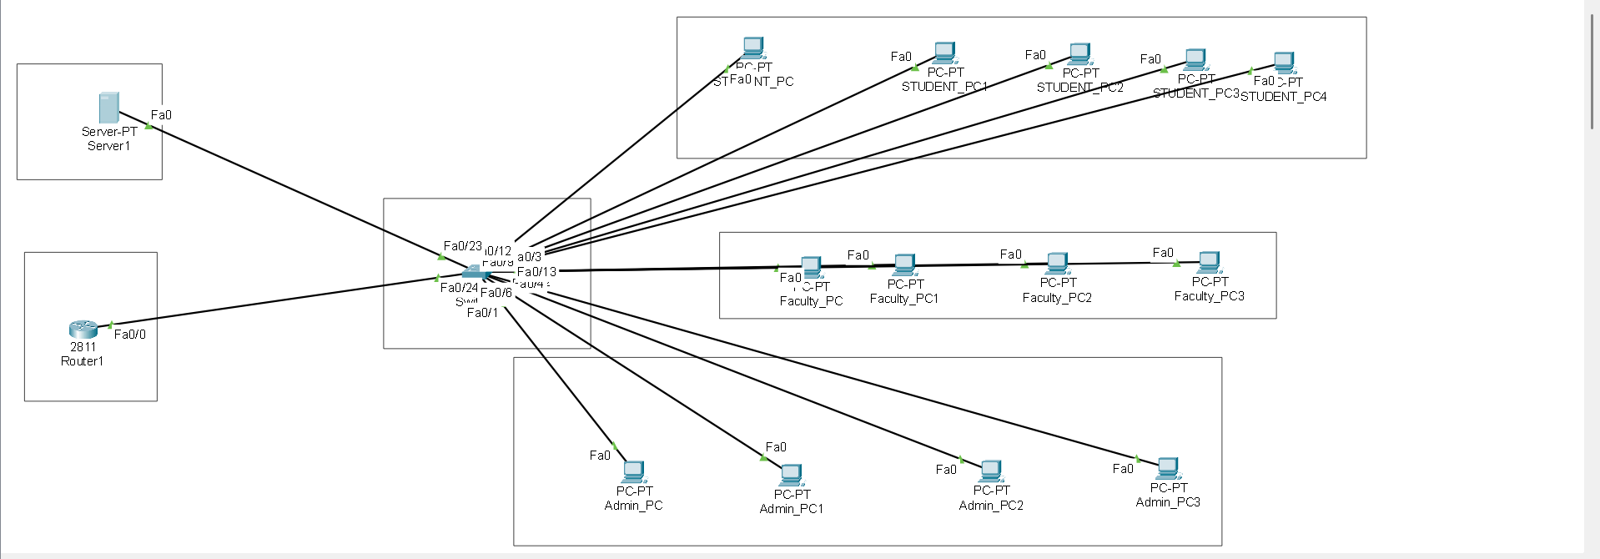
FINAL DESGIN

Slide 12
Security Implementation
I applied Access Control Lists (ACLs).
Students are restricted from accessing Admin and Faculty.
Admin is allowed full access.
“This is how real campus networks enforce security.”

Slide 13
Ethical Hacking (How I Tested My Network)
Cisco Packet Tracer is used only for design.
Ethical hacking was done in a separate lab.
Kali Linux was used as attacker.
Metasploitable2 was used as vulnerable server.

Slide 14
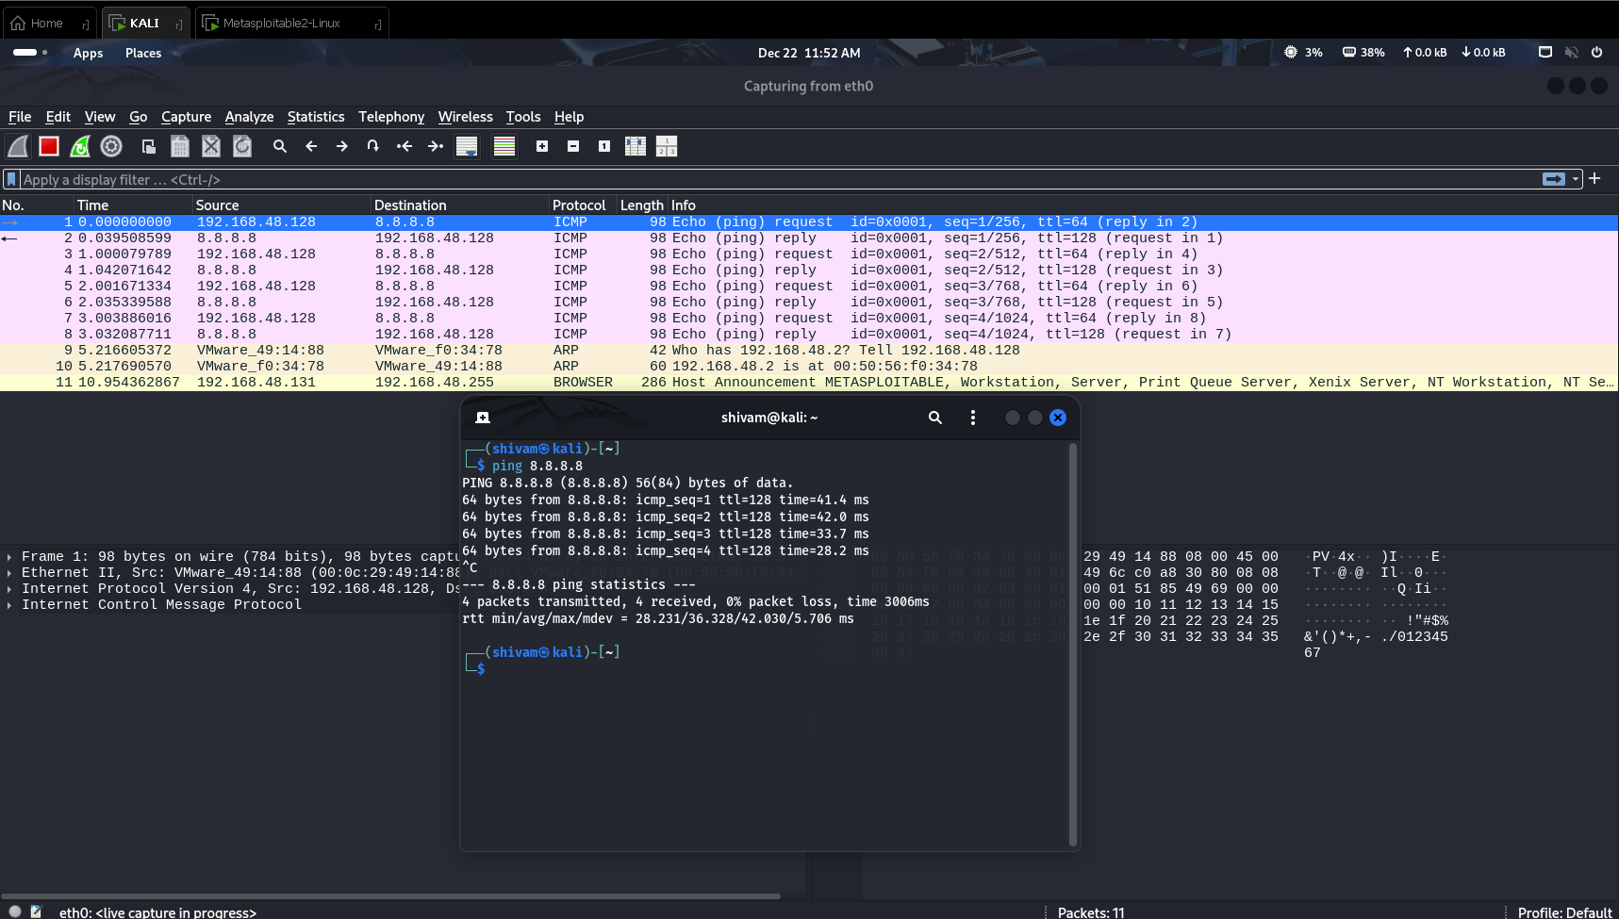
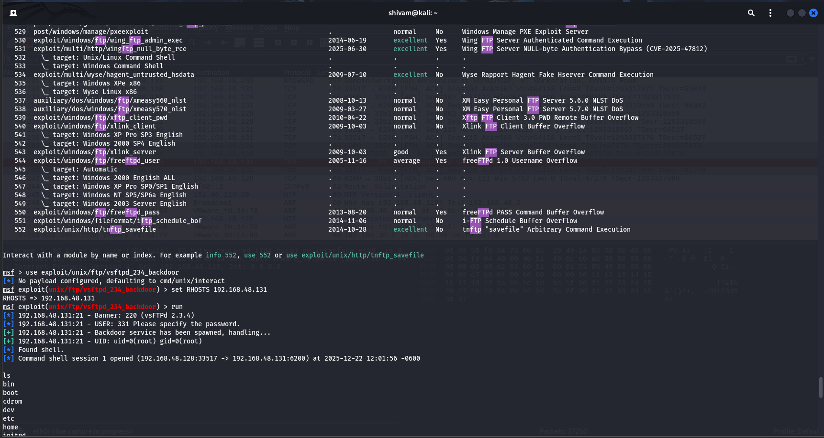
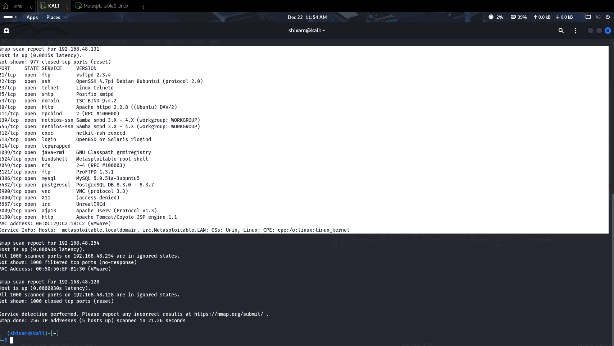
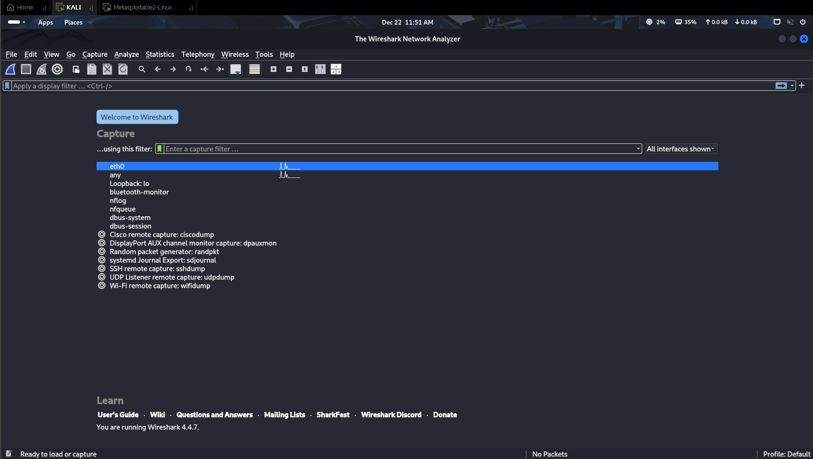
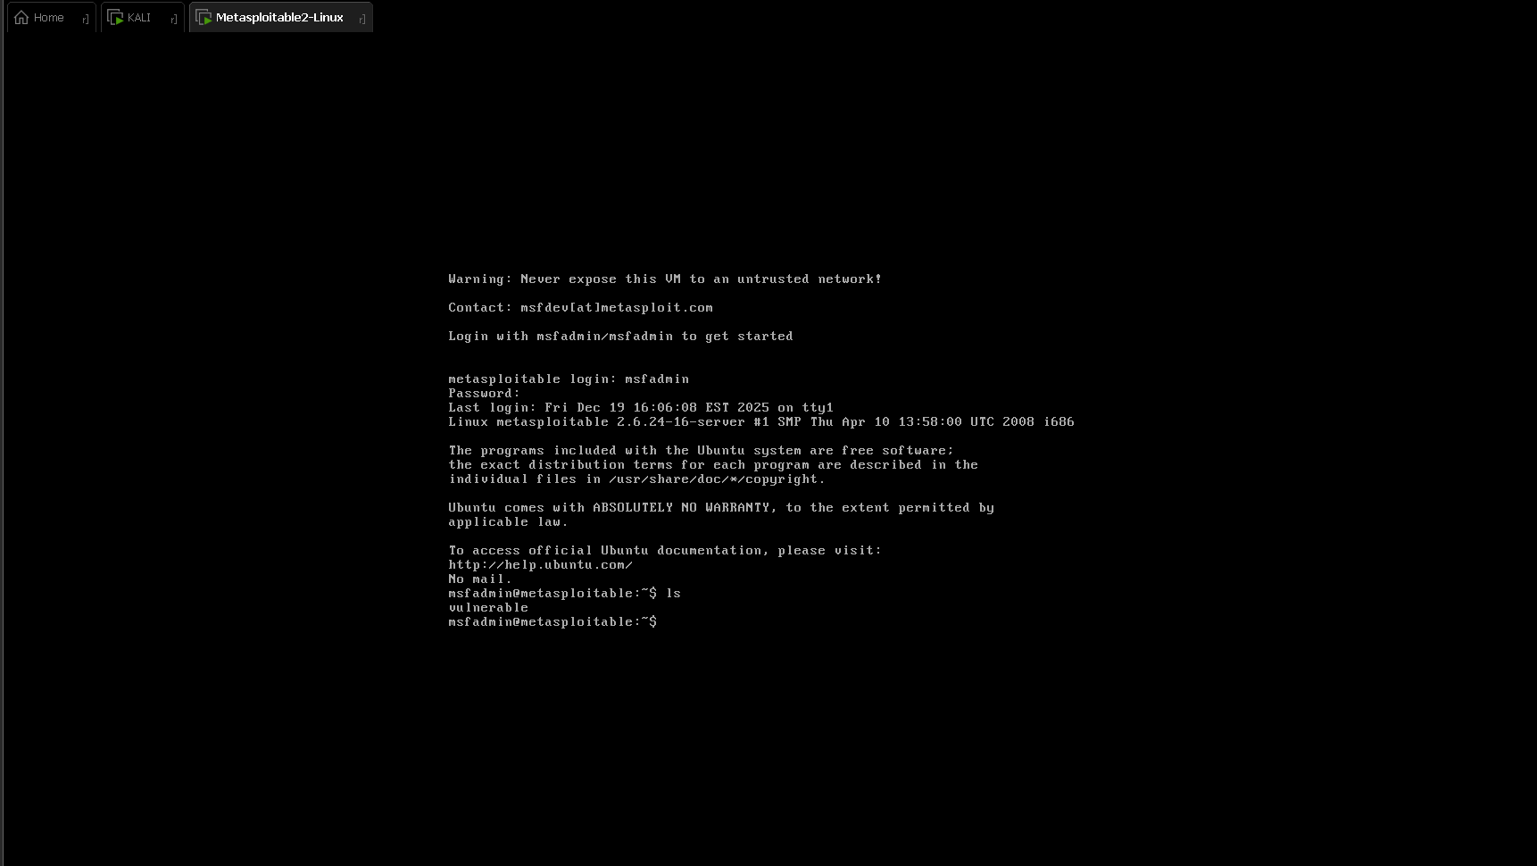
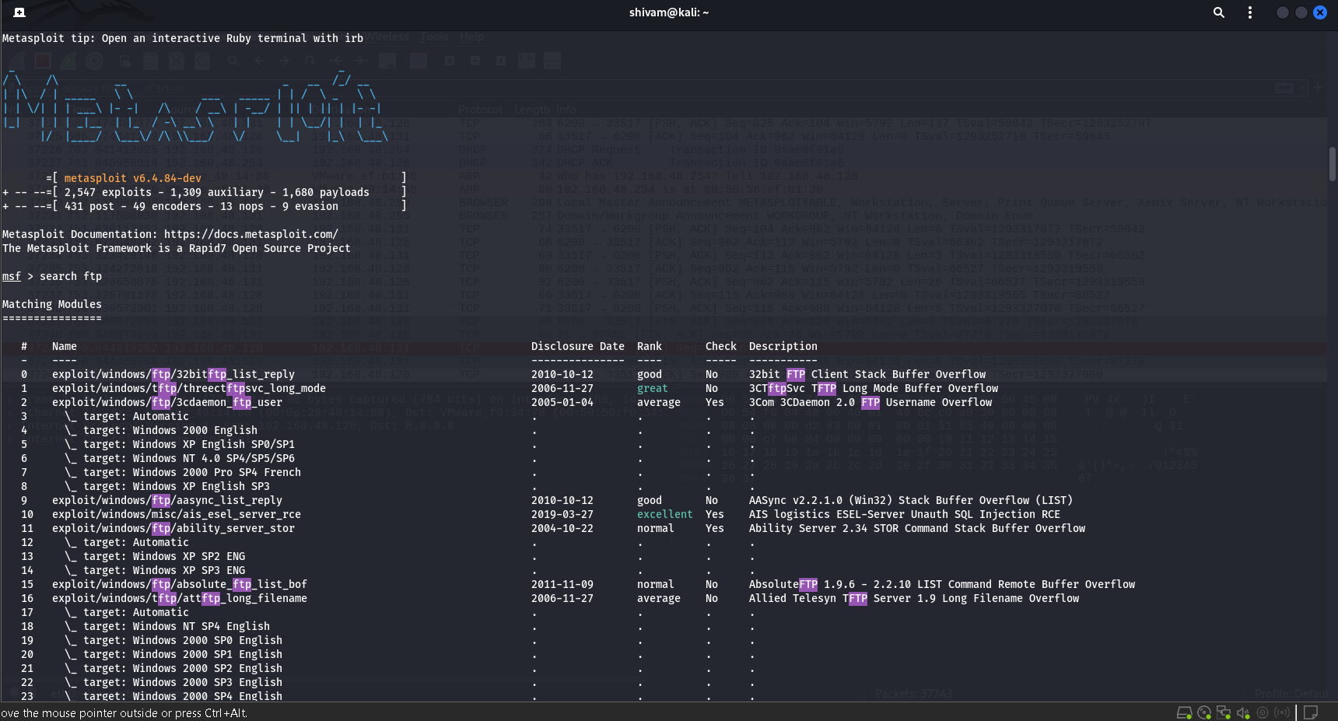
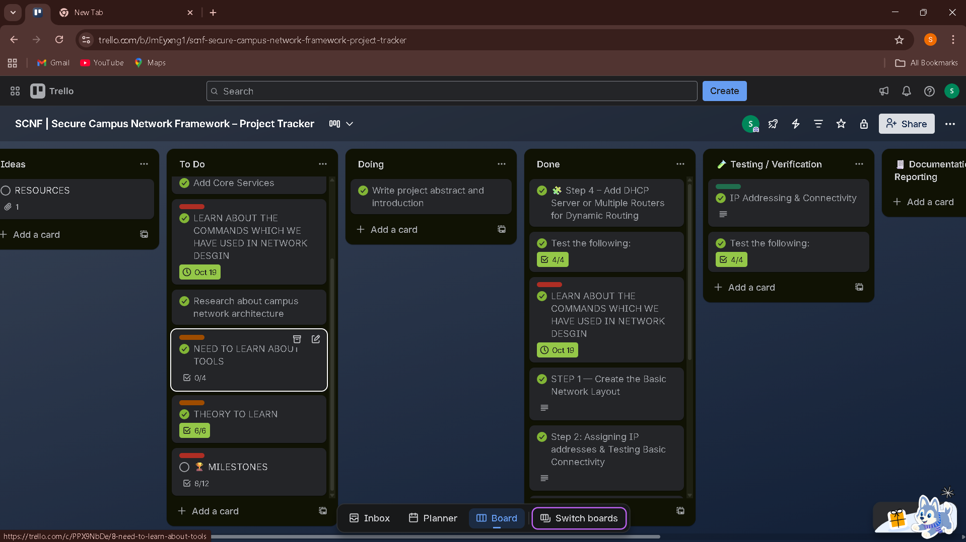
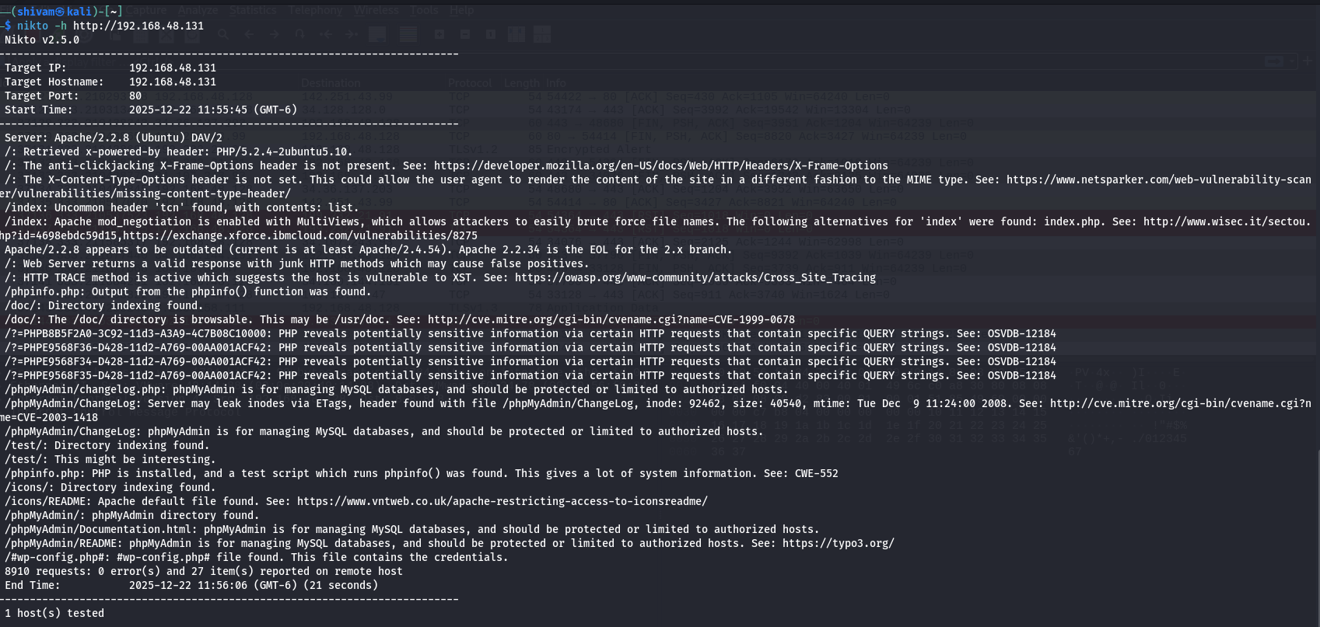
SCREENSHOTS

Slide 15
SCREENSHOTS
SCREENSHOTS

Slide 16
SCREENSHOTS
SCREENSHOTS
SCREENSHOTS

Slide 17
SCREENSHOTS
SCREENSHOTS
SCREENSHOTS
SCREENSHOTS

Slide 18
Tools I Used
Cisco Packet Tracer – Network design
Kali Linux – Ethical hacking
Nmap, Nikto – Scanning
Metasploit – Exploitation demo
Wireshark – Traffic analysis
Trello – Project management
ChatGPT – Learning & guidance
YouTube & TryHackMe – Skill building
“Each tool was used for a specific purpose.”

Slide 19
THANK YOU

