Slide 1
Introduction to Pizza Sales Data Analysis
Understanding the dynamics of pizza sales through comprehensive data analysis is crucial for making informed business decisions. This presentation will delve into various aspects of SQL analysis in the context of pizza sales.
by Shivam Sharma

Slide 2
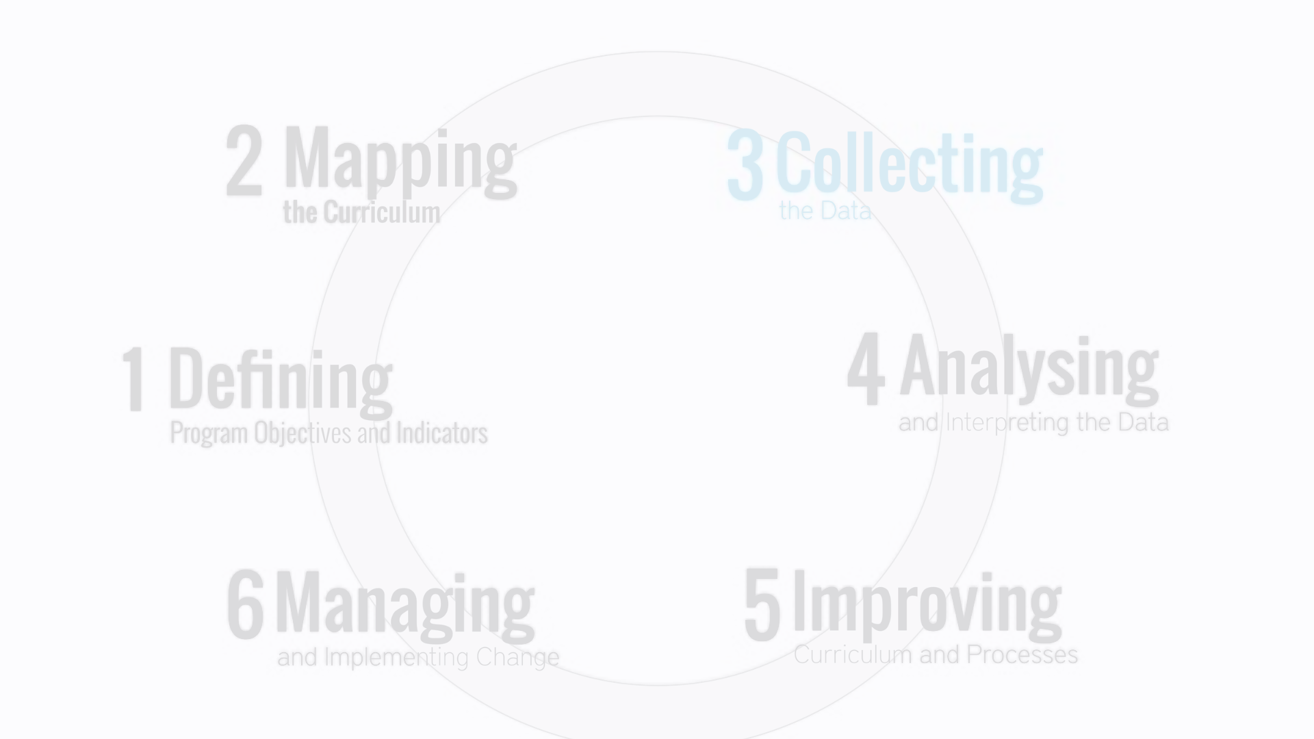
Data Sources and Collection Methods
Transactional Data
Customer Feedback
Online Analytics Tools
Exploring transaction data from various sources including POS systems, online orders, and in-store purchases to understand customer behavior.
Utilizing customer feedback, surveys, and reviews to extract valuable insights about preferences, satisfaction, and areas for improvement.
Discussing the utilization of web and mobile analytics tools to track traffic, user behavior, and online pizza orders.

Slide 3
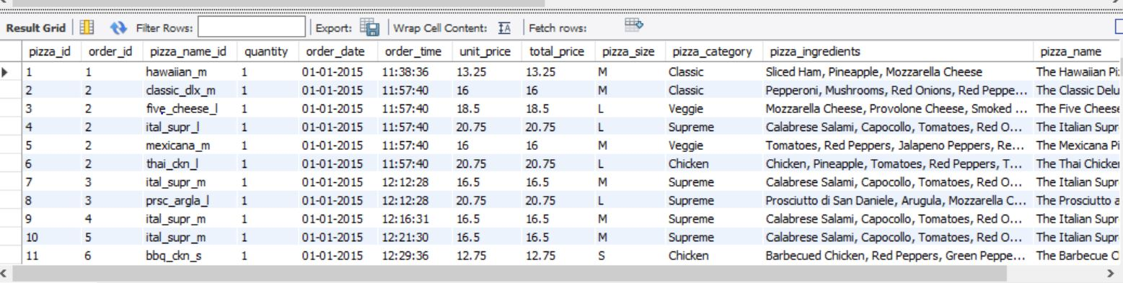
Overview of SQL and its Relevance to Data Analysis
1
Data Retrieval
2
Data Manipulation
How SQL enables efficient extraction of relevant data for analysis, including filtering and aggregation techniques.
Exploring the various SQL commands used for modifying and optimizing raw data for analytical processes.
3
Data Joining
Understanding the SQL methods for combining data from multiple sources to create a comprehensive dataset for analysis.

Slide 4
Data Cleaning and Preparation using SQL
Data Cleaning
Data Transformation
Exploring SQL techniques for identifying and rectifying data quality issues and inconsistencies.
Utilizing SQL to transform raw data into a structured and standardized format suitable for analysis.

Slide 5
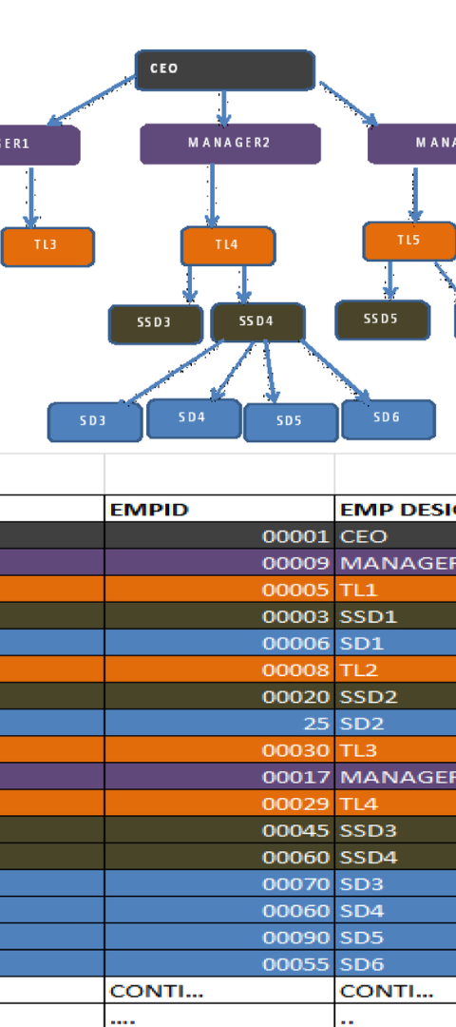



SQL Queries for Analyzing Pizza Sales Data
Basic Queries
Understanding how to execute simple SQL queries to extract specific subsets of pizza sales data.
Aggregate Functions
Using SQL aggregate functions to analyze total sales, average orders, and other key metrics.
Subqueries
Exploring the use of subqueries to retrieve complex data subsets and perform in-depth analysis.

Slide 6
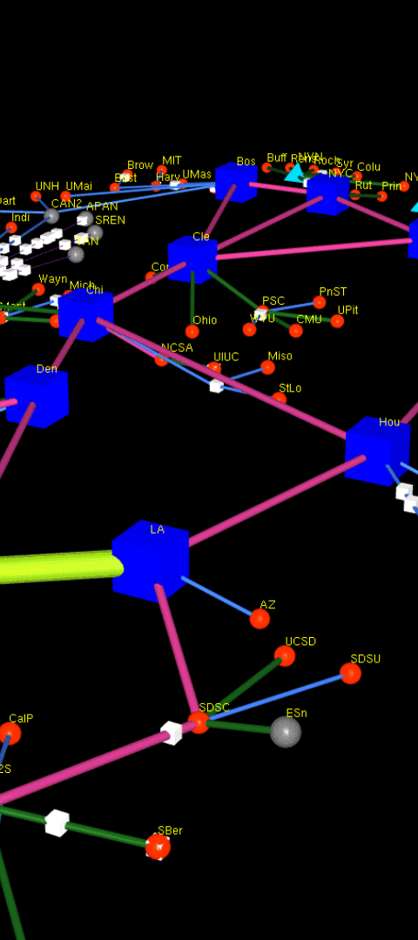
Visualizing Pizza Sales Data using SQL
1
Bar Charts
Creating bar charts using SQL to visualize trends in pizza sales across different geographic regions.
2
Line Graphs
Utilizing SQL to generate line graphs depicting sales fluctuations over time periods, such as daily, weekly, or monthly.
3
Pie Charts
Understanding the creation of pie charts to represent the distribution of pizza types based on sales data.

Slide 7
Identifying Trends and Patterns in Pizza Sales Data
2
3
Seasonal Variations
Preferred Toppings
Identifying seasonal peaks and dips in pizza sales data to strategize promotional offers and marketing campaigns.
Unveiling the top three popular pizza toppings based on sales, aiding in menu optimization.

Slide 8
Key Insights and Findings from the Analysis
Location
Demand
Trend
Urban Areas
High
Consistent
Rural Areas
Medium
Seasonal

Slide 9

Recommendations for Improving Pizza Sales based on the Analysis
Menu Optimization
Promotional Strategies
Location-based Campaigns
Proposing menu enhancements based on popular pizza types and toppings to cater to customer preferences.
Formulating targeted promotions and loyalty programs based on identified sales patterns and trends.
Suggesting area-specific marketing initiatives tailored to urban and rural customer segments.

Slide 10

Conclusion and Next Steps
1
Implementation Plan
2
Continuous Monitoring
Outlining a systematic implementation plan based on the recommendations for driving sales growth.
Emphasizing the importance of ongoing data analysis to adapt to changing consumer behaviors and preferences.
3
Future Research
Highlighting the potential for further research into emerging pizza consumption trends and market dynamics.

