Slide 1
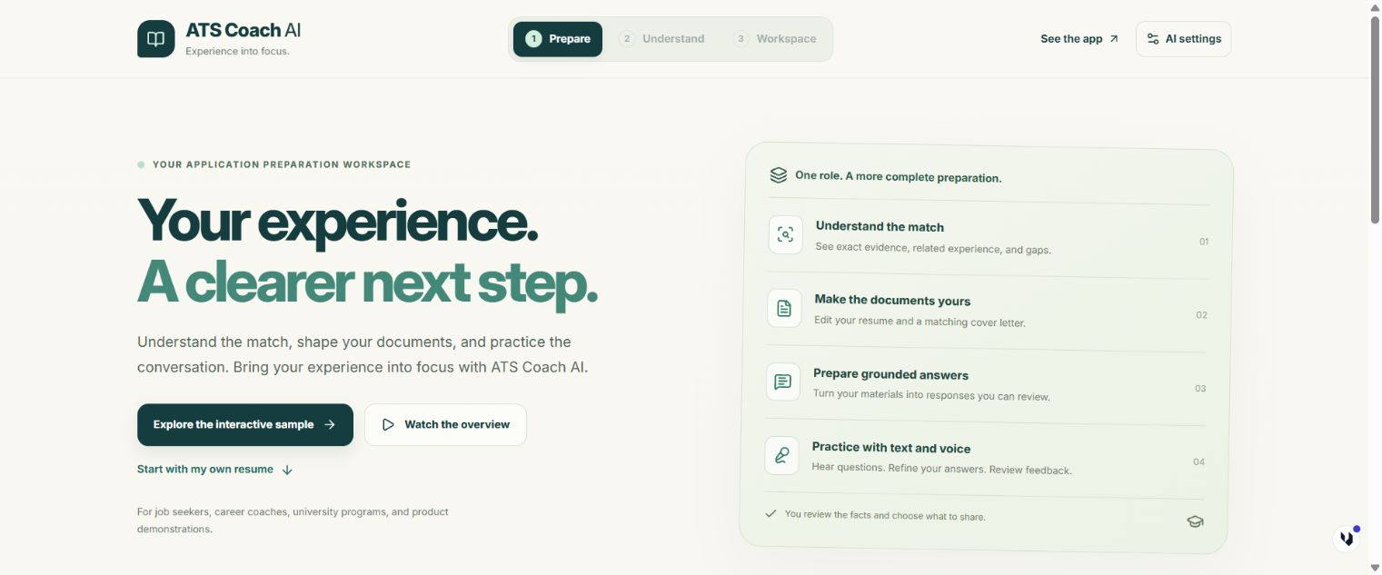
A CLEAR WALKTHROUGH OF ATS COACH AI
Your first application workspace
A guided tour using
anonymized sample materials.
ATS COACH AI / HOW TO USE
01 / 13
Notes:
Welcome to ATS Coach AI. This walkthrough follows the real app using anonymized sample materials. You will see the diagnosis, editable documents, application answers, and interview voice controls, then learn how to save your work.
Product: https://remix-remix-ats-coach-ai-1403.ai.studio/
Screenshots use anonymized sample application materials.

Slide 2
The interactive sample
A prepared example you can explore immediately
Choose Explore the interactive sample.
Review the sample label before continuing.
1
Choose Explore the interactive sample.
ATS COACH AI / HOW TO USE
02 / 13
Notes:
Choose Explore the interactive sample on the welcome screen. It opens a prepared diagnosis and documents without waiting for live AI. The sample banner stays visible so you can distinguish example content from a personalized live response.
Choose Explore the interactive sample.
Review the sample label before continuing.
Product: https://remix-remix-ats-coach-ai-1403.ai.studio/
Screenshots use anonymized sample application materials.

Slide 3
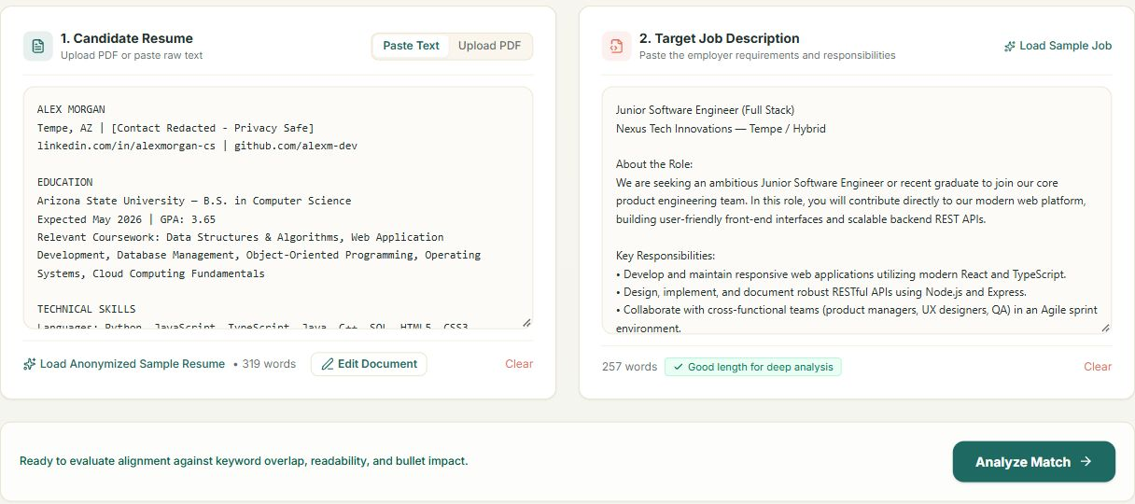
Your resume and target role
Live analysis begins with your own materials
1
Paste resume text or upload a PDF.
ATS COACH AI / HOW TO USE
03 / 13
Notes:
For a real application, choose Start with my own resume. Paste resume text or upload a PDF, then paste the job description. Remove private identifiers before sending materials to AI. Analyze Match begins the live comparison.
Paste resume text or upload a PDF.
Add the target job description.
Select Analyze Match for a live diagnosis.
Product: https://remix-remix-ats-coach-ai-1403.ai.studio/
Screenshots use anonymized sample application materials.

Slide 4
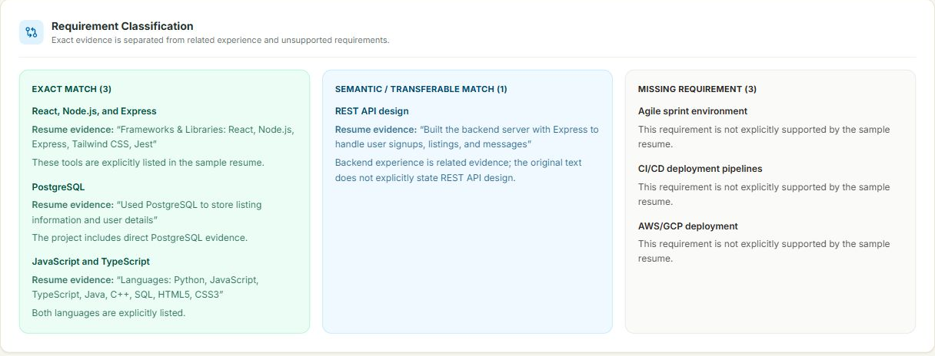
The match diagnosis
The explanation matters more than the number
Review exact and related evidence separately.
ATS COACH AI / HOW TO USE
04 / 13
Notes:
Review the match diagnosis and its evidence. Exact matches quote your resume. Related experience explains a connection without treating it as an exact skill claim. Missing requirements identify gaps. The scores are educational estimates, so check the details yourself.
Review exact and related evidence separately.
Treat missing requirements as gaps to review.
Use the score as an educational estimate.
Product: https://remix-remix-ats-coach-ai-1403.ai.studio/
Screenshots use anonymized sample application materials.

Slide 5
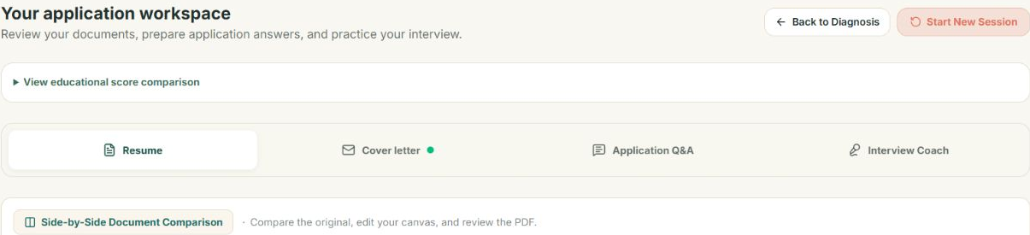
The application workspace
Four sections keep your preparation together
1
Open the workspace after diagnosis.
ATS COACH AI / HOW TO USE
05 / 13
Notes:
Choose Open sample workspace in the example, or Generate Tailored Resume after live analysis. The workspace contains Resume, Cover letter, Application Q and A, and Interview Coach. Switch sections to continue working without losing a draft within these tabs.
Open the workspace after diagnosis.
Use the four section buttons to move between tools.
Product: https://remix-remix-ats-coach-ai-1403.ai.studio/
Screenshots use anonymized sample application materials.

Slide 6
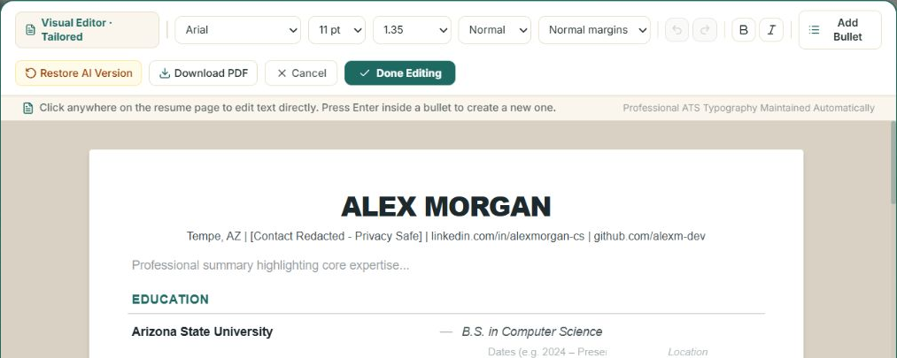
The resume canvas
Direct text editing and document formatting
1
2
Open Edit Resume Canvas and click the text.
ATS COACH AI / HOW TO USE
06 / 13
Notes:
Open Edit Resume Canvas. Click the text you want to change, then use the toolbar for font size, spacing, and margins. Long content wraps inside the document. Select Done Editing to save your changes, then review the resulting PDF.
Open Edit Resume Canvas and click the text.
Adjust formatting with the toolbar.
Select Done Editing and inspect the final PDF.
Product: https://remix-remix-ats-coach-ai-1403.ai.studio/
Screenshots use anonymized sample application materials.

Slide 7
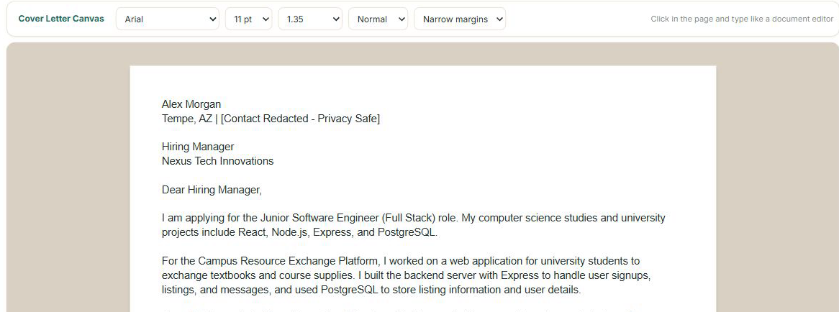
The matching cover letter
A starting point you can revise
1
Open Cover letter.
ATS COACH AI / HOW TO USE
07 / 13
Notes:
Switch to Cover letter. Generate a letter from your application materials, or explore the prepared sample letter. Open its canvas to revise the text and formatting. Check the company, role, and factual claims before downloading your approved PDF.
Open Cover letter.
Review the role, company, and facts.
Edit the letter and download the approved PDF.
Product: https://remix-remix-ats-coach-ai-1403.ai.studio/
Screenshots use anonymized sample application materials.

Slide 8
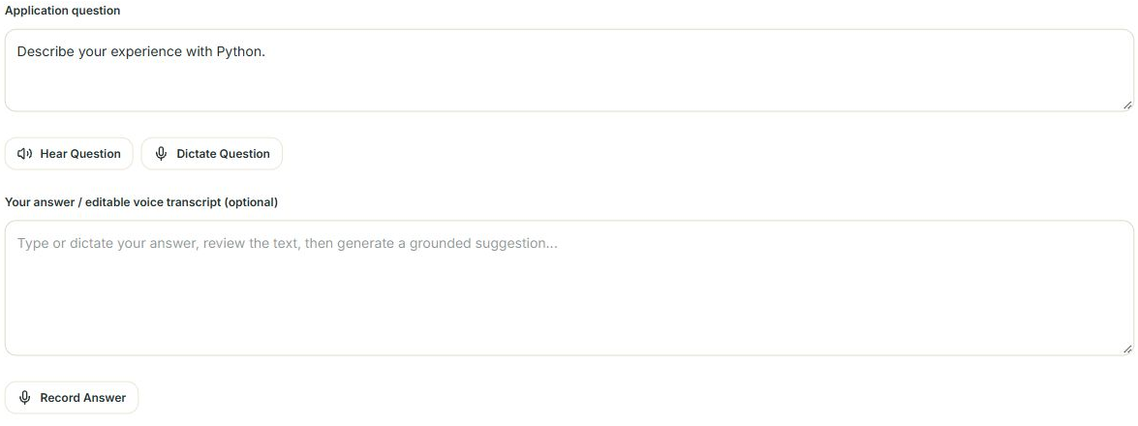
Application questions and answers
Text or voice input with evidence to review
1
2
Type or dictate a question.
ATS COACH AI / HOW TO USE
08 / 13
Notes:
In Application Q and A, type a question or select an example. Hear Question reads it aloud. Dictate Question uses your microphone. You can also record an answer draft, edit the transcript, and request a grounded suggestion with supporting evidence.
Type or dictate a question.
Type or record an answer draft.
Review the suggestion and its evidence before sharing.
Product: https://remix-remix-ats-coach-ai-1403.ai.studio/
Screenshots use anonymized sample application materials.

Slide 9
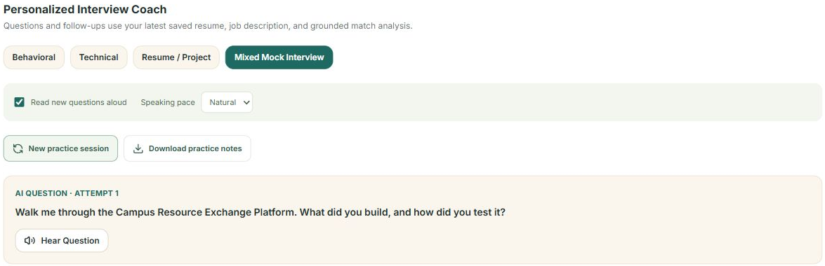
The interview practice session
A question tailored to your application materials
1
2
Choose a practice type and start.
ATS COACH AI / HOW TO USE
09 / 13
Notes:
Open Interview Coach and choose a practice type. Start the interview. The question appears as text and can play aloud automatically. Hear Question repeats it. Choose Slower, Natural, or Faster to adjust the speaking pace.
Choose a practice type and start.
Use Hear Question to repeat the question.
Set the speaking pace to suit you.
Product: https://remix-remix-ats-coach-ai-1403.ai.studio/
Screenshots use anonymized sample application materials.

Slide 10
Your spoken answer becomes editable text
You control what reaches the AI
01
02
03
04
Spoken question
+ written text
Microphone
+ editable transcript
Review
+ Submit Answer
AI feedback
+ follow-up
Only Submit Answer sends the reviewed answer text for feedback.
ATS COACH AI / HOW TO USE
10 / 13
Notes:
Select Start Recording and allow microphone access if prompted. Speak your answer, stop recording, and correct the transcript. Only Submit Answer sends that text for feedback. The sample shows prepared feedback, while live practice evaluates the answer you submit.
Hear the question
Speak or type an answer
Review the text
Submit for feedback
Product: https://remix-remix-ats-coach-ai-1403.ai.studio/
Screenshots use anonymized sample application materials.

Slide 11
Microphone access
Browser and Windows permissions both matter
01
Chrome site controls: Microphone / Allow
02
Windows: Privacy & security / Microphone
03
Enable microphone and desktop app access
04
Save your workspace before reloading
Use the published app in a separate Chrome tab. Text entry remains available.
ATS COACH AI / HOW TO USE
11 / 13
Notes:
If recording is unavailable, open the published app in its own Chrome tab. In the address bar site controls, allow the microphone. In Windows Privacy and security, enable microphone access for desktop apps. Reload only after saving your workspace. Text entry always remains available.
Chrome site controls: Microphone → Allow
Windows: Privacy & security → Microphone
Enable microphone and desktop app access
Save your workspace before reloading
Product: https://remix-remix-ats-coach-ai-1403.ai.studio/
Screenshots use anonymized sample application materials.
Microphone references: https://support.google.com/chrome/answer/2693767
https://support.microsoft.com/en-us/windows/turn-on-app-permissions-for-your-microphone-in-windows-94991183-f69d-b4cf-4679-c98ca45f577a

Slide 12
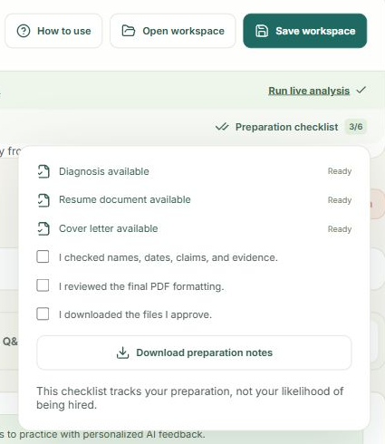
Saving and reviewing your work
Separate workspaces for separate roles
1
Name the application and save the workspace file.
Download answers and interview notes separately.
2
Review facts and final PDFs with the checklist.
Name the application and save the workspace file.
ATS COACH AI / HOW TO USE
12 / 13
Notes:
Name the application and choose Save workspace. Keep the downloaded JSON file, then use Open workspace to restore inputs, diagnosis, documents, and formatting. Download application answers and interview notes separately. The checklist helps you review facts and final PDFs before sharing.
Name the application and save the workspace file.
Download answers and interview notes separately.
Review facts and final PDFs with the checklist.
Product: https://remix-remix-ats-coach-ai-1403.ai.studio/
Screenshots use anonymized sample application materials.

Slide 13
Thank you
You are ready to explore your next application
1. Explore the sample
2. Prepare your own application
remix-remix-ats-coach-ai-1403.ai.studio
ATS COACH AI / HOW TO USE
13 / 13
Notes:
You have seen the complete preparation workflow. Return to the interactive sample whenever you want to explore, or start with your own resume and target role. Use How to use to reopen this guide. Review the facts and choose what to share. Thank you.
Explore the sample
Prepare your own application
Product: https://remix-remix-ats-coach-ai-1403.ai.studio/
Screenshots use anonymized sample application materials.

