Slide 1
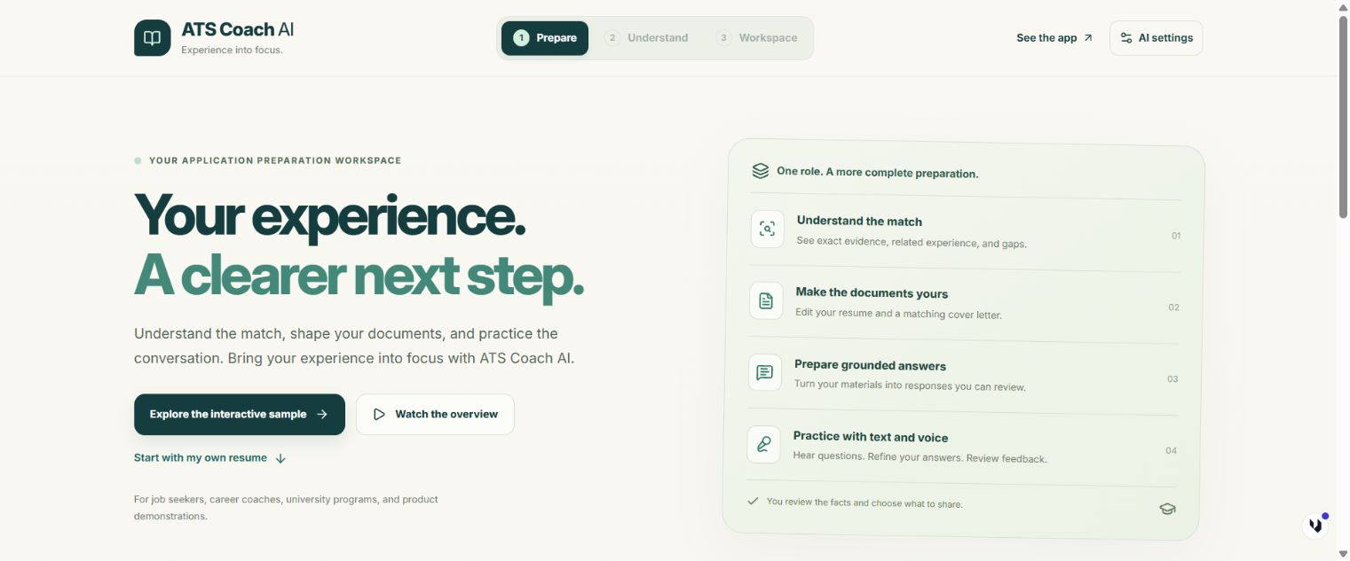
ATS COACH AI
Your experience. A clearer next step.
Understand your fit.
Prepare your application.
ATS COACH AI / PRODUCT OVERVIEW
01 / 8
Notes:
Your experience deserves a clear introduction. ATS Coach AI helps you understand how your background fits a role, prepare your application, and practice the conversation. Explore the complete workflow with an interactive sample.
Product: https://remix-remix-ats-coach-ai-1403.ai.studio/
Screenshots use anonymized sample application materials.

Slide 2
One application workspace
A connected path through preparation
01
02
03
04
Understand the match
Edit your documents
Prepare answers
Practice interviews
Your resume and the target role connect every step.
ATS COACH AI / PRODUCT OVERVIEW
02 / 8
Notes:
Bring a resume and a target job. Review the evidence behind the match, edit your resume and cover letter, prepare application answers, and practice interviews. Each step keeps your own experience at the center.
Understand the match
Edit your documents
Prepare answers
Practice interviews
Product: https://remix-remix-ats-coach-ai-1403.ai.studio/
Screenshots use anonymized sample application materials.

Slide 3
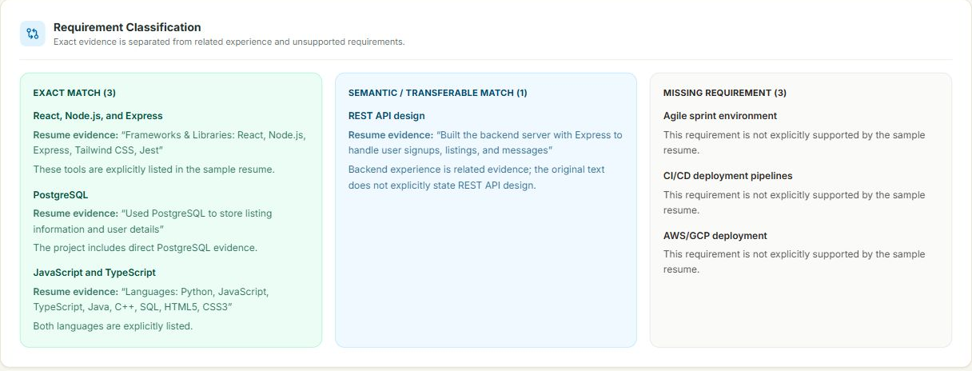
The evidence behind the match
Exact evidence, related experience, and gaps
Anonymized sample. Educational estimates do not predict hiring outcomes.
ATS COACH AI / PRODUCT OVERVIEW
03 / 8
Notes:
The diagnosis explains what your resume supports. Separate exact matches from related experience and missing requirements. Use the educational score as a starting point for review. It does not predict a hiring decision.
Product: https://remix-remix-ats-coach-ai-1403.ai.studio/
Screenshots use anonymized sample application materials.

Slide 4
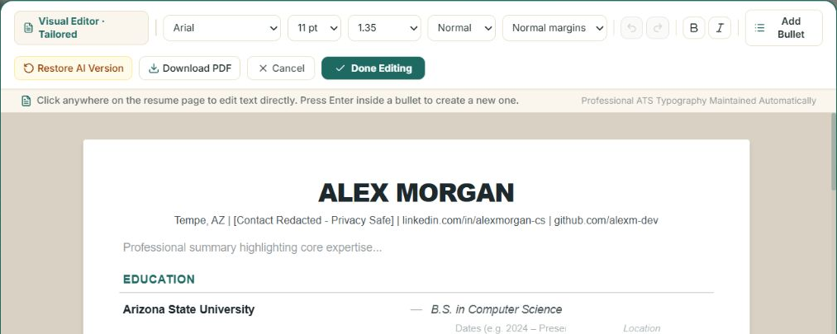
Documents you can make your own
Direct editing with fonts, spacing, and PDF review
01
Edit the text directly
02
Control the formatting
03
Review the final PDF
ATS COACH AI / PRODUCT OVERVIEW
04 / 8
Notes:
Click into the document canvas to edit your text. Adjust the font, spacing, and margins, then review the PDF. A matching cover letter gives you another starting point that you can revise in your own voice.
Edit the text directly
Control the formatting
Review the final PDF
Product: https://remix-remix-ats-coach-ai-1403.ai.studio/
Screenshots use anonymized sample application materials.

Slide 5
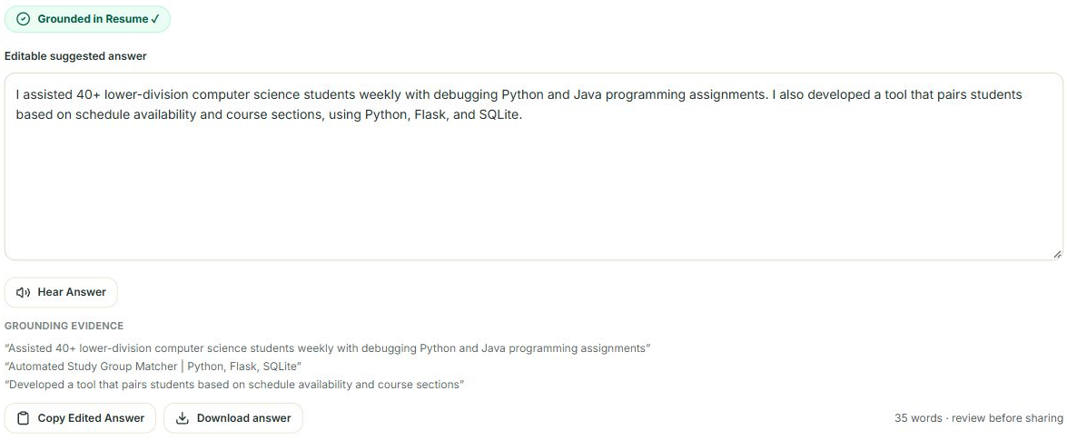
Application answers with evidence
A suggestion you can inspect and revise
Prepared sample answer shown. Live AI actions use your submitted materials.
ATS COACH AI / PRODUCT OVERVIEW
05 / 8
Notes:
Prepare answers using your saved materials. Type a question or dictate it, then review a grounded suggestion and its supporting evidence. Unsupported details prompt a request for information instead of invented experience.
Product: https://remix-remix-ats-coach-ai-1403.ai.studio/
Screenshots use anonymized sample application materials.

Slide 6
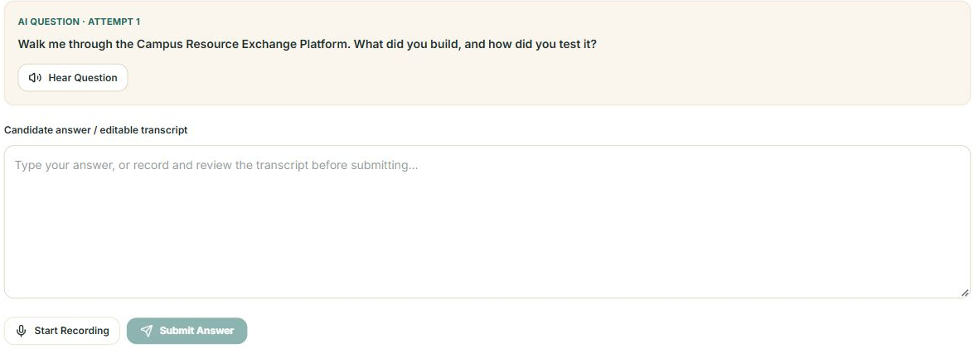
Interview practice with text and voice
Spoken questions and editable answer transcripts
01
Hear the question
02
Review your transcript
03
Learn from feedback
ATS COACH AI / PRODUCT OVERVIEW
06 / 8
Notes:
Hear a question through your speakers. Respond by typing or speaking into your microphone, then review the transcript before submitting. Live practice adds feedback and follow-up questions, with your latest application materials as context.
Hear the question
Review your transcript
Learn from feedback
Product: https://remix-remix-ats-coach-ai-1403.ai.studio/
Screenshots use anonymized sample application materials.

Slide 7
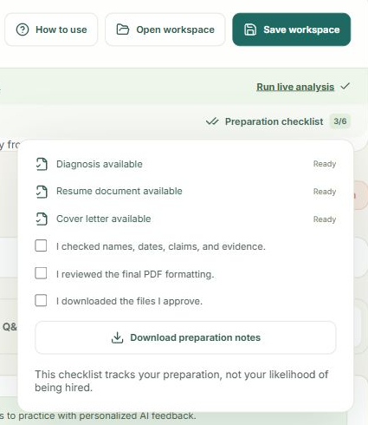
Useful for individual and guided preparation
Job seekers, coaches, universities, and client demos
One workspace for each role
Save locally and reopen later
Review before sharing
Workspace files contain your application materials. Store them with care.
ATS COACH AI / PRODUCT OVERVIEW
07 / 8
Notes:
Job seekers can prepare independently. Coaches and university programs can guide a review using the same explained workflow. Save the application workspace locally, download the files you approve, and keep a separate set for each role.
Product: https://remix-remix-ats-coach-ai-1403.ai.studio/
Screenshots use anonymized sample application materials.

Slide 8
Thank you
Try the interactive sample
1. Open ATS Coach AI
2. Choose the interactive sample
remix-remix-ats-coach-ai-1403.ai.studio
ATS COACH AI / PRODUCT OVERVIEW
08 / 8
Notes:
See how the workflow fits your next application. Open ATS Coach AI and choose Explore the interactive sample. Use the walkthrough whenever you need help. You review the facts and choose what to share. Thank you.
Open ATS Coach AI
Choose the interactive sample
Product: https://remix-remix-ats-coach-ai-1403.ai.studio/
Screenshots use anonymized sample application materials.

