Slide 1
ME623 Dynamics of Machining Processes
Group No: 10
Shivam Kumar Jaiswal 234103437
Deepak Kumar 234103414
Mukesh Kumar 234103423

Slide 2
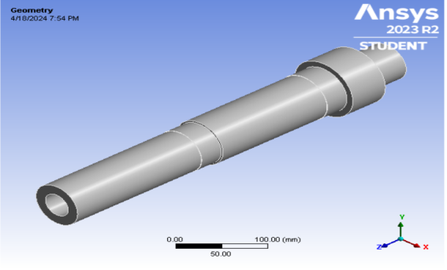
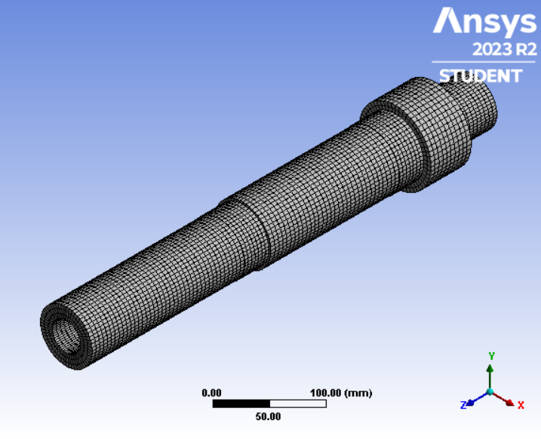
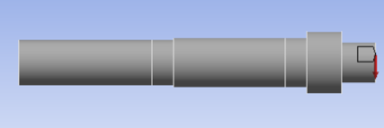

Introduction, Objectives and Methodology
.
Lathe is the conventional machine tool in which Spindle tool is an important mechanical constituent which provides relative motion between work piece and cutting tool during material removal operation.
Static and dynamic analysis of spindle bearing system plays a crucial role as it directly affects the machining, productivity as well as the quality of the product.
Using FEM we determine various stresses and strains under the same boundary conditions in dynamic behavior of lathe spindle under turning operation . And also, observe that the change in deformation.
Fig1.
Fig2.
Boundary Conditions :
Fig3.
Fig4.

Slide 3
Results
Cutting Force(N) | AISI 1045 Carbon Steel | AISI 4140 alloy Steel | AISI 304 Stainless steel | Grey cast iron
610 | .0013768 | .0013954 | .0013428 | .0025055
660 | .0014896 | .0015098 | .0014529 | .0027108
720 | .0016256 | .0018072 | .0016804 | .0029573
790 | .0017388 | .0018072 | .0018438 | .0032776
Cutting Force(N) | AISI 1045 Carbon Steel | AISI 4140 alloy Steel | AISI 304 Stainless steel | Grey cast iron
610 | 5.4472 | 5.4441 | 2.1621 | 5.4466
660 | 5.8937 | 5.8903 | 2.3393 | 5.8931
720 | 6.4295 | 7.0505 | 6.431 | 6.4288
790 | 7.0546 | 7.0565 | 7.0562 | 7.1253
Table 1. Maximum total deformation (mm) variation with cutting force
Table2. Maximum equivalent stress (MPa) variation with cutting force

Slide 4
Results and Discussions
Total deformations of different materials under varied cutting forces are studied different cutting forces are applied on one end and load due to tension in belt is applied on the spindle end.
Total deformation for all four materials at different cutting forces is presented in Table 1. Maximum total deformation is increasing with increment in cutting force. For the cutting force of 790N, maximum deformation of 0.003277 mm is observed in grey cast iron and minimum deformation of 0.001738 mm is in AISI 1045 carbon steel. And from the table 2 it is observed
AISI 304 steel has deformation more than AISI 4140 steel and less than grey cast iron for all the cases. Also, AISI 4140 steel has intermediate values of AISI 1045 carbon steel and AISI 304 Steel deformation values are less in AISI 1045 carbon steel for most of the spindle area. it can be observed that under the same loading condition, the total deformation pattern for the material AISI 1045 carbon steel is different and has the lowest value than other three materials. The location of maximum and minimum deformation regions varied with material.

Slide 5
Results
Rotational Speed (Rpm) | AISI 1045 Carbon Steel | AISI 4140 alloy Steel | AISI 304 Stainless steel | Grey cast iron
1800 | .072021 | .081441 | .067405 | .067418
3500 | .2723 | .30792 | .25485 | .2549
4500 | .45013 | .509 | .42128 | .42136
6000 | .80023 | .9049 | .74894 | .74909
Rotational Speed (Rpm) | AISI 1045 Carbon Steel | AISI 4140 alloy Steel | AISI 304 Stainless steel | Grey cast iron
1800 | 4.5888e-7 | 5.231e-7 | 4.401e-7 | 7.8369e-7
3500 | 1.735e-6 | 1.9778e-6 | 1.6712e-6 | 2.6429e-6
4500 | 2.868e-6 | 3.2694e-6 | 2.7625e-6 | 4.898e-6
6000 | 5.0986e-6 | 5.8122e-6 | 4.9112e-6 | 8.7075e-6
Table 4. Maximum stress (MPa) variation with Rotational Speed (Rpm)
Table 3. Maximum total strain variation with Rotational Speed (Rpm)

Slide 6
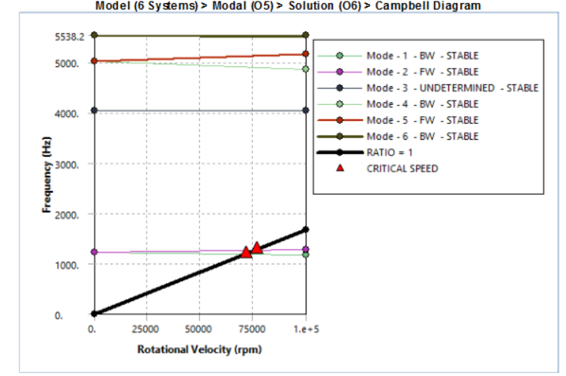
Now the dynamic behavior of spindle with rotational speed is also analyzed with Campbell diagram.
Since the spindle working speed range is between 0 to 6000 rpm, it is expected that the critical speeds are much above this range.
The analysisis conducted for the speeds between 0 to 100000 rpm with multiple load steps in order to find the critical speeds. With the Campbell diagram as shown in Fig. 5, it is also possible to obtain the natural frequency of the spindle at any working speed within the conducted speed range of analysis.
The critical speeds of the spindle are marked on the Campbell diagram. It is found that within the working speed range of the spindle (0-6000 rpm), the critical speeds stay above 1000 Hz
Fig 5.
Mode | Whirl Direction | Mode Stability | Critical Speed (rpm)
1 | BW | STABLE | 71729
2 | FW | STABLE | 76537
Table 4.

Slide 7
Conclusions
Deformations and Equivalent stresses are analyzed with the cutting force ranging from 600 to 800 N. AISI 1045 carbon steel shows the minimum value of maximum total deformation in 790N case, which is 0.0017388 mm. The maximum deformation in grey cast iron is thus high at 790N force (0.0032776 mm), which is not desirable.
Maximum equivalent stress of 7.1253 MPa is observed in grey cast iron and the minimum stress of 7.0546 MPa is observed in AISI 1045 carbon steel. AISI 4140 alloy steel has stresses and deformation less than AISI 304 stainless steel. Overall, AISI 1045 carbon steel showed good results as less stresses and deformation are observed for all the cases of cutting forces. Changes in the values of stresses and strains are less with the change of material. Change of deformation is significant with change of material.
Also, the rotational speed has an effect on the development of stresses and strains in the spindle. Similar to stresses, less variation is observed in the values of strain in lathe spindle with speed. Using Campbell diagram, it is found that within the speed range of the spindle (0-6000 rpm), the critical speeds stay above 1000 Hz.
Results thus give better understanding of the materials suitable for lathe spindle, which is the main rotational component of the machines used in any metal cutting process. This work can be easily applied for any specific spindle with varied parameters like speed and force, as per the application.

