Slide 1
WEEK 1
INTRODUCTION TO WEB DATABASE PROGRAMMING

Slide 2
OBJECTIVES
During this lecture, you will:
Revisit the architecture of the World Wide Web
Review communication protocols and Web addressing
Learn how multiple server processes can run on the same Web server

Slide 3
OBJECTIVES
During this lecture, you will:
Become familiar with data-based Web pages
Examine technologies to create data-based Web pages
Understand eXtensible Markup Language (XML) with data-based Web applications
Understand client-side scripts for validating user inputs in data-based Web pages

Slide 4
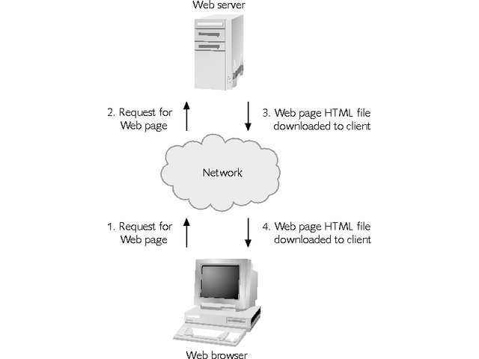
THE ARCHITECTURE OF THE
WORLD WIDE WEB
The Web has a client/server architecture
Programs on servers communicate and share files with client workstations over a network

Slide 5
THE ARCHITECTURE OF THE
WORLD WIDE WEB
Client-side computers that are connected to the Internet use Web browsers to access information on the Internet
Web servers are computers connected to the Internet that run special Web server software
Web servers store the files that people can access via the Internet

Slide 6
THE ARCHITECTURE OF THE
WORLD WIDE WEB
HTML is a document-layout language that defines the content and appearance of Web pages
The listener is a server process that “listens” for messages sent to the server from client browsers
When a Web server receives a message from a browser requesting a Web page, it reads and sends, or downloads, the requested HTML file back across the Internet to the user’s browser

Slide 7
COMMUNICATION PROTOCOLS AND WEB ADDRESSES
Communication protocols are agreements between a sender and a receiver regarding how to send and interpret data
All data transported over the Internet is broken into packets
Transmission Control Protocol (TCP) defines how
  sending computer breaks down long messages into packets
  receiving computer reassembles them into complete messages

Slide 8
COMMUNICATION PROTOCOLS AND WEB ADDRESSES
Internet Protocol (IP) specifies how the sending computer formats message addresses
Every computer connected to the Internet has a unique IP address that specifies the computer’s network location
Information on the World Wide Web is usually transferred via HyperText Transfer Protocol (HTTP)

Slide 9
COMMUNICATION PROTOCOLS AND WEB ADDRESSES
Users request a Web page from a Web server by entering the Web page’s Web address in their browser
A Web address, called a Uniform Resource Locator (URL), specifies:
  Communications protocol (such as HTTP or FTP)
  Domain name or IP address of a Web server

Slide 10
RUNNING MULTIPLE SERVER PROCESSES ON THE SAME WEB SERVER
A server process listens for and responds to requests from clients
Servers using Internet protocols manage multiple listener processes through the concept of ports
A port corresponds to a memory location on a server
Every request sent from a client to a server must specify:
  Server’s IP address
  Port number of the server process to which the message is directed

Slide 11
DATA-BASED WEB PAGES
Whenever a static Web page is accessed, it always displays the same information
In a dynamic Web page, the content varies based on user inputs or data retrieved from external sources
Data-based Web pages refer to dynamic Web pages that
  Derive content from data files or databases
  May be based on user inputs

Slide 12
DATA-BASED WEB PAGES
Data-based Web pages can
  be created using data stored in data files or data stored in a database
  use data retrieved from XML files, which are text files that store data using a standardized structure

Slide 13
CREATING DATA-BASED WEB PAGES USING DIRECT DATABASE RETRIEVALS
Data-based Web pages can be created using data that is retrieved from a database and then placed in the Web page
Server-side or client-side processing can be used to retrieve the data

Slide 14
SERVER-SIDE PROCESSING
Most server-side data-based Web page technologies use HTML forms – enhanced HTML documents that collect user inputs and send them to the Web server for processing
When an HTML form is submitted to a Web server, the servicing program processes the form inputs and dynamically composes a Web page reply
Form servicing programs can be compiled executable programs, uncompiled programs (scripts), or a hybrid of both

Slide 15
SERVER-SIDE COMPILED PROGRAMS
Compiled programs are
  Written in a text-based programming language
  Translated into the machine language
When a program is compiled
  It is stored on the hard drive
  Does not need to be recompiled each time it is run

Slide 16
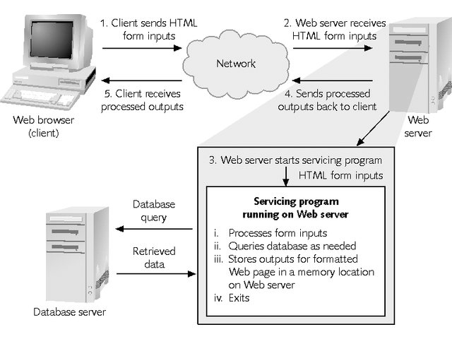
USING A SERVER-SIDE COMPILED PROGRAM TO CREATE A DATA-BASED WEB PAGE

Slide 17
SERVER-SIDE SCRIPT PROCESSING
A script is a computer program that is
  Translated into a machine-readable format
  Executed one line at a time
Scripts execute more slowly than compiled programs
Every time a script is run, it must be translated to machine-readable format
Server-side scripts can do everything compiled programs do

Slide 18
SERVER-SIDE SCRIPT PROCESSING
Older ways of creating server-side scripts
  Use the CGI communication protocol
  Write the script using the PERL scripting language
Originally, Microsoft’s Active Server Page (ASP) technology provided an approach for creating server-side scripts that did not use the CGI protocol
By default, the commands in an ASP file were in the VBScript programming language
Programmers could also create ASPs using the JavaScript language

Slide 19
SERVER-SIDE HYBRID PROCESSING
Hybrid server-side programming combines the advantages of compiled server-side programs and server-side scripts
When a programmer creates a server-side script, it does not need to be compiled explicitly
The first time a user accesses a Web page that calls the script, it is
  Compiled into machine-readable format
  Stored as an executable file

Slide 20
SERVER-SIDE HYBRID PROCESSING
The programmer can always work with an ordinary text file and need not install an integrated programming development environment to modify the script
The program does not need to be translated into machine language each time it runs

Slide 21
SERVER-SIDE HYBRID PROCESSING
Original ASPs used server-side script processing
Java Server Pages (JSPs) use server-side hybrid processing
Server-side hybrid processing
  Reduces the Web server’s processing
  Shortens the user wait to view a response from the Web server
ASP.NET (originally released in 2002)
  Uses the server-side hybrid processing model
  Adds features that simplify database access
  http://en.wikipedia.org/wiki/ASP.NET#Versions

Slide 22
CLIENT-SIDE PROCESSING
Data-based Web pages that perform direct database retrievals can be created using compiled programs that are downloaded and subsequently installed and executed on the client workstation
Such programs send data directly to and retrieve data directly from the database server as needed, bypassing the Web server

Slide 23
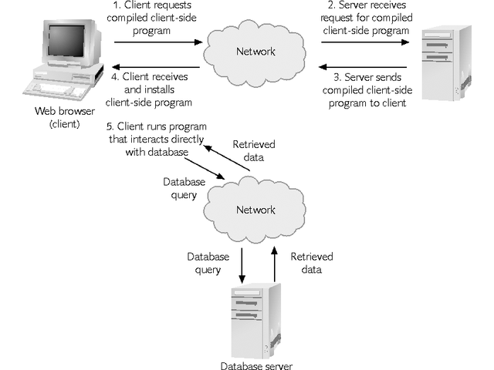
USING A COMPILED CLIENT-SIDE PROGRAM TO CREATE DATA-BASED WEB PAGES

Slide 24
CLIENT-SIDE PROCESSING
Java applets are
  Run in a generic Java runtime environment supplied by most Web browsers
  Can send data to and receive data only from a database server process running on the same computer as the Web server process

Slide 25
CREATING DATA-BASED WEB PAGES USING DATA STORED IN XML FILES
Different applications often use different database and file formats for storing data
Problems may arise when these applications need to share data
One solution: translate data into a standard format, compatible with a variety of applications
XML (eXtensible Markup Language) provides rules, guidelines, and conventions for representing data in a text file format

Slide 26
CREATING DATA-BASED WEB PAGES USING DATA STORED IN XML FILES
In server-side XML processing:
  A conversion program running on the Web server extracts data from the database and converts to an XML format
  The XML data is translated into a formatted HTML file
  The HTML file is then transmitted across the network to the user’s browser

Slide 27
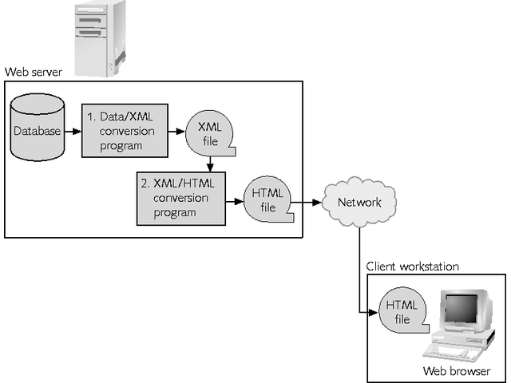
SERVER-SIDE XML PROCESSING

Slide 28
CREATING DATA-BASED WEB PAGES USING DATA STORED IN XML FILES
Client-side XML processing:
  Converts the database data to an XML-formatted file on the Web server and then downloads XML file to the client workstation
  On the client workstation, the XML file is processed by an XML parser running on the client

Slide 29
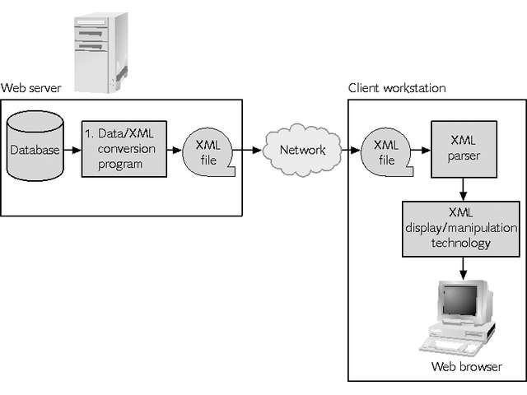
CLIENT-SIDE XML PROCESSING

Slide 30
CLIENT-SIDE SCRIPTS
Client-side scripts:
  Add functionality to Web pages
  Consist of text commands embedded in an HTML document
  Support tasks such as verifying data, opening new browser windows, providing animated graphics, and performing other programming tasks that do not require interaction with the Web server
The most popular language for creating client-side scripts is JavaScript

Slide 31
CREATING DATA-DRIVEN WEB SITES
Many different technologies can be used to create programs that generate data-based Web pages
These technologies differ based on whether the programs:
  Run on the server or on the client workstation
  Whether the programs are stored in a text (script) format or in a machine language (compiled) format

Slide 32
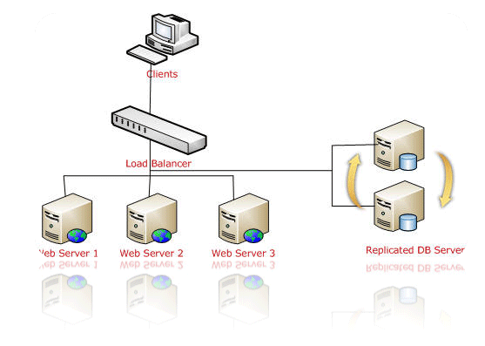
DATABASE-DRIVEN WEB SITE TECHNOLOGIES (WEB FARM)

Slide 33
SUMMARY
The Web has a client/server architecture consisting of Web servers that communicate with client workstations running Web browsers
A communication protocol is an agreement between a sender and a receiver that specifies how to send and interpret data
Every computer that is connected to the Internet has a unique IP address

Slide 34
SUMMARY
Data-based Web pages are dynamic Web pages
Data-based Web pages that derive their data from a database can be created using either server-side or client-side processing
XML provides rules, guidelines, and conventions for representing data in a text file format
Client-side scripts perform tasks such as verifying data and opening new browser windows on data-based Web pages

