Slide 1
WEEK 3 AND 4
USING CLIENT-SIDE SCRIPTS TO ENHANCE WEB APPLICATIONS

Slide 2
OBJECTIVES
In this chapter, you will:
Learn how to create JavaScript programs to validate HTML form inputs
Use arrays to structure data and reference form elements
Use JavaScript commands to validate values represented by HTML form option buttons, check boxes, and selection lists
Learn how to use the Script Debugger to locate and correct errors in client-side scripts

Slide 3
OBJECTIVES
In this chapter, you will:
Learn different ways to display messages in JavaScript programs
Use JavaScript commands to create and read cookies
Use JavaScript commands to change the page that appears in an existing browser window and open a new browser window

Slide 4
USING CLIENT-SIDE SCRIPTS TO VALIDATE HTML FORM INPUTS
Form validation function: client-side script function that validates the HTML form values before sending them to the server
By validating form inputs in a client-side script:
  Browser avoids sending incomplete or incorrect inputs to the Web server
  Speeds up Web page processing

Slide 5
CREATING AND CALLING A FORM VALIDATION FUNCTION
The Web browser executes a client-side form validation function before the browser submits the form values to the Web server
To create an onsubmit event handler, which calls a form validation function from within the <form> tag, the following general syntax is used:
<form onsubmit="return form_validation_function ()">
In the onsubmit event handler syntax, the keyword return should always be used

Slide 6
CREATING AND CALLING A FORM VALIDATION FUNCTION
If the form validation function returns
  True: the browser submits the form to the Web server
  False: the browser does not submit the form to the Web server
If return is omitted, the event handler:
  Calls the form validation function
  Submits the form to the Web server regardless of the value that the function returns

Slide 7
CREATING AND CALLING A FORM VALIDATION FUNCTION
When the onsubmit event handler is used to call a form validation function, the function must be structured so that it tests whether multiple different error conditions exist
Use an if/else if decision control structure to test for multiple different error conditions
Each condition tests to determine whether a specific error condition is true

Slide 8
VALIDATING NUMERIC AND DATE INPUT VALUES
isNaN() function:
  Verifies that the value the user enters in a text input is numeric
  Returns:
    true if the parameter passed to it is not a number
    false if the parameter passed to it is a number

Slide 9
VALIDATING NUMERIC AND DATE INPUT VALUES
isNaN() call is placed in an if decision structure using the following syntax:
if (isNaN (input_string ) == true) {
//commands to execute if input_value is not a number
}
input_string parameter: the value that the function evaluates as numeric or non-numeric

Slide 10
VALIDATING NUMERIC AND DATE INPUT VALUES
To test for a valid date value:
  Date object is created
  Its value property is assigned as either a text string or a value represented by a variable, using the following syntax:
var date_object_name = new Date (date_value )
If date_value is a string literal, the value must be enclosed in quotation marks
If date_value references a variable or a form element, the name is not enclosed in quotation marks

Slide 11
VALIDATING NUMERIC AND DATE INPUT VALUES
Create a new date object, evaluate whether a date object is a valid date value, and then execute commands if the date value is not valid:
var date _object_name = new Date (value );
if (date_object_name == "NaN") {
//commands to execute if value is not a date
}

Slide 12
USING ARRAYS TO REFERENCE FORM ELEMENTS
Array: a data structure to store and process similar data items
Row number is called the array index
Each row has an associated data value in the first column, which is called an array element or item
Arrays can be particularly useful for validating several inputs having the same data type

Slide 13
CREATING AND PROCESSING AN ARRAY
Array creation: an instance of the JavaScript built-in Array object is created using the following syntax:
var arrayName = new Array ([size ]);
The size parameter is optional
An error will occur if a programmer tries to reference an array item that is beyond the maximum array size

Slide 14
CREATING AND PROCESSING AN ARRAY
Create a new array item and assign a value to it:
arrayName [index ] = value ;
index references the row number to which the associated value is assigned
To reference a specific array value:
value = arrayName [index ];

Slide 15
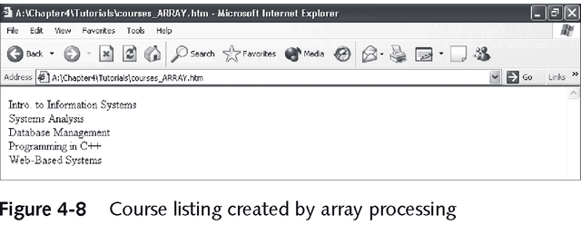
CREATING AND PROCESSING AN ARRAY
Loops are usually used to process array values
The starting index value is always 0
To determine the final array index value, the Array object’s length property is used

Slide 16
USING ARRAYS THAT REFERENCE
DOCUMENT OBJECTS
JavaScript commands reference Web page objects using the HTML document object model (DOM)
When a browser loads an HTML document, it creates arrays to reference DOM objects
For example, if an HTML document contains two separate sets of <form> tags, the browser creates an array named forms to reference the document’s form objects

Slide 17
USING ARRAYS THAT REFERENCE
DOCUMENT OBJECTS
A programmer can reference these forms using the following dot syntax:
document.forms [0]
document.forms [1]
These document arrays are useful in writing JavaScript commands to systematically examine all objects in a document or a form

Slide 18
VALIDATING RADIO BUTTON, CHECK BOX, AND SELECTION LIST VALUES
The form validation functions created so far evaluate values that users enter into form text inputs
HTML forms also allow users to specify input values using form controls such as radio buttons, check boxes, and selection lists
Referencing the values that these controls represent in JavaScript commands requires different programming approaches from those used for form text inputs

Slide 19
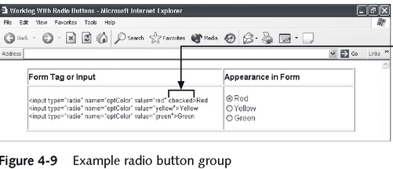
VALIDATING VALUES REPRESENTED BY RADIO BUTTONS
Radio button group: allows the user to select a value from a predefined group of related values
Radio button group: defined by specifying that multiple radio buttons have the same name attribute

Slide 20
VALIDATING VALUES REPRESENTED BY RADIO BUTTONS
When a form contains radio buttons, programmers often need to verify that the user has checked one of the buttons
The form validation function must examine each radio button in the radio group and determine whether its checked property value is true
To support this process, the browser maintains an array for every radio button group

Slide 21
VALIDATING VALUES REPRESENTED BY RADIO BUTTONS
To reference an individual radio button within an HTML form radio button group array:
document.form_name .radio_group_name [i ]
The array index value i indicates the number of the radio button within the group, and corresponds to the order in which the buttons are defined in the form

Slide 22
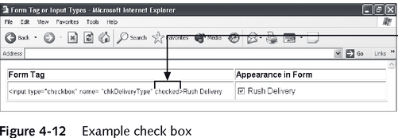
VALIDATING VALUES REPRESENTED BY CHECK BOXES
Check box: can be used on a Web form to define an element that can have one of two opposite values
Unlike radio buttons, check boxes do not exist in groups

Slide 23
VALIDATING VALUES REPRESENTED BY CHECK BOXES
To determine status of a check box use the following syntax:
if (document.form_name .checkbox_name .checked == true) {
commands to execute if the check box is checked
} else {
commands to execute if the check box is cleared
}

Slide 24
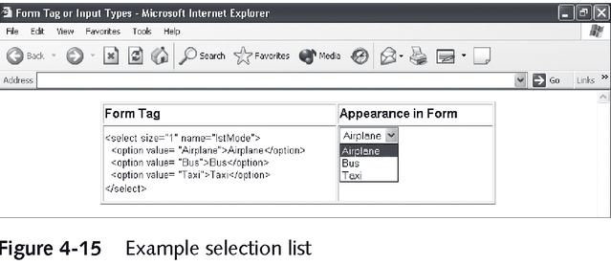
VALIDATING VALUES FROM SELECTION LISTS
Selection list: allows the user to select predefined values
When a form contains a selection list, the browser maintains an array named options to reference the list’s elements

Slide 25
VALIDATING VALUES FROM SELECTION LISTS
Each list element can be referenced as follows:
document.form_name .list_name .options [i ]
The index i references each individual list element
The selectedIndex property specifies the index value of the list element that is currently selected
  If the selectedIndex property value is 0 or greater, a list item is selected
  If no list item is selected, the selectedIndex property value is the default value, –1

Slide 26
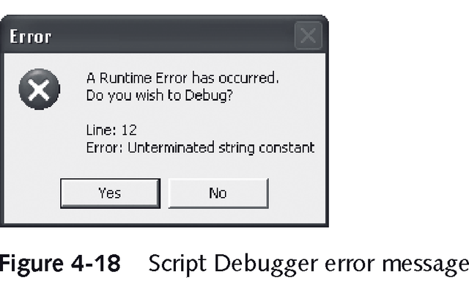
USING THE SCRIPT DEBUGGER TO DEBUG CLIENT-SIDE SCRIPTS
When Visual Studio .NET is installed on the workstation and Internet Explorer is configured to use the default script error settings, a Script Debugger error message box appears when a script error occurs

Slide 27
FINDING ERRORS USING SCRIPT DEBUGGER MESSAGES
To find errors using Script Debugger error messages, the line number on which the error occurred is noted
Then No is clicked on the default error message dialog box to ignore the error and open the Web page in Internet Explorer
After that, the associated script command line is examined in Visual Studio .NET and an attempt is made to locate the error

Slide 28
FINDING ERRORS USING THE SCRIPT DEBUGGER IN VISUAL STUDIO .NET
The Script Debugger allows the programmer to:
  Step through individual script commands
  View how script variable values change during execution
  Identify the command line on which errors occur
To start the Script Debugger from a Script Debugger error message, click Yes on the error message, make selections in the dialog boxes, and connect the debugger to the browser execution process

Slide 29
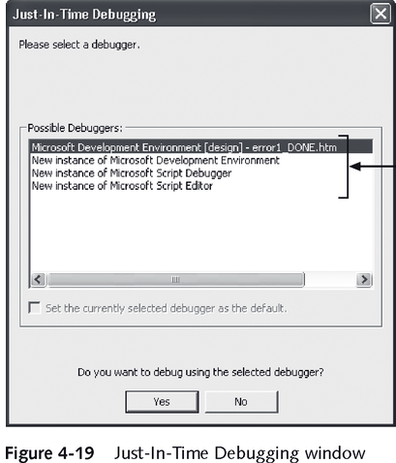
FINDING ERRORS USING THE SCRIPT DEBUGGER IN VISUAL STUDIO .NET
Possible Debuggers list: to select from different debugging applications that are installed on the workstation

Slide 30
FINDING ERRORS USING THE SCRIPT DEBUGGER IN VISUAL STUDIO .NET
There are two basic types of program errors: syntax errors and logic errors
Syntax error: programmer writes a command that does not follow the rules of the programming language
Logic error: programmer writes a command that follows the rules of the language, but does not perform the operation as intended

Slide 31
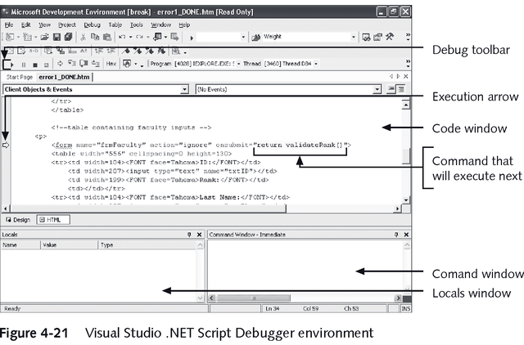
THE SCRIPT DEBUGGER ENVIRONMENT

Slide 32
THE SCRIPT DEBUGGER ENVIRONMENT
Script Debugger: programmers can create breakpoints on script commands
Breakpoint:
  Pauses execution on a specific command
  Allows the programmer to examine the current values of variables
  Allows the programmer to step through subsequent commands and view
    Execution through control structures
    Variable value changes

Slide 33
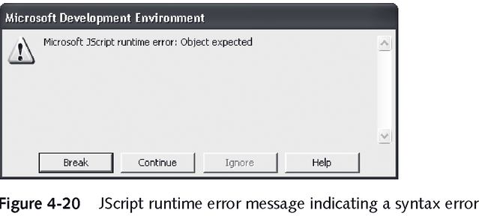
USING THE SCRIPT DEBUGGER TO IDENTIFY SYNTAX ERRORS
When a script has syntax errors, a JScript runtime error message usually appears

Slide 34
USING THE SCRIPT DEBUGGER TO IDENTIFY SYNTAX ERRORS
If the Script Debugger is started, the program will break on the code line with the syntax error or the line that calls the erroneous function
Stop Debugging button: Use this when you locate the error
The file then appears in the Visual Studio .NET development environment, where the error can be corrected

Slide 35
VIEWING VARIABLE VALUES IN THE SCRIPT DEBUGGER
Three ways to view variable values in the Script Debugger:
  Move the mouse pointer over the variable in a command in the code window; the variable’s current value appears in a ScreenTip
  Watch: a watch can be created to observe how a variable value changes during execution
  To view a variable value in the Command window, a question mark must be typed in the window, followed by the variable name

Slide 36
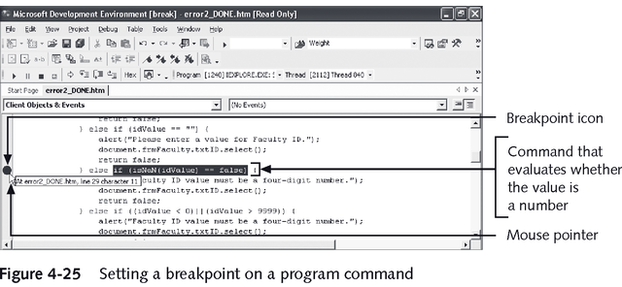
USING THE SCRIPT DEBUGGER TO SET BREAKPOINTS AND FIND LOGIC ERRORS
To debug scripts with many commands, it is useful to create a breakpoint to pause program execution on a specific command

Slide 37
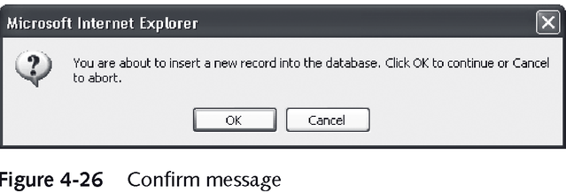
DISPLAYING A CONFIRM MESSAGE
A confirm message displays a message similar to an alert, but also displays two buttons: OK and Cancel

Slide 38
DISPLAYING A CONFIRM MESSAGE
A confirm message is created using the JavaScript window.confirm() method
Then, an if/else control structure is written to evaluate whether the user clicks OK or Cancel and execute different commands for each case
The following general syntax is used to create a confirm message:
var return_value = window.confirm ("message ");

Slide 39
DISPLAYING A CONFIRM MESSAGE
To evaluate which button on a confirm message the user has clicked and then execute appropriate commands, the following if/else control structure is used:
if (return_value == true) {
commands to execute if the user clicks OK
} else {
commands to execute if the user clicks Cancel
}

Slide 40
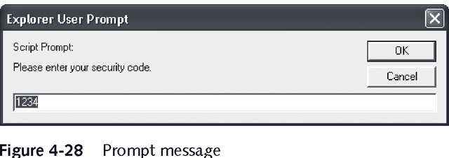
DISPLAYING A PROMPT MESSAGE
A prompt message displays a message, a text input, and OK and Cancel buttons

Slide 41
DISPLAYING A PROMPT MESSAGE
The window.prompt() method is used to create a prompt message
If the user clicks OK, the window.prompt() method returns the text value that the user entered into the prompt’s text input
If the user clicks Cancel, the window.prompt() method returns the JavaScript value null, which means the value is undefined

Slide 42
DISPLAYING A PROMPT MESSAGE
The general syntax for creating a prompt message is:
var return_value = window.prompt
("message ", ["initial_value "]);
To evaluate the value that the user enters in the prompt text input, an if/else, if/else if, or switch control structure is used

Slide 43
USING CLIENT-SIDE SCRIPTS TO CREATE COOKIES
Cookies: data items stored on the browser’s computer
Temporary cookies: also called session cookies, store information in the main memory of the user’s computer
When the browser session ends, the system reclaims this memory space, and the cookie information is no longer available
Persistent cookies: store information in text files on the user’s workstation
  This information is available after the user exits the browser

Slide 44
STRUCTURING COOKIE INFORMATION
Although a cookie can store information in any format, the convention is to store information in ordered pairs of variable names and associated values using the following format:
variable_name = variable_value
A cookie can contain multiple name/value pairs
Each name/value pair is separated using a semicolon (;)

Slide 45
CREATING AND REFERENCING TEMPORARY COOKIES
To reference a document’s cookie property, the following dot syntax is used:
document.cookie
A temporary cookie is created as follows:
document.cookie = "variable_name =" + "variable_value ";
To retrieve the contents of a cookie, the document.cookie property is referenced to return the name of the cookie variable and the associated text string

Slide 46
CREATING PERSISTENT COOKIES
A persistent cookie must specify an expiration date
Persistent cookie syntax:
document.cookie = "variable_name =" + "variable_value " + ";
expires=expiration_date ";
The expiration_date is specified as a text string using the following date format:
Day, dd-Mon-yyyy hh:mm:ss GMT

Slide 47
RETRIEVING INDIVIDUAL COOKIE VARIABLE VALUES
Because a single cookie usually stores multiple name/value pairs, programmers often need to extract a single value
GetCookie
  Can be used to search a cookie
  Finds a desired cookie variable name and returns the associated variable value
To call the GetCookie() function:
var variableValue = GetCookie (variable_name );

Slide 48
NAVIGATING TO A NEW WEB PAGE IN THE CURRENT BROWSER WINDOW
To display a new Web page in the current browser window, the window’s window.location.href property is assigned the URL of the new Web page using the following syntax:
window.location.href = "Web_page_URL "
The Web_page_URL specifies the new Web page using any valid URL format

Slide 49
OPENING A NEW BROWSER WINDOW
window.open(): displays a new Web page in a new browser window:
var window_identifier = window.open (["Web_page_URL "], ["target "], ["option_list "])
The window_identifier can be omitted in the method call if there is no need to manipulate the window using the window object methods
All of the window.open() method parameters are optional

Slide 50
SUMMARY
Form validation function: client-side script that confirms that the user has entered all required values in an HTML form and that the values are valid
Array: data structure that organizes similar data items in a list structure
Script Debugger:
  Step through individual script commands
  View how script variable values change
  Identify the command line on which errors occur

Slide 51
SUMMARY
Syntax error: programmer writes a command that does not follow the rules of the programming language
Logic error: programmer writes a command that follows the rule of the language, but does not perform the operation as intended
ScreenTips, watches, or the Command window are used in the Script Debugger to view variable values during program execution
Cookie: contains information that a Web server stores on a user’s computer

