Slide 1
HTML Review

Slide 2
Objectives
In this chapter, you will:
Learn about the Visual Studio .NET integrated development environment
Review HTML documents and basic HTML commands

Slide 3
Objectives
In this chapter, you will:
Use the Visual Studio .NET HTML Designer to create static Web pages
Create HTML tables
Use HTML commands to create hyperlinks in HTML documents
Create HTML forms that accept user inputs

Slide 4
The Visual Studio .Net Integrated Development Environment
Visual Studio .NET is an integrated development environment (IDE) for creating Windows and Web-based applications
IDE helps programmers:
  Develop programs
  Display multiple windows for different tasks
Visual Studio Start Page is the default home page for the Visual Studio .NET Web browser

Slide 5
The Visual Studio .Net Integrated Development Environment
A project is a set of related files comprising an application
The Solution Explorer window lists all solutions that are currently open in the IDE
A solution consists of one or more projects
When a new project is created on the Start Page, the IDE automatically creates a new solution
New projects can be added to an existing solution

Slide 6
HTML Documents and Basic HTML Commands
HTML
  A document layout language with hypertext-specification capabilities
  Consists of special formatting symbols that developers use to specify the document’s appearance
Hypertext allows navigation through a document by following links represented by keywords or images

Slide 7
HTML Documents and Basic HTML Commands
HTML documents
  Text files with .htm or .html extensions
  Contain formatting symbols, called tags, which define how a Web page appears in a Web browser
  Contain text that appears on the Web page
HTML files can be created using:
  Text editor
  HTML converter
  HTML editor

Slide 8
HTML Tags
HTML tags are enclosed in angle brackets (< >) using the following general syntax:
<tag_name>element</tag_name>
Elements can be enclosed in multiple tag pairs to specify multiple formatting instructions
Tags can be modified with attributes, which instruct the tag to display its enclosed element in a certain way
The general syntax for a tag attribute is:
attribute_name ="attribute_value "

Slide 9
HTML Document Structure
The first line contains the document type declaration tag, or DOCTYPE tag, which specifies the HTML version that the developer used to create the Web page
The <html> opening and closing tags tell the interpreter to process the enclosed text as an HTML document
The <head> opening and closing tags enclose the document’s header section, which contains information about the Web page

Slide 10
HTML Document Structure
The header section:
  Contains meta tags
    Information about the Web page that the Web page does not display
  Defines the Web_page_title
    The text that appears in the title bar of the user’s browser window when the page appears
The Web_page_body_elements are the text, graphics, and other elements comprising the content of the Web page, and the HTML tags that format the Web page content

Slide 11
Using Visual Studio .NET to Create an HTML Document
HTML Designer is the Visual Studio HTML editor
The HTML Designer provides two views of the document:
  Design view
  HTML view
Design view: specifies Web page content as it will appear in the user’s browser
HTML view: view and edit the underlying HTML tags and Web page content

Slide 12
HTML Headings
HTML headings can create page headings consisting of large font text that is distinct from the other text on a Web page
A heading is created using a heading tag
<h level_number >heading_text </h level_number >

Slide 13
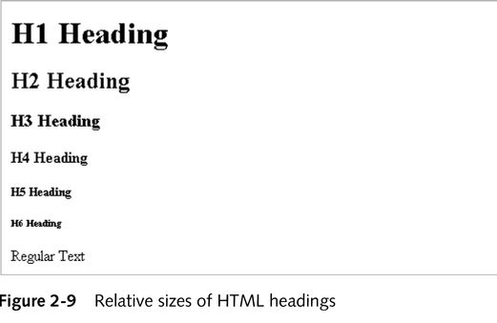
HTML Headings
HTML supports six levels of headings, numbered from 1 to 6
Level 1 headings use a very large font size, and level 6 headings use a very small font size

Slide 14
Modifying the Alignment of Web Page Text
By default, headings are always left-justified
The HTML align attribute allows different alignment
The basic syntax of an opening level 1 heading tag with the align attribute is:
<h1 align="desired_alignment ">
Alignment values are center, right, and left

Slide 15
Modifying the Alignment of Web Page Text
Style attribute: another way to change the alignment of Web page text
Style attribute syntax is:
style="style_name :style_value”
style_name parameter identifies the style, such as the font size or background color
style_value parameter specifies the corresponding style value

Slide 16
Text Formatting Commands
Tags and special characters must be added to display blank spaces and to create line breaks
Special formatting characters can add non-keyboard elements such as bullets
The paragraph tag (<p>) places in a new paragraph
The line break tag (<br>) inserts a line break

Slide 17
Text Formatting Commands
Align attribute specifies paragraph alignment
Paragraph tag syntax with align attribute:
<p align="desired_alignment ">
Character entities are numbers or character strings inserted directly within the Web page body text
Character entity codes are always preceded with an ampersand (&) and followed with a semicolon (;)

Slide 18
Text Formatting Commands
HTML character tags help specify text properties
  boldface, superscript, or italic font styles
Text can be enclosed in multiple character tags to specify multiple formatting instructions
To comply with the XHTML standard, the tags must be nested, with closing tags in the reverse order of the opening tags

Slide 19
Graphic Images
Web pages usually contain graphic images and objects to make them more appealing or to convey visual information
Inline images appear directly on the Web page, and the user’s browser loads them while loading the Web page

Slide 20
Graphic Images
Image tag:
  displays an inline graphic image in a Web page
  <img src="image_filename "/>
The src attribute specifies the image source file
image_filename value is the name of a graphics file (.gif or .jpg extension)

Slide 21
Graphic Images
The image_filename value can be
  An absolute file path
  A relative file path
  An absolute URL location
Absolute file path: exact location of a file in the browser’s file system, including the drive letter, complete folder path, and file-name
Relative file path: file location relative to the location of the current HTML file
Absolute URL: location of a graphics file on a Web server

Slide 22
Graphic Images
By default, images appear on the left edge of a Web page
Width and height can be specified with the width attribute and the height attribute within the image tag using the following syntax:
<img src="image_filename " width="desired_width "height="desired_height "/>
Alternate method: use the style attribute and values for the WIDTH and HEIGHT style names, with the general syntax:
style="WIDTH: Npx"

Slide 23
Graphic Images
Horizontal rule: horizontal line that separates a Web page into sections for easier reading
Horizontal rule tag creates a horizontal rule
Syntax: <hr />

Slide 24
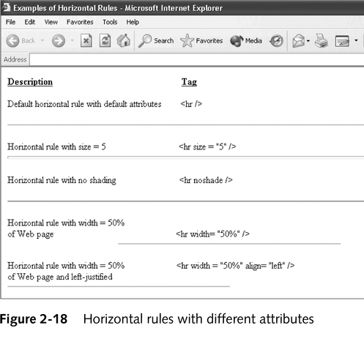
Graphic Images

Slide 25
HTML Lists
Unordered HTML lists: items have no particular order
Use the unordered list tag (<ul>)
Each list item is defined using the list item tag (<li>)

Slide 26
HTML Lists
Ordered lists: items have a definite sequential order
An ordered list is defined using the ordered list tag (<ol>)
Each list item is included within the opening and closing ordered list tag using the list item tag

Slide 27
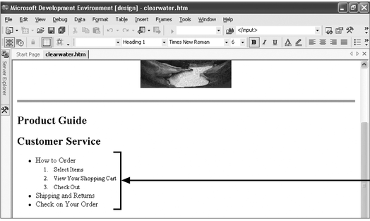
Ordered Lists and Unordered Lists

Slide 28
Comments in HTML Documents
Comments:
  Not visible when the Web page appears in a Web browser
  Users can view the HTML source code for the page and view the comments
Opening comment tag syntax: <!--
Closing comment tag syntax: -->

Slide 29
Tables in Web Pages
HTML tables:
  Display Web page elements in columns and rows
  Allow the HTML designer to control relative position of elements
  Useful for displaying data retrieved from relational databases
  Useful for displaying text next to graphic images instead of above or below them, and for displaying graphic images beside each other

Slide 30
HTML Table Definition Tags
An HTML table can be defined using the table tag: <table>table_contents </table>
Individual rows within the table_contents are defined using the table row tag (<tr>)
Individual elements are defined within each row using the table data tag (<td>)
Elements within table data tags can be text, graphic images, lists, other tables, or most other types of Web page elements

Slide 31
Table Size and Alignment
Web browsers determine
  Width of a table based on the widths of the data values in the individual table columns
  Height based on the number of data rows
Table size can also be specified using width and height attributes within the table tag
By default, browser tables align on the left edge of the Web page
The align attribute ("desired_alignment") can change the table alignment

Slide 32
Column Headings
Heading row displays the column heading text in a larger, boldface font
Create column headings with the table heading tag (<th>) in place of the table data tag for the first column row
By default, table headings appear centered within table columns
A table can have multiple heading rows

Slide 33
Table Borders and Cell Spacing
Border attribute:
  Instructs the browser to display a table border
  Gridlines around the table columns and rows
  Syntax: border="thickness”
Cellspacing attribute:
  Determines the amount of space, in pixels, between the inside border lines of adjacent table cells
  Syntax: cellspacing="spacing”

Slide 34
Table Borders and Cell Spacing
Cellpadding attribute:
  Amount of space, in pixels, between the inside cell border and the object or text within the cell
  Syntax cellpadding="padding“

Slide 35
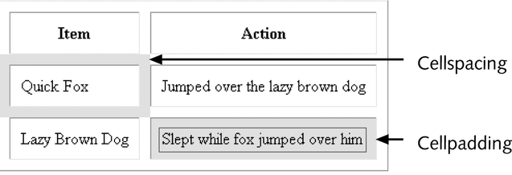
Table Borders and Cell Spacing

Slide 36
Specifying Table Column Widths
Web browsers automatically size the width of table columns based on the data values they contain
Width attribute:
  Specify the widths of table columns explicitly
  Added to the table heading tag for each column in the row that contains the table headings, usually the first row of the table
In Visual Studio .NET, HTML designers can visually resize the columns

Slide 37
Aligning Table Objects
By default, table data items appear left-justified and vertically centered within table cells
Align and vertical align attributes control vertical align and vertical text placement
Syntax: valign="vertical_alignment "

Slide 38
Hyperlinks
Hyperlink:
  Reference in an HTML document that enables a user to jump to another location
  Can be associated with a single keyword, a group of words, or a graphic object
  Can reference an object on the same Web page or a separate HTML document
  Could also be associated with a Web processing program that creates a dynamic Web page

Slide 39
Hyperlinks
Link tag creates a hyperlink to a different Web page
Opening link tag syntax: <a href="marker ">
The closing link tag is </a>

Slide 40
HTML Forms
HTML forms are enhanced HTML documents that look like paper forms
When a user submits a form to the Web server, the browser
  Submits the value of each form element to the Web server as a parameter
  Submits the form element values in a parameter list, containing the name of every form element and its current value
A form can be created anywhere within an HTML document using the form tag

Slide 41
HTML Forms
Input Boxes
  Web page developers use input boxes to gather text inputs
Command Buttons:
  A command button is a form element that a user clicks to perform an action
  A special kind of command button called a submit button can be created by setting the type attribute value to submit

Slide 42
HTML Forms
Command Buttons:
  When a user clicks a submit button, the form submits the values of the form elements as parameters to a form processing program defined in the form definition tag
  A reset button can also be created in a Web form
  Reset button: form clears all form element values or resets them to their initial values
  To create a reset button, the input type attribute value is set to reset

Slide 43
HTML Forms
Radio Buttons:
  Radio buttons allow the user to select a single value from a group of related values
  Related radio buttons are defined as a radio button group, which allows the user to select only one button in the group at one time
  Each radio button in a radio button group has the same name attribute value

Slide 44
HTML Forms
Check Boxes:
  Define an element that can have one of two opposite values, such as true or false, or on or off
  If the check box’s input tag contains the checked attribute, the check box appears checked when the form first opens
Text Areas
  A text area is an input box that can contain multiple lines of text

Slide 45
HTML Forms
Selection Lists:
  Define a list from which the user can select specified values
  The Web developer can populate the list using static values or from a database
Hidden Form Elements
  A hidden form element is an element that is not visible to the user
  Developers use hidden form elements to submit data values to the Web server that are not currently visible on the form

Slide 46
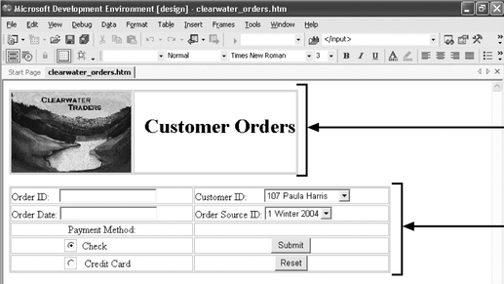
Creating a Web Form
This Web page contains a form that Clearwater Traders customers would use to enter order information

Slide 47
Summary
Visual Studio .NET is an integrated development environment for creating applications
HTML is a document layout language that can be used to define the structure and appearance of Web pages and to enable Web pages to contain embedded hypertext links to other documents or Web pages
An HTML document contains Web page elements, which include the text and images that appear on the Web page, and HTML tags, which are codes that define how the Web page elements appear

Slide 48
Summary
HTML documents can contain tables to display Web page content in a matrix format
A hyperlink is a reference in an HTML document that allows the user to jump to an alternate location
HTML forms collect user inputs using form elements, such as input boxes, radio buttons, command buttons, check boxes, selection lists, and text areas

