Slide 1
WEEK 2
INTRODUCTION TO CLIENT-SIDE SCRIPTS
1

Slide 2
OBJECTIVES
In this chapter, you will:
Learn how to reference objects in HTML documents using the HTML Document Object Model and dot syntax
Learn how to create and debug client-side scripts that use JavaScript methods, event handlers, and custom functions
Create and manipulate JavaScript variables
Create and use JavaScript built-in objects

Slide 3
OBJECTIVES
In this chapter, you will:
Learn how to use JavaScript global functions to perform data type conversions
Become familiar with JavaScript decision control and looping structures
Understand the differences between JavaScript and Java

Slide 4
WHAT JAVASCRIPT CAN DO
JavaScript allows you to:
Display information based on the time of the day
Detect the visitor's browser
Control Browsers' window aspect (size, buttons) when you open another web page
Validate forms data (using regular expressions)
Create Cookies to remember user choices for the next time he visits a website
Add interactivity to your website based on browser events and user interaction
Change page contents dynamically without taking a new trip to the server

Slide 5
WHAT JAVASCRIPT CANNOT DO
JavaScript does not allow you to:
Write to files on the server without the help of a server side script
Access databases unless you use Ajax
Read from or write to files in the client
Close a window if it didn't open it
Access scripts and info from web pages hosted on another domain (same origin security policy)
Protect your page source or images

Slide 6
REFERENCING HTML DOCUMENT OBJECTS
To enhance Web pages, JavaScript program commands must be able to reference objects on a Web page
JavaScript commands reference Web page objects using the HTML document object model (DOM)

Slide 7
OBJECT-ORIENTED CONCEPTS
Object: abstract representation of something in the real world, with specific properties and actions
Object class: defines the properties and actions of similar objects
Class instance: object that belongs to a class
Event: an action that occurs within an object as a result of a user action
Event handler: block of program commands that executes when an event occurs

Slide 8
THE HTML DOCUMENT OBJECT MODEL
The HTML document object model (DOM):
  Hierarchical naming system
  Enables a developer to reference and access HTML objects and their properties, methods, and events within JavaScript commands
Current browsers support the basic DOM, first introduced in Netscape Navigator 2

Slide 9
THE HTML DOCUMENT OBJECT MODEL
In the DOM currently used:
  Window: top-level object class; represents a browser window
  Child object classes within a window: history, document, and location
  A document object contains all of the elements, or child objects, on a Web page
  Primary child objects: link, form, and anchor

Slide 10
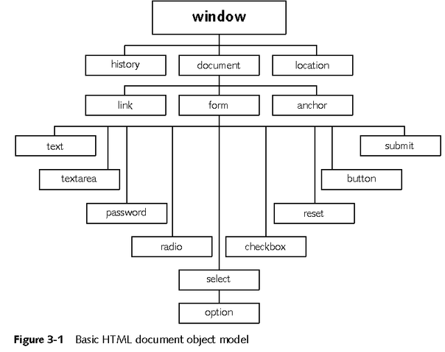
THE HTML DOCUMENT OBJECT MODEL

Slide 11
REFERENCING HTML OBJECTS USING DOT SYNTAX
Dot syntax: references an object in an HTML document based on its hierarchical location among the DOM HTML objects
This hierarchy is called the object path

Slide 12
DOT SYNTAX USING OBJECT NAMES
An HTML link, form, or anchor object can be referenced using its object name in dot syntax as follows: window.document.object_name
To reference a child element within a document form, a dot is placed after the form’s object_name and then the name of the form element is specified
Once you specify the object path, you can then reference an object’s properties and call its methods

Slide 13
DOT SYNTAX USING OBJECT IDS
Object ID attribute:
  alternate way to reference HTML objects in dot syntax
  uniquely identifies an element within an HTML document
  can be used instead of the name attribute value when specifying the path to an object
Any HTML tag can have an ID attribute value

Slide 14
USING THE VISUAL STUDIO .NET IDE TO CREATE A CLIENT-SIDE SCRIPT
IntelliSense lists can be used to provide choices in JavaScript commands
The IntelliSense information lists available child objects, methods, properties, and events that can be used to complete HTML, dot syntax, and program statements
Items within the IntelliSense lists have visual icons to specify the item type

Slide 15
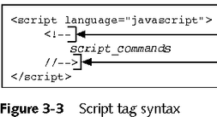
ADDING SCRIPT TAGS TO AN HTML DOCUMENT
Client-side script can be created by enclosing JavaScript commands within the script tag
JavaScript commands are usually enclosed in HTML comment tags

Slide 16
ADDING SCRIPT TAGS TO AN HTML DOCUMENT
JavaScript commands:
  Are case-sensitive
  Can span multiple lines in a text editor and HTML file
  End of each command is designated with a semicolon (;)
  Comment statements can be included
The line signaling the end of the script must be prefaced by typing the JavaScript comment indicator (/) followed by the closing HTML comment tag (->)

Slide 17
ADDING SCRIPT TAGS TO AN HTML DOCUMENT
Script tags:
  Can be placed almost anywhere in an HTML document
  Should not be placed within document title tags or within a style tag because the script interpreter does not look for script tags in these locations
Avoid nesting scripts within additional elements
A document can contain multiple sets of script tags, however, you should enclose all script commands within a single script tag

Slide 18
JAVASCRIPT METHODS
An object has associated methods that:
  Perform specific actions on the object
  Use the object in a way that affects the document or script
Syntax to call a method:
document.obj_name .method_name(para1,para2,…)
If the method has no associated parameters, use empty parentheses after the method name

Slide 19
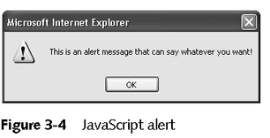
JAVASCRIPT METHODS
The alert method opens a message box that displays a short message
The text in an alert can reference and display properties of HTML form elements

Slide 20
JAVASCRIPT METHODS
Document methods create dynamic Web pages using client-side scripts
Examples:
  document.clear method clears the contents of the current document
  document.write method adds new HTML tags and elements dynamically

Slide 21
JAVASCRIPT FUNCTIONS
Function: self-contained group of program commands that programmers call within a larger program
Global functions: built-in functions that can be called from any JavaScript command
Custom functions: programmers create custom functions to perform program-specific tasks

Slide 22
JAVASCRIPT FUNCTIONS
All function code should be placed in the heading section of the HTML document
The commands that call the functions are placed where they need to be executed in the document body
The command that calls a function may pass one or more parameters to the function
Function commands may perform an action or return a data value to the calling command

Slide 23
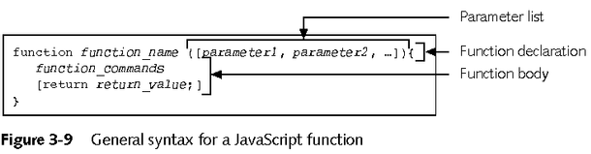
CREATING A CUSTOM FUNCTION
The first line of a function contains the function declaration, which defines the function name and specifies the parameters that the function receives from the calling program or command

Slide 24
CREATING A CUSTOM FUNCTION
Function declaration:
  Begins with the reserved word function
  Then the name of the function and an optional parameter list is specified
The function name must begin with a letter, and can contain numbers, letters, and underscores (_)
Function names cannot contain any other special characters, such as hyphens (-) or pound signs (#)
Letters within function names are case-sensitive

Slide 25
CALLING A FUNCTION
A JavaScript function can be called from directly within a JavaScript command by specifying:
  Name of the function
  List of parameter values that are to be passed to the function
  Syntax:
function_name (param1_value, param2_value, …)

Slide 26
EVENT HANDLERS
HTML objects have events that occur as a result of user actions
Event handlers:
  Contain program commands that execute when an event occurs
  Syntax
<element attributes
event_handler_name ="JavaScript_command ">

Slide 27
EVENT HANDLERS
It is not a good practice to place JavaScript tags and commands at the end of the body section of an HTML document
To execute a script when a browser first loads, an onload event handler associated with the HTML document is created, and this event handler calls a function or executes a command

Slide 28
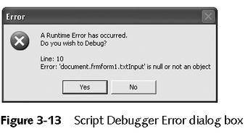
DISPLAYING SCRIPT ERROR INFORMATION IN INTERNET EXPLORER
When an error occurs in a client-side script, Internet Explorer displays a default error notification message
For debugging client-side scripts, script developers usually configure Internet Explorer to display a Script Debugger Error dialog box, providing information about script errors

Slide 29
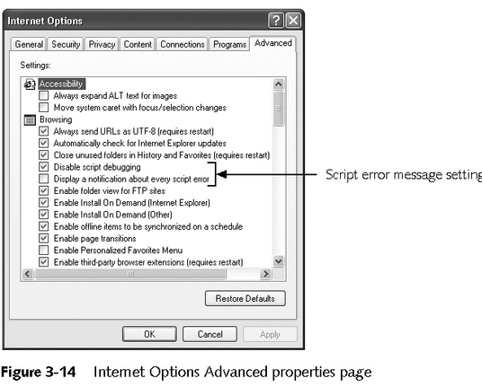
CONFIGURING INTERNET EXPLORER TO DISPLAY OR SUPPRESS DEFAULT SCRIPT ERROR NOTIFICATION MESSAGES

Slide 30
CONFIGURING INTERNET EXPLORER TO DISPLAY OR SUPPRESS DEFAULT SCRIPT ERROR NOTIFICATION MESSAGES
Defaults on Advanced properties page:
  Check the Disable script debugging check box
  Clear Display a notification about every script error
Browser displays the error notification message and allows the user to retrieve additional information

Slide 31
CONFIGURING YOUR WORKSTATION TO DISPLAY THE SCRIPT DEBUGGER ERROR MESSAGE BOX
If the Display a notification about every script error check box is checked, Internet Explorer displays the Script Debugger message box only if Script Debugger is installed on the workstation

Slide 32
USING VARIABLES IN JAVASCRIPT COMMANDS
Programs use variables:
  to store numbers, text, dates, and other types of data that the browser can display and that client-side script commands can manipulate
Variables have a name and data type that specifies the kind of data that the variable stores
Data types enable:
  Program error checking
  Optimization of memory

Slide 33
USING VARIABLES IN JAVASCRIPT COMMANDS
Strongly typed language:
  requires programmer to declare variables and their data types before they are used in a program command
JavaScript is loosely typed: programmer does not need to specify the data type when the variable is declared

Slide 34
DECLARING JAVASCRIPT VARIABLES AND ASSIGNING VALUES TO VARIABLES
Variable declaration syntax: var variable_name ;
Variable names must begin with a letter, and can contain numbers, letters, and underscores (_)
Letters within variable names are case-sensitive
To assign a value to a variable
  variable_name = value;
Can declare and initialize a variable
var variable_name = initial_value ;

Slide 35
USING JAVASCRIPT OPERATORS TO MANIPULATE VARIABLES
Operators perform arithmetic and string operations on literal and variable values
Concatenation operator (+): joins two separate string elements into a single string element
Display string values on multiple lines: use “\n” in a string to break its display into separate lines

Slide 36
USING JAVASCRIPT OPERATORS TO MANIPULATE VARIABLES
Assignment operators: allow programmers to perform operations and assignments in a single command
Plus sign:
  Is overloaded, which means it can be used for two different operations
  Can be used for numeric addition and string concatenation

Slide 37
SPECIFYING THE ORDER OF OPERATIONS
Operations are evaluated in a specific order
The interpreter evaluates operations in parentheses or square brackets first, and then evaluates additional operations in the order listed
The interpreter evaluates assignment operations last

Slide 38
SPECIFYING THE ORDER OF OPERATIONS
Operations at the same level, such as addition and subtraction, are evaluated from left to right
Concatenation operations are evaluated from left to right, with operations in parentheses evaluated first

Slide 39
USING JAVASCRIPT BUILT-IN OBJECT CLASSES
To perform similar operations in JavaScript, built-in object classes are used
To use a built-in object, create an instance and assign a value to the new object’s value property
The object’s methods can then be used to perform tasks on the associated value
Syntax to create a new object:
var variable_name = new object_type ();

Slide 40
USING JAVASCRIPT BUILT-IN OBJECT CLASSES
String Objects
  Create a new String object named currentItem and assign “3-Season Tents” to its value property:
var currentItem = new String();
currentItem.value = "3-Season Tents";
Math Objects
  The Math object class expands the usefulness of the JavaScript arithmetic operators
  Object instances of the Math class do not need to be created

Slide 41
USING JAVASCRIPT BUILT-IN OBJECT CLASSES
Date Objects
  Date objects format and manipulate date and time values and retrieve the date and time on the workstation
  Date value is divided into individual year, month, day, current hour, minute, and second components
Number Objects
  Number objects format numeric values

Slide 42
USING GLOBAL FUNCTIONS TO PERFORM EXPLICIT DATA TYPE CONVERSIONS
By default, all data values that users enter into Web page forms are text strings
To convert text strings to numbers, perform an explicit data type conversion
To perform a conversion, write a program command to convert a value from one data type to another
JavaScript provides global functions to perform explicit data type conversions

Slide 43
CONVERTING STRINGS TO NUMBERS
parseInt() global function:
  Converts a string representation of a number into a number representation
  Removes any decimal or fractional parts
parseFloat() global function:
  Converts a string representation of a number into a number representation
  Retains the decimal or fractional parts
The general syntax for these functions is:
number_variable = parseInt ("string_number ");
number_variable = parseFloat ("string_number ");

Slide 44
CONVERTING NUMBERS TO STRINGS
The easiest way to convert a date or number variable to a string data type is to concatenate the date or number variable to an empty string literal
An empty string literal:
  String value that does not contain any characters
  Consists of two double quotation marks, with no characters inserted in between: “”

Slide 45
DECISION CONTROL STRUCTURES
Decision control structures: execute alternate statements based on true/false conditions
“if” control structure tests whether a condition is true or false
  If the condition is true, the interpreter executes a set of program statements
  If the condition is false, the interpreter skips the program statements

Slide 46
DECISION CONTROL STRUCTURES
if/else control structure
  Tests a condition
  Executes one set of statements if the condition is true, and an alternate set if the condition is false
if/else if control structure allows the program to test for many unrelated conditions, and execute specific program statements for each true condition

Slide 47
DECISION CONTROL STRUCTURES
switch control structure:
  Program can test multiple conditions that compare the same variable value
  Executes faster than the equivalent if/else if structure
  Requires fewer program lines
However, it can only be used when the condition evaluates whether an expression is equal to another expression

Slide 48
USING THE AND AND OR LOGICAL OPERATORS IN CONTROL STRUCTURE CONDITIONS
AND operator (&&): overall condition is true if both conditions are true
OR operator (||): overall condition is true if either condition is true

Slide 49
CREATING REPETITION (LOOPING) STRUCTURES
Loop:
  A repetition structure that processes multiple values the same way
  Repeatedly executes a series of program statements and periodically evaluates an exit condition
Pretest loop: evaluates the exit condition before any program commands execute
Posttest loop: one or more program commands execute before the loop evaluates the exit condition the first time

Slide 50
CREATING REPETITION (LOOPING) STRUCTURES
while loop: pretest loop
do while loop: posttest loop
for loop: counting loop
  Programmers declare and control a counter variable from within the loop structure

Slide 51
CONTRASTING JAVASCRIPT AND JAVA
Even though both JavaScript and Java use a C-style syntax for common programming tasks, their underlying structures and purposes are very different
Java is a full-featured object-oriented programming language
JavaScript is more limited and runs within HTML documents

Slide 52
SUMMARY
Programmers use client-side scripts for tasks such as validating user inputs entered on HTML forms, opening new browser windows, and creating cookies
The HTML document object model (DOM) is a hierarchical naming system that enables scripts to reference browser objects
DOM objects are accessed and manipulated using dot syntax containing either object name or id attribute values

Slide 53
SUMMARY
Events: actions that take place in a document as a result of a user action
Functions: self-contained groups of program commands that are called within a script
User-defined functions perform specific tasks
JavaScript is a loosely typed language
Decision control structures are created using if, if/else, if/else if, and switch statements
Loops include while, do while, and for loops

