Slide 1
6.1 Introduction
JavaScript
  Scripting language that facilitates a disciplined approach to designing computer programs that enhance the functionality and appearance of web pages.
Before you can run code examples with JavaScript on your computer, you may need to change your browser’s security settings.
  IE prevents scripts on the local computer from running by default
  FF enables JavaScript by default

Slide 2
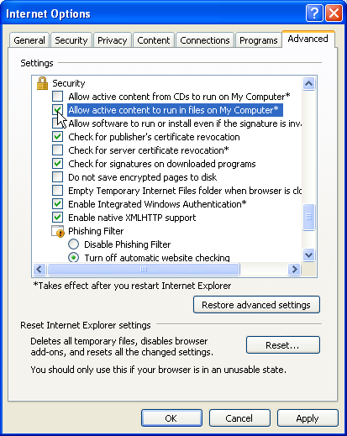
Fig. 6.1 | Enabling JavaScript in Internet Explorer 7

Slide 3
6.2 Simple Program: Displaying a Line of Text in a Web Page
Spacing displayed by a browser in a web page is determined by the XHTML elements used to format the page
Often, JavaScripts appear in the <head> section of the XHTML document
The browser interprets the contents of the <head> section first
The <script> tag indicates to the browser that the text that follows is part of a script. Attribute type specifies the scripting language used in the script—such as text/javascript

Slide 4
Portability Tip 6.1
Some browsers do not support the <script> </script> tags. If your document is to be rendered with such browsers, enclose the script code between these tags in an XHTML comment, so that the script text does not get displayed as part of the web page. The closing comment tag of the XHTML comment (-->) is preceded by a JavaScript comment (//) to prevent the browser from trying to interpret the XHTML comment as a JavaScript statement.

Slide 5
Common Programming Error 6.1
Forgetting the ending </script> tag for a script may prevent the browser from interpreting the script properly and may prevent the XHTML document from loading properly.

Slide 6
6.2 Simple Program: Displaying a Line of Text in a Web Page (Cont.)
A string of characters can be contained between double (") or single (') quotation marks
A string is sometimes called a character string, a message or a string literal

Slide 7
Software Engineering Observation 6.1
Strings in JavaScript can be enclosed in either double quotation marks (") or single quotation marks (').

Slide 8
6.2 Simple Program: Displaying a Line of Text in a Web Page (Cont.)
Browser’s document object represents the XHTML document currently being displayed in the browser
  Allows a script programmer to specify XHTML text to be displayed in the XHTML document
Browser contains a complete set of objects that allow script programmers to access and manipulate every element of an XHTML document
Object
  Resides in the computer’s memory and contains information used by the script
  The term object normally implies that attributes (data) and behaviors (methods) are associated with the object
  An object’s methods use the attributes’ data to perform useful actions for the client of the object—the script that calls the methods

Slide 9
6.2 Simple Program: Displaying a Line of Text in a Web Page (Cont.)
The parentheses following the name of a method contain the arguments that the method requires to perform its task (or its action)
Every statement should end with a semicolon (also known as the statement terminator), although none is required by JavaScript
JavaScript is case sensitive
  Not using the proper uppercase and lowercase letters is a syntax error

Slide 10
Good Programming Practice 6.1
Always include a semicolon at the end of a statement to terminate the statement. This notation clarifies where one statement ends and the next statement begins.

Slide 11
Common Programming Error 6.2
JavaScript is case sensitive. Not using the proper uppercase and lowercase letters is a syntax error. A syntax error occurs when the script interpreter cannot recognize a statement. The interpreter normally issues an error message to help you locate and fix the incorrect statement. Syntax errors are violations of the rules of the programming language. The interpreter notifies you of a syntax error when it attempts to execute the statement containing the error. The JavaScript interpreter in Internet Explorer reports all syntax errors by indicating in a separate popup window that a “runtime error” has occurred (i.e., a problem occurred while the interpreter was running the script). [Note: To enable this feature in IE7, select Internet Options from the Tools menu. In the Internet Options dialog that appears, select the Advanced tab and click the checkbox labelled Display a notification about every script error under the Browsing category. Firefox has an error console that reports JavaScript errors and warnings. It is accessible by choosing Error Console from the Tools menu.]

Slide 12
6.2 Simple Program: Displaying a Line of Text in a Web Page (Cont.)
The document object’s writeln method
  Writes a line of XHTML text in the XHTML document
  Does not guarantee that a corresponding line of text will appear in the XHTML document.
  Text displayed is dependent on the contents of the string written, which is subsequently rendered by the browser.
  Browser will interpret the XHTML elements as it normally does to render the final text in the document

Slide 13
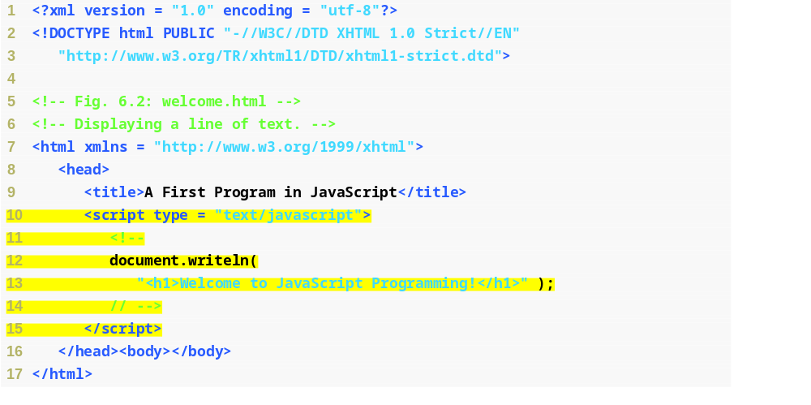
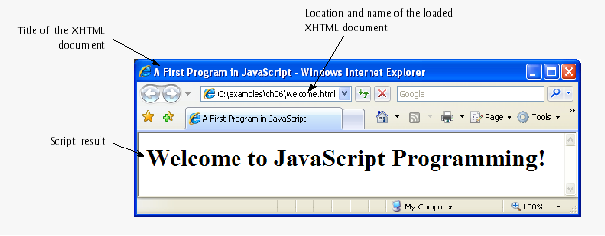
Fig. 6.2 | Displaying a line of text.
Script begins
Specifies that we are using the JavaScript language
Prevents older browsers that do not support scripting from displaying the text of the script
Writes an h1 welcome message in the XHTML document
XHTML comment delimiter, commented for correct interpretation by all browsers
Script ends

Slide 14
Error-Prevention Tip 6.1
When the interpreter reports a syntax error, sometimes the error is not on the line number indicated by the error message. First, check the line for which the error was reported. If that line does not contain errors, check the preceding several lines in the script.

Slide 15
6.3 Modifying Our First Program
Method write displays a string like writeln, but does not position the output cursor in the XHTML document at the beginning of the next line after writing its argument

Slide 16
6.3 Modifying Our First Program (Cont.)
You cannot split a statement in the middle of a string. The + operator (called the “concatenation operator” when used in this manner) joins two strings together

Slide 17
Common Programming Error 6.3
Splitting a statement in the middle of a string is a syntax error.

Slide 18
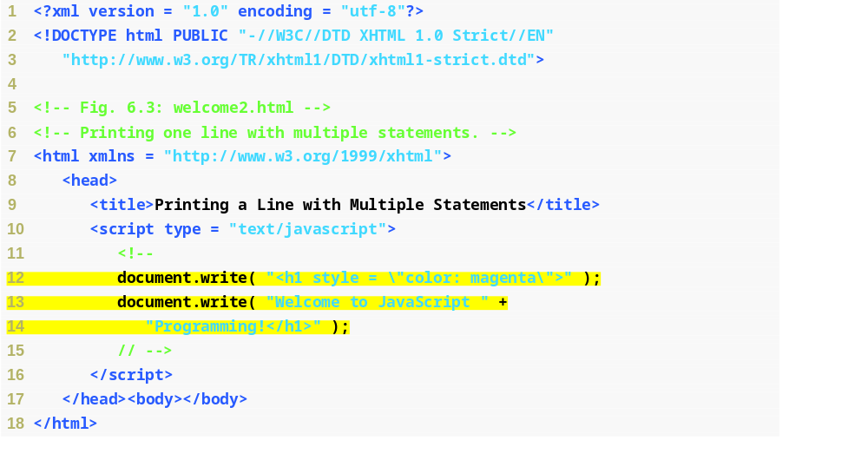
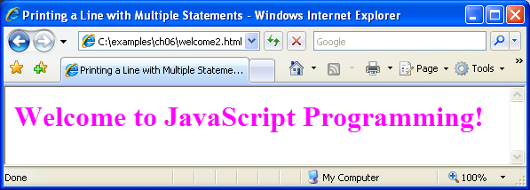
Fig. 6.3 | Printing one line with separate statements.
Two write statements create one line of XHTML text
Concatenation operator joins the string together, as it is split into multiple lines

Slide 19
Common Programming Error 6.4
Many people confuse the writing of XHTML text with the rendering of XHTML text. Writing XHTML text creates the XHTML that will be rendered by the browser for presentation to the user.

Slide 20
6.3 Modifying Our First Program (Cont.)
A single statement can cause the browser to display multiple lines by using line-break XHTML tags ( <br/>) throughout the string of XHTML text in a write or writeln method call

Slide 21
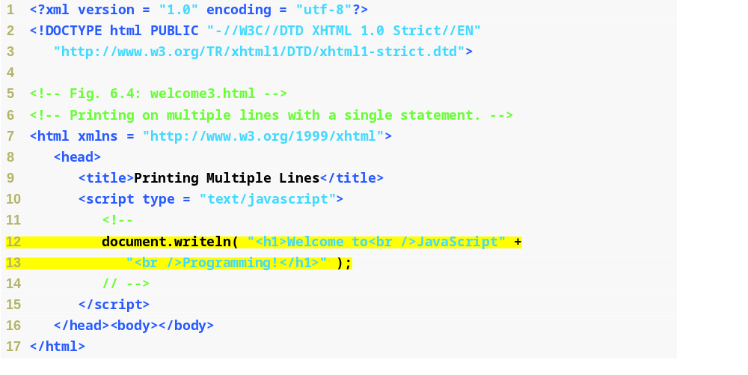
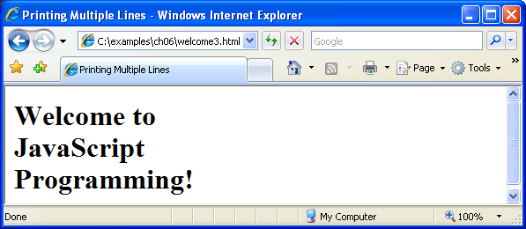
Fig. 6.4 | Printing on multiple lines with a single statement.
Inserts line-break
Inserts line-break

Slide 22
6.3 Modifying Our First Program (Cont.)
Dialogs
  Useful to display information in windows that “pop up” on the screen to grab the user’s attention
  Typically used to display important messages to the user browsing the web page
  Browser’s window object uses method alert to display an alert dialog
  Method alert requires as its argument the string to be displayed

Slide 23
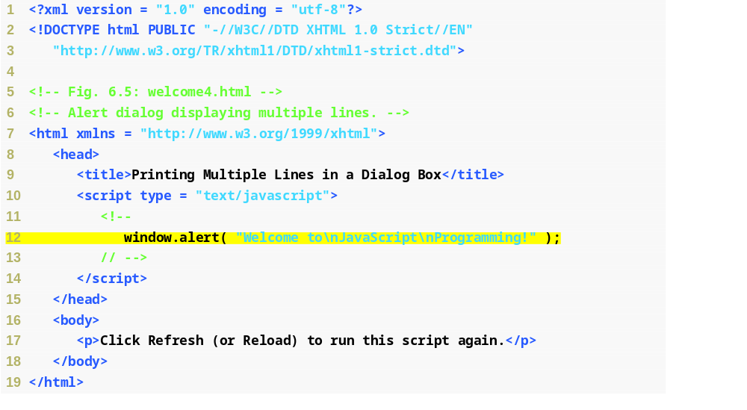
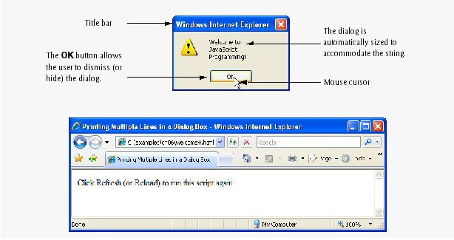
Fig. 6.5 | Alert dialog displaying multiple lines.
Creates a pop up box that alerts the welcome text to the user

Slide 24
Common Programming Error 6.5
Dialogs display plain text; they do not render XHTML. Therefore, specifying XHTML elements as part of a string to be displayed in a dialog results in the actual characters of the tags being displayed.

Slide 25
Common Programming Error 6.6
XHTML elements in an alert dialog’s message are not interpreted as XHTML.This means that using <br />, for example, to create a line break in an alert box is an error. The string <br/> will simply be included in your message.

Slide 26
6.3 Modifying Our First Program (Cont.)
When a backslash is encountered in a string of characters, the next character is combined with the backslash to form an escape sequence. The escape sequence \n is the newline character. It causes the cursor in the XHTML document to move to the beginning of the next line.

Slide 27
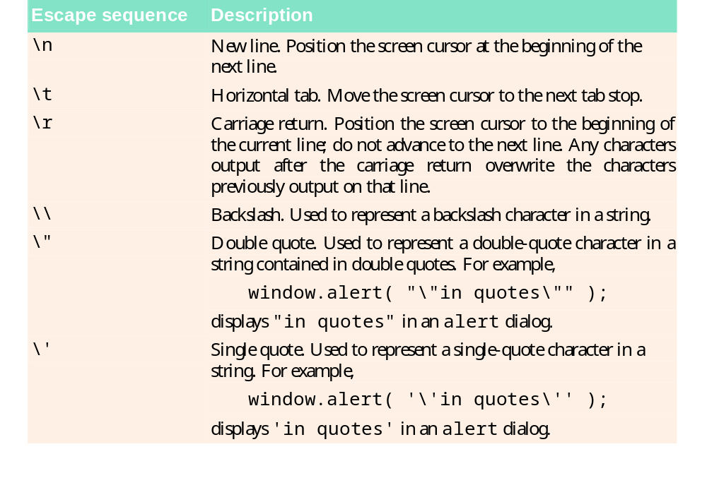
Fig. 6.6 | Some common escape sequences.

Slide 28
6.4 Obtaining User Input with prompt Dialogs
Scripting
  Gives you the ability to generate part or all of a web page’s content at the time it is shown to the user
  Such web pages are said to be dynamic, as opposed to static, since their content has the ability to change

Slide 29
6.4 Obtaining User Input with prompt Dialogs (Cont.)
Keywords are words with special meaning in JavaScript
Keyword var
  Used to declare the names of variables
  A variable is a location in the computer’s memory where a value can be stored for use by a program
  All variables have a name, type and value, and should be declared with a var statement before they are used in a program
A variable name can be any valid identifier consisting of letters, digits, underscores ( _ ) and dollar signs ($) that does not begin with a digit and is not a reserved JavaScript keyword.

Slide 30
Good Programming Practice 6.2
Choosing meaningful variable names helps a script to be “self-documenting” (i.e., easy to understand by simply reading the script, rather than having to read manuals or extended comments).

Slide 31
Good Programming Practice 6.3
By convention, variable-name identifiers begin with a lowercase first letter. Each subsequent word should begin with a capital first letter. For example, identifier itemPrice has a capital P in its second word, Price.

Slide 32
Common Programming Error 6.7
Splitting a statement in the middle of an identifier is a syntax error.

Slide 33
Good Programming Practice 6.4
Some programmers prefer to declare each variable on a separate line. This format allows for easy insertion of a descriptive comment next to each declaration. This is a widely followed professional coding standard.

Slide 34
6.4 Obtaining User Input with prompt Dialogs (Cont.)
Declarations end with a semicolon (;) and can be split over several lines, with each variable in the declaration separated by a comma (forming a comma-separated list of variable names)
  Several variables may be declared in one declaration or in multiple declarations.
Comments
  A single-line comment begins with the characters // and terminates at the end of the line
  Comments do not cause the browser to perform any action when the script is interpreted; rather, comments are ignored by the JavaScript interpreter
  Multiline comments begin with delimiter /* and end with delimiter */
    All text between the delimiters of the comment is ignored by the interpreter.

Slide 35
Common Programming Error 6.8
Forgetting one of the delimiters of a multiline comment is a syntax error.

Slide 36
Common Programming Error 6.9
Nesting multiline comments (i.e., placing a multiline comment between the delimiters of another multiline comment) is a syntax error.

Slide 37
6.4 Obtaining User Input with prompt Dialogs (Cont.)
The window object’s prompt method displays a dialog into which the user can type a value.
  The first argument is a message (called a prompt) that directs the user to take a specific action.
  The optional second argument is the default string to display in the text field.
Script can then use the value that the user inputs.

Slide 38
6.4 Obtaining User Input with prompt Dialogs (Cont.)
A variable is assigned a value with an assignment statement, using the assignment operator, =.
The = operator is called a binary operator, because it has two operands.

Slide 39
Good Programming Practice 6.5
Place spaces on either side of a binary operator. This format makes the operator stand out and makes the program more readable.

Slide 40
6.4 Obtaining User Input with prompt Dialogs (Cont.)
null keyword
  Signifies that a variable has no value
  null is not a string literal, but rather a predefined term indicating the absence of value
  Writing a null value to the document, however, displays the word “null”
Function parseInt
  converts its string argument to an integer
JavaScript has a version of the + operator for string concatenation that enables a string and a value of another data type (including another string) to be concatenated

Slide 41
Common Programming Error 6.10
Confusing the + operator used for string concatenation with the + operator used for addition often leads to undesired results. For example, if integer variable y has the value 5, the expression "y + 2 = " + y + 2 results in "y + 2 = 52", not "y + 2 = 7", because first the value of y (i.e., 5) is concatenated with the string
"y + 2 = ", then the value 2 is concatenated with the new, larger string "y + 2 = 5". The expression
"y + 2 = " + (y + 2) produces the string
"y + 2 = 7" because the parentheses ensure that
y + 2 is executed mathematically before it is converted to a string.

Slide 42
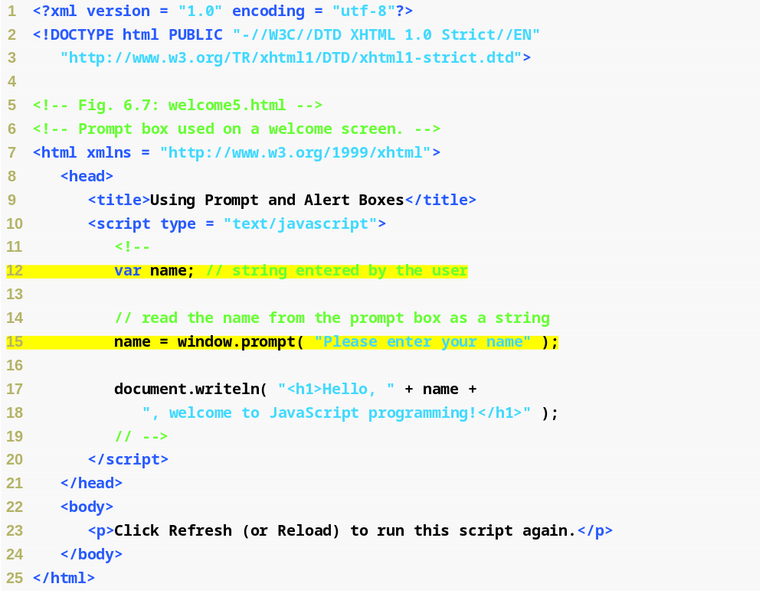
Fig. 6.7 | Prompt box used on a welcome screen (Part 1 of 2).
Declares a new variable
Sets the identifier of the variable to name
Inserts the value given to name into the XHTML text
Assigns the string entered by the user to the variable name

Slide 43
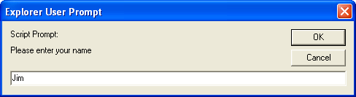
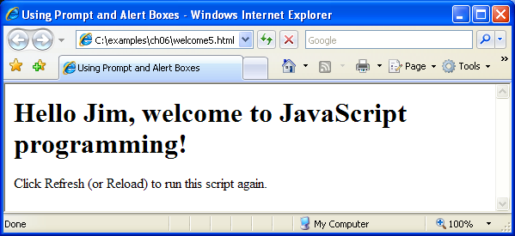
Fig. 6.7 | Prompt box used on a welcome screen (Part 2 of 2).

Slide 44
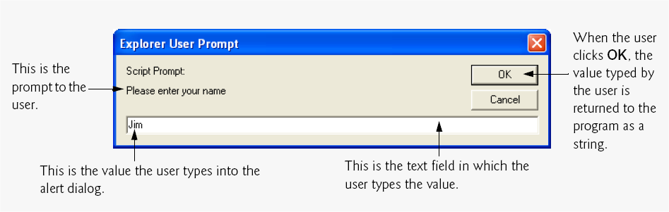
Fig. 6.8 | Prompt dialog displayed by the window object’s prompt method.

Slide 45
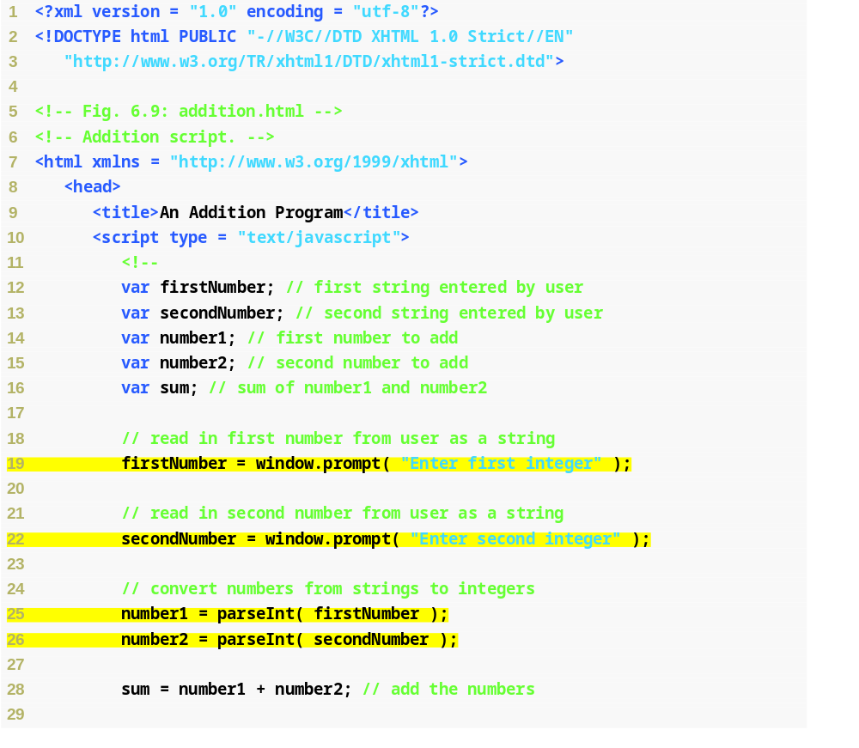
Fig. 6.9 | Addition script (Part 1 of 2).
Assigns the first input from the user to the variable firstNumber
Assigns the second input from the user to the variable secondNumber
Converts the strings entered by the user into integers

Slide 46
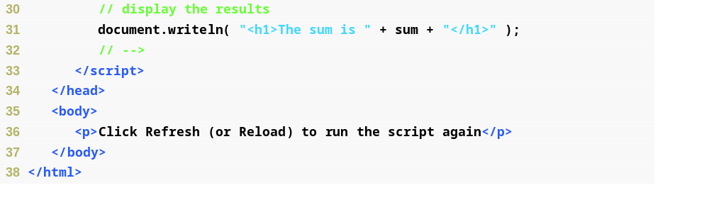
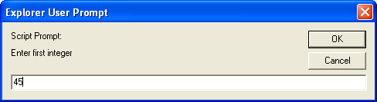
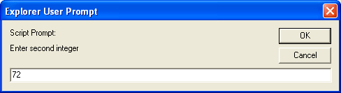
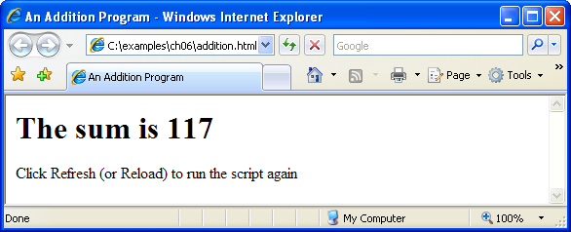
Fig. 6.9 | Addition script (Part 2 of 2).

Slide 47
6.5 Memory Concepts
Variable names correspond to locations in the computer’s memory.
Every variable has a name, a type and a value.
When a value is placed in a memory location, the value replaces the previous value in that location.
When a value is read out of a memory location, the process is nondestructive.

Slide 48
Fig. 6.10 | Memory location showing the name and value of variable number1.

Slide 49

Fig. 6.11 | Memory locations after inputting values for variables number1 and number2.

Slide 50

Fig. 6.12 | Memory locations after calculating the sum of number1 and number2 .

Slide 51
6.5 Memory Concepts (Cont.)
JavaScript does not require variables to have a type before they can be used in a program
A variable in JavaScript can contain a value of any data type, and in many situations, JavaScript automatically converts between values of different types for you
JavaScript is referred to as a loosely typed language
When a variable is declared in JavaScript, but is not given a value, it has an undefined value.
  Attempting to use the value of such a variable is normally a logic error.
When variables are declared, they are not assigned default values, unless specified otherwise by the programmer.
  To indicate that a variable does not contain a value, you can assign the value null to it.

Slide 52
6.6 Arithmetic
The basic arithmetic operators (+, -, *, /, and %) are binary operators, because they each operate on two operands
JavaScript provides the remainder operator, %, which yields the remainder after division
Arithmetic expressions in JavaScript must be written in straight-line form to facilitate entering programs into the computer

Slide 53
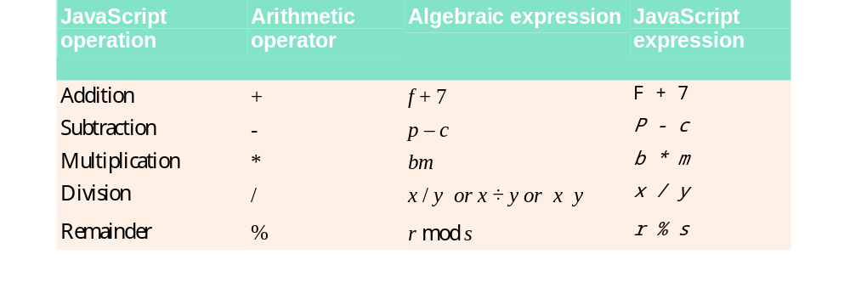
Fig. 6.13 | Arithmetic operators.

Slide 54
6.6 Arithmetic (Cont.)
Parentheses can be used to group expressions as in algebra.
Operators in arithmetic expressions are applied in a precise sequence determined by the rules of operator precedence:
  Multiplication, division and remainder operations are applied first.
  If an expression contains several of these operations, operators are applied from left to right.
  Multiplication, division and remainder operations are said to have the same level of precedence.
  Addition and subtraction operations are applied next.
  If an expression contains several of these operations, operators are applied from left to right.
  Addition and subtraction operations have the same level of precedence.
When we say that operators are applied from left to right, we are referring to the associativity of the operators. Some operators associate from right to left.

Slide 55
Good Programming Practice 6.6
Using parentheses for complex arithmetic expressions, even when the parentheses are not necessary, can make the arithmetic expressions easier to read.

Slide 56
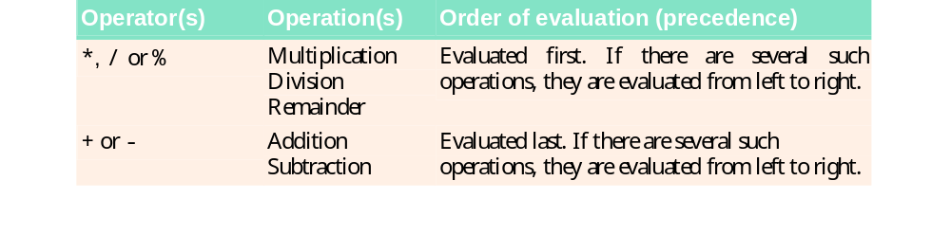
Fig. 6.14 | Precedence of arithmetic operators.

Slide 57
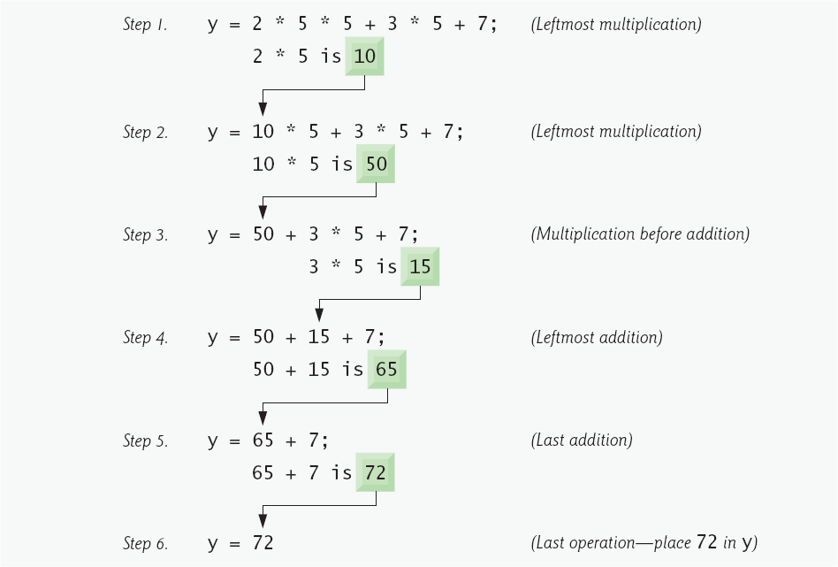
Fig. 6.15 | Order in which a second-degree polynomial is evaluated.

Slide 58
6.7 Decision Making: Equality and Relational Operators
if statement allows a program to make a decision based on the truth or falsity of a condition
  If the condition is met (i.e., the condition is true), the statement in the body of the if statement is executed
  If the condition is not met (i.e., the condition is false), the statement in the body of the if statement is not executed
Conditions in if statements can be formed by using the equality operators and relational operators

Slide 59
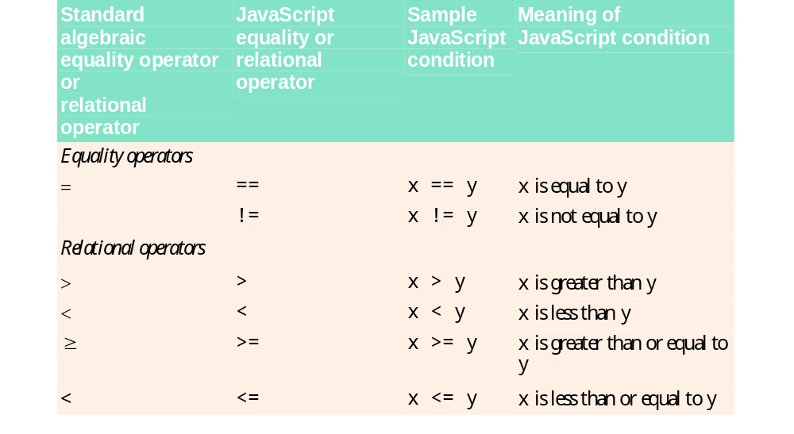
Fig. 6.16 | Equality and relational operators.

Slide 60
6.7 Decision Making: Equality and Relational Operators (Cont.)
Equality operators both have the same level of precedence, which is lower than the precedence of the relational operators.
The equality operators associate from left to right.

Slide 61
Common Programming Error 6.11
It is a syntax error if the operators ==, !=, >= and <= contain spaces between their symbols, as in = =, ! =, > = and < =, respectively.

Slide 62
Common Programming Error 6.12
Reversing the operators !=, >= and <=, as in =!, => and =<, respectively, is a syntax error.

Slide 63
Common Programming Error 6.13
Confusing the equality operator, ==, with the assignment operator, =, is a logic error. The equality operator should be read as “is equal to,” and the assignment operator should be read as “gets” or “gets the value of.” Some people prefer to read the equality operator as “double equals” or “equals equals.”

Slide 64
6.7 Decision Making: Equality and Relational Operators (Cont.)
If more than one variable is declared in a single declaration, the names are separated by commas (,)
  This list of names is referred to as a comma-separated list

Slide 65
6.7 Decision Making: Equality and Relational Operators (Cont.)
Date object
  Used acquire the current local time
  Create a new instance of an object by using the new operator followed by the type of the object, Date, and a pair of parentheses

Slide 66
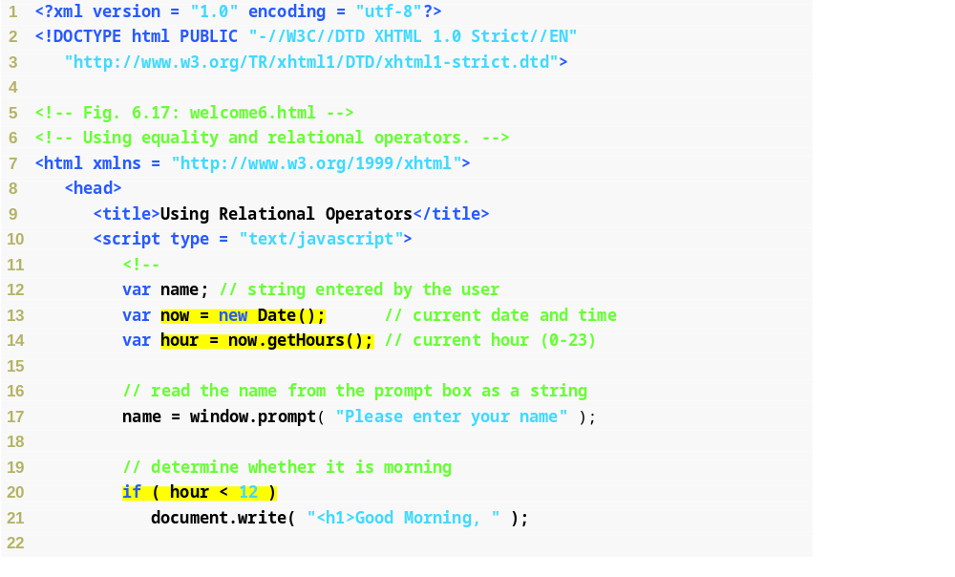
Fig. 6.17 | Using equality and relational operators (Part 1 of 3).
Set variable now to a new Date object
Assigns hour to the value returned by the Date object’s getHours method
Conditional statement: checks whether the current value of hour is less than 12
This statement will execute only if the previous condition was true

Slide 67
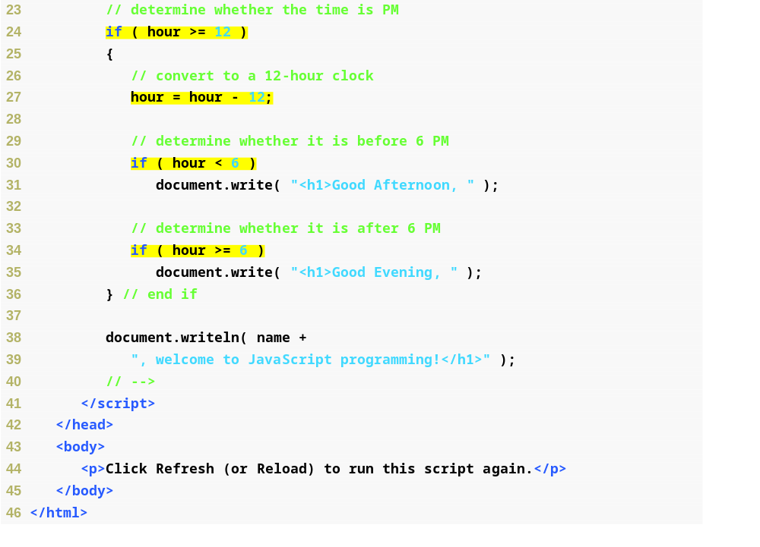
Fig. 6.17 | Using equality and relational operators (Part 2 of 3).
Conditional statement: checks whether the current value of hour is greater than or equal to 12
If hour is 12 or greater (the previous condition was true), subtract 12 from the value and reassign it to hour
Conditional statement: checks whether the current value of hour is less than 6
Conditional statement: checks whether the current value of hour is greater than or equal to 6

Slide 68
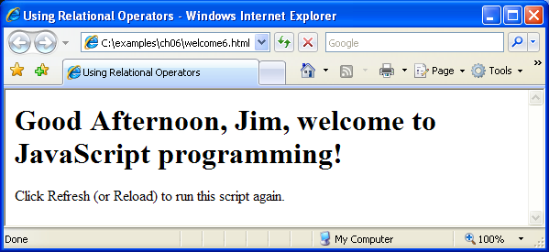
Fig. 6.17 | Using equality and relational operators (Part 3 of 3).

Slide 69
Good Programming Practice 6.7
Include comments after the closing curly brace of control statements (such as if statements) to indicate where the statements end, as in line 36 of Fig. 6.17.

Slide 70
Good Programming Practice 6.8
Indent the statement in the body of an if statement to make the body of the statement stand out and to enhance program readability.

Slide 71
Good Programming Practice 6.9
Place only one statement per line in a program. This enhances program readability.

Slide 72
Common Programming Error 6.14
Forgetting the left and/or right parentheses for the condition in an if statement is a syntax error. The parentheses are required.

Slide 73
Common Programming Error 6.15
Placing a semicolon immediately after the right parenthesis of the condition in an if statement is normally a logic error. The semicolon would cause the body of the if statement to be empty, so the if statement itself would perform no action, regardless of whether its condition was true. Worse yet, the intended body statement of the if statement would now become a statement in sequence after the if statement and would always be executed.

Slide 74
Common Programming Error 6.16
Leaving out a condition in a series of if statements is normally a logic error. For instance, checking if hour is greater than 12 or less than 12, but not if hour is equal to 12, would mean that the script takes no action when hour is equal to 12. Always be sure to handle every possible condition.

Slide 75
Good Programming Practice 6.10
A lengthy statement may be spread over several lines. If a single statement must be split across lines, choose breaking points that make sense, such as after a comma in a comma-separated list or after an operator in a lengthy expression. If a statement is split across two or more lines, indent all subsequent lines.

Slide 76
Good Programming Practice 6.11
Refer to the operator precedence chart when writing expressions containing many operators. Confirm that the operations are performed in the order in which you expect them to be performed. If you are uncertain about the order of evaluation in a complex expression, use parentheses to force the order, exactly as you would do in algebraic expressions. Be sure to observe that some operators, such as assignment (=), associate from right to left rather than from left to right.

Slide 77
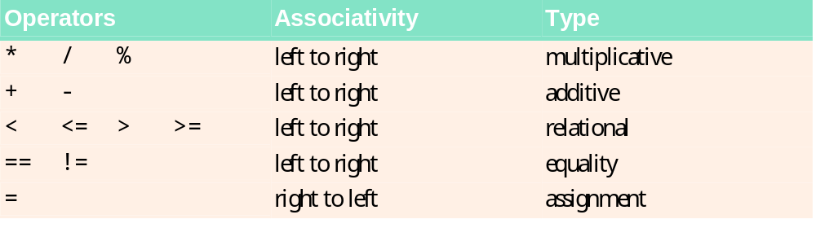
Fig. 6.18 | Precedence and associativity of the operators discussed so far.

