Slide 1
Data Representations
Sunil Bhutada

Slide 2
Agenda
Introduction
Formats of Data
Data Models
Data Storage Layouts
Data Serialization
Data Processing Types

Slide 3
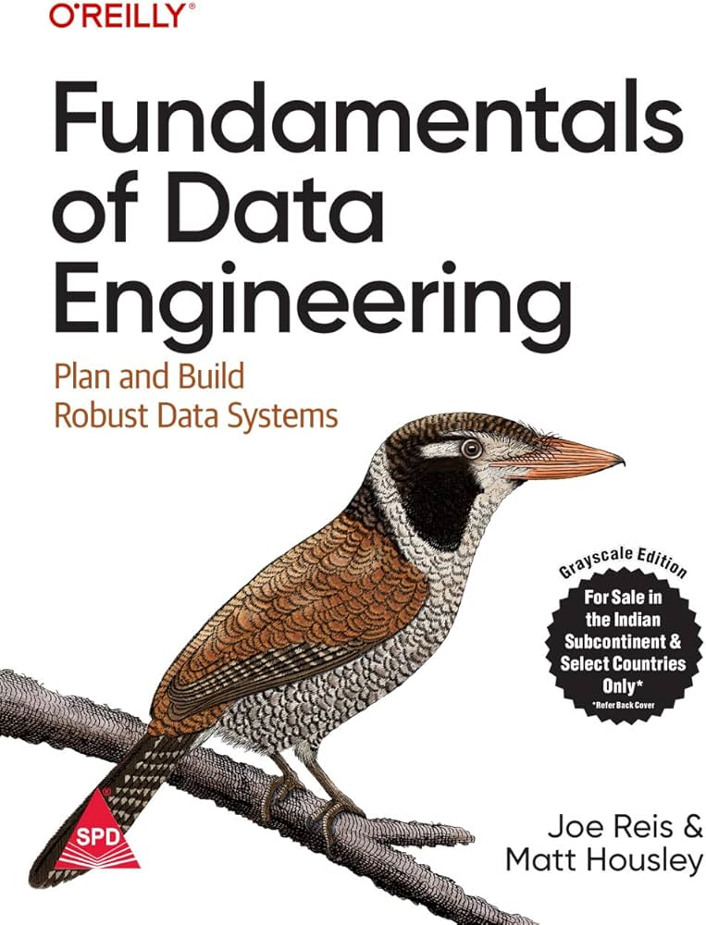

Books
Fundamentals of Data Engineering: Plan and Build Robust Data Systems by Reis and Housley
Reliable Machine Learning By Cathy Chen, Niall Richard Murphy, KrantiParisa, D. Sculley, Todd Underwood

Slide 4
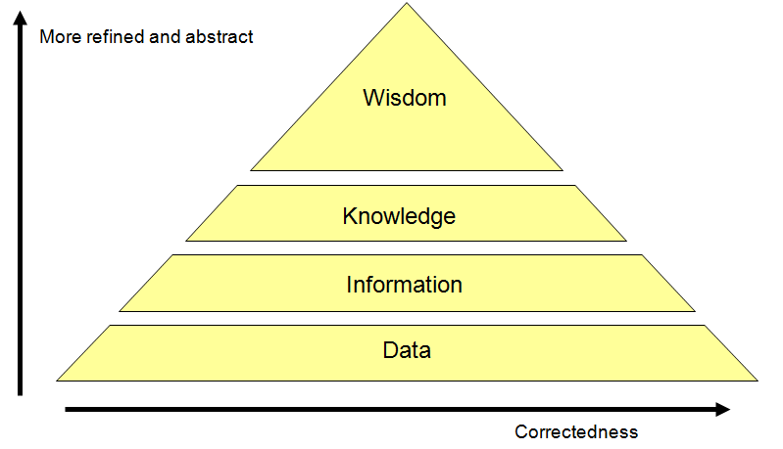
Information Hierarchy (Basic Concepts)

Slide 5
Information Hierarchy (Basic Concepts)
Data :
The raw material of information
Information :
Data organized and presented in a particular manner
Knowledge :
“Justified true belief”. Information that can be acted upon
Wisdom :
Distilled and integrated knowledge Demonstrative of high-level “understanding”

Slide 6
Information Hierarchy (A facetious Example)
Data
98.6º F, 99.5º F, 100.3º F, 101º F, …
Information
Hourly body temperature: 98.6º F, 99.5º F, 100.3º F, 101º F, …
Knowledge
If you have a temperature above 100º F, you most likely have a fever
Wisdom
If you don’t feel well, see a doctor

Slide 7
Abbreviations
NF | Normal Forms
BCNF | Boyce Code Normal Form
DB | DataBase
DBMS | DataBase Management System
OLTP | OnLine Transaction Processing
OLAP | OnLine Analytical Processing
JSON | JavaScript Object Notation
XML | eXtensible Markup Language
BSON | Binary JavaScript Object Notation
JSONB | JSON Binary
CSV | Comma Separated Values
SQL | Structured Query Language

Slide 8
Introduction

Slide 9
Have you heard these in your work?
Data Architecture
Databases
Internal / confidential data
Data officers
Connection to source data failed
Lot of nulls – what to do
Oh! No. That is old data
The information is on mails – what should we do now?
Generate pie or bar chart

Slide 10
What is Data Management?
Those words that you heard are in a way connected to data management
Data management is the practice of ingesting, processing, securing and storing an organization’s data, where it is then utilized for strategic decision-making to improve business outcomes
What are the key words?
Data management is the practice of ingesting, processing, securing and storing an organization’s data, where it is then utilized for strategic decision-making to improve business outcomes

Slide 11
Why Data Management?
Growth of Big Data
Over the last decade, developments within hybrid cloud, artificial intelligence, the Internet of Things (IoT), and edge computing have led to the exponential growth of big data creating even more complexity for enterprises to manage
Increasing and changing priorities
A data management discipline within an organization has become an increasing priority as this growth has created significant challenges, such as data silos, security risks, and general bottlenecks to decision-making
Improve Business Outcomes
Need clean interactive data for business insights and improve the business outcomes
Why DM for ML????

Slide 12
Relationship between Data and ML Pipelines
Data Used to construct the models
Interests
Processing pipelines that takes data and transforms into models
What is a ML System?
Essentially a data processing pipeline? Yes
What is the purpose of ML System?
Extract usable and repeatable insights of data? Yes
How is this different from traditional log processing or analysis pipelines?
ML systems’ success are hard to measure
Detection of failures are difficult
Depends fully on underlying data (management) systems in terms of
Structure
Performance
Accuracy
Reliability

Slide 13
Formats of Data

Slide 14
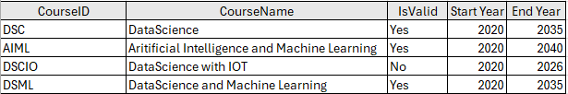






Overview
Structured
Follows a predefined schema or structured
(Schema : blueprint or structure that defines how data is organized, stored, and related. It specifies the rules, format, and constraints of the data)
Types
Unstructured
Doesn’t adhere to any schema
Semi-Structured
Structured + Unstructured

Slide 15
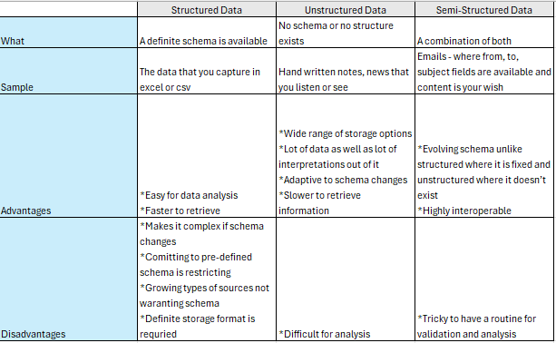
Structured vs Unstructured vs Semi-Structured
Home Work: What is Quasi structure and to which in the above category this is related to?

Slide 16
Data Models

Slide 17
Definition & Types
Data Model
The way data is structured, stored and organized
Relational
Hierarchical
Graph
Document
Key value pair

Slide 18
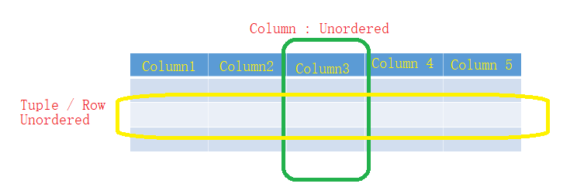
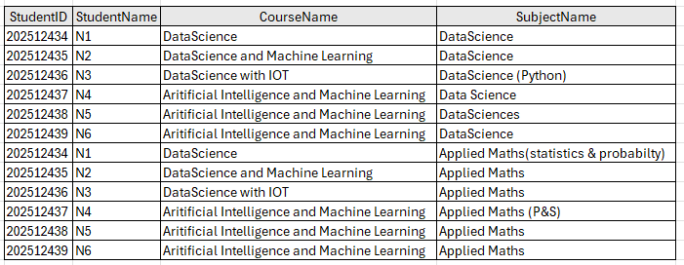
Relational Data Model
Data is organized into relations; Each relation is a set of tuples
Table is visual representation of relation, each row of table makes up a tuple
Relations are unordered – can shuffle order of rows or columns
What is this?
Do you observe any problem?

Slide 19
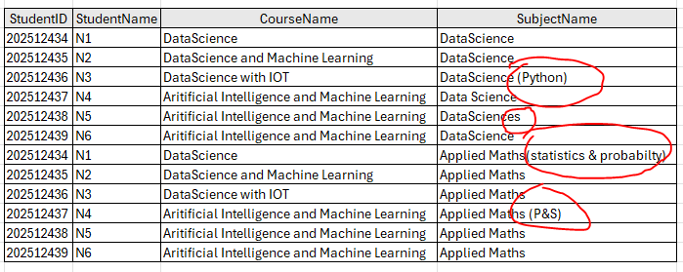
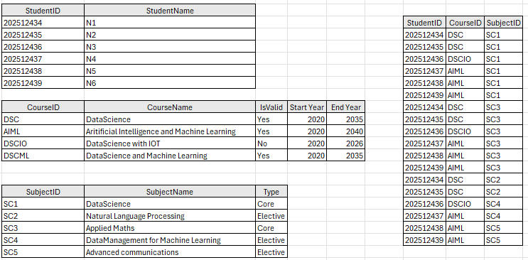
Which is Better?
Disadvantages:
Data Integrity is not there
Difficult to interpret
Highly redundant values
Not expandable
Normalization
Reduced data redundancy
Improved data integrity
Flexible for expansion
Types
1 NF, 2 NF, 3NF, BNCF, 5NF
Solution

Slide 20
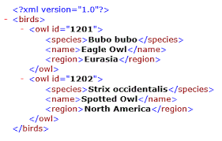
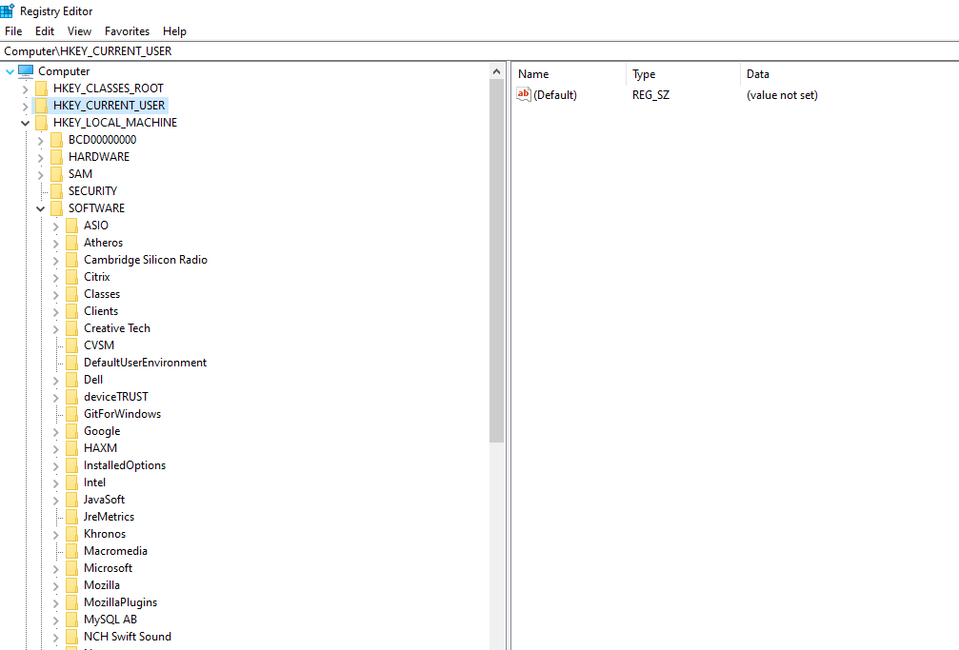
Hierarchical Data Model
Have you seen this window?
Type Regedit in your command prompt in windows

Slide 21
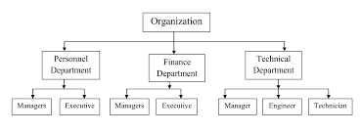
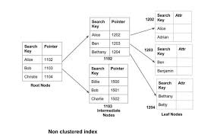
Where is this used?
Organization Structure
DB Indexing

Slide 22
Graph Data Model
Built around concept of “Graph”
Graph consists of nodes and edges, where edges represents relationship between the nodes
Database that uses graph structures to store its data is graph database
In document database, content of each document is priority
In graph database, relationships between data items are priority!
Faster to retrieve data faster as relationships are models in that way
Eg: Graph Databases : Neo4j, Neptune, Gephi

Slide 23
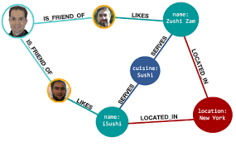
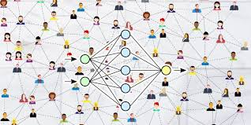
Where is this used?
LinkedIn or Facebook
Can you think a scenario in your organization where this is or can be used?
Sample :
Mapping the projects to the business objectives to see how many projects are aligned to business objectives related to each other in terms of functionality redundant with any other in terms of functionality

Slide 24
Document Datamodel
Built around concept of “document”
Single continuous string, encoded as JSON, XML
Each document has a unique key that represents that document, which can be used to retrieve it
Collection of document analogous to table in relational database, document analogous to row
Can convert relation into a collection of documents
Collection of document much more flexible than table
For example, a book can be represented as document as follows
{
“Title”: “Book1”,
“Author” : “Pravin”,
“Publisher”: “ Press1”,
“Country”: “US”,
“Sold as”: [
{ “format”: “Paperback”, “Price”: “20”},
{ “format”: “E-books”, “Price”: “10”},
]
}
Eg: Amazon DocumentDB
Apache CouchDB,
Firebase Firestore,
These are all document databases that store semi‑structured data as JSON‑like documents.

Slide 25
Where is this used?
Storing of unstructured or semi-structured data
Emails stored as evidences
Logs from devices or events
Photos or images for references

Slide 26
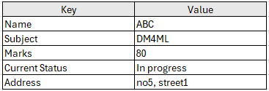
Key-Value Pair
Stores data as a collection of key-value pairs

Slide 27
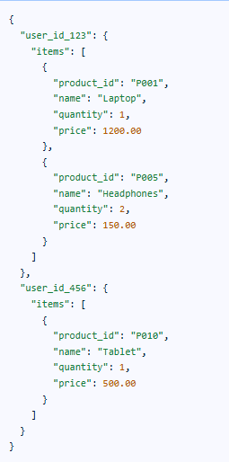
Where is this used?
Caching of data - to store copies of data in a temporary storage area for faster retrieval
JSON objects – internally is a key value pair

Slide 28
Summary of Data Models
Data Model
Relational
Hierarchical
Graph
Document
Key value pair
SQL
NoSQL

Slide 29
Comparison of various datamodels
 | Relational | Hierarchical | Graph | Document | Key-Value Pair
Structure | Strictly schema-based (tables, rows, columns) | Tree-like (parent-child) | Nodes and edges (flexible) | Semi-structured (JSON/XML) | Simple key → value pairs
Querying | SQL (standardized, powerful) | Navigational (e.g., DL/I) | Cypher, Gremlin (relationship-oriented) | JSONPath, MongoDB Query Language | By key only (very limited querying)
Performance (Storage & Retrieval) | Moderate (optimized for complex queries) | Fast for hierarchical traversal | Fast for connected data queries | Fast for document reads/writes | Extremely fast for simple reads/writes
Usage | Traditional business apps, ERP, CRM | Legacy systems, file systems | Social networks, fraud detection, recommendation engines | Content management, catalogs, APIs | Caching, session storage, config data
Sample Databases | MySQL, PostgreSQL, Oracle, SQL Server | IBM IMS | Neo4j, Amazon Neptune, TigerGraph | MongoDB, CouchDB, Amazon DocumentDB | Redis, Amazon DynamoDB, Riak

Slide 30
Query Languages For Data

Slide 31
Basics
You already have data. Now what next?
How will you retrieve them and use them next?
What if you need to retrieve data from multiple tables or databases?
What is required?
Let us discuss about query languages
Declarative
Categories
Imperative / Procedural

Slide 32
What is the difference?
How these two approaches are different?
Sample:
Open the door
Go to car parking
Open the car
Check if the bag is not empty
If so, take the bag
Close the car
Come inside the house
Close the door
Give the bag to me
Which do you think imperative or declarative?
Why?
Sample:
Bring the bag from the car to me if bag is not empty
Imperative:
Every step of execution should be carefully given
You are detailing the how part here
Declarative:
You are just saying what you want
You are asking for what you need with all conditions applied

Slide 33
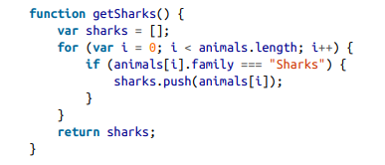
Imperative vs Declarative
Imperative
Declarative
Both wants retrieve sharks from the animals list
Here just the pattern of data that is needed is specified along with
what conditions the results must meet
how you want it to be transformed e.g. sorted, grouped and aggregated
How part is not mentioned
Up to the database system’s query optimizer to decide
Indexes & joins to use
Order of execution of various parts of the query
Here the computer is instructed to perform the certain operations in a particular order
Stepping through the code
Evaluating conditions
Updating relevant variables
Decision to go and fetch the next record or not
Here how to achieve the result is given
The developer/programmer should know the optimal way

Slide 34
Imperative vs Declarative
Imperative
Declarative
The underlying system cannot optimize the execution or memory
Ordering of the output is assured
Though CPUs are evolving and so an optimal performance can be achieved, still it is explicit mostly
Parallel execution of a sequence of instruction is quite complex
Easy to work when compared to imperative language
Hides implementation details
Database systems can introduce performance improvements with out need for any changes to queries (Refer to execution plan of SQL for example)
Because it is limited in functionality, there are lot of room for the database system to optimize automatically
Often lend themselves to parallel execution across
The decision of parallel execution is also taken by database systems

Slide 35
Data Storage Layouts

Slide 36
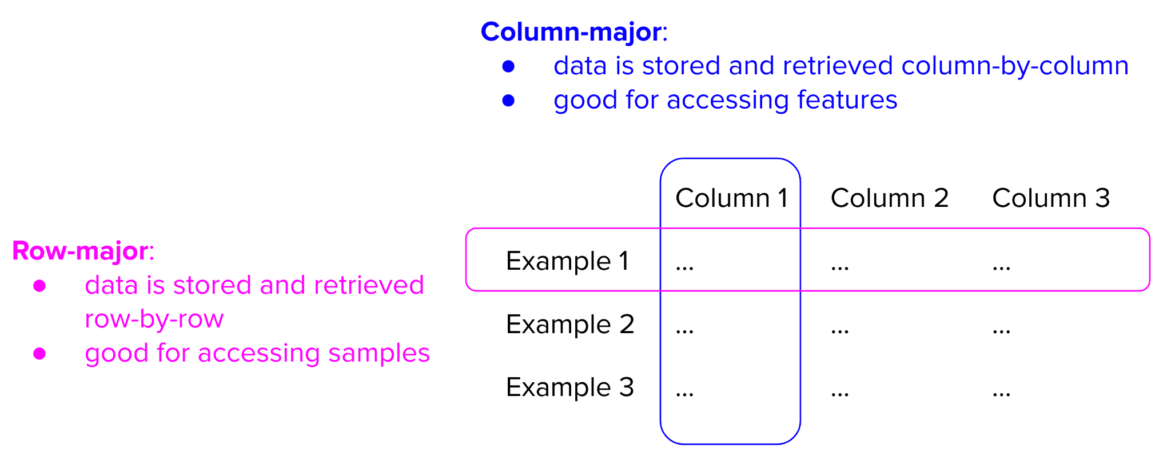
Row Format vs Column Major Format

Slide 37
Row Format vs Column Major Format
Row Format | Column Format
Stores all columns of a row sequentially in the memory | Stores all values of a particular column sequentially in the memory
If a table is row-major, accessing its rows will be faster than accessing its columns in expectation For row-major formats, accessing data by rows is expected to be faster than accessing data by columns | Column-major formats allow flexible column-based reads, especially if data is large with thousands, if not millions, of features
Faster data writes | Faster data reads
Good for OLTP | Good for OLAP
Eg: Format - CSV DB – MS SQL | Eg: Format - Parquet DB – Amazon Redshift

Slide 38
Data Serialization

Slide 39
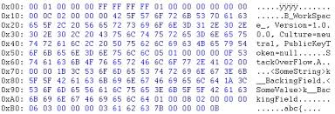
What and Why?
What?
In Simple terms – it is converting of one data from one form to other
Example converting from text to binary format
Why?
To easily
Store – size constraints
Transfer – bandwidth constraints
Points to Remember
Both serialization & deserialization should use same algorithm
Care should be taken if different programming languages or technologies used during the process

Slide 40
Process
Source System
Destination System
Data Producer
Data Consumer
Data in original format
Data in original format
Serializer
De-Serializer
Serialized Data
Serialized Data
Transfer

Slide 41
Serialization Formats
CSV
Comma separated simple table format with no nesting
XML
Hierarchical format used in old systems
Text
JSON
Commonly used in modern days, which is programming language agnostic
Simple
Commonly used in modern days, which is programming language agnostic
Format
Protobuf
Protocol buffer introduced by Google
Binary
Avro
Introduced by Apache to be compatible with Hadoop, Spark
BSON
Binary format is introduced and used by MongoDB
JSONB
Binary format is introduced and used by Postgres for semi structured data

Slide 42
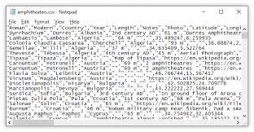
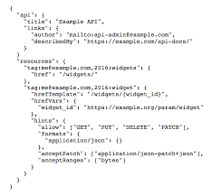
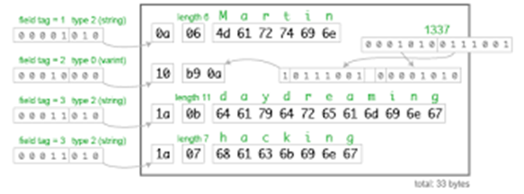
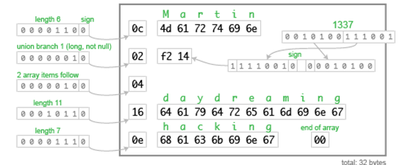
Sample
CSV
JSON
Avro
ProtoBuf

Slide 43
Sample Process
A program(written in C#/Java/Python,etc..)
**Same programming language, JSON structure and algorithm should be used for deserialization
JSON
JSON to BSON Serializer
BSON-in binary format
Database
Matching
JSON
BSON to JSON Deserializer
BSON-in binary format
This is a 2 step process viz.,
JSON is converted to BSON format
BSON is converted to binary format

Slide 44
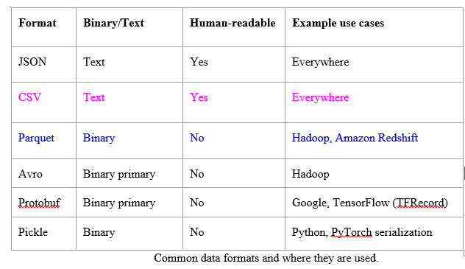
Summary

Slide 45
Data Processing Types

Slide 46
Data Processing Types
Types
OLTP
OLAP
 | OLTP | OLAP
Stands for | Online Transaction Processing | Online Analytical Processing
Purpose | To save the transactions immediately | Data derived from OLTP for analytical purposes
Type of data | Current, operational data | Historical, consolidated data
Volume | Handles many small transactions | Handles fewer but large data sets
Optimization | For faster write | For faster reads
Usage example | Gpay transactions Swipe records of your entry and exit in your office | Gpay analysis on your spend Attendance calculation with the swipe record

Slide 47

OLAP – For insights
Sharp enterprise-wide profitability dip
Countrywide monthly sales for last 3 months?
Sales OK, profitability down last 3 months
Monthly sales by worldwide regions?
Sharp reduction in European region
European sales by countries ?
Increase in a few countries, flat in others, sharp decline in some
European sales by countries, products?
Additional tax on some products in EU
Direct and indirect costs for EU countries?
Sharp decline in EU countries, last 2 months
Direct costs OK, indirect costs up

Slide 48
Typical Calculations
Roll-ups to provide summaries and aggregations along the hierarchies of the dimensions.
Drill-downs from the top level to the lowest along the hierarchies of the dimensions,
in combinations among the dimensions.
Simple calculations, such as computation of margins (sales minus costs).
Share calculations to compute the percentage of parts to the whole.
Algebraic equations involving key performance indicators.
Moving averages and growth percentages.
Trend analysis using statistical methods.

Slide 49
OLAP operations
LINE | 1998 | 1999 | 2000 | TOTAL
Clothing | $3,457,000 | $3,590,050 | $5,789,400 | $12,836,450
Electronics | $5,894,800 | $4,078,900 | $6,094,600 | $16,068,300
Video | $7,198,700 | $6,057,890 | $8,005,600 | $21,262,190
Kitchen | $4,875,400 | $5,894,500 | $6,934,500 | $17,704,400
Appliances | $5,947,300 | $6,104,500 | $7,549,000 | $19,600,800
Total | $27,373,200 | $25,725,840 | $34,373,100 | $87,472,140
Drill down
LINE | TOTAL SALES
Clothing | $12,836,450
Electronics | $16,068,300
Video | $21,262,190
Kitchen | $17,704,400
Appliances | $19,600,800
Total | $87,472,140
Rotate / Pivot
YEAR | Clothing | Electronics | Video | Kitchen | Appliances | TOTAL
1998 | $3,457,000 | $5,894,800 | $7,198,700 | $4,875,400 | $5,947,300 | $27,373,200
1999 | $3,590,050 | $4,078,900 | $6,057,890 | $5,894,500 | $6,104,500 | $25,725,840
2000 | $5,789,400 | $6,094,600 | $8,005,600 | $6,934,500 | $7,549,000 | $34,373,100
Total | $12,836,450 | $16,068,300 | $21,262,190 | $17,704,400 | $19,600,800 | $87,472,140

Slide 50
Features of OLAP
Multidimensional analysis | Consistent performance | Fast response times for interactive queries
Drill-down and roll-up | Navigation in and out of details | Slice-and-dice or rotation
Multiple view modes | Easy scalability | Time intelligence (yearto-date, fiscal period)
Basic Features
Advanced Features
Powerful calculations | Cross-dimensional calculations | Pre-calculation or pre-consolidation
Drill-through across dimensions or details | Sophisticated presentation & displays | Collaborative decision making
Derived data values through formulas | Application of alert technology | Report generation with agent technology

Slide 51
References:
Designing Data-Intensive Applications by Martin Kleppmann
Reliable Machine Learning By Chen, Murphy, Sculley, Underwood
Designing Machine Learning Systems by Chip Huyen
https://phoenixnap.com/kb/acid-vs-base

Slide 52
Thank You!
In our next session:

Slide 53
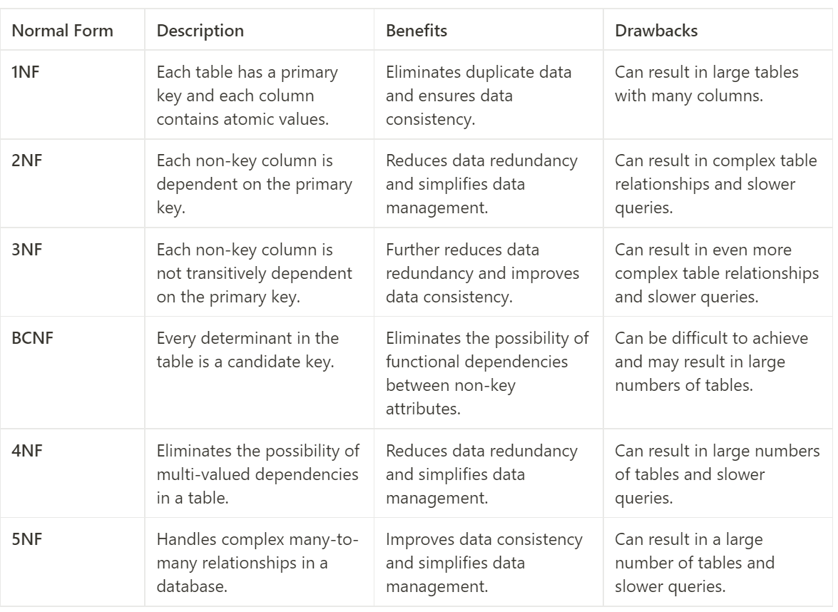
Normalization – Additional Information

Slide 54
Transaction Compliance of Data

Slide 55
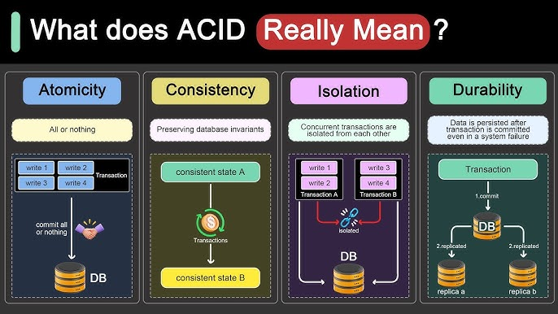
ACID properties
Source

Slide 56
BaSE properties
Ba
Basically Available
Prioritises system availability over consistency
S
Soft State
The state of the system or specific data can change over time
E
Eventual Consistency
The consistency of data across systems are achieved with moderate delay

Slide 57
ACID vs BaSE
Feature | ACID | BASE
Availability | Lower availability. | Highly available.
Consistency | Strong consistency after each transaction. | Consistent over time.
Performance | Slower but accurate. | Faster but less accurate.
Scalability | Difficult to scale. | Highly scalable.
Use Case | Banking, finance, and e-commerce. | Social media, real-time analytics, and big data.

