Slide 1


Employees and Employment Trends
Group presentation

Slide 2
Group members
Aadil Thapa (NPI000015)
Bikash Baral (NPI000021)
Sandesh Devkota (NPI000042)
Tirtha Chapagain (NPI000055 )
Shivam Ranabhat (NPI000047)
Bikram Shrestha ( NPI000022)
Kapil Pokhrel (NPI000030)
Saroj Kandel (NPI000043)
Suraj Kumar (NPI000052)
Binod Pun (NPI000024)
Bibek Bhandari (NPI000019)
Roshan Rana (NPI000036)

Slide 3

Introduction
Code Red is a full-stack technical services firm specializing in artificial intelligence (AI), data engineering, and product production.
Code Red distributes world-class software solutions at the lowest possible cost while maximizing the use of available resources.
The goal of Code Red is to raise client awareness of new technology and to create new job opportunities because of this technology
Code Red is dedicated to creating software that is easy to use for its users. As of 2018, Code Red has gained the trust of more than 100 consumers around the world since its establishment.

Slide 4
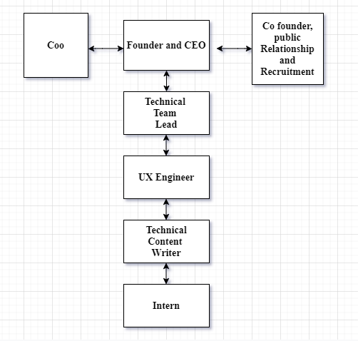
Organizational chart
An organizational chart is a graphic that depicts a company's internal structure by outlining the roles, responsibilities, and connections between employees.
It explains a wide range of company relationships and behavioural practices.
Based on their distinct processes, the organizational chart varies from company to company.

Slide 5
2. Employees Hiring Trends
The procedure of finding a suitable applicant in an organization is known as hiring trends.
Organizations adopt a variety of distinct practices base on their organizational practices. The organizational procedures of our Code Red Company follows four distinct trends.

Slide 6
2.1 Recruitment on Social Media basis
In order to find an appropriate applicant for the perfect position, LinkedIn, Twitter and email have become standard practices.
. LinkedIn is a skilful business networking site. If a Company wants to know about an individual behaviour and how they work on success LinkedIn profile is required.
Therefore, checking the person’s profile on social media can be a easy method to appoint on their preference position like Manager, Engineer etc.

Slide 7
2.2 Interpersonal Skills and Softs Skills
1.Interpersonal Skills
A skill used to interact and communicate
Some examples are listening, communication skills
2.Soft Skills
Character qualities which describe a relation which a person have with others
Also called behavior or attitude
With the help of interview, we can hire an employee who is best in both related field and these skills.

Slide 8

2.2.1. Interview
Face-to-face communication between interviewer and interviewee
Best way to determine interpersonal and soft skill
Behavioral interview were conducted
We conducts an online interview due to pandemic
Types of interview which we conduct
Structured interview: Created set of question asked in same order
Semi-Structured interview: Formal questions with more open-ended question
Unstructured interview: Informal questions and open-ended question

Slide 9
2.3. Reviewing their social backgrounds
Crime and Criminal Information System (CCIS) has been keeping records of crimes related to national crimes and criminals for decades. (IGI Global, 2021).
The company requests a police report during the recruiting process to verify the candidate's history of criminal activity.
It is essential to ensure that the applicant has not been involved in any significant crimes.
The Company must ensure that the candidate is honest and obedient in his work.
The background check is necessary to ensure that the candidate is not a threat to the organization or society.
CCIS may be used by the company to investigate the candidate's criminal record.

Slide 10
2.4 Participation in Extra-curricular activities
Those activities that is outside of sector or field
Play a major role in an individual’s recruitment.
It helps individual to learn about themselves and develop their skills and knowledge in different sectors.
Have Opportunity and priority
Some soft skills are communication skills, interpersonal skills, understanding the colleague’s thoughts and viewpoints.
By participating in Extra-curricular activities, the company can be able to examine the individual’s behavior and mentality so that they can guide them accordingly.

Slide 11

2.5 Organization Behaviour
Organizational behavior is the study and application of knowledge about how people act within an organization. It is a human tool for human benefit. It applies broadly to the behavior of people in all types of organization.

Slide 12
2.6 Employee Benefits
The indirect, non-cash or financial remuneration and services provided to an employee in addition to their wages by the organization.
It is also known as fringe or perks benefits.
It is taken as important tool for improvement in bottom-line of the organization.
It helps to achieving organization’s goals and objective.
It helps to motivate the employee to get the work done.
For example: health insurance, salary increment, bonus, transit benefit allowances, profit sharing and others.

Slide 13

3. Project Outcomes
The value of any project cannot be measured without defining success. It requires focus on outcomes. The workshop leaded as strong motivation aspect for leaning on different aspects on practical world

Slide 14
3.1 Raise Awareness on the Anatomy of Good Cover Letter and Resume
A good cover letter explains on candidate’s communication skills and a resume explains about his/her achievements, qualification and experiences. Our research revealed that a cover letter is a document submitted with a resume that includes relevant information about the applicant's education, recognition, and experience..

Slide 15
3.2 Current Hiring trends of Companies
Hiring the appropriate right employees for a company is critical to its success, regardless of the type of work The hiring or recruitment process are also evolving with time. Many companies have their own hiring trends.In today’s world technology is helping companies to recruit new people in an easy way. Social medias are playing a vital role in recruitment process. Recruitment agencies today recruit people by seeing their social media portfolios and pick out the candidates with the most impressive social media profiles and invite them for an appointment or meeting. Also the technology has helped job applicants explore the company's history, reputation, and organizational culture before applying for a position in the company

Slide 16
4.0 Critical Analysis
Critical analysis is a technique of systematically assessing the efficiency of any subjective matter.
It brings together a precise framework and dependable detail screening and assessment for professional argumentation.
There are some elements in this endeavor that we find critically analyzed.

Slide 17
4.1. Analysis of Current Employment Trends of Code Red Company
The current trends implemented by the firm are satisfactory, since these trends are known in most organizations, according to our research and surveys.
Social media also play an important function in searching for the applicant's improved portfolio.
This is the key approach to search for a job applicant because it saves time and money.
In relying on cover letter and abstract trends, the behavioural pattern is defined in essential parts and the worth of the applicants to the company is added.
These characteristics illuminate a personal examination of the achievements of the individual.
The cover letter is also a professional and perfect technique, which gives your personal identity a unique match.

Slide 18
5. Conclusion
Our group had conducted a workshop on the topic of “Current Employment Trends”. Code Red Company provides a quality learning platform for newcomers in the field of information technology and other software related programs.
In this workshop we discuss and cover the following topics – Employees and the current trends related to them, resume and CV writing, interview code and conducts and some other related content.
We had gained information on the existing trends of employment of different companies.
This session taught us to how to collaborate and work in a team.
We asked the volunteer to express through opinions and views related to the workshop conducted.
The company representatives said that it will build a professional relation between the institute and the corporates, which is an opportunity for the students to excel in their careers.

