Slide 1

MOBILE AND WIRELESS TECHNOLOGY(CT090-3-2)
TITLE: WLAN Deployment In Small Office/Home Office
Present by
Shivam Ranabhat(NPI000047)

Slide 2

ACKNOWLEDGEMENT
I would like thank our MTW lecturer Mr. Laxmi Prasad Bastola
for his guidance and clearing all the doubts regarding our
assignment so that I completed it on time .Similarly, I would
like to thank our College “Infomax college of IT and
Management” who provide me an opportunity to work as an
individual network consultant.

Slide 3
INTRODUCTION
WLAN
Project
Scenario
AIM
A wireless computer network within a certain local area
Connects two or more devices and allow them to share data
Helps to increases flexibility and satisfaction in working field
Operate a WLAN in SOHO having 10 to 20 staffs
Internet access including software like word processor and spreadsheet
Provide a good wireless LAN inside United Reference Laboratory in order to access internet and use software with good speed.

Slide 4

WLAN-SITE SURVEY
Introduction
Network Scope
Conduct WLAN site survey to collect information about various obstacles and their solutions
Provide internet access along with software like spreadsheet in United Reference Laboratory.

Slide 5
OBJECTIVES
WLAN proposed for the laboratory should meet
Network Reliability
Network Security
Network Availability
Good speed and constantly better performance
Secured and protected network to secure private information
Should be available 24/7 with constant speed

Slide 6
REQUIREMENT GATHERING
To make proposed network better following questions were asked
What speed could be enough for your laboratory?
After the installation of WLAN network, Will it boost your accessibility to the internet and use of software?
What are the major features you desired to have in new installed WLAN network?
What types of application which are being used mostly?
What are the maximum and minimum number of users in laboratory?
For what purposes you want the WLAN network to be used for the most?
What is the main problem you faced due to previous network?

Slide 7
WIRELESS SITE SURVEY CONSIDERATION
We prefer following types of site survey methodology
Passive Site Survey
Spectrum Site Survey
It is about the measurement of signal form sender to receiver in the site
It is about identifying the source of interferences and eliminate them.

Slide 8
COVERAGE AREA AND CAPACITY
Main thing during WLAN site survey is to collect information about the size of the site.
Following questions were asked related to coverage area and capacity
Do you want to provide access to the public?
What is the coverage area of the site?
Can you provide the map, blueprint of the building?
What range of speed is enough for your laboratory?

Slide 9
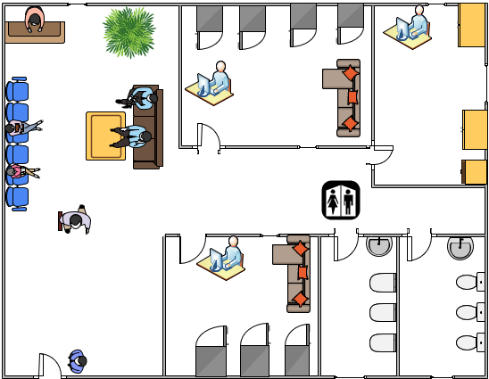
Size of the area
800 square feet
3 rooms excluding reception area, washrooms and waiting area

Slide 10
Number of Users
Types of Applications
Internet Browsers
Software like spreadsheet and word processer
Obstacles
Concrete wall ( 15 cm)
Doors and windows
Furnitures and other objects
Users | Available In Peak Hours
Head Doctor | 1
Assistant Doctor | 2
Co-workers | 3
Nurses | 2
Receptionist | 1
Patients | 5
Guard | 1
Total | 15 (max)

Slide 11
RADIO FREQUENCY RANGE AND SPEED
Line of sight
Interference
Environmental Behavior
Reflection
Refraction
Scattering
Absorption
Line of Sight | In laboratory
Visual line of sight | No
RF line of sight | Yes
Devices | In laboratory
Bluetooth devices | Yes
Microwave | Yes
Other Medical devices | Yes
Normal types of furniture and density of wall is also normal
Different glass equipment inside the laboratory can cause refraction
So, such equipment should be placed away from wireless devices
There is no any rough surfaces inside the laboratory
Can cause by human body. 7 people at a time whole day inside the laboratory excluding patients (appointed before meal)

Slide 12


TOOL USED
For Floor Plan
For Heat Map
Microsoft Visio
VisiWave Site Survey

Slide 13
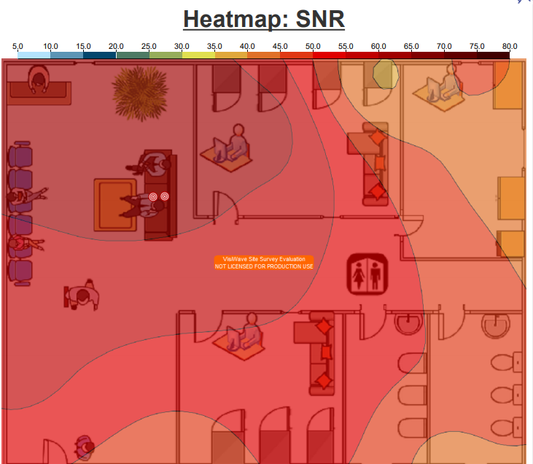
WLAN DEPLOYMENT DIAGRAM
Current Bandwidth: 40 Mbps
ISP: Word Link
SNR heat map

Slide 14
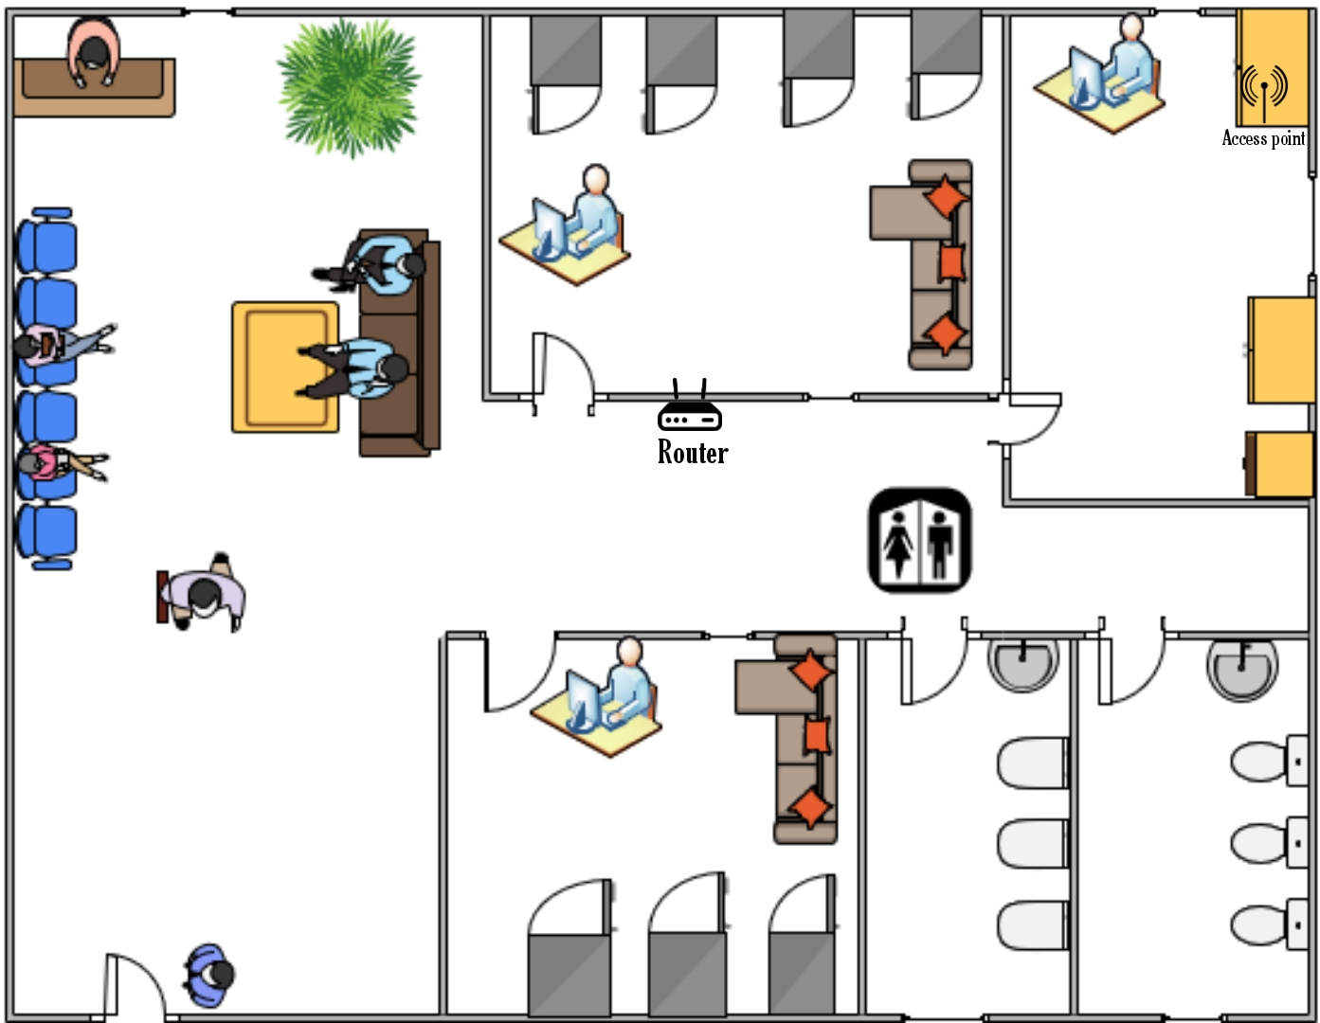
PLACEMENT

Slide 15
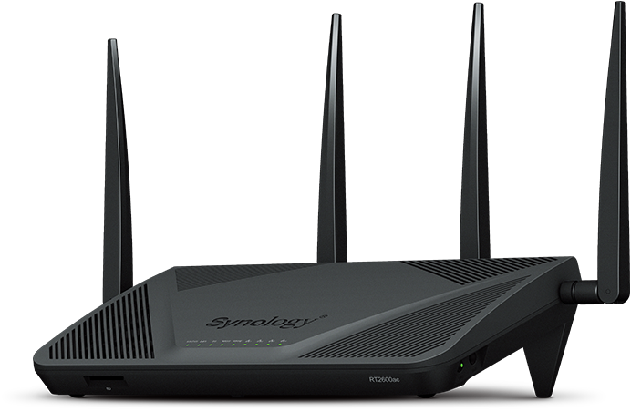

HARDWARE REQUIREMENT
Router
Synology RT2600ac Dual band router (best in all fields)
Cabling
Cat 6 cable (1 Gbps within 100m)
Affordable
Less interference
2.5 and 5G Ethernet within 55 meters
Supports Gigabit Ethernet
CPU | 1.7Ghz Dual Core
AC2600, Wave 2 | With MU-MIMO and Beamforming
Antenna type | 4T4R Omnidirectional high-gain dipole (2.4GHz/ 5 GHz)
Memory | DDR3 512MB
Wireless Security | WEP, WPA/WPA2-Personal and Enterprise

Slide 16

Access point
Meraki Go
Features
It blocks unwanted websites.
It set the limit of usage.
It helps to prioritize bandwidth.
It is specially used for indoor purposes.
It consists of single port and internal antennas.

Slide 17
SOFTWARE REQUIREMENT
Firewall
A security layer between home network and the internet
Preserves the privacy of home network and block unwanted traffics
Also detects and eliminates any threats that harms computer system
Anti Virus Software
Bitdefender Antivirus ($ 32 per year for 3 devices)
Router Manager
PRTG Router Manager
Protects from web attack
Anti-phishing protection
Threat protection from network
Monitors the router 24/7
Calculates network usage by connected devices
Notify if anything seems to be wrong with router

Slide 18

Conclusion
At last of this assignment, I am able to understand the ways to conduct a site survey and get knowledge about various factors that can affect the signal of a particular network and the ways to implement the WLAN on a certain site.

Slide 19
REFERENCES
B. (2017, September 8). Meraki Go GR10 | Access point | Indoor, Dual-band, 802.11ac Wave 2,2x2:2 MU-MIMO. Batna24. https://www.batna24.com/en/p/cisco-meraki-go-gr10-access-point-rmmkh
Bitdefender Internet Security - Internet Security Software. (2011, January 2). Bitdefender. https://www.bitdefender.com/solutions/internet-security.html
ComputerNetworkingNotes. (2019, March 17). Types of Firewalls Explained with Functions and Features. https://www.computernetworkingnotes.com/ccna-study-guide/types-of-firewall-explained-with-functions-and-features.html
Synology Inc. (2019, March 22). Synology RT2600ac │ AC2600 high-speed Wi-Fi router │ Parental controls & security │ | Synology Incorporated. https://Www.Synology.Com/En-Global/Products/RT2600ac.
The 8 Best Small Business Routers of 2021. (2020, June 11). The Balance Small Business. https://www.thebalancesmb.com/best-small-business-routers-4171956

Slide 20


