Slide 1

Object oriented Development With java(CT038-3-2)
Present by
Kapil Pokhrel(NPI000030)
Shivam Ranabhat(NPI000047)

Slide 2

K.S Courier Service System
Courier Service System maintains real-world things like as orders and items
It simplifies and streamlines the whole distribution and tracking of items.
This application allows staff to customize their delivery and manage their orders from anywhere.

Slide 3
Objectives
To Reduce data redundancy by simplifying the ordering and delivery procedures.
To decrease the time spent by staff writing orders when it isn't necessary.

Slide 4

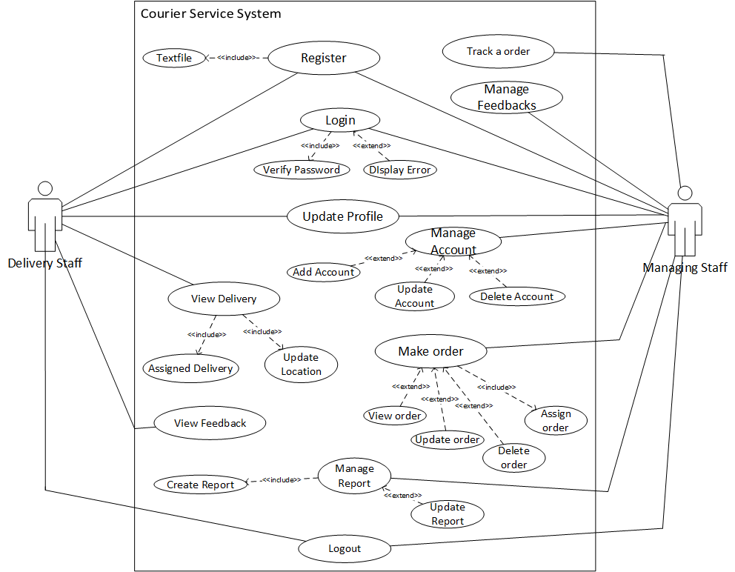



System Design Use Case Diagram

Slide 5
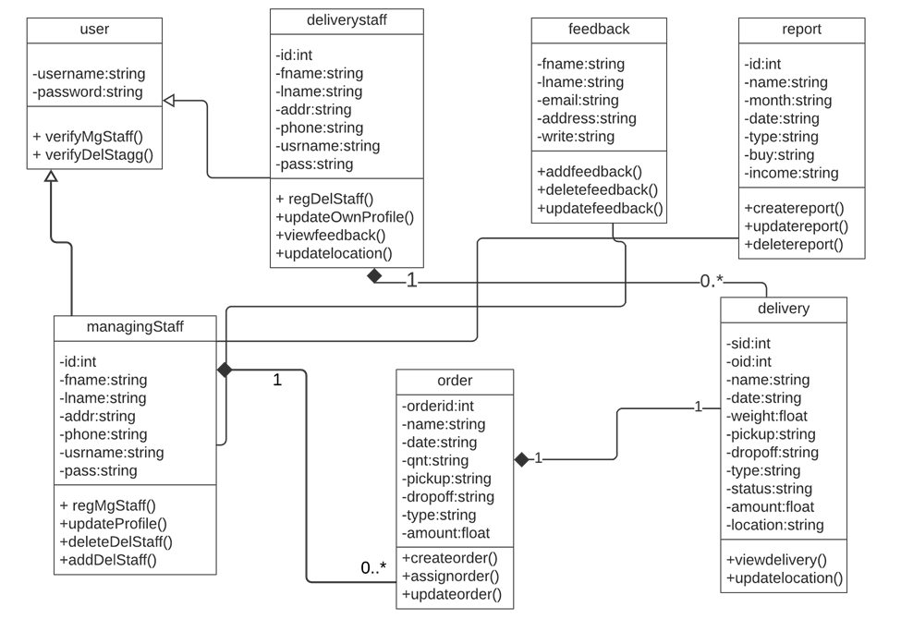
System Design
Class Diagram

Slide 6
User Account Management | Register own account Update own profile Add delivery staff Update delivery staff profile Delete delivery staff profile
Order Management | Create order Update order Delete order Assign order
Feedback Management | Create feedback Update feedback Delete feedback
Report Management | Create report Update report Delete report
User’s Role In System
Managing Staff

Slide 7
Individual profile management | Register own account Update own profile
Delivery Management | View assigned delivery Update location for tracking
Feedback | a. View feedback
2. Delivery staff

Slide 8
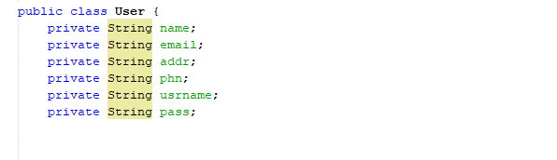
Object oriented concept
Class
a. Class are also called blueprint or template.
b. Objects are created using class.
c. Class contains different fields ,methods, constructor.

Slide 9
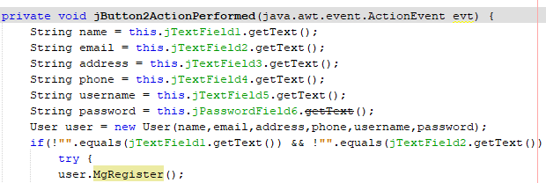
Object
Instance of class which includes data variables, functions.
An object is used to call a class.

Slide 10
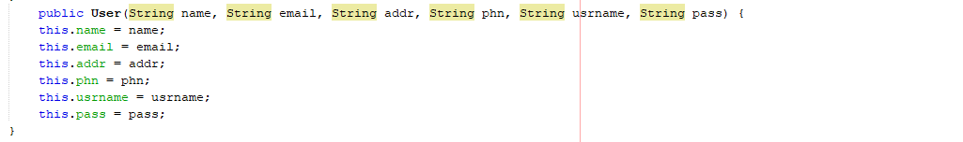
Constructor
Like method and it is call when an object is created.
Have same name as that of main class.

Slide 11
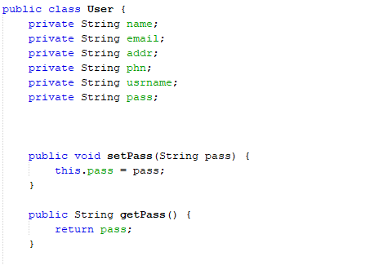
Encapsulation
Variable are declared as private
Provide public getter and setter method to access in another class.

Slide 12

Inheritance
It represents IS-A relationship between parent and child class.
It uses word “extends”

Slide 13
Workload Matrix
 | Kapil Pokhrel (NPI000030) | Shivam Ranabhat (NPI000047)
User management | --- | ✓
Order management | --- | ✓
Report management | --- | ✓
Feedback management | ✓ | ---
Individual profile management | ✓ | ---
Delivery management | ✓ | ---

Slide 14
Advantages Of Object-Oriented System
Data hiding due to encapsulation
New functions can be easily added whenever necessary
Faster Development of the system
OOP methods make the code more maintainable.

Slide 15
Limitation of system
This system only interacts with staff members of courier service system. (not for customer)
Each entry like order, feedback should be handled by managing staff.
Tracking service is only for managing staff.

Slide 16

Conclusion
To provide an overview of the system, use case diagrams, class diagrams, and activity diagrams are utilized
This project focuses on object-oriented programming, which is necessary to utilize or apply OOP principles in the system
We learned more about problem solving and object-oriented development as a result of this assignment

Slide 17
References
felici, m., 2009. Activity Diagram. [Online] School of informatics (1) Available at: www.inf.ed.ac.uk/teaching/courses/seoc/2009_2010/notes/10_notes.pdf [Accessed 10 Aug 2021].
RajKumar Buyya, S Thamarai Selvi, Xingchen Chu, 2009. Object-oriented Programming with Java: Essentials and Applications. 1st ed. New Delhi: Tata McGraw.
java, t.p., 2014. java encapsulation. [Online] (1) Available at:http://www.tutorialspoint.com/java/java_encapsulation.htm [Accessed 11 Aug 2021].

